Slide 1
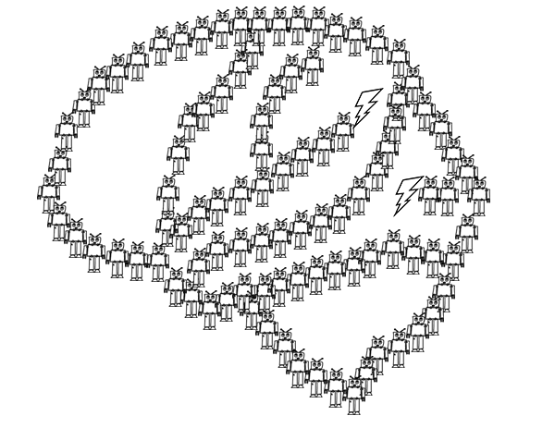
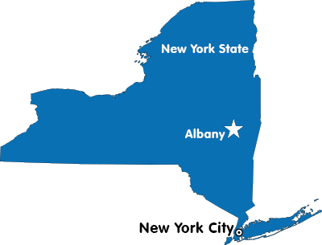
Exploring the Creative Use of Conceptual Knowledge
Binghamton
Notes:
I am Nolan Conaway, a postdoc in Joe’s lab. I came here in August from Binghamton University where I worked on some really basic category learning research with Ken Kurtz. With Joe I’ve been working on a handful of projects, and today I’m going to talk about one project exploring how category knowledge is used creatively.

Slide 2
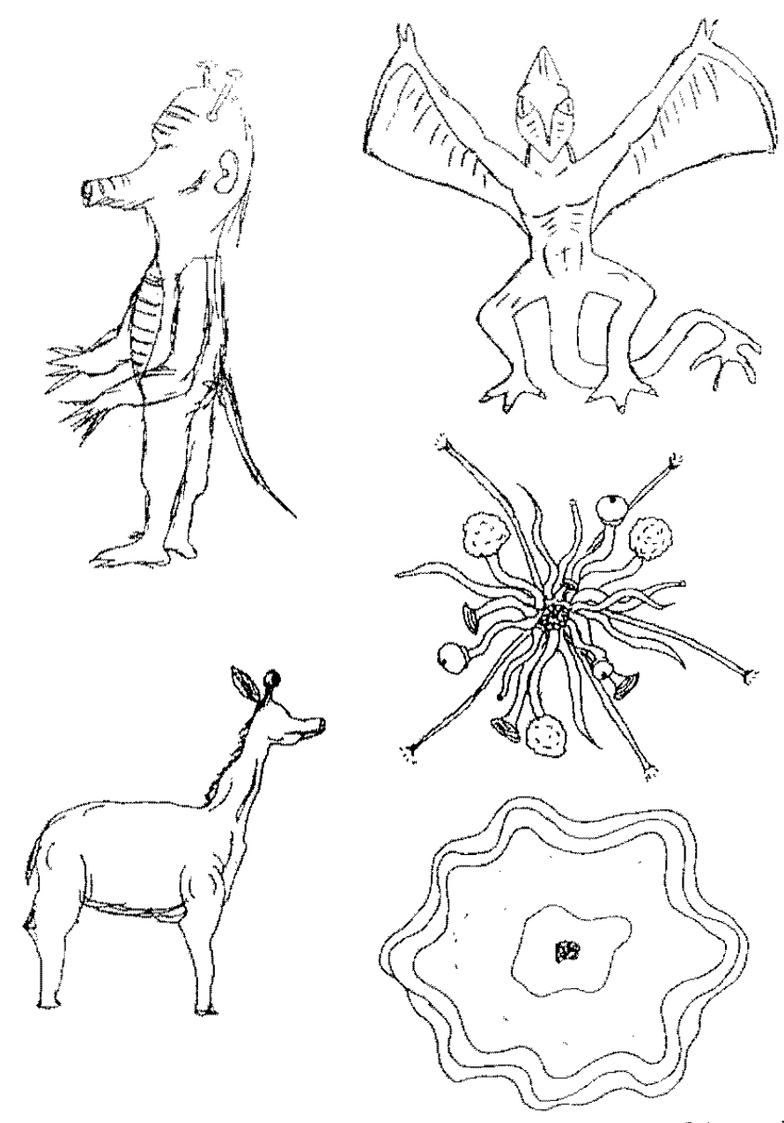
…really, this talk is about category generation.
Classic paradigm: participants asked to draw species of plants and animals from other planets
What we learned—
Shared physical attributes:
Aliens possess the same structural forms as on earth species (arms, legs, ears, etc…)
Shared distributional properties:
Same feature correlations as found on earth (e.g., wings usually found with feathers)
Less within-species variance compared to between-species variance.
Images from Ward (1994), Cognitive Psychology
Notes:
The creative use of conceptual knowledge is actually a really broad topic and I’m not quite that ambitious. in reality, all of the work I’m going to tell you about is on category generation, which is just one of the many ways that conceptual knowledge can be used creatively.
In general, studies on category generation basically ask people to generate new categories of things, and the the experimenter analyzes the created categories to figure out what sources of prior knowledge were used in the creative process. In the classic paradigm, participants are asked to draw new species of plants and animals that might exist on other planets. In reality there are other backstories but i’m going to stick with the alien for simplicity.
The typical finding is that prior knowledge is hugely constraining on creative generation. On the slide I have some example alien species from a study conduced by Thomas Ward, and you can see that alien species resemble earth species not only in their structural forms (having things like arms and legs), but also members of alien species tend to be distributed like earth species (in the correlations between features, but also the similarity between examples belonging to the same and different species).

Slide 3
Classic paradigm: participants asked to draw species of plants and animals from other planets
Psychological account—
Copy-and-Tweak (Ward, 1995)
Participants retrieve an earth animal from memory, and then change a few of its features to make something new.
Images from Ward (1994), Cognitive Psychology
Notes:
There isn’t a lot in the way of real accounts explaining these observations, mostly because the work was super exploratory. The most commonly cited idea from this era is that people “copy-and-tweak” some real example to make something new. But really, there was never any formalization of that idea because the behaviors to be explained are really high level, which makes them tough to simulate.

Slide 4
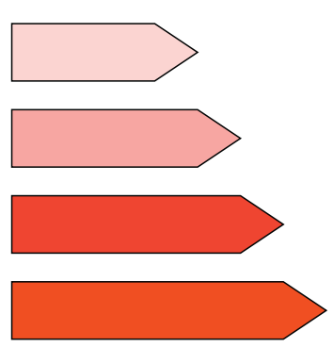
Making category generation more model-able…
Jern & Kemp (2013), Cognitive Psychology
Approach: ask people to generate new categories in an artificial, low-dimensional domain.
Domain: ”Crystals”
Saturation
Hue
Size
Notes:
So, as is typically the case when you want to develop a formal model of complex behavior, the approach taken to model category generation has been to simplify the domain. Alan Jern & Charles Kemp were the first to report anything like this. They developed a artifical, three-dimensional domain of what they called “crystals”, varying in size, hue, and saturation. Each on these items at the bottom of the slide is one crystal, which can be conceptualized as a point in the three dimensional domain space.

Slide 5

Making category generation more model-able…
Jern & Kemp (2013), Cognitive Psychology
Approach: ask people to generate new categories in an artificial, low-dimensional domain.
Generation Interface: Sliding scales to adjust each of the physical attributes.
Domain: ”Crystals”
Can you create a new category?
Adjust Size
Preview
Saturation
Adjust Hue
Hue
Adjust Saturation
DONE
Size
Notes:
An experimenter can define a category as a collection of crystals, or multiple points in the space. And so the general procedure is to teach people about one or more experimenter-defined categories, and then ask participants to make new categories.
In this paradigm, participants create the new category one item at a time, and each item is made with a set of sliding scales that can be used to change the feature values. They get as much time as they want, and when they’re finished they move on to create the next example

Slide 6
Does this count as a creative use of conceptual knowledge?
Disadvantages
Really boring, small domain.
Doesn’t *feel* very creative.
Advantages
Can control prior knowledge
possible to simulate with formal models!
Can you create a new category?
Adjust Size
Preview
Saturation
Adjust Hue
Hue
Adjust Saturation
DONE
Size
Notes:
So I’ll be the first to admit that this doesn’t feel as creative as the older stuff on drawing aliens. But the core elements are in place – the only thing that has changed is that the domain is way smaller and a lot more boring. The advantage, of course, is that you get a lot more control over the experience, and then you can build computational models to test theories about how people do this sort of thing.
So I’d argue that, just like list learning experiments can tell us a lot about memory, this artificial category generation paradigm can reveal a lot about more naturalistic cases.
Anyway, this artificial categorization paradigm is where my talk is going to live, but I’m going to try to phrase my conclusions so that they apply to the broader world of category generation.

Slide 7
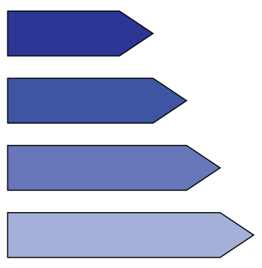
Replicating classic results in the artificial domain.
Jern & Kemp (2013):
Generated categories possessed the same correlations as in the experimenter-defined categories.
Domain: ”Crystals”
Positive Size-Saturation correlation
Negative Size-Saturation correlation
Saturation
Hue
Size
Notes:
So since Jern & kemp published the first study taking this approach, I’ll briefly describe what they found. Their manipulation was in the relationship between size and saturation, within the experimenter define categories. Some participants learned a categories with a positive correlation, some with negative. And there are examples of each of these on the slide.
And it turns out that participants generated novel categories following the same correlations. So if they learned a category with a positive size-saturation correlation, they tended to generate a new category with the same pattern. And this lines up really nicely with the earlier observation that alien species obey the same correlations as found on earth.

Slide 8
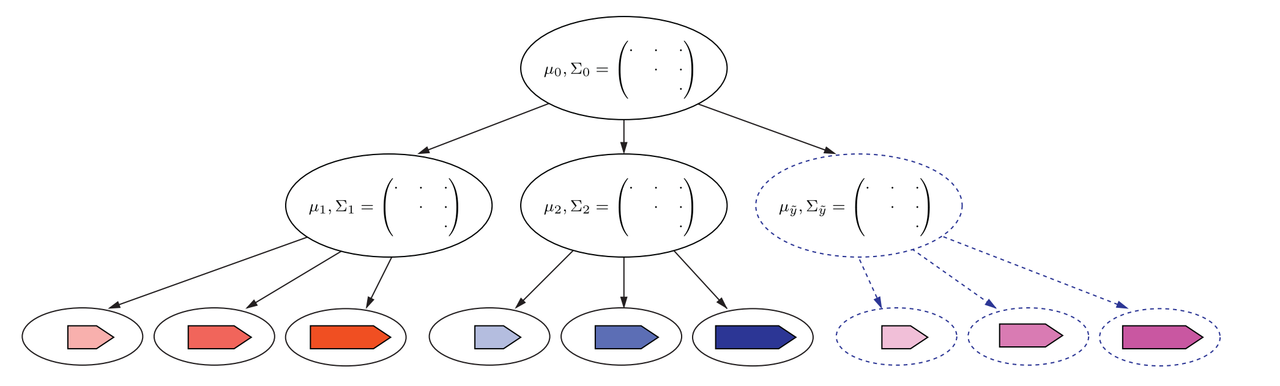
A hierarchical sampling model
Represent categories as (multivariate normal) distributions in the space.
Infer the the patterns of variability common among known categories.
Generate a new category with similar patterns.
Domain
representation
Category representation
Category members
Notes:
I don’t want to get too far into the weeds on this one, but they ended up building a hierarchical sampling model of category generation in order to explain their results. I’ll be showing simulations from this model in a little bit so here’s the introduction.
Basically, the model learns about how each category is distributed across the space -- in terms of how each physical attribute varies, and how they are correlated. Then, the model makes an inference using the common patterns of variability – so it tries to identify if the existing categories have a positive or negative correlation. And then it uses that inference to make a new category with similar properties.

Slide 9
Taking a step back…
Known phenomena
Generation is influenced by prior knowledge.
Distributional structure of known categories is obeyed in generated ones.
Existing models
Copy+Tweak (formalized by Jern & Kemp).
Hierarchical sampling
Both those models were designed to explain the above phenom
But that’s actually not much phenom
What else is there?
Notes:
Okay, so that’s sort of the state of things when Joe and I started working on this last year. We have some strong evidenc

