Slide 2
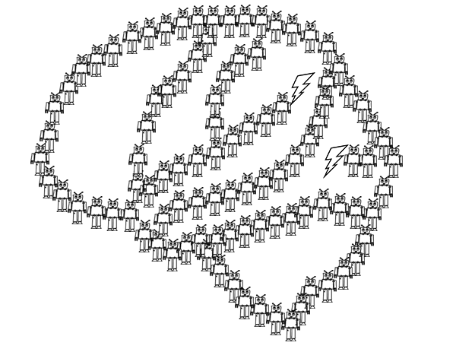
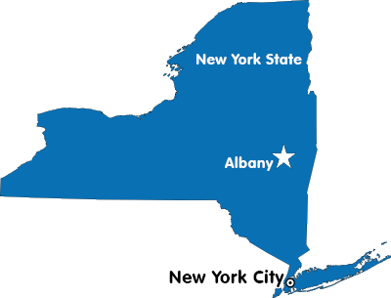
Exploring the Creative Use of Conceptual Knowledge
Binghamton
Notes:
I am Nolan Conaway, a postdoc in Joe’s lab. I came here in August from Binghamton University where I worked on some really basic category learning research with Ken Kurtz. With Joe I’ve been working on a handful of projects, and today I’m going to talk about one project exploring how category knowledge is used creatively.

Slide 3
…really, this talk is about category generation.
Category
Learning
Creativity
Real World Examples:
science, art, design, etc…
Notes:
The creative use of conceptual knowledge is actually a really broad topic and I’m not quite that ambitious. in reality, all of the work I’m going to tell you about is on category generation, which is just one of the many ways that conceptual knowledge can be used creatively.
Generating new categories, as it turns out, is an important part of doing science, or art, or design, or really any intellectual undertaking where you need to come up with new and interesting ideas. I assume that sort of thing is familiar to the people in this room…
So there’s a lot of reasons for us to want to understand this.

Slide 4
…really, this talk is about category generation.
Category
Learning
Creativity
Real World Examples:
science, art, design, etc…
Experimental Approaches
“Draw an alien” experiments (e.g., Ward, 1994)
Artificial category learning studies (Jern & Kemp, 2013)
What do we know?
Generation is influenced by prior knowledge.
Distributional structure of generated categories reflects known categories.
That’s where we are!
Notes:
And really you can think about category generation as sort of the intersection between straight up categorization research and creativity. And both of those are really well studied topics, but when you look into it, we actually know very little about how people creatively generate new categories.
So on the slide I have listed sort of the state of the field when Joe and I started working on this, and I’m going to go over each of these points in more detail, but suffice it to say that that these lists are not large. So our approach has really been first about establishing a set of basic observations, and then we use computational models to try to explain them.

Slide 5
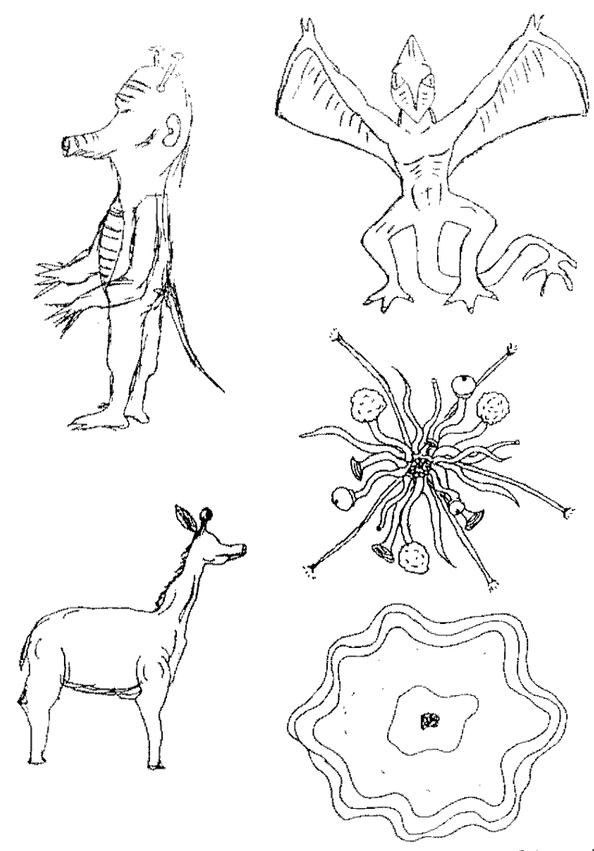
General Approach: ask people to generate new categories, then analyze what they create.
Classic paradigm: participants asked to draw species of plants and animals from other planets.
Images from Ward (1994), Cognitive Psychology
Notes:
Ok, since we don’t know very much, and so my introduction is going to be short.
So in general, studies on category generation basically ask people to generate new categories of things. In the early studies from the 90s, people were asked to draw pictures of alien plants or animals, and the experimenter would analyze the pictures to figure out what sources of prior knowledge were used in the creative process.

Slide 6
General Approach: ask people to generate new categories, then analyze what they create.
Classic paradigm: participants asked to draw species of plants and animals from other planets.
Shared physical attributes:
Aliens possess the same structural forms as on earth species (arms, legs, ears, etc…)
Shared distributional properties:
Same feature correlations as found on earth (e.g., wings usually found with feathers)
Less within-species variance compared to between-species variance.
Images from Ward (1994), Cognitive Psychology
Notes:
The typical finding is that prior knowledge is hugely constraining on creative generation. On the slide I have some example alien species from a study conduced by Thomas Ward, and you can see that alien species resemble earth species not only in their structural forms (having things like arms and legs), but also members of alien species tend to be distributed like earth species (in the correlations between features, but also the similarity between examples belonging to the same and different species).

Slide 7
…really, this talk is about category generation.
Category
Learning
Creativity
Real World Examples:
science, art, design, etc…
Experimental Approaches
“Draw an alien” experiments (e.g., Ward, 1994)
Artificial category learning studies (Jern & Kemp, 2013)
What do we know?
Generation is influenced by prior knowledge.
Distributional structure of generated categories reflects known categories.
That’s where we are!
Notes:
Right, and so that’s what I mean when I said that that generation is influenced by prior knowledge, and that distributional structure of generated categories reflects known categories.

Slide 8
General Approach: ask people to generate new categories, then analyze what they create.
Classic paradigm: participants asked to draw species of plants and animals from other planets.
Copy-and-Tweak (Ward, 1995)
Participants retrieve an earth animal from memory, and then change a few of its features to make something new.
Interpreted as an exemplar approach.
Recently formalized by Jern & Kemp (2013)
Images from Ward (1994), Cognitive Psychology
Notes:
There isn’t a lot in the way of real accounts explaining these observations, mostly because the work was really exploratory. The most commonly cited idea to explain the resemblance between alien and earth species was that people “copy-and-tweak” some real example to make something new. But really, there was never any formalization of theidea during that era

Slide 9
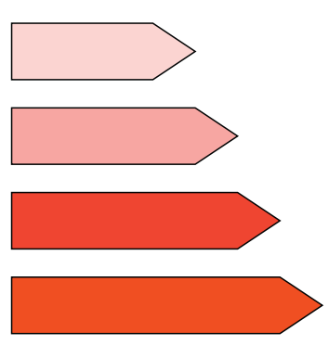
Making category generation more model-able…
Jern & Kemp (2013), Cognitive Psychology
Approach: ask people to generate new categories in an artificial, low-dimensional domain.
Domain: ”Crystals”
Saturation
Hue
Size
Notes:
So, as is typically the case when you want to develop a formal model of complex behavior, the approach taken to model category generation has been to simplify the domain. Alan Jern & Charles Kemp were the first to report anything like this. They developed a artificial, three-dimensional domain of what they called “crystals”, varying in size, hue, and saturation. Each on these items at the bottom of the slide is one crystal, which can be conceptualized as a point in the three dimensional domain space.

Slide 10

Making category generation more model-able…
Jern & Kemp (2013), Cognitive Psychology
Approach: ask people to generate new categories in an artificial, low-dimensional domain.
Generation Interface: Sliding scales to adjust each of the physical attributes.
Domain: ”Crystals”
Can you create a new category?
Adjust Size
Preview
Saturation
Adjust Hue
Hue
Adjust Saturation
DONE
Size
Notes:
An experimenter can define a category as a collection of crystals, or multiple points in the space. And so the general procedure is to teach people about one or more experimenter-defined categories, and then ask participants to make new categories.
In this paradigm, participants create the new category one item at a time, and each item is made with a set of sliding scales that can be used to change the feature values. They get as much time as they want, and when they’re finished they move on to create the next example

Slide 11
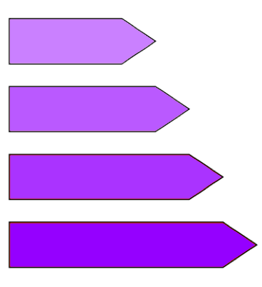
Making category generation more model-able…
Jern & Kemp (2013), Cognitive Psychology
Approach: ask people to generate new categories in an artificial, low-dimensional domain.
Generation Interface: Sliding scales to adjust each of the physical attributes.
Domain: ”Crystals”
Experimenter Defined
Participant Generated
Saturation
Hue
Size
Notes:
When they’ve finished, they will have created multiple crystals, which constitutes a category, and we can analyze their category to make conclusions about the creative process. So if you imagine that a participant created these for examples into their category, then you could also plot the generated category within the space and that can lead you to a lot of nice insights.

Slide 12
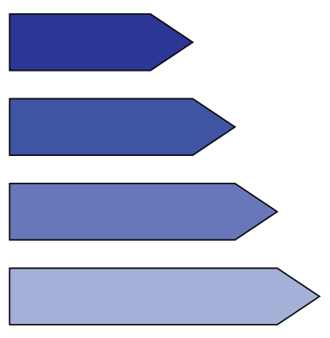
The classic results replicates in the artificial domain!
Generated categories possessed the same correlations as in the experimenter-defined categories.
Domain: ”Crystals”
Positive Size-Saturation correlation
Negative Size-Saturation correlation
Saturation
Hue
Size
Notes:
And broadly speaking what Jern and Kemp found was pretty much what we already knew. Their manipulation was in the relationship between size and saturation, within the experimenter define categories. Some participants learned a categories with a positive correlation, some with negative. And there are examples of each of these on the slide.
And it turns out that participants generated novel categories following the same correlations. So if they learned a category with a positive size-saturation correlation, they tended to generate a new category with the same pattern. And this lines up really nicely with the earlier observation that alien species obey the same correlations as found on earth.

Slide 13
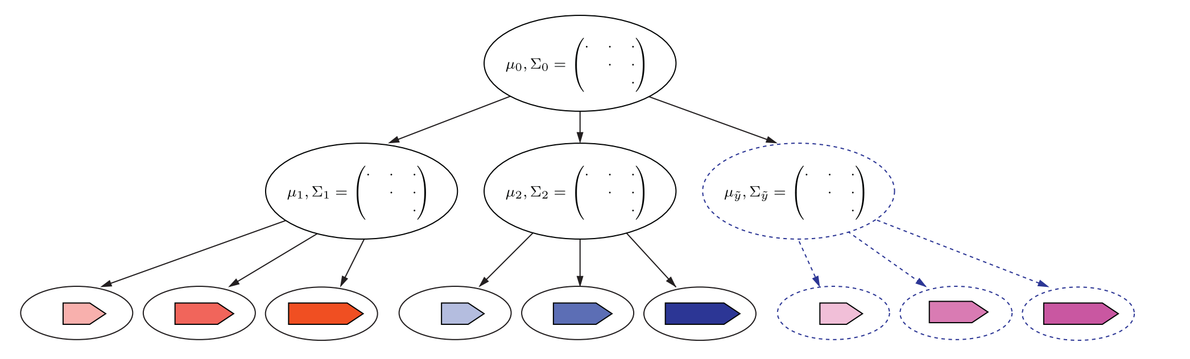
A probabilistic hierarchical sampling model
Represent categories as (multivariate normal) distributions in the space. Note: this produces a prototype representation.
Infer the the patterns of variability common among known categories.
Generate a new category with similar patterns.
Domain
representation
Category representation
Category members
Notes:
I don’t want to get too far into the weeds on this one, but they ended up building a hierarchical sampling model of category generation in order to explain their results. I’ll be showing simulations from this model in a little bit so here’s the introduction.
Basically, the model learns about how each category is distributed across the space -- in terms of how each physical attribute varies, and how they are correlated. Then, the model makes an inference using the common patterns of variability – so it tries to identify if the existing categories have a positive or negative correlation. And then it uses that inference to make a new category with similar properties.

Slide 14
…really, this talk is about category generation.
Category
Learning
Creativity
Real World Examples:
science, art, design, etc…
Experimental Approaches
“Draw an alien” experiments (e.g., Ward, 1994)
Artificial category learning studies (Jern & Kemp, 2013)
What do we know?
Generation is influenced by prior knowledge.
Distributional structure of generated categories reflects known categories.
Our investigation
What else drives category generation?
Do existing categorization approaches yield any insights?
Notes:
Ok, so, that’s where the field was as of last year. But really, all of those studies just served to identify this one constraint on category generation, and it seems a little silly to assume that’s all there is to it. So our experiments have been about identifying other constraints on generation

Slide 15
Goals:
Replicate Jern & Kemp (2013) and Ward (1994)
Characterize the types of categories people generate.
General Approach
Teach participants about an experimenter defined “Alpha” category.
Ask participants to generate a new “Beta” category.
Domain: Squares
Training phase
Generation Phase
Smaller
Bigger
Darker
Lighter
Size (2.5 – 7.1cm)
This is a member of the Alpha Category
Use the sliders to create a Beta Category example.
OK
DONE
Color (RGB 25-230)
Notes:
So the first thing we wanted to do was try to replicate the canonical effects that I just explained, and we sort of used these data as a springboard for later work.
We developed a two dimensional domain of squares varying in color and in size. In our experiments, participants first complete a training phase where they are taught about a category that we defined as a collection of these squares. Then, they complete a generation phase where they we ask them generate a new category.
In each experiment, we call the category that we created the “alpha category”, and the participants are supposed to make the “Beta” category

Slide 16
Training
“Supervised Observation” (Levering & Kurtz, 2015)
Participants exposed to members of the Alpha category, one at a time.
Three random blocks = 12 trials.
In this experiment, you will observe geometric figures like the ones below:
Training phase
We will show you some examples like these, all belonging to a common category called "Alpha". Examples of the Alpha category will appear one at a time, and your job is to learn as much as you can about the category.
Afterwards, we will ask you a series of questions about what you have learned.
This is a member of the Alpha Category
OK
Notes:
So the training phase is what you would call “supervised observation”. On each trial, participants see a single alpha category member and they are told it is an alpha, and they can move on whenever they want. So on the left I have a depiction of what each trial looked like, and on the right I have the instructions participants saw before beginning the training phase. These instructions are purposefully very boring because we don’t want participants bringing in any prior knowledge to the experiment.

Slide 17
Generation
Participants generated four members of the “Beta” class
Generation via sliding scaling interface, as in Jern & Kemp (2013)
As it turns out, there is another category of geometric figures called "Beta". Instead of showing you examples of the Beta category, we would like to know what you think is likely to be in the Beta category.
You will now be given the chance to create examples of any size or color in order to show what you expect about the Beta category. You will be asked to produce 4 Beta examples - they can be quite similar or quite different to each other, depending on what you think makes the most sense for the category.
Each example needs to be unique, but the computer will let you know if you accidentally create a repeat.
Generation
Smaller
Bigger
Darker
Lighter
Use the sliders to create a Beta Category example.
DONE
Notes:
The generation phase is just like in Jern and Kemp’s study. On each trial, they make a single beta category example by using sliders to adjust the example’s color and size. On the right I have the instructions that participants read before completing the generation task.
Again, the instructions were kept very vague because we did not want to bias participants towards creating any specific kind of category.

Slide 18
Experiment 1
Between subjects, n = 22 per condition.
Domain: Squares
XOR
Cluster
Row
Size (2.5 – 7.1cm)
Color (RGB 25-230)
* “A” = member of the ”Alpha” category
Notes:
Ok, so moving on to the first experiment. We developed three different conditions that we are calling XOR, Cluster, and Row. In each condition, participants are exposed to a category called “Alpha”, but in each condition the alpha category is different. So in each of these plots I’m showing the conceptual organization of the class in the domain, with A markers corresponding to members of a the “alpha” category.

Slide 19
Experiment 1
Between subjects, n = 22 per condition.
Conditions visualized as points in 2D Space, participants never see this representation (they only see the physical stimuli)
Domain: Squares
XOR
Cluster
Row
Size (2.5 – 7.1cm)
Color (RGB 25-230)
Notes:
It is important to note that participants never see the Alpha category represented as points in one of these spaces. We just plot it like this for illustrative reasons. Participants are only ever exposed to squares of a particular size and color.
So this slide is just to give you a sense of how these categories are physically instantiated. So the Alpha category that people learn about in the XOR, or exclusive or, condition is made of small dark squares and large light squares. In Cluster they are all small and light, and in Row that are all very small but both dark and light.

Slide 20
Experiment 1
Between subjects, n = 22 per condition.
Conditions visualized as points in 2D Space, participants never see this representation (they only see the physical stimuli)
Axis assignment (x = size, y = color) counterbalanced.
Domain: Squares
XOR
Cluster
Row
Size (2.5 – 7.1cm)
Color (RGB 25-230)
Notes:
From here on out though, I’ll be referring to the axes as X and Y axis, since in the behavioral study the assignment between the perceptual feature and the axis of the space is counterbalanced. But remember going forward, that each point in one of these multidimensional spaces corresponds to a particular square with a particular size and color.

Slide 21
Predictions
XOR
Cluster
Row
Lots of variance along both features.
Perfect positive feature correlation
Small amount of variance, both features
No feature correlation
No Y-Axis variance, lots of X-axis variance.
No feature correlation
Notes:
So given what we know about category generation, what do we think should happen here. Since people seem to emulate the structure of known categories, then the patterns of covariance in the Beta categories should reflect whatever Alpha category was learned.
So in the XOR condition, we should see more widely distributed Beta categories, with strong, positive feature correlations. In the cluster condition, people should make tightly clustered categories. In the row condition, people should make new rows.

Slide 22
XOR
*representative participants.
Notes:
Ok, so jus to give you a sense of the richness of these data I’ll show some samples on the slide. Each of these subplots came from a single participant, and I’ve just plotted the locations of the members of category A as well as the locations of the generated examples in category B.
And again, remember that each point in one of these plots corresponds to a physical stimulus. Each one of these plots is generated based on the collection of squares each person generates into the Beta category, and we produce these figures after the fact because it reveals a lot about each person’s approach.
So here are some samples from the XOR condition

Slide 23
XOR
CLUSTER
*representative participants.
Notes:
And here are the samples from the cluster condition

Slide 24
XOR
CLUSTER
ROW
*representative participants.
Notes:
And finally the samples from the row condition. And what I hope you can see is that there’s a huge degree of differences between people and conditions, but there’s also a lot of commonalities. SO this data is just super super rich.

Slide 25
Analysis Approach
Characterize each category in terms of underlying statistics, compare conditions on category statistics.
Core stats
Range of examples along each axis (X, Y)
Correlation between features.
XOR
CLUSTER
ROW
*representative participants.
Notes:
So the approach we’ve taken to deal with this richness is try to characterize each participants category in terms of a set of statistics, like the range of the Beta category along each feature, or the correlation between the features.

Slide 26
(Mostly) Replicating the classic effects…
XOR
Cluster
Row
Notes:
Here are boxplots showing the distribution of X- and Y- axis range and correlations for the beta categories in each condition. And in these data we see almost but not entirely broad support for the classic effects, So let me just walk you through these.

Slide 27
(Mostly) Replicating the classic effects…
XOR
Cluster
Row
XOR > Cluster p < 0.001
XOR > Row p = 0.007
Cluster = Row p = 0.29
As Predicted
XOR has more X Range than Row and Cluster
Notes:
So with respect the X axis, or horizontal range, just as the classic effect would predict, the XOR condition had the most X axis range, followed by the Row condition, followed by the cluster condition

Slide 28
(Mostly) Replicating the classic effects…
XOR
Cluster
Row
XOR = Cluster p = 0.13
XOR > Row p < 0.001
Cluster > Row p = 0.001
As Predicted
Row has less Y Range than XOR and Cluster
Notes:
The row categories had less Y axis, or vertical range than the other conditions.

Slide 29
(Mostly) Replicating the classic effects…
XOR
Cluster
Row
XOR <= Cluster p = 0.086
XOR <= Row p = 0.057
Cluster = Row p = 0.88
Not quite as predicted…
XOR has correlations opposite that of Alpha category.
XOR correlations are negative?
Notes:
And the XOR condition actually had more negative correlations compared to the other two conditions. That one is opposite of what we had originally predicted, but makes sense if you think about what areas of the space are left for the Beta category, given the Alpha category.

Slide 30
Betas are most commonly generated in extremes of the space, distant from Alphas.
Notes:
So I think that’s some pretty good evidence that people do emulate the distributional properties of learned categories in what they generate.
So then I just sort of explored the data to get a sense of what else was going on. On the slide now I’m showing you heatmaps of where people tended to generate beta category examples. Each figure is for one condition, and the shading of the figure shows how often people generated exemplars in each location. Areas shaded blue correspond to locations where Beta examples were generated most frequently.
And you can see that people really prefer to put the betas along the edges and corners of the space. I think this reflects a goal to have the beta category exemplars as far away from the alphas as possible.

Slide 31
Betas are most commonly generated in extremes of the space, distant from Alphas.
Distant examples are more frequently generated.
Notes:
So to test that out more specifically, I counted the number of times each item was generated, relative to its distance from members of the Alpha category. And you can see the pattern in each condition that the most distant possible examples are by far the most frequently generated.

Slide 32
Betas are most commonly generated in extremes of the space, distant from Alphas.
Distant examples are more frequently generated.
Betas are (usually) more similar to each other than they are to alphas.
Notes:
And finally, I computed the amount of within-class distance, or the overall space between Beta examples and compared it to the overall between-class distance, which is the amount of space between Beta examples and Alpha examples. I’ve plotted each person in a scatter plot here, and you can see that most people are in this upper triangle, which means that they have more between distance within distance.
And that indicates that people want the betas to be closer to one another than they are to the alpha category.

Slide 33
Summary
Generated categories are, on average, distributed like known categories. But that is not the whole story!
There are a lot of individual differences.
Contrast effects are very strong.
People try to make something consistent with the Alpha category, but perceptually dissimilar to it.
Notes:
SO just as a quick summary, we replicated the classic effect that generated categories tend to have the same distributional properties as known categories. But we also observed a pretty striking degree of individual differences. And this point is apparent if you just look at the categories people made. On the slide I have some samples from the Cluster condition, and you can see they there is a wide amount of variability in the underlying structure of the Betas.
The one thing all of these examples have in common is that Beta category is placed pretty far away from the alphas. So while it’s clear that prior knowledge effects what types of categories will be generated, I think it’s also clear that generated categories need to be different from known categories, and those contrast effects are really strong.

Slide 34
Experiment 2
Question: Does contrast influence how people generate categories?
Existing models assume generated class structure is exclusively based on known categories.
An alternative: generation is influenced by the shape of the unoccupied space. Inspired by classification lit (Hidaka & Smith, 2011).
Notes:
So that led Joe and I to start asking questions about whether these contrast effects could actually influence the types of categories people make. And the thought here is that existing models, which is pretty much just the hierarchical sampling model, assume that the internal structure, or distribution, of generated categories simply reflects the distribution of the known categories. The idea we had was that, actually, the shape of the remaining space, without any category items, influences generation.

Slide 35
Experiment 2
Question: Does contrast influence how people generate categories?
Existing models assume generated class structure is exclusively based on known categories.
An alternative: generation is influenced by the shape of the unoccupied space. Inspired by classification lit (Hidaka & Smith, 2011).
Super minimal manipulation!
Categories differ only slightly in Y axis position.
Identical distributional structure: between-condition differences can be attributed to contrast.
Notes:
So we developed these two conditions for the next experiment. And the manipulation here is super super minimal. In both cases, the Alphas have the same distributional structure because they are both pretty tight clusters. In the middle condition, the cluster is in the middle of the space, and in the bottom condition the cluster is sort of lower-middle.
But the key is, since both categories have have the same distributional structure, than any difference between the conditions must be due to something besides that.
So we ran a bunch of participants in each condition, using the same methods as in the last experiment.

Slide 36
Predictions
Conditions differ only in y-axis position (not in distributional structure)
Jern & Kemp: Distributions of generated categories should not differ.
Shape of unoccupied space differs considerably
Will participants make different kinds of categories, based on where there is space to put the exemplars?
Notes:
Before I get to the results its worth going over what we can expect based on what we know. So since Bottom and Middle do not differ in terms of the structure of the Alpha category, then the prediction given all those classic effects is that people should generally make the same types of categories in each condition, because they all have the same prior knowledge of the distributional structure.
But you can also see that the shape of the open space differs between the two conditions, so our question is about whether that will lead to qualitatively different kinds of categories.

Slide 37
Question: Does contrast influence how people generate categories?
Middle | Top Used | Top Not Used
Bottom Used | 28 | 18
Bottom Not Used | 11 | 4
Bottom | Top Used | Top Not Used
Bottom Used | 16 | 8
Bottom Not Used | 31 | 6
“Top”
“Bottom”
* n = 61 per condition
Notes:
So since our manipulation was in the Y axis position of the Alpha category, we started by analyzing how frequently participants generated Beta examples above and below the alphas. So for each participant, we counted whether they used the top of the space and the bottom of the space. And I have these regions highlighted on the slide.
On the right I have the contingency tables of these data. So we have two, 2x2 contingency tables, which I know from personal experience can be surprisingly difficult to analyze, so let me walk you though this.

Slide 38
Question: Does contrast influence how people generate categories?
Only 10 participants did not use the the top and/or bottom.
Middle | Top Used | Top Not Used
Bottom Used | 28 | 18
Bottom Not Used | 11 | 4
Bottom | Top Used | Top Not Used
Bottom Used | 16 | 8
Bottom Not Used | 31 | 6
“Top”
“Bottom”
Notes:
The first thing to note is that nearly every one put at least one item at the top or one item at the bottom. Only 10 people put all four betas in the interior of the space.

Slide 39
Question: Does contrast influence how people generate categories?
Only 10 participants did not use the the top and/or bottom.
Middle participants were more likely to use the bottom, p < 0.001.
Middle | Top Used | Top Not Used
Bottom Used | 28 | 18
Bottom Not Used | 11 | 4
Bottom | Top Used | Top Not Used
Bottom Used | 16 | 8
Bottom Not Used | 31 | 6
“Top”
“Bottom”
Notes:
The second thing is that participants in the bottom condition were less likely to use the bottom of the space. This is just the contrast effect we’ve been seeing – the bottom zone is a lot closer to the Alphas in the bottom condition.

Slide 40
Question: Does contrast influence how people generate categories?
Only 10 participants did not use the the top and/or bottom.
Middle participants were more likely to use the bottom, p < 0.001.
Middle was more likely to use the top and bottom, p = 0.038.
Middle | Top Used | Top Not Used
Bottom Used | 28 | 18
Bottom Not Used | 11 | 4
Bottom | Top Used | Top Not Used
Bottom Used | 16 | 8
Bottom Not Used | 31 | 6
“Top”
“Bottom”
Notes:
And finally, more participants in the middle condition used the top AND the bottom. And what this means is that participants in the middle condition were more likely to create categories that span the entire Y axis. And this result I think is key, because it indicates that the actual distribution of generated categories has changed simply due to the shape of the space that is already filled with another category.

Slide 41
Four Corners
Row
Column
Cluster
Middle
Bottom
* representative participants
Notes:
The second approach we took was to try to find the common patterns of generation in each condition. We just manually inspected the data, and we came up with four common profiles, which I’m showing on the slide.
There was what we’re calling a “four corners” category, with one beta example in each of the corners. Probably the most common types were row and column categories, where the betas are widely distributed along one dimension but not the other, creating rows or columns. But we also saw a lot of tightly clustered categories.

Slide 42
Four Corners
Row
Column
Cluster
Middle
Bottom
Varied performance tough to explain via prior knowledge of distributional structure.
Can variation be explained by the category’s location, relative to the Alphas?
Notes:
And if you didn’t notice, those profiles sort of fill out four quadrants in the relationship between the X and Y axis ranges. Right, so here I’ve plotted the X and Y axis range from each participant's category, and you can see that people are all over the place. And honestly this looks like a big mess, we’ve got a huge amount of variability in the types of categories that people generate.
This sort of thing is tough to account for if your only explanatory mechanism based on knowledge of how other categories are distributed. Like, how could you explain such huge variability when everybody in the study has the same prior knowledge?
But I think you can explain a lot about each participant’s profile if you consider where the exemplars in the category are actually located, relative to the members of the Alpha category.

Slide 43
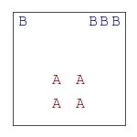
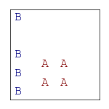
Each beta category characterized by difference in feature ranges:
D = range(X) – range(Y)
Positive D: more X range, indicating a row-like category
Negative D: more Y range, indicating a column-like category.
D were averaged for each stimulus, revealing overall tendency.
Categories are locally distributed to allow for maximum distance from Alphas.
”Column” categories placed to the side of Alphas
“Rows” categories placed above/below.
Middle
Bottom
Notes:
So Joe and I are still exploring these data, but here’s one thing we did to relate category structure to category location. So the heat maps at the bottom show, for each stimulus, how the categories it was placed in tend to be distributed. So purple areas correspond to items that were often in horizontally aligned categories, or row-like categories. Orange areas correspond to items that were in vertically aligned, or column-like categories.
And what I think is really apparent here is that people tend to put rows above or below the alphas, and they tend to put columns to the sides, which is just real clear evidence that people are organizing their generated category in order to maximize distance from the Alpha category.

Slide 44
Experiment 1
Replicated classic effects: Distributional structure of known categories is reflected in generated categories. Exemplars in generated categories are similar to one another.
But also: Generated categories are perceptually dissimilar to known categories.
Experiment 2
“Open Space” effect: The shape of unoccupied space influences generation.
Individual differences: Generated categories vary considerably from person to person. Often little resemblance to known categories.
Contrast is local: Generated categories are distributed to be maximally dissimilar to known categories, given their location.
Notes:
Ok, so that’s all I have in the way of experiments to tell you all about. And as I said earlier, before Joe and I started working on this, we really didn’t know that much about category generation, so a lot of this has been about establishing some very fundamental principles. And I think these two experiments have revealed quite a bit, most notably that people in some sense seek out unoccupied areas of space to generate a category in, and that the structure of their categories is influenced by contrast from known categories.

Slide 45
Experiment 1
Replicated classic effects: Distributional structure of known categories is reflected in generated categories. Exemplars in generated categories are similar to one another.
But also: Generated categories are perceptually dissimilar to known categories.
Experiment 2
“Open Space” effect: The shape of unoccupied space influences generation.
Individual differences: Generated categories vary considerably from person to person. Often little resemblance to known categories.
Contrast is local: Generated categories are distributed to be maximally dissimilar to known categories, given their location.
Formal Modeling
Do popular category learning models offer any insights?
Notes:
And as it turns out, a lot of our intuitions about category contrast some from really foundational work in the categorizations, where we know that people tend to learn categories more easily if the categories are more distinct from one another. So we began to look into how popular category learning models might explain these effects.

Slide 46

PACKER: An Exemplar Model
Producing Alike and Contrasting Knowledge using Exemplar Representations
An extension of the the Generalized Context Model (GCM; Nosofsky, 1984)
Categories represented as a collection of observed members (exemplars).
Notes:
The model we ended up building was called PACKER, which stands for producing alike and contrasting knowledge with exemplar representations. We called it packer first, because go packers!, but second because one of the key principles is that the model generated categories by trying to pack unoccupied space with examples. I don’t think I have time to review the core principles of the exemplar view, but I’d be happy to talk through the math later if any anyone asks me.

Slide 47
PACKER: An Exemplar Model
Producing Alike and Contrasting Knowledge using Exemplar Representations
An extension of the the Generalized Context Model (GCM; Nosofsky, 1984)
Categories represented as a collection of observed members (exemplars).
Generation is based on dual constraints
Dissimilarity to members of opposite categories.
Similarity to members of the target category.
Notes:
So PACKER generates items by trying to satisfy two constraints. It wants new categories to be dissimilar to all the known categories, and it wants items belonging to the same category to be similar to one another.
The heatmaps I have on the slide I think provide a solid ignition about how the model works. Each of these plots show how likely the model is to generate a category B example at each point in the space, with blue areas being more likely. So in this case the model knows about one item in category A and one item in category B. The first plot shows how the category A example contributes to generation, and basically things get exponentially more likely as you move away from the A. The second one shows the influence of the category B example, and basically things get exponentially less likely as you move away from it.
So the combination of those is the actual distribution from which an example is generated, and you can see the model is predicting that an item will be generated close to the B but far from the A. And so basically the model has a little kernel for each example, and in the end generation is the combination of all of them.

Slide 48

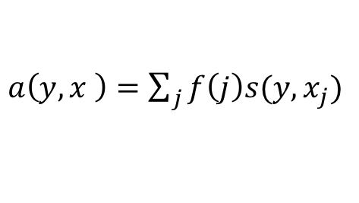
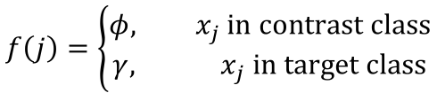



PACKER: An Exemplar Model
Producing Alike and Contrasting Knowledge using Exemplar Representations
Similarity as inverse-exponential function of distance across k dimensions.
$$s\left(x_{i},x_{j}\right)=\exp\left\{−c\sum_{k}{\left|x_{ik}−x_{jk}\right|w_{k}}\right\}$$
Generation is based on aggregation over stored examples x. Similarity is weighted differently according to class assignment.
$a\left(y,x \right)=\sum_{j}{f\left(j\right)s(y,x_{j})}$
$$f\left(j\right)=\left\{\begin{aligned}φ, x_{j} \text{in} \text{contrast} \text{class} \\ γ, { x}_{j} \text{i}\text{n} \text{target} \text{class}\end{aligned}\right.$$
$$φ=−1, γ=0$$
$$φ=0, γ=1$$
$$φ=−1, γ=1$$
Notes:
So that gives you a pretty good intuition about how the model works, but I have this slide with the actual mathematics. And again I’m happy to talk this through more carefully if anyone asks, but really I’m showing this mostly for joe. Basically, we set the model up so that the influence of the contrast and target categories is parameterized, so by fitting the model to a single person’s category, we can interpret the parameters to get a sense of where their priorities are.

Slide 49
Model Comparison
Parameters fitted (4 per model), maximized log-likelihood to all responses.
Each participant’s generation simulated 50 times with the best-fitting parameters.
PACKER has a clear advantage over the Copy & Tweak and Hierarchical sampling models.
Notes:
Now it turns out this system explains all sort of things that we’re observing, but joe and I are really just beginning to conduct systematic tests. This is a figure from a paper we submitted to the cogsci conference, and it’s showing that PACKER nicely explains the interaction between category location and distribution we observed. Just like human category generators, PACKER tends to put row like categories above and below the alphas, and it tends to put column like categories to the sides.

Slide 50
What does PACKER contribute?
Links exemplar classification learning to category generation.
Explains contrast & similarity-driven effects.
Explains “open space” effects.
Explains individual differences (via parameter changes).
Possible interpretation as an importance sampling process (ask Joe!)
But…
PACKER does not explain the classic distributional-copying effects.
Notes:
PACKER actually ends up being a very well-defined and expressive model that explains a lot of what Joe and I have observed. The only problem, and this could be a big deal depending on your perspective, is that it has no mechanism to explain the classic distributional-consistency effects like in the Jern and Kemp study.

Slide 51
But…
PACKER does not explain the classic distributional-copying effects.
Rebuttal!
There is a lot going into category generation, besides prior knowledge.
Possible to devise a model explaining contrast and distributional similarity.
Notes:
So if I were going to defend PACKER, and I will, I would argue that there are actually a lot of influences on generation, and the distributional copying effect is only a small part of it. If you remember from before, this plot shows the huge amount of variation we observe from people with highly similar sources of prior knowledge, and I think the goal of the field should be to describe why different people generate different types of categories.

Slide 52
Questions?
Special thanks to
Ken Kurtz
Alan Jern
Charles Kemp
Jeff Zemla

Slide 54
Extras

Slide 55
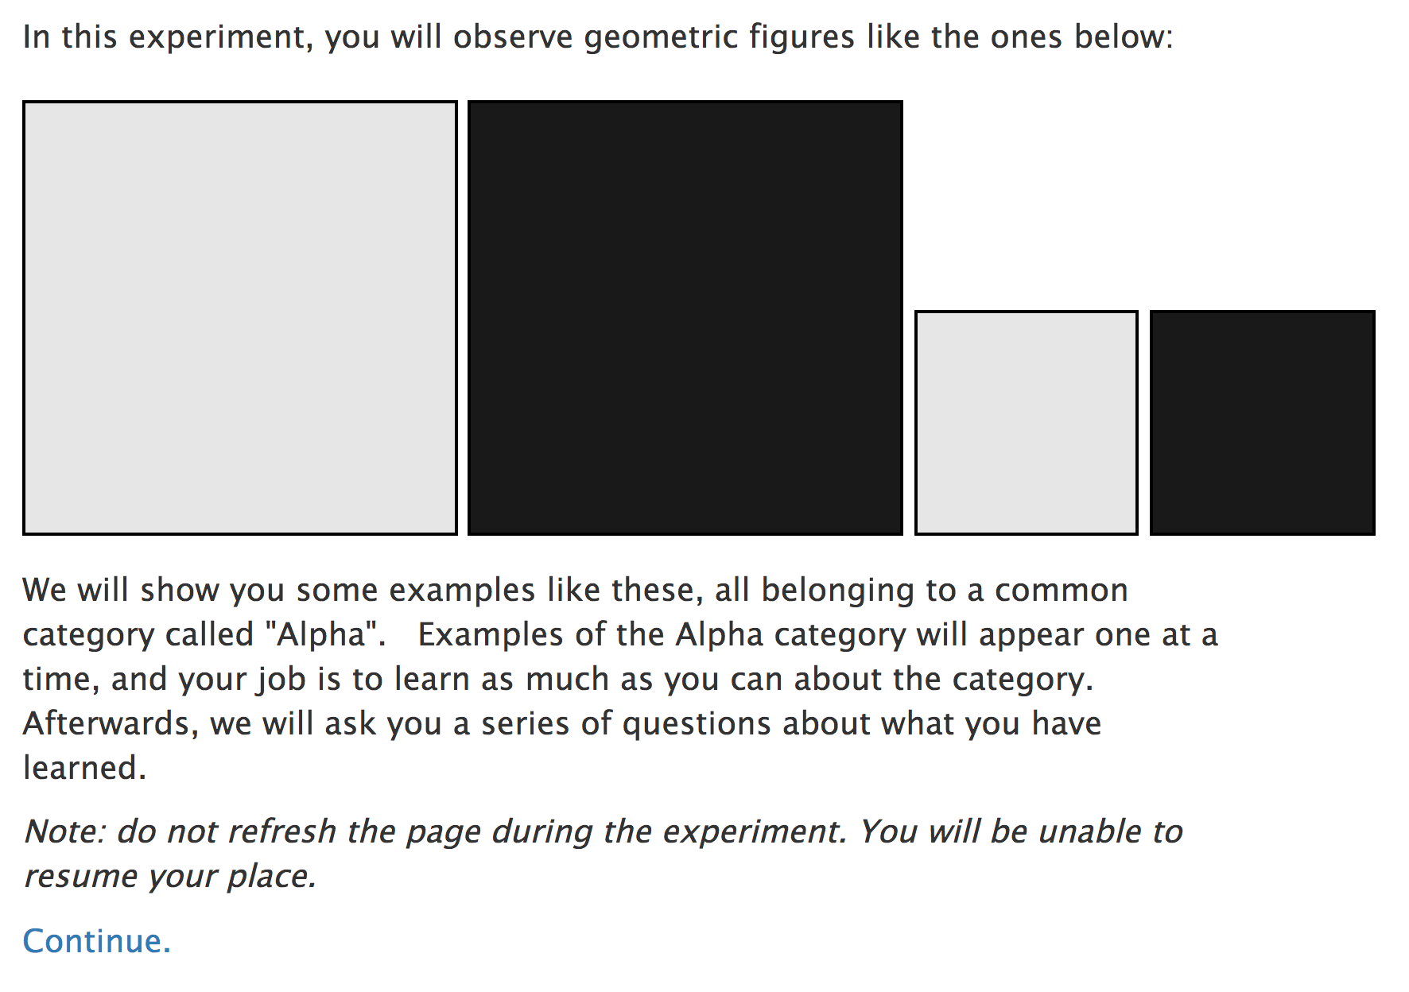
Training Instructions

Slide 56
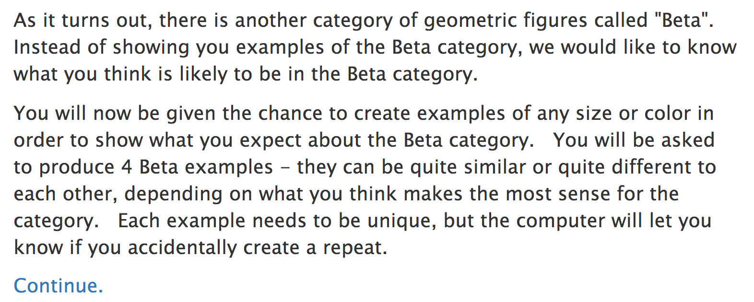
Generation Instructions

Slide 57
Does this count as a creative use of conceptual knowledge?
Disadvantages
Really boring, small domain.
Doesn’t *feel* very creative.
Advantages
Can control prior knowledge
possible to simulate with formal models!
Can you create a new category?
Adjust Size
Preview
Saturation
Adjust Hue
Hue
Adjust Saturation
DONE
Size
Notes:
So before I start talking about what we’ve been doing, I just want to acknowledge right away that I know that these artificial category learning experiments don’t feel as creative as the older stuff on drawing aliens. But the core elements are in place – the only thing that has changed is that the domain is way smaller and a lot more boring.
The advantage, of course, is that you get a lot more control over the experience, and then you can build computational models that we would hope yield useful information about the more naturalistic case.
Anyway, this artificial categorization paradigm is where my talk is going to live, but I’m going to try to phrase my conclusions so that they apply to the broader world of category generation.

Slide 58
Huge variation in Y axis Range, but everyone’s Alpha category had the same range!
Each participant is a line, depicting the start and end points of their category along the Y axis. Notches for each example.
Most people have very little or maximum ranges, very little middle ground.

