Slide 1
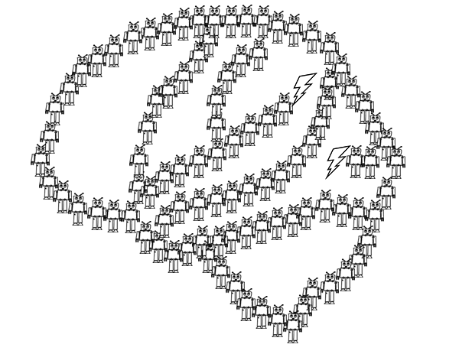
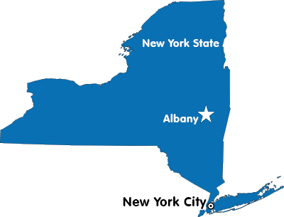
Exploring the Creative Use of Conceptual Knowledge
Binghamton
Notes:
I am Nolan Conaway, a postdoc in Joe’s lab. I came here in August from Binghamton University where I worked on some really basic category learning research with Ken Kurtz. With Joe I’ve been working on a handful of projects, and today I’m going to talk about one project exploring how category knowledge is used creatively.

Slide 2
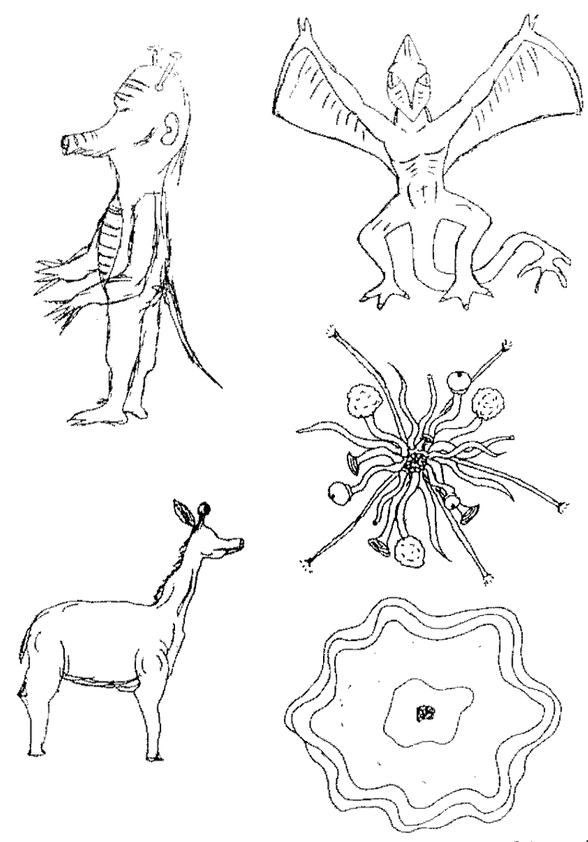
…really, this talk is about category generation.
Classic paradigm: participants asked to draw species of plants and animals from other planets
What we learned—
Shared physical attributes:
Aliens possess the same structural forms as on earth species (arms, legs, ears, etc…)
Shared distributional properties:
Same feature correlations as found on earth (e.g., wings usually found with feathers)
Less within-species variance compared to between-species variance.
Images from Ward (1994), Cognitive Psychology
Notes:
The creative use of conceptual knowledge is actually a really broad topic and I’m not quite that ambitious. in reality, all of the work I’m going to tell you about is on category generation, which is just one of the many ways that conceptual knowledge can be used creatively.
In general, studies on category generation basically ask people to generate new categories of things, and the the experimenter analyzes the created categories to figure out what sources of prior knowledge were used in the creative process. In the classic paradigm, participants are asked to draw new species of plants and animals that might exist on other planets.
The typical finding is that prior knowledge is hugely constraining on creative generation. On the slide I have some example alien species from a study conduced by Thomas Ward, and you can see that alien species resemble earth species not only in their structural forms (having things like arms and legs), but also members of alien species tend to be distributed like earth species (in the correlations between features, but also the similarity between examples belonging to the same and different species).

Slide 3
Classic paradigm: participants asked to draw species of plants and animals from other planets
Psychological account—
Copy-and-Tweak (Ward, 1995)
Participants retrieve an earth animal from memory, and then change a few of its features to make something new.
Images from Ward (1994), Cognitive Psychology
Notes:
There isn’t a lot in the way of real accounts explaining these observations, mostly because the work was really exploratory. The most commonly cited idea from this era is that people “copy-and-tweak” some real example to make something new. But really, there was never any formalization of that idea.

Slide 4
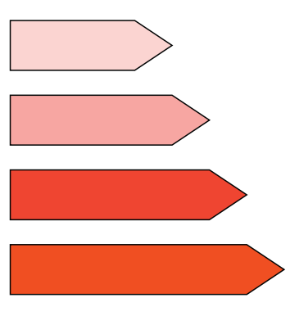
Making category generation more model-able…
Jern & Kemp (2013), Cognitive Psychology
Approach: ask people to generate new categories in an artificial, low-dimensional domain.
Domain: ”Crystals”
Saturation
Hue
Size
Notes:
So, as is typically the case when you want to develop a formal model of complex behavior, the approach taken to model category generation has been to simplify the domain. Alan Jern & Charles Kemp were the first to report anything like this. They developed a artificial, three-dimensional domain of what they called “crystals”, varying in size, hue, and saturation. Each on these items at the bottom of the slide is one crystal, which can be conceptualized as a point in the three dimensional domain space.

Slide 5

Making category generation more model-able…
Jern & Kemp (2013), Cognitive Psychology
Approach: ask people to generate new categories in an artificial, low-dimensional domain.
Generation Interface: Sliding scales to adjust each of the physical attributes.
Domain: ”Crystals”
Can you create a new category?
Adjust Size
Preview
Saturation
Adjust Hue
Hue
Adjust Saturation
DONE
Size
Notes:
An experimenter can define a category as a collection of crystals, or multiple points in the space. And so the general procedure is to teach people about one or more experimenter-defined categories, and then ask participants to make new categories.
In this paradigm, participants create the new category one item at a time, and each item is made with a set of sliding scales that can be used to change the feature values. They get as much time as they want, and when they’re finished they move on to create the next example

Slide 6
Does this count as a creative use of conceptual knowledge?
Disadvantages
Really boring, small domain.
Doesn’t *feel* very creative.
Advantages
Can control prior knowledge
possible to simulate with formal models!
Can you create a new category?
Adjust Size
Preview
Saturation
Adjust Hue
Hue
Adjust Saturation
DONE
Size
Notes:
So I’ll be the first to admit that this doesn’t feel as creative as the older stuff on drawing aliens. But the core elements are in place – the only thing that has changed is that the domain is way smaller and a lot more boring. The advantage, of course, is that you get a lot more control over the experience, and then you can build computational models to test theories about how people do this sort of thing.
Anyway, this artificial categorization paradigm is where my talk is going to live, but I’m going to try to phrase my conclusions so that they apply to the broader world of category generation.

Slide 7
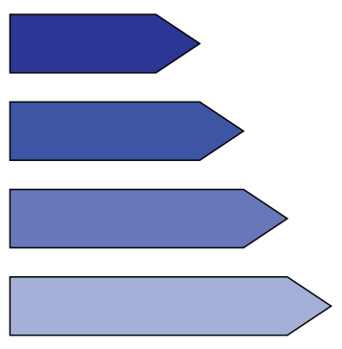
Replicating classic results in the artificial domain.
Jern & Kemp (2013):
Generated categories possessed the same correlations as in the experimenter-defined categories.
Domain: ”Crystals”
Positive Size-Saturation correlation
Negative Size-Saturation correlation
Saturation
Hue
Size
Notes:
So since Jern & kemp published the first study taking this approach, I’ll briefly describe what they found. Their manipulation was in the relationship between size and saturation, within the experimenter define categories. Some participants learned a categories with a positive correlation, some with negative. And there are examples of each of these on the slide.
And it turns out that participants generated novel categories following the same correlations. So if they learned a category with a positive size-saturation correlation, they tended to generate a new category with the same pattern. And this lines up really nicely with the earlier observation that alien species obey the same correlations as found on earth.

Slide 8
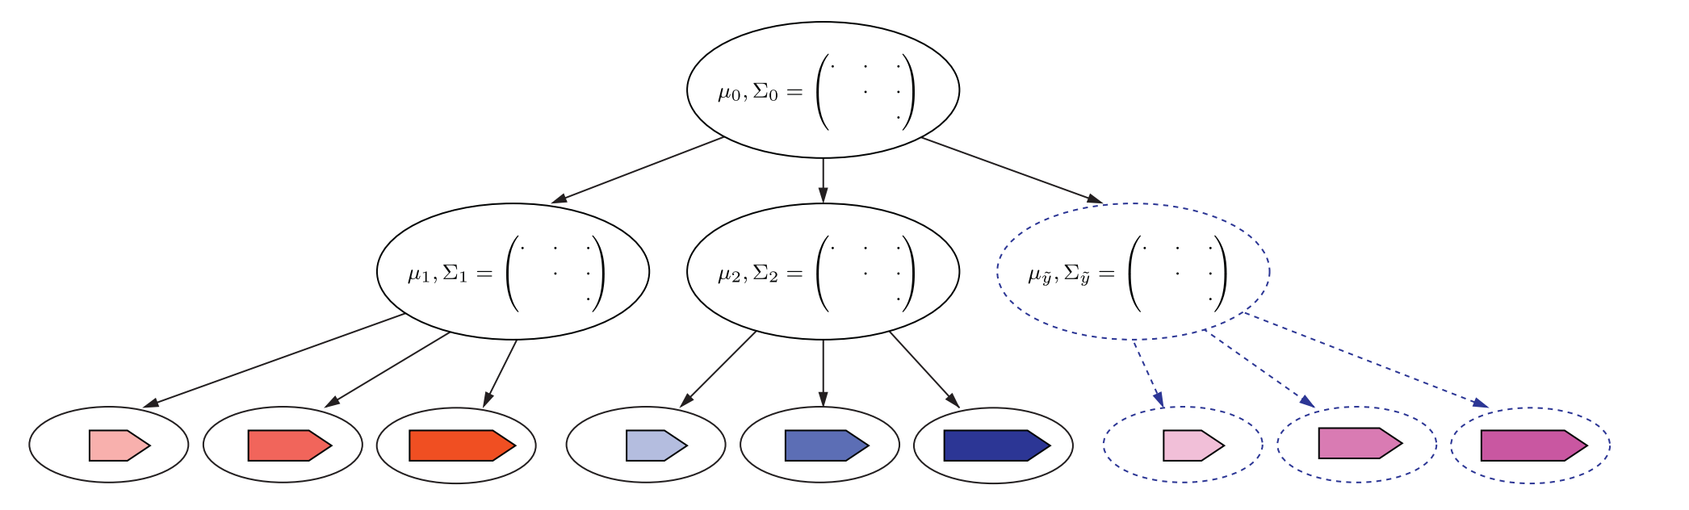
A hierarchical sampling model
Represent categories as (multivariate normal) distributions in the space.
Infer the the patterns of variability common among known categories.
Generate a new category with similar patterns.
Domain
representation
Category representation
Category members
Notes:
I don’t want to get too far into the weeds on this one, but they ended up building a hierarchical sampling model of category generation in order to explain their results. I’ll be showing simulations from this model in a little bit so here’s the introduction.
Basically, the model learns about how each category is distributed across the space -- in terms of how each physical attribute varies, and how they are correlated. Then, the model makes an inference using the common patterns of variability – so it tries to identify if the existing categories have a positive or negative correlation. And then it uses that inference to make a new category with similar properties.

Slide 9
Taking a step back…
Experimental Approaches
Naturalistic “draw an alien” experiments (e.g., Ward, 1994)
Artificial category learning studies (Jern & Kemp, 2013)
What do we know?
Generation is influenced by prior knowledge.
Distributional structure of generated categories reflects known categories.
Hierarchal sampling model explains prior knowledge effects.
That’s where we are!
Notes:
Okay, so that’s sort of the state of things when Joe and I started working on this last year. We have some strong evidence that prior knowledge influences category generation because people appear to create categories with the same distributional properties as known categories. And you can explain those results by assuming that people abstract knowledge about the domain itself, rather than just the categories in it.
But that’s actually a really small set of phenomena, especially when you consider that we’re dealing with the intersection of creativity and categorization, which are both very well studied topics.

Slide 10
Taking a step back…
Experimental Approaches
Naturalistic “draw an alien” experiments (e.g., Ward, 1994)
Artificial category learning studies (Jern & Kemp, 2013)
What do we know?
Generation is influenced by prior knowledge.
Distributional structure of generated categories reflects known categories.
Hierarchal sampling model explains prior knowledge effects.
Our investigation
What else drives category generation?
Do existing categorization approaches yield any insights?
Notes:
So early on Joe and I, with my old advisor Ken Kurtz, ran some pretty exploratory experiments to get a sense of what types of effects you can get in a category generation experiment, and what parts of category generation you can explain with the ideas from the category learning literature.

Slide 11
Experiment 1
Goals:
Replicate Jern & Kemp (2013) and Ward (1994)
Characterize the types of categories people generate.
Domain: Squares
XOR
Cluster
Row
* “A” = member of the ”Alpha” category
Notes:
So the first thing we wanted to do was try to replicate the canonical effects that I just explained, and to just sort of get a sense of generation in general.
We developed a two dimensional domain of squares varying in color and in size. Then, we developed three different conditions that vary in the organization of the starter categories. So in each of these plots I’m showing the conceptual organization of the class in the domain, with A markers corresponding to members of a known category that we call the “alpha” category.

Slide 12
Experiment 1
Goals:
Replicate Jern & Kemp (2013) and Ward (1994)
Characterize the types of categories people generate.
Domain: Squares
XOR
Cluster
Row
Notes:
And this slide is just to give you a sense of how these categories are physically instantiated. So the Alpha category in the XOR, or exclusive or, condition is made of small dark squares and large light squares. In Cluster they are all small and light, and in Row that are all very small but both dark and light.

Slide 13
Experiment 1
Goals:
Replicate Jern & Kemp (2013) and Ward (1994)
Characterize the types of categories people generate.
Procedure:
n = 22 per condition
Participants exposed to members of the Alpha category, one at a time (12 trials)
Participants generated four members of the “Beta” class
Generation via sliding scaling interface, as in Jern & Kemp (2013)
Domain: Squares
XOR
Cluster
Row
* “A” = member of the ”Alpha” category
Notes:
So we trained each participant on one of the classes by showing them the examples one at a time for twelve trials. Then we told there was another category called Beta, and asked them to generate four examples just like in the Jern and kemp experiments.

Slide 14
Predictions
XOR
Cluster
Row
Notes:
So if people generate categories with the same distributional properties as existing categories

Slide 18
Sample behavioral data
XOR
CLUSTER
ROW
*representative participants.
Notes:
Ok, so here are just some sample behavioral data points we collected. Each of these subplots came from a single participant, and I’ve just plotted the locations of the members of category A as well as the locations of the generated examples.

Slide 19
Where are the Betas?
Generated exemplars are localized in extremes of space (on edges).
Exemplars are maximally distant from members of existing category on at least one dimension.
Notes:
Okay, so the first question we wanted to answer was just, very broadly, where did participants end up localizing the Beta exemplars. So on the slide I have three figures, one for each condition, and the shading of the figure shows how often people generated exemplars in each location. Areas shaded blue correspond to locations where Beta examples were generated most frequently.
And you can see that people really prefer to put the betas along the edges and corners of the space. I think this reflects a goal to have the beta category exemplars as far away from the alphas as possible, which results ion a lot of use of the corners.

Slide 20
Characterizing Beta categories
Summarized generated Beta categories using three statistics:
Variance along X axis feature (e.g., color).
Variance along Y-axis feature (e.g., size).
Correlation between features.
*representative participants.
Large X variance
No Y variance
No correlation
Little X variance
Little Y variance
Strong Correlation
Large X variance
Large Y variance
Perfect Correlation
Notes:
So, digging in a litter deeper, the next thing we wanted to so is to try to characterize the structure of the generated categories. For example, we want to know if people created categories that are opposites of the alphas, or if they made rows or columns or whatever.
And so we ended up using three summary statistics to describe each participant's category. We calculated the variability of the exemplars along each dimension, size and color, as well as the correlation between features within the category. I have on the slide a few examples from our dataset, which sort of give you the sense of how these three statistics really capture a lot about the generations strategy.

Slide 21
Characterizing Beta categories
XOR more variable than Cluster & Row (along both dimensions).
Row more variable along X than Y.
Notes:
Here are the comparisons for the variance. Each plot show the variance along a given dimension for each condition, and I have depicted the conditions within each plot.
The results here show two things mainly. First, the categories generated after exposure to an XOR category are generally more variable than Cluster and Row. And this makes sense because the Alpha categories in XOR are also much more variable.
The second thing is that the row condition has much less variance along the vertical dimension, which again makes sense because those Alphas are a row, and so people are likely making Betas as rows.

Slide 22
Characterizing Beta categories
Replicates Jern & Kemp (2013)
Distribution of generated category members varies according to the distribution of the existing category.
Notes:
Right, and so I think this pretty nicely replicates the core finding from Jern & Kemp. The degree of variance of the generated categories on average can be traced back to the variance of the existing Alpha category.

Slide 23
Characterizing Beta categories
Cluster & Row show no systematic correlations.
XOR categories are negatively correlated.
Correlation
Density
Correlation
Notes:
Here’s the data for the feature correlations. Again, each condition’s average is shown on a separate bar. You can see that Cluster and row do not have much in terms of systematic correlations, but beta categories from the XOR condition have strongly negative feature correlations. This is actually pretty cool, because the alphas in the XOR condition have a strongly positive correlation, and this shows that participants are generating betas as the opposite of alphas.
On the right side of the slide I have histograms of each condition’s feature correlations, and this is just to confirm that the zero averages in Row and Cluster are not simply due to bimodality with strongly positive and negative correlations. If anything, there looks like there could be a subgroup of individuals in the XOR condition with strongly positive correlations.

Slide 24
Characterizing Beta categories
XOR Results oppose Jern & Kemp (2013)
Alpha feature correlation was not applied in Beta category. Instead the correlation was reversed.
Correlation
Density
Correlation
Notes:
And if you consider this more carefully, it turns out that in the results for the XOR condition we actually see a departure from the Jern & Kemp findings. People didn’t just transfer the positive correlation in the alpha category, which is what Jern & Kemp would predict, but its actually as if they made a decision that the Beta category should be opposite of alphas, which produces a negative correlation. And so I think that’s a really interesting piece of phenomena that I’d like to explain in a future experiment.

Slide 25
Structure of Alpha categories is broadly reflected in the Beta categories.
However, Beta category structure often opposes the Alpha category. High degree of individual differences.
*representative participants.
Notes:
So from these summary statistics, we definitely get the sense that there are properties of the Alpha category that are applied when people generate members of a new category. But I think its clear that the structure of the alpha category is not the only determinant of the structure of the Beta category. Not only did participants in the XOR condition appear to reverse the feature correlation, but casual observation of the generate categories makes it pretty clear that participants often induce structure in the Betas that is not present in the Alphas.

Slide 28
Extras

Slide 29
Full generation instructions
As it turns out, there is another category of geometric figures called "Beta" that is different from the Alpha category you just learned about. Instead of showing you examples of the Beta category, we would like to know what you think is likely to be in the Beta category.
You will now be given the chance to create examples of any size or color in order to show what you expect about the Beta category. You will be asked to produce 4 Beta examples - they can be quite similar or quite different depending on what you think makes the most sense for the category. Each example needs to be unique, but the computer will let you know if you accidentally create a repeat.
Press the spacebar when you are ready to continue.

