Slide 2
The Creative Use of Conceptual Knowledge

Slide 3
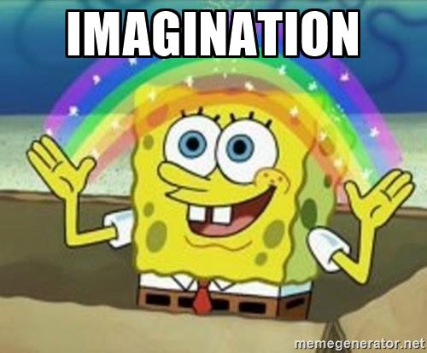
Or…

Slide 4
Draw a new animal…
Notes:
Clearly we use imagination all of the time…

Slide 5
Draw a new animal…
Category generation.
Categorization
Creativity
Notes:
What’s not obvious is that there is a lot of interesting cognition …

Slide 6
Experimental Approaches
“Draw an alien” experiments (e.g., Ward, 1994)
Artificial category learning studies (Jern & Kemp, 2013)
What do we know?
Generation is influenced by prior knowledge.
Distributional structure of generated categories reflects known categories.
That’s where we are!
Notes:
But we really don’t know very much about creativity.
On the slide I have listed sort of the state of the field when I started working on this, and I’m going to go over each of these points in more detail, but suffice it to say that that these lists are not large. So our approach has really been first about establishing a set of basic observations, and then we use computational models to try to explain them.

Slide 7
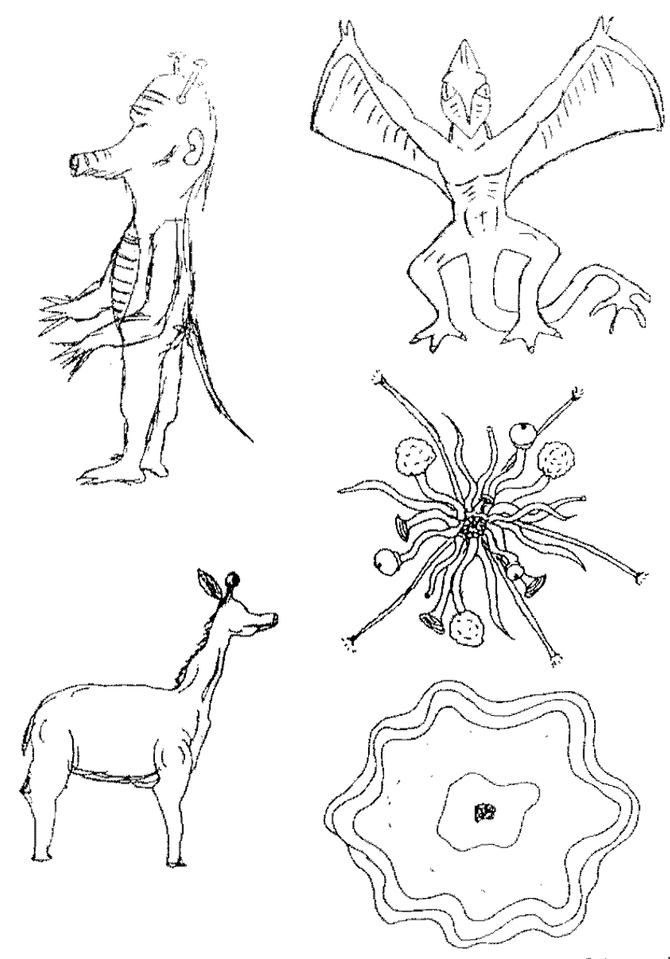
General Approach: ask people to generate new categories, then analyze what they create.
Classic paradigm: participants asked to draw species of plants and animals from other planets.
Images from Ward (1994), Cognitive Psychology
Notes:
The classic studies were a lot like what we just did--
People were asked to draw pictures of alien plants or animals, and the experimenter would analyze the pictures to figure out what sources of prior knowledge were used in the creative process.

Slide 8
Shared physical attributes:
Aliens possess the same structural forms as on earth species (arms, legs, ears, etc…)
Shared distributional properties:
Same feature correlations as found on earth (e.g., eyes found with ears)
Less within-species variance compared to between-species variance.
Images from Ward (1994), Cognitive Psychology
Notes:
The typical finding is that prior knowledge is hugely constraining on creative generation.
[Analyze the animal we drew]
But even more interestingly is that they tend to have the same distributional properties as earth species.

Slide 9
Experimental Approaches
“Draw an alien” experiments (e.g., Ward, 1994)
Artificial category learning studies (Jern & Kemp, 2013)
What do we know?
Generation is influenced by prior knowledge.
Distributional structure of generated categories reflects known categories.
That’s where we are!
Notes:
So that’s what I meant when I said …
And as you can see, that describes pretty much entirety of our knowledge on this subject.

Slide 10
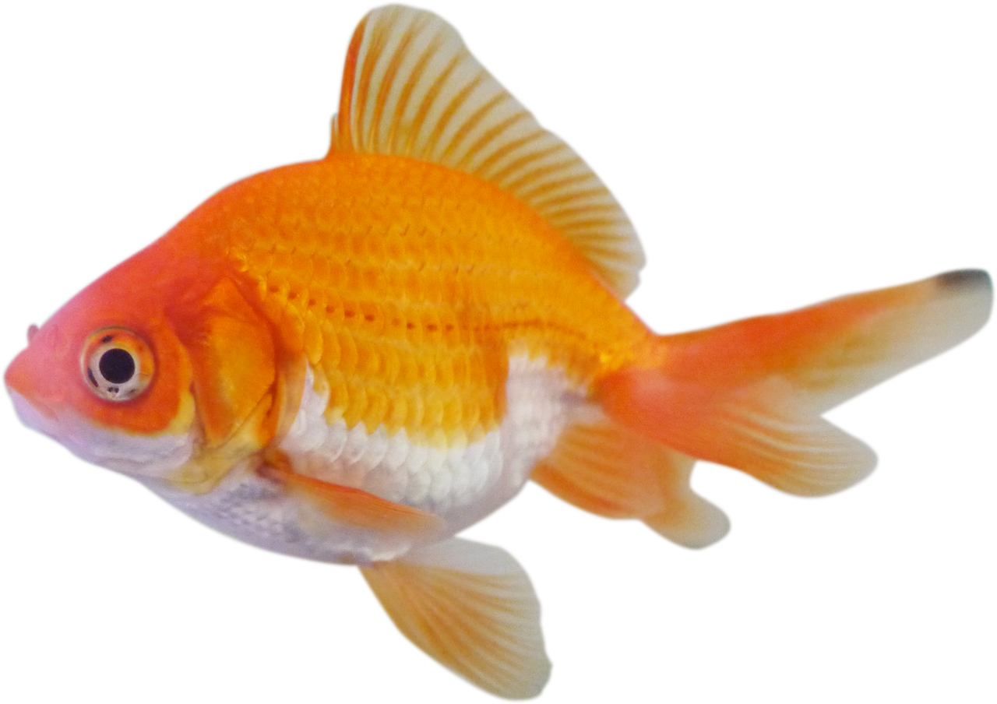
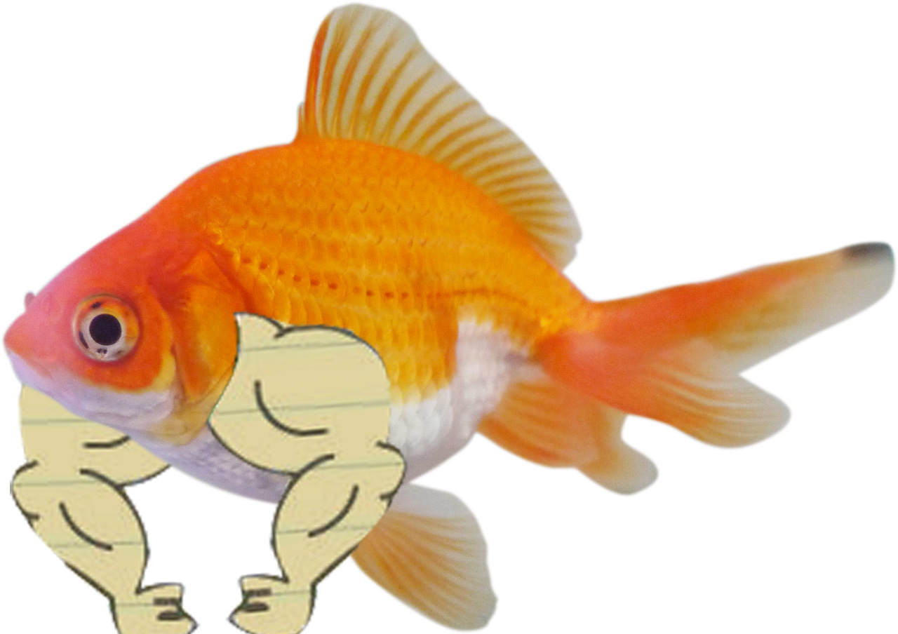

Path-Of-Least-Resistance (Ward, 1995)
Participants retrieve a known animal from memory, and then change a few of its features to make something new.
Later termed “Copy-and-Tweak” by Jern & Kemp (2013)
Goldfish
Beefy Arm
Beefy Goldfish
+
=
Notes:
So how can you apply a cognitive-style interpretation to these findings?
The most commonly cited idea is what we now call the “copy and tweak account”, but was originally termed the path of least resistance model….

Slide 11
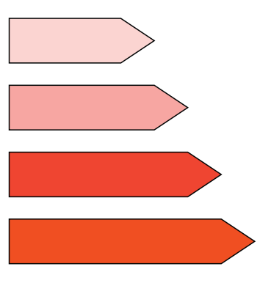
Moving things forward…
Jern & Kemp (2013), Cognitive Psychology
Approach: ask people to generate new categories in an artificial, low-dimensional domain.
Domain: ”Crystals”
Saturation
Hue
Size
Notes:
But its really hard to test a theory on that sort of data, because drawing pictures is a really complex behavior. So to move things forward, researchers simplified the domain, which allows for theories to be more easily tested.
Alan Jern & Charles Kemp were the first to report anything like this. They developed a artificial, three-dimensional domain of what they called “crystals”, varying in size, hue, and saturation, so you can visualize the domain as a cube. Each on these items at the bottom of the slide is one crystal, which can be conceptualized as a point in the three dimensional domain space.

Slide 12
Moving things forward…
Jern & Kemp (2013), Cognitive Psychology
Approach: ask people to generate new categories in an artificial, low-dimensional domain.
Domain: ”Crystals”
Saturation
Hue
Size
Understanding this is super important!
Notes:
Its really important to grasp the idea that you can represent one of these artificial domains using Cartesian coordinates.
Will be lost for the rest of lab meeting!
Speak up if you lose track of what the spaces are.

Slide 13

Moving things forward…
Jern & Kemp (2013), Cognitive Psychology
Instead of drawing…
Use scales to adjust the features.
Domain: ”Crystals”
Can you create a new category?
Adjust Size
Preview
Saturation
Adjust Hue
Hue
Adjust Saturation
DONE
Size
Notes:
So within a space, an experimenter can define a category as a collection of crystals, or multiple points in the space. And so the general procedure is to teach people about one or more experimenter-defined categories, and then ask participants to make new categories.
In this paradigm, participants create the new category one item at a time, and each item is made with a set of sliding scales that can be used to change the feature values. They get as much time as they want, and when they’re finished they move on to create the next example

Slide 14
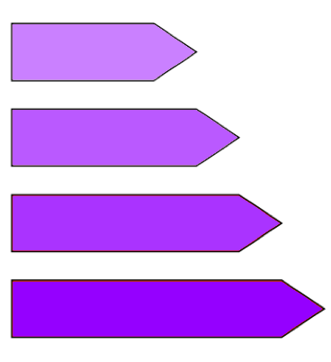
Moving things forward…
Jern & Kemp (2013), Cognitive Psychology
Instead of drawing…
Use scales to adjust the features.
Domain: ”Crystals”
Experimenter Defined
Participant Generated
Saturation
Hue
Size
Notes:
When they’ve finished, they will have created multiple crystals, which constitutes a category, and we can analyze the category they made by plotting the positions of each of their crystals within the space. So if you imagine that a participant created these for examples into their category, then you could plot their category next to the category that they learned to reveal a lot about their approach.

Slide 15
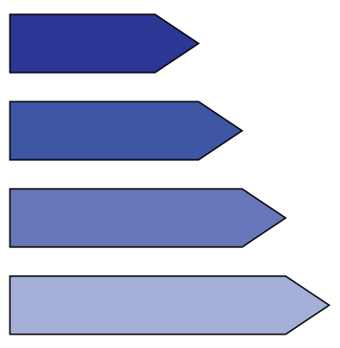
The classic results replicates in the artificial domain!
Generated categories possessed the same correlations as in the experimenter-defined categories.
Positive Size-Saturation correlation
Negative Size-Saturation correlation
Domain: ”Crystals”
Saturation
Hue
Size
Notes:
And broadly speaking what Jern and Kemp found was pretty much what we already knew. Their manipulation was in the relationship between size and saturation, within the experimenter define categories. Some participants learned this category with positive correlation, so larger crystals tend to be more saturated, and some participants learned this negative correlation category.
And after participants learned the categories, they tended to generate new categories with the same properties. So if they learned the positive correlation category, then they tended to generate a new category with positive correlation, and vice-versa. And this lines up really nicely with the earlier observation that alien species obey the same correlations as found on earth.

Slide 16
Experimental Approaches
“Draw an alien” experiments (e.g., Ward, 1994)
Artificial category learning studies (Jern & Kemp, 2013)
What do we know?
Generation is influenced by prior knowledge.
Distributional structure of generated categories reflects known categories.
What we’re up to:
How do people make something distinct from what they know?

Slide 17
Category contrast:
How do you make your new category different from all the other ones?
Notes:
SO what this is about is category contrast. Like, the first goal of making something new…
This is actually a pretty tough issue because there are a million ways that your new category could be different, and you need to choose just one or two.

Slide 18
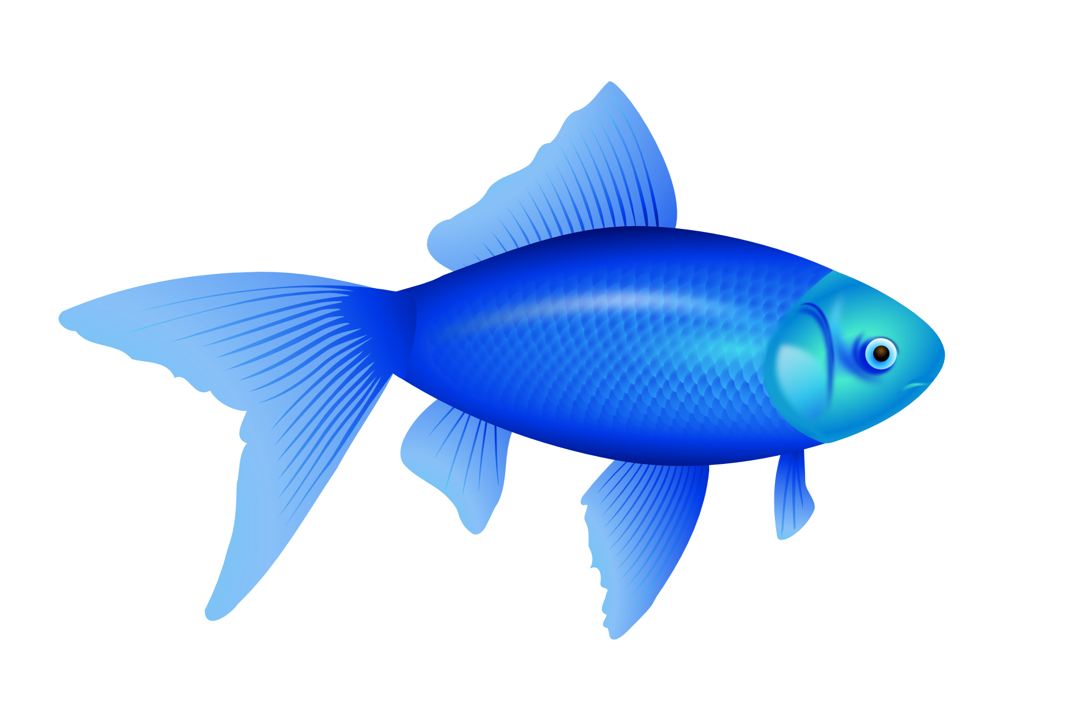
ALREADY EXISTS
Goldfish
Blue
Bluefish
+
=
Goldfish
Beefy Arm
Beefy Goldfish
+
=
SUCCESS!
Notes:
For example…
You can’t make a new animal by making a goldfish blue, because that’s…

Slide 19

PACKER: An Exemplar Model
Producing Alike and Contrasting Knowledge using Exemplar Representations
An extension of the the Generalized Context Model (GCM; Nosofsky, 1984)
Categories represented as a collection of observed members (exemplars).
Notes:
The model we ended up building was called PACKER, which stands for producing alike and contrasting knowledge with exemplar representations. We called it packer first, because go packers!, but second because one of the key principles is that the model generated categories by trying to pack unoccupied space with examples.

Slide 20
PACKER: An Exemplar Model
Producing Alike and Contrasting Knowledge using Exemplar Representations
An extension of the the Generalized Context Model (GCM; Nosofsky, 1984)
Categories represented as a collection of observed members (exemplars).
Generation is based on dual constraints
Dissimilarity to members of opposite categories.
Similarity to members of the target category.
Notes:
Here’s what I mean. PACKER wants new categories to be dissimilar to all the known categories, and it wants items belonging to the same category to be similar to one another.
The heatmaps I have on the slide I think provide a solid ignition about how the model works. Each of these plots show how likely the model is to generate a category B example at each point in the space, with blue areas being more likely. So in this case the model knows about one item in category A and one item in category B. The first plot shows how the category A example contributes to generation, and basically things get exponentially more likely as you move away from the A. The second one shows the influence of the category B example, and basically things get exponentially less likely as you move away from it.
So in one of these low dimensional worlds, making something distinct is about making sure the item is far away from what you know about.

Slide 21
Category contrast:
How do you make your new category different from all the other ones?
Proposal: Packing!
Notes:
So PACKER’s answer to this tough question is that it ‘packs’ the categories in.

Slide 22
Predictions:
Positive relationship between distance from opposite category and frequency of generation.
Negative relation between distance from target category and frequency of generation.
Generated categories should be DISTINCT from everything else, but their members should be SIMILAR to one another.
Notes:
So the question then, is do people pack their categories in?
If this were the case, then we’d

Slide 23
Experiments
Teach participants about an experimenter defined “Alpha” category.
Ask participants to generate a new “Beta” category.
Domain: Squares
Training phase
Generation Phase
Smaller
Bigger
Darker
Lighter
Size (3.0 – 5.8cm)
This is a member of the Alpha Category
Use the sliders to create a Beta Category example.
OK
DONE
Color (RGB 25-230)
Notes:
So we tested these predictions within this domain…
We developed a two dimensional domain of squares varying in color and in size. In our experiments, participants first complete a training phase where they are taught about a category that we defined as a collection of these squares. In each of our experiments, participants only learn about one experimenter-defined category, which we call the “alpha category”.
Then, they complete a generation phase where they we ask them generate a new category, which we call the “Beta” category.

Slide 24
Training
“Supervised Observation” (Levering & Kurtz, 2015)
Participants exposed to members of the Alpha category, one at a time.
Three random blocks = 12 trials.
In this experiment, you will observe geometric figures like the ones below:
Training phase
We will show you some examples like these, all belonging to a common category called "Alpha". Examples of the Alpha category will appear one at a time, and your job is to learn as much as you can about the category.
Afterwards, we will ask you a series of questions about what you have learned.
This is a member of the Alpha Category
OK
Notes:
So the training phase is what you would call “supervised observation”. On each trial, participants see a single alpha category member and they are told it is an alpha, and they can move on whenever they want. So on the left I have a depiction of what each trial looked like, and on the right I have the instructions participants saw before beginning the training phase. These instructions are purposefully very boring because we don’t want participants bringing in any prior knowledge to the experiment.

Slide 25
Generation
Participants generated four members of the “Beta” class
Generation via sliding scaling interface, as in Jern & Kemp (2013)
As it turns out, there is another category of geometric figures called "Beta". Instead of showing you examples of the Beta category, we would like to know what you think is likely to be in the Beta category.
You will now be given the chance to create examples of any size or color in order to show what you expect about the Beta category. You will be asked to produce 4 Beta examples - they can be quite similar or quite different to each other, depending on what you think makes the most sense for the category.
Each example needs to be unique, but the computer will let you know if you accidentally create a repeat.
Generation
Smaller
Bigger
Darker
Lighter
Use the sliders to create a Beta Category example.
DONE
Notes:
The generation phase is just like in Jern and Kemp’s study. On each trial, they make a single beta category example by using sliders to adjust the example’s color and size. On the right I have the instructions that participants read before completing the generation task.
Again, the instructions were kept very vague because we did not want to bias participants towards creating any specific kind of category.

Slide 26
Experiment 1
Between subjects, n > 50 per condition.
Domain: Squares
XOR
Cluster
Row
Size (3.0 – 5.8cm)
Color (RGB 25-230)
* “A” = member of the ”Alpha” category
Notes:
The idea was to test for this in a variety of circumstances.
Not really a between-condition comparison type of study.

Slide 27
Experiment 1
Between subjects, n > 50 per condition.
Participants never see conceptual representation (they only see the physical stimuli)
Domain: Squares
XOR
Cluster
Row
Size (3.0 – 5.8cm)
Color (RGB 25-230)
Notes:
It is important to note that participants never see the Alpha category represented as points in one of these spaces. We just plot it like this for illustrative reasons. Participants are only ever exposed to squares of a particular size and color, so any conceptual representation of the classes must be learned.
So this slide is just to give you a sense of how these categories are physically instantiated. So the Alpha category that people learn about in the XOR, or exclusive or, condition is made of small dark squares and large light squares. In Cluster they are all small and light, and in Row that are all very small but both dark and light.
From here on out though, I’ll be referring to the axes as X and Y axis just to make things easier to plot…
But remember…

Slide 28
Predictions
XOR
Cluster
Row
Lots of variance along both features.
Perfect positive feature correlation
Small amount of variance, both features
No feature correlation
No Y-Axis variance, lots of X-axis variance.
No feature correlation
Notes:
So given what we know about category generation, we can make a few predictions about what we should expect to see. Since people seem to emulate the structure of learned categories, then the distribution of generated categories should reflect whatever Alpha category was learned.
So in the XOR condition, we should see more widely distributed Beta categories, with strong, positive feature correlations. In the cluster condition, people should make tightly clustered categories. In the row condition, people should make new rows.

Slide 29
*representative participants.
What is the question, again?
Do people ‘pack’ categories by making new categories different from old ones, but members of new categories similar to one another?
Notes:
Ok, so just to give you a sense of the form that this data comes in I’m showing some samples on the slide. Each of these subplots came from a single participant, and I’ve just plotted the members of alpha category for the condition the participant was in, as well as where they generated the betas. And again, remember that each point in one of these plots corresponds to a physical stimulus.

Slide 30
Betas are most commonly generated in extremes of the space, distant from Alphas.
Notes:
So I think that’s some pretty good evidence that people do emulate the distributional properties of the categories they know about.
On the slide now I’m showing you heatmaps of where people tended to generate beta category examples. Each figure is for one condition, and blue areas correspond to stimuli that were frequently generated.
And you can see that people really prefer to put the betas along the edges and corners of the space. I think this reflects a goal that the beta category members should be perceptually dissimilar, or distant in space, from the alphas. Right, so the three corners opposite the alphas are most popular in cluster, the top row opposite the alphas is most popular I row, and the two corners opposite the alphas are most popular in XOR.

Slide 31
Betas are most commonly generated in extremes of the space, distant from Alphas.
Distant examples are more frequently generated.
Notes:
So to test that out more specifically, I counted the number of times each item was generated, relative to its distance from members of the Alpha category. And you can see the pattern in each condition that the most distant possible examples are by far the most frequently generated.

Slide 32
Betas are most commonly generated in extremes of the space, distant from Alphas.
Distant examples are more frequently generated.
Betas are (usually) more similar to each other than they are to alphas.
Notes:
And finally, I computed the amount of within-class distance, or the overall space between Beta examples and compared it to the overall between-class distance, which is the amount of space between Beta examples and Alpha examples. I’ve plotted each person in a scatter plot here, and you can see that most people are in this upper triangle, which means that they have more between distance within distance.
And that indicates that people want the betas to be closer to one another than they are to the alpha category.

Slide 33
Experiment 2: A throwback to those old results:
What do we know?
Generation is influenced by prior knowledge.
Distributional structure of generated categories reflects known categories.
How do these forces (packing, distributional structure) interact?
Does packing influence distributional structure?
Notes:
So that led Joe and I to start asking questions about whether these contrast effects could actually influence the types of categories people make.
This is a throwback to those classic results that I told you about earlier…

Slide 34
Super minimal manipulation!
Categories differ only slightly in Y axis position.
If packing does not influence distributional structure:
We should observe no differences between conditions, as the known category is identically distributed in each condition.
Shape of unoccupied space differs considerably
Will participants make different kinds of categories, based on where there is space to put the exemplars?
Notes:
So we developed these two conditions for the next experiment. And the manipulation here is super super minimal. In both cases, the Alphas have the same distributional structure because they are both pretty tight clusters. In the middle condition, the cluster is in the middle of the space, and in the bottom condition the cluster is sort of lower-middle.
But the key is, since both categories have have the same distributional structure, than any difference between the conditions must be due to something besides that.
So we ran a bunch of participants in each condition, using the same methods as in the last experiment.

Slide 35
Replicating Experiment 1
Extreme areas of the space are favored
Distant examples most frequently generated, usually more between than within-class distance.

Slide 36
Question: Does packing influence distributional structure?
Middle | Top Used | Top Not Used
Bottom Used | 28 | 18
Bottom Not Used | 11 | 4
Bottom | Top Used | Top Not Used
Bottom Used | 16 | 8
Bottom Not Used | 31 | 6
“Top”
“Bottom”
* n = 61 per condition
Notes:
So since our manipulation was in the Y axis position of the Alpha category, we started by analyzing how frequently participants generated Beta examples above and below the alphas. So for each participant, we counted whether they used the top of the space and the bottom of the space. And I have these regions highlighted on the slide.
On the right I have the contingency tables of these data. So we have two, 2x2 contingency tables, which I know from personal experience can be surprisingly difficult to analyze, so let me walk you though this.

Slide 37
Question: Does packing influence distributional structure?
Only 10 participants did not use the the top and/or bottom.
Middle | Top Used | Top Not Used
Bottom Used | 28 | 18
Bottom Not Used | 11 | 4
Bottom | Top Used | Top Not Used
Bottom Used | 16 | 8
Bottom Not Used | 31 | 6
“Top”
“Bottom”
Notes:
The first thing to note is that nearly every one put at least one item at the top or one item at the bottom. Only 10 people put all four betas in the interior of the space.

Slide 38
Question: Does packing influence distributional structure?
Only 10 participants did not use the the top and/or bottom.
Middle participants were more likely to use the bottom, p < 0.001.
Middle | Top Used | Top Not Used
Bottom Used | 28 | 18
Bottom Not Used | 11 | 4
Bottom | Top Used | Top Not Used
Bottom Used | 16 | 8
Bottom Not Used | 31 | 6
“Top”
“Bottom”
Notes:
The second thing is that participants in the bottom condition were less likely to use the bottom of the space. This is just the contrast effect we’ve been seeing – the bottom zone is a lot closer to the Alphas in the bottom condition.

Slide 39
Question: Does packing influence distributional structure?
Only 10 participants did not use the the top and/or bottom.
Middle participants were more likely to use the bottom, p < 0.001.
Middle was more likely to use the top and bottom, p = 0.038.
Middle | Top Used | Top Not Used
Bottom Used | 28 | 18
Bottom Not Used | 11 | 4
Bottom | Top Used | Top Not Used
Bottom Used | 16 | 8
Bottom Not Used | 31 | 6
“Top”
“Bottom”
Notes:
And finally, more participants in the middle condition used the top AND the bottom. And what this means is that participants in the middle condition were more likely to create categories that span the entire Y axis. And this result I think is key, because it indicates that the actual distribution of generated categories has changed simply due to the shape of the space that is already filled with another category.

Slide 40
Things we now know
Similarity matters. People generate things that are distinct.
Unoccupied regions of space (items that are dissimilar to everything that is known) are sought out.
Packing can influence the nature of what is generated, not just where it is generated!
Things we still do not know
What matters more? Packing or Distributional Emulation?
How much planning in involved? Do people pre-allocate space?

