Slide 2
Two categories for the price of one: Generating a contrast category after single-category learning
Nolan B. Conaway^{1*}, Joseph L. Austerweil², & Kenneth J. Kurtz¹
¹ Binghamton University
² University of Wisconsin-Madison
*Now at University of Wisconsin-Madison

Slide 3
Broad issues in category learning research:
How are categories represented?
How is category knowledge acquired?
How do people generalize category knowledge?
Notes:
Research in the field of category learning generally seeks to answer questions about how category knowledge is learned and represented. We want to know what sort of representations are used to store category knowledge, and how those representations are formed and applied.

Slide 4
Broad issues in category learning research:
How are categories represented?
How is category knowledge acquired?
How do people generalize category knowledge?
Traditional Artificial Classification Learning (TACL)
A
Time
B
Choose the correct category.
A
B
A
B
A
B
A
B
Size
A
B
B
A
A
B
This is a member of Category B
Color
Notes:
To address these questions, researchers generally work within a traditional artificial classification learning paradigm. Categorization problems are formulated using a set of artificial exemplars that can be represented as points in a stimulus space. So on the slide, I have made two categories called A and B that are each made of squares varying in shading and size, so its in a two dimensional space.
In a typical experiment, participants might acquire knowledge about the categories during a training phase, in where they are asked to guess the label of a given category member and after they make a response the experimenter tells them what the correct answer was. We have learned a lot about category learning from studies that follow this traditional paradigm. But of course there is a lot to be learned through other techniques. In particular, today I want to talk abut some exploratory work we’ve done with a category generation paradigm.

Slide 5
Generating a category after learning.
Training phase: participants observe members of a known category “Alpha”.
Generate phase: participants generate members of a second category “Beta”.
Generalization phase: classify new examples (A vs. B)
A
A
B
A
A
B
A
A
B
A
A
B
A
A
B
B
A
A
A
A
B
Notes:
So the paradigm works like this. First, participants are exposed to members of an existing category that we call Alpha. After training, we ask them to generate members of a second, different category called Beta. Then, we ask people to classify new items into the two categories, Alpha and Beta.

Slide 6
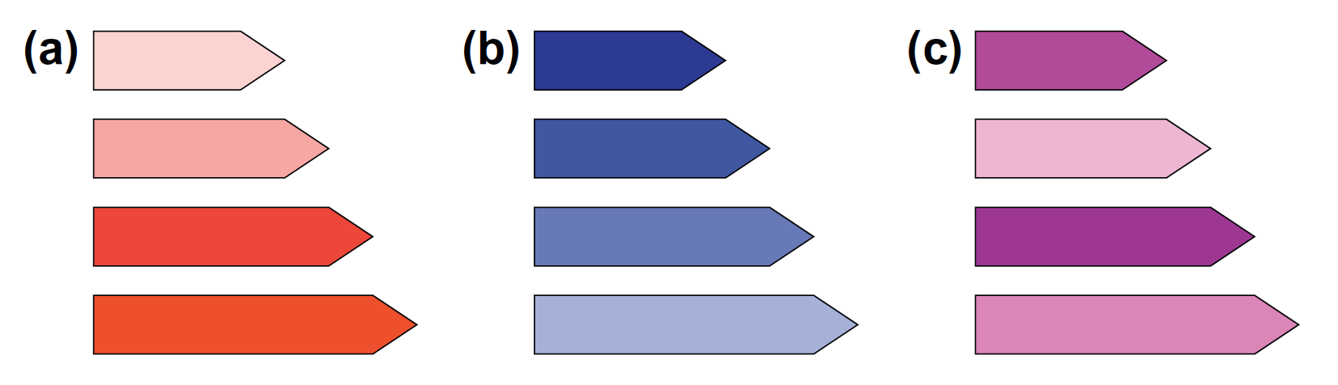
Jern & Kemp (2013; Experiments 3-4)
Training on categories containing:
Positively correlated features,
Negatively correlated features, or
Uncorrelated features.
Participants generated novel categories containing the correlations within existing categories. Generated categories reflect knowledge of existing categories.
Notes:
To my knowledge, the only published paper on the topic of category generation is a pretty recent paper by Jern & Kemp. In their experiments, the angle was to try to understand the processes used to generate exemplar and categories. Participants were exposed to one of three existing categories of what they called crystals, and the three conditions really differ in the relationship between the two features -- the color and size of the crystals. In condition A, smaller crystals were lighter in color, and the opposite was true in Condition B. In condition C there was no correlation.
After training people were asked to make new categories of crystals, and they found that the correlation between features in the generated categories was generally the same as the correlation in the existing categories.

Slide 7
Jern & Kemp (2013; Experiments 3-4)
Participants generated novel categories containing the correlations within existing categories. Generated categories reflect knowledge of existing categories.
Question: Do people always follow the structure of the existing category? What happens when this is not the case?
Notes:
I actually think these really are really cool. Right, so people appear to have learned the correlations that were present in an existing category, and then they transferred those correlations to an entirely new category they theses invented, which is think is really interesting.
So just following up from these results, I wanted to know if people always sort of steadfastly use the regularities of an existing category to generate something new, or if they sometimes induce an entirely independent structure.

Slide 8
*Assignment between perceptual and conceptual dimensions was counterbalanced across participants.
XOR
Cluster
Row
Size
XOR
Cluster
Row
Color
Notes:
So today I’m just going to describe some exploratory work we’ve conducted to address this question. In our experiment, we tested three different conditions that we call XOR, Cluster, and Row. I have a depiction of each of these configurations in terms of two-dimensional stimuli on the slide. Right, so in XOR the Alphas are small and dark or large and light squares, in Cluster they are all small and light, and in Row that are all very small but both dark and light. The only thing to note here is that in our experiment the location of the category within this space was counterbalanced.

Slide 9
Training phase
Participants randomly assigned to condition (XOR, Cluster, Row).
22 participants per condition.
Exemplars were observed one at a time.
Three blocks of four exemplars (12 trials total).
This is a member of Category A.
OK
XOR
Cluster
Row
Notes:
The first part of the experiment is the training phase. We just showed them each of the examples three times each, and each example was shown once at a time, so there were 12 trials.

Slide 10
Generation
Participants were asked to create four exemplars, one at a time.
Example preview did not appear until both features were selected.
Participants were allowed to change the example as desired.
Participants were not allowed to make the same example twice.
Smaller
Bigger
Darker
Lighter
Use the sliders to create a Category B example.
DONE
XOR
Cluster
Row
Notes:
The main focus of the experiment is in the generation phase. And I’ve sort of illustrated with what participants were presented with here.
So they have to make four items, one at a time. Participants get an on screen preview of the example they are creating, and two slides that they can use to adjust its features. There was a slider for size and they could make it smaller or larger, and there was a slider color color so they could make it darker or lighter. And participants could adjust the features as much as they wanted, and then they just click a DONE button.

Slide 11
Generalization
81 items, sampled evenly from the stimulus space (9x9 grid).
Known members of Category A and B included (randomly intermixed).
Click a button to choose the correct category.
A
B
XOR
Cluster
Row
Notes:
And finally, we had a pretty standard generalization phase, where participants classified novel items into categories A or B.

Slide 12
Sample behavioral data
XOR
CLUSTER
ROW
*representative participants.
Notes:
Ok, so here are just some sample behavioral data points we collected. Each of these subplots came from a single participant, and I’ve just plotted the locations of the members of category A as well as the locations of the generated examples.

Slide 13
Observation #1: many individual differences.
Observation #2: alphas & betas are often asymmetric.
XOR
CLUSTER
ROW
*representative participants.
Notes:
And you can see just from these samples that there are huge numbers of differences between participant generation patterns. On the slide I have identified the samples from the XOR condition, and I think its clear that we have two distinct patterns of generalization, one where the Betas are opposite of the Alphas, and one where the betas occupy a row in the center of the space.
The second thing to note I think I some sense follows from the first, but the beta categories is not always just the opposite of the alphas. And often, the beta category contains structural regularities not present in the alphas.

Slide 14
Where are the Betas?
Generated exemplars are localized in extremes of space (on edges).
Exemplars are maximally distant from members of existing category on at least one dimension.
Notes:
Okay, so the first question we wanted to answer was just, very broadly, where did participants end up localizing the Beta exemplars. So on the slide I have three figures, one for each condition, and the shading of the figure shows how often people generated exemplars in each location. Areas shaded blue correspond to locations where Beta examples were generated most frequently.
And you can see that people really prefer to put the betas along the edges and corners of the space. I think this reflects a goal to have the beta category exemplars as far away from the alphas as possible, which results ion a lot of use of the corners.

Slide 15
Characterizing Beta categories
Summarized generated Beta categories using three statistics:
Variance along X axis feature (e.g., color).
Variance along Y-axis feature (e.g., size).
Correlation between features.
*representative participants.
Large X variance
No Y variance
No correlation
Little X variance
Little Y variance
Strong Correlation
Large X variance
Large Y variance
Perfect Correlation
Notes:
So, digging in a litter deeper, the next thing we wanted to so is to try to characterize the structure of the generated categories. For example, we want to know if people created categories that are opposites of the alphas, or if they made rows or columns or whatever.
And so we ended up using three summary statistics to describe each participant's category. We calculated the variability of the exemplars along each dimension, size and color, as well as the correlation between features within the category. I have on the slide a few examples from our dataset, which sort of give you the sense of how these three statistics really capture a lot about the generations strategy.

Slide 16
Characterizing Beta categories
XOR more variable than Cluster & Row (along both dimensions).
Row more variable along X than Y.
Notes:
Here are the comparisons for the variance. Each plot show the variance along a given dimension for each condition, and I have depicted the conditions within each plot.
The results here show two things mainly. First, the categories generated after exposure to an XOR category are generally more variable than Cluster and Row. And this makes sense because the Alpha categories in XOR are also much more variable.
The second thing is that the row condition has much less variance along the vertical dimension, which again makes sense because those Alphas are a row, and so people are likely making Betas as rows.

Slide 17
Characterizing Beta categories
Replicates Jern & Kemp (2013)
Distribution of generated category members varies according to the distribution of the existing category.
Notes:
Right, and so I think this pretty nicely replicates the core finding from Jern & Kemp. The degree of variance of the generated categories on average can be traced back to the variance of the existing Alpha category.

Slide 18
Characterizing Beta categories
Cluster & Row show no systematic correlations.
XOR categories are negatively correlated.
Correlation
Density
Correlation
Notes:
Here’s the data for the feature correlations. Again, each condition’s average is shown on a separate bar. You can see that Cluster and row do not have much in terms of systematic correlations, but beta categories from the XOR condition have strongly negative feature correlations. This is actually pretty cool, because the alphas in the XOR condition have a strongly positive correlation, and this shows that participants are generating betas as the opposite of alphas.
On the right side of the slide I have histograms of each condition’s feature correlations, and this is just to confirm that the zero averages in Row and Cluster are not simply due to bimodality with strongly positive and negative correlations. If anything, there looks like there could be a subgroup of individuals in the XOR condition with strongly positive correlations.

Slide 19
Characterizing Beta categories
XOR Results oppose Jern & Kemp (2013)
Alpha feature correlation was not applied in Beta category. Instead the correlation was reversed.
Correlation
Density
Correlation
Notes:
And if you consider this more carefully, it turns out that in the results for the XOR condition we actually see a departure from the Jern & Kemp findings. People didn’t just transfer the positive correlation in the alpha category, which is what Jern & Kemp would predict, but its actually as if they made a decision that the Beta category should be opposite of alphas, which produces a negative correlation. And so I think that’s a really interesting piece of phenomena that I’d like to explain in a future experiment.

Slide 20
Structure of Alpha categories is broadly reflected in the Beta categories.
However, Beta category structure often opposes the Alpha category. High degree of individual differences.
*representative participants.
Notes:
So from these summary statistics, we definitely get the sense that there are properties of the Alpha category that are applied when people generate members of a new category. But I think its clear that the structure of the alpha category is not the only determinant of the structure of the Beta category. Not only did participants in the XOR condition appear to reverse the feature correlation, but casual observation of the generate categories makes it pretty clear that participants often induce structure in the Betas that is not present in the Alphas.

Slide 21
General Discussion
Generated category exemplars are maximally distant from existing category exemplars.
Notes:
Okay, so from this small, pretty exploratory experiment, we’ve learned several things. The first thing is that people tend to place examples in a generated category so that they are maximally distant from the known category, along one or both dimensions.

Slide 22
General Discussion
Generated category exemplars are maximally distant from existing category exemplars.
Generated categories are often distributionally similar to known categories (replicating Jern & Kemp, 2013).
Notes:
The second thing is that, on average, the generated categories have similar distributional properties as known category. Much of the dimensional variance and feature correlation statistics can be explained through the structure of the existing category, and this I think nicely replicates the core finding from Jern & Kemp.

Slide 23
General Discussion
Generated category exemplars are maximally distant from existing category exemplars.
Generated categories are often distributionally similar to known categories (replicating Jern & Kemp, 2013).
Generated category properties also often differ from known categories.
*representative participants.
Notes:
The third thing is that people often impose structure on the generated class that is not present in the Alpha category. The issue here, of course, is that we don’t know if people generated the Betas in this fashion because that is how they represented the existing category, or if its because they simply aimed to make up an entirely new kind of category. I think this is a really interesting place for future work.

Slide 24
Thanks!

Slide 26
Extras

Slide 27
Full generation instructions
As it turns out, there is another category of geometric figures called "Beta" that is different from the Alpha category you just learned about. Instead of showing you examples of the Beta category, we would like to know what you think is likely to be in the Beta category.
You will now be given the chance to create examples of any size or color in order to show what you expect about the Beta category. You will be asked to produce 4 Beta examples - they can be quite similar or quite different depending on what you think makes the most sense for the category. Each example needs to be unique, but the computer will let you know if you accidentally create a repeat.
Press the spacebar when you are ready to continue.

Slide 28
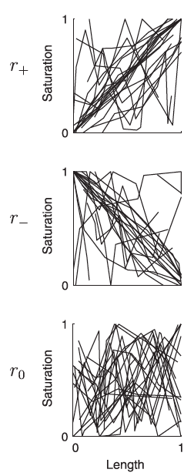
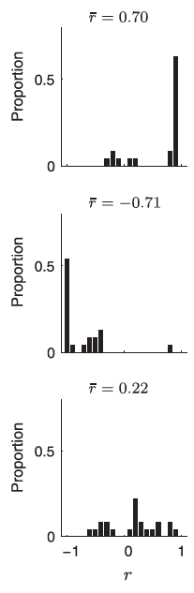
Jern & Kemp (2013) Experiment 3 Data
Possible individual differences in correlation valence?
Not analyzed in original paper.

Slide 29
Individual differences in generated classes.
K-means clustering of generalization responses.
Generated class statistics (variance, correlation) vary across subgroups.
Notes:
To analyze the individual differences in the generated categories, I clustered the generalization data using a K means analysis. The hope here is that, through identifying distinct patterns of generalization, we may turn up specific types of Beta categories. I tried running the analysis with a bunch of different numbers of clusters, but we only have 22 data points in each condition, so I found that the most revealing analysesen w
So on the slide I have four plots. The first two show the generalization data from each K means cluster, and the second two show the variance and correlations of the beta categories from each subgroup.

Slide 30
Individual differences in generated classes.
Group 1
Generalization Betas are opposite of Alphas.
Beta categories Equal variance across dimensions. Negative correlations.
Group 2
Generalization Betas generalized horizontally.
Beta categories More variance on X. No correlation.
Notes:
In the XOR condition, Group 1 shows pretty typical XOR generalization, and group 2 is a little less systematic, but it looks like they generalize the Beta category horizontally, across the middle of the space. These differences in generalization I think are pretty strongly represented in the types of Beta categories each subgroup generated. You can see that group 1 has pretty strong variance along both dimension and a strongly negative feature correlation, and so these people likely generated betas in the two quadrants not occupied by alphas,

Slide 31
Individual differences in generated classes.
Group 1
Generalization Categories differ along X-axis.
Beta categories More variance on Y. No correlation.
Group 2
Generalization Categories differ along Y-axis.
Beta categories More variance on X. No correlation.
Notes:
The generalization data from the cluster condition mainly differs in terms of the dimension that was used to discriminate between the classes. In group 1, the X axis was used, and in group 2 the Y axis was used. And those differences come out in the distribution of the generated class – when the X dimension is used as the basis for generalization, the generate categories tend to vary more along the Y dimension. And The opposite is true for when the Y dimension is used as the basis for generalization. Essentially, people are filling a section of the space with the generated class, and they generalize according to the dimension that the categories differ along most.

Slide 32
Individual differences in generated classes.
Group 1
Generalization “Lower” boundary, stronger generalization.
Beta categories More variance on X. No correlation.
Group 2
Generalization “Upper” boundary, weaker generalization.
Beta categories More variance on X. No correlation.
Notes:
The subgroups in the row condition really appear to differ only In the strength of generalization of the generated class. Whereas group 1 very strongly generalizes, generalization in group 2 is stronger for the existing class.

