Slide 1
Social Media ClusterFucking
Zach Brueske, Spencer Hanson, Auston Schendzielos

Slide 2
Objectives
Run three clustering algorithms on the data set
Observe and compare difference in output

Slide 3
Summary of Data
140,707 instances of words that are followed during an observation time of 7 days
77 total attributes
Buzz
No missing values
19% instances created buzz, 81% did not create buzz

Slide 4
Attributes
Number of Created Discussions
Author Increase
Attention Level
Burstiness Level
Number of Atomic Containers
Attention Level
Contribution Sparseness
Author Interaction
Number of Authors
Average Discussion Length
Average Discussion Length

Slide 5
Preprocessing
Averaged out the 77
Left with 11 attributes per entry

Slide 6
Partition Around Medoids (PAM)
Involves finding representative objects, called medoids, in clusters
Very effective on small data sets, but scales poorly with large
Handles outliers and noise better

Slide 7
Use real object to represent the cluster
Select k representative objects arbitrarily
For each pair of non-selected object h and selected object i, calculate the total swapping cost TC_{ih}
For each pair of i and h,
If TC_{ih} < 0, i is replaced by h
Then assign each non-selected object to the most similar representative object
repeat steps 2-3 until there is no change

Slide 8
Calculating Total Cost
C_{jih} = d(j, j2) – d(j, i)
C_{jih} = d(j, h) = d (j, i)
C_{jih} = 0
C_{jih} = d(j, h) = d(j, j2)
t
j
h
i

Slide 9
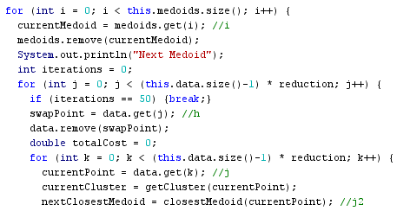
Time Complexity
PAM does not do large data sets well
O(k(n – k)²)

Slide 10
Group Average
Zach Brueske

Slide 11
OPTICS
Auston Schendzielos

Slide 12
Results (PAM)
20,000 Entries:
50,000 Entries:
Num Medoids | InformationGain | WSS | BSS
k = 2 | 0.87307018 | 1.52E+10 | 1.09E+21
k = 4 | 0.884333673 | 1.46E+10 | 2.24E+20
k = 8 | 0.894090057 | 1.05E+10 | 7.67E+19
k = 16 | 0.895729101 | 5.41E+09 | 7.17E+18
Num Medoids | InformationGain | WSS | BSS
k = 2 | 0.875373642 | 3.56E+10 | 4.81E+22
k = 4 | 0.89075752 | 3.11E+10 | 9.57E+21
k = 8 | 0.894101904 | 2.48E+10 | 2.24E+21
k = 16 | 0.89646021 | 2.08E+10 | 4.82E+20

Slide 13
Information Gain

Slide 14
WSS

Slide 15
BSS

Slide 16
Algorithm

Slide 17
Visual Stuff

Slide 18
Complexity Analysis
DBSCAN
OPTICS

Slide 19
Entropy by Cluster

Slide 20
Prediction Assessment

Slide 21
Final Analysis

Slide 22
PAM
Group Average
OPTICS
Entropy

Slide 23
Future Work
CLARA
More suitable data set
Different sigma values

