Slide 1
Social Media ClusterFucking
Zach Brueske, Spencer Hanson, Auston Schendzielos

Slide 2
Objectives

Slide 3
Preprocessing

Slide 4
Partition Around Medoids (PAM)
Involves finding representative objects, called medoids, in clusters
Very effective on small data sets, but scales poorly with large
Handles outliers and noise better

Slide 5
Use real object to represent the cluster
Select k representative objects arbitrarily
For each pair of non-selected object h and selected object i, calculate the total swapping cost TC_{ih}
For each pair of i and h,
If TC_{ih} < 0, i is replaced by h
Then assign each non-selected object to the most similar representative object
repeat steps 2-3 until there is no change

Slide 6
Calculating Total Cost
C_{jih} = d(j, j2) – d(j, i)
C_{jih} = d(j, h) = d (j, i)
C_{jih} = 0
C_{jih} = d(j, h) = d(j, j2)
t
j
h
i

Slide 7
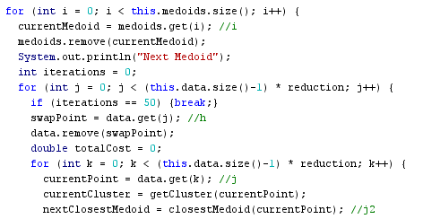
Time Complexity
PAM does not do large data sets well
O(k(n – k)²)

Slide 8
Group Average
Zach Brueske

Slide 9
OPTICS
Auston Schendzielos

Slide 10
Algorithm

Slide 11
Visual Stuff

Slide 12
Complexity Analysis
DBSCAN
OPTICS

Slide 13
Entropy by Cluster

Slide 14
Prediction Assessment

Slide 15
Final Analysis

Slide 16
PAM
Group Average
OPTICS
Entropy

Slide 17
Future Work

