Slide 1
Social Media Clustering
Zach Brueske, Spencer Hanson, Auston Schendzielos

Slide 2
Objectives
Run three clustering algorithms on the data set
PAM, OPTICS, Group Average
Observe and compare difference in output
Info gain, average core distance, WSS, BSS, etc…

Slide 3
Summary of Data
140,707 instances of words that are followed during an observation time of 7 days
77 total attributes
Buzz
No missing values
19% instances created buzz, 81% did not create buzz

Slide 4
Attributes
Number of Created Discussions
Number of Created Discussions
Author Increase
Attention Level
Burstiness Level
Number of Atomic Containers
Attention Level
Contribution Sparseness
Author Interaction
Number of Authors
Average Discussion Length
Average Discussion Length
Feature | Min | Max | Mean | Std
NCD_0 | 0 | 24210 | 172.267 | 509.768
NCD_1 | 0 | 22899 | 155.135 | 471.615
NCD_2 | 0 | 20495 | 165.459 | 495.287
NCD_3 | 0 | 27007 | 176.811 | 528.350
NCD_4 | 0 | 30957 | 186.929 | 560.329
NCD_5 | 0 | 28603 | 216.197 | 632.107
NCD_6 | 0 | 37505 | 243.856 | 707.354

Slide 5
Preprocessing
Median value of attribute over the 7 days
Still too big
Used a random selector to make smaller datasets from the original
Samples sizes of 20,000, 50,000, and 5,000 were used

Slide 6
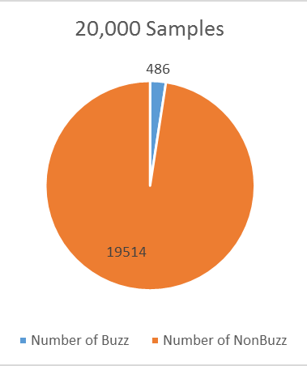
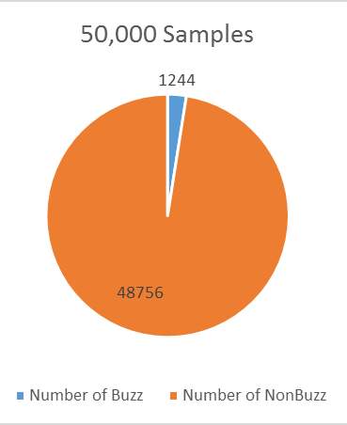
Problems with Datasets
Initial data set is way too big
Originally used for Classification
Poor Parent Entropy even for smaller sets
 | 20,000 | 50,000
Buzz | 2.43% | 2.488%
NonBuzz | 97.57% | 97.512%
Parent Entropy | 0.164947 | 0.168026

Slide 7
Partition Around Medoids (PAM)
Uses medoids instead of centroids
Very effective on small data sets, but scales poorly with large
Handles outliers and noise better than K-Means

Slide 8
Use real object to represent the cluster
Select k representative objects arbitrarily
For each pair of non-selected object h and selected object i, calculate the total swapping cost TC_{ih}
For each pair of i and h,
If TC_{ih} < 0, i is replaced by h
Then assign each non-selected object to the most similar representative object
repeat steps 2-3 until there is no change

Slide 9
Calculating Total Cost
C_{jih} = d(j, j2) – d(j, i)
C_{jih} = d(j, h) = d (j, i)
C_{jih} = 0
C_{jih} = d(j, h) = d(j, j2)
t
j
h
i

Slide 10
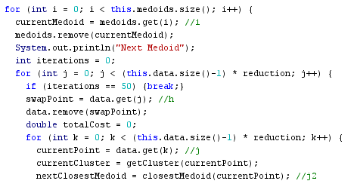
Time Complexity
PAM does not do large data sets well
O(k(n – k)²)

Slide 11
Group Average
Zach Brueske

Slide 12
Algorithm
Compute the proximity matrix
Let each data point be a cluster
Repeat
Merge the two closest clusters
Update the proximity matrix
Until only a single cluster remains
(Or when you reach the desired number of clusters)

Slide 13
Differences From Other Similar Algorithms
Takes the average distance of all points in the cluster to all points in another cluster
Less susceptible to noise and outliers
Get more accurate readings for better results

Slide 14
OPTICS
The answer to Dbscan’s weakness

Slide 15
Comparisons to DBSCAN
DBSCAN
OPTICS
Both
Not sensitive to differing densities
Can handle differing densities based off of reachability-distance
O(n*log(n))
Good for outlier detection
Can handle non-globular shapes
Variables epsilon and MinPoints are arbitrary
Run-time complexity depends highly on epsilon and MinPoints selection

Slide 16
Definitions

Slide 17
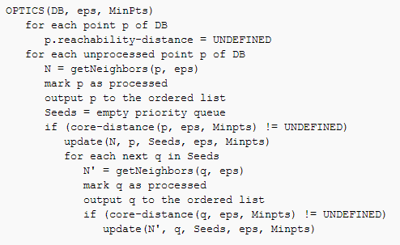
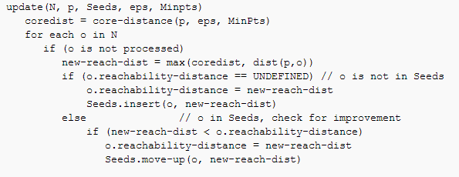
Algorithm

Slide 18
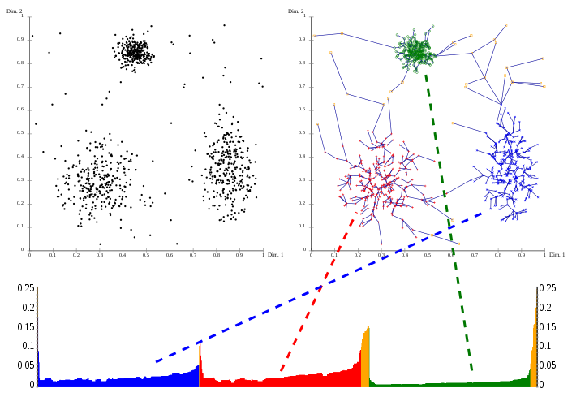
Visualization

Slide 19
Results

Slide 20
PAM
20,000 Entries:
50,000 Entries:
Num Medoids | InformationGain | WSS | BSS
k = 2 | 0.87307018 | 1.52E+10 | 1.09E+21
k = 4 | 0.884333673 | 1.46E+10 | 2.24E+20
k = 8 | 0.894090057 | 1.05E+10 | 7.67E+19
k = 16 | 0.895729101 | 5.41E+09 | 7.17E+18
Num Medoids | InformationGain | WSS | BSS
k = 2 | 0.875373642 | 3.56E+10 | 4.81E+22
k = 4 | 0.89075752 | 3.11E+10 | 9.57E+21
k = 8 | 0.894101904 | 2.48E+10 | 2.24E+21
k = 16 | 0.89646021 | 2.08E+10 | 4.82E+20

Slide 21
Information Gain

Slide 22
WSS

Slide 23
BSS

Slide 24
OPTICS

Slide 25
Density Analysis

Slide 26
Time Analysis

Slide 27
Reachability Plot

Slide 28
Reachability

Slide 29
Final Analysis

Slide 30
Future Work
PAM
Group Average
OPTICS
CLARA
Different way to store data
Find a way to go through the data faster, parallelism?
Experiment with MinPoints

Slide 31
Future Work
More suitable data set
Preprocess more
Make smaller datasets with better than random selection
Different sigma values
Do Prediction analysis on test set

