Slide 1


ESOP minimization for reversible quantum circuit Synthesis
Group 8
Presenter:
B10901003 李博翰
B10901184 錡亭勳
Instructor: Jie-Hong Roland Jiang
ALCom Lab

Slide 2
ESOP minimization for reversible quantum circuit Synthesis

Slide 3
Reversible Quantum Circuit
Consists of Toffoli, FredKin, SWAP, CNOT, and X gates.
Many synthesis method:
Transformation-based synthesis
BDD-based synthesis
ESOP synthesis
And many
Focus on ESOP minimization

Slide 4
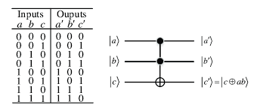
Reversible Quantum Circuit
Reversible Quantum Circuit can be viewed as combination of
n-control Not gates.
Can be represented as ESOP (XOR SOP) form
E.g. c’ = c xor (a*b)

Slide 5
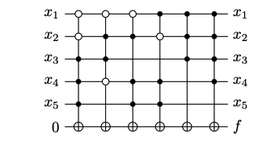
Reversible Quantum Circuit
We focus on the synthesis tasks when the functions are operated on ancilla.
Can be directly constructed from ESOP form.
Assuming only positive control gates.

Slide 6
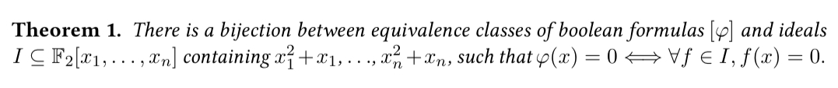

ESOP Boolean Formulas
Set F_2 = {0,1}, with multiplication = AND, addition = XOR, we can view a polynomial f=$\sum_{i}{\prod_{j}{y_{ij}}}$ $∈F_{2}\left[x_{1}, …, x_{n}\right], y_{ij}∈\{x_{1}, …, x_{n}\}$ as a Boolean formula $⊕_{i}⋀_{j}y_{ij}$ and we can also convert a ESOP form into a polynomial.
$¬x=x⊕1=x+1, x∨y= ¬\left(¬x∧¬y\right)=1+(x+1)(y+1)$
Algebraic encoding

Slide 7
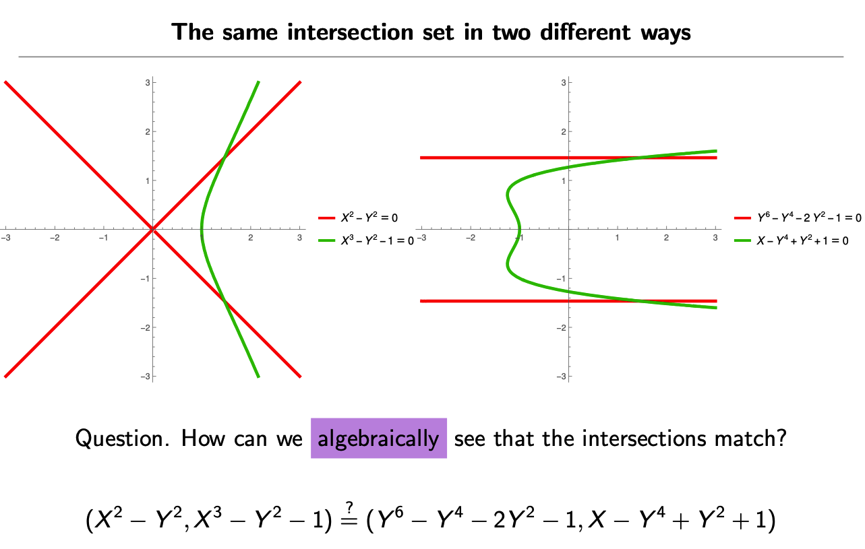
Gröbner Basis
https://www.dtubbenhauer.com/slides/my-favorite-theorems/26-groebner.pdf
A Gröbner Basis (in our application) can be view as follows: given a set of polynomials I, the Gröbner Basis of I consists of sets of polynomials that have the same solution as I.

Slide 8
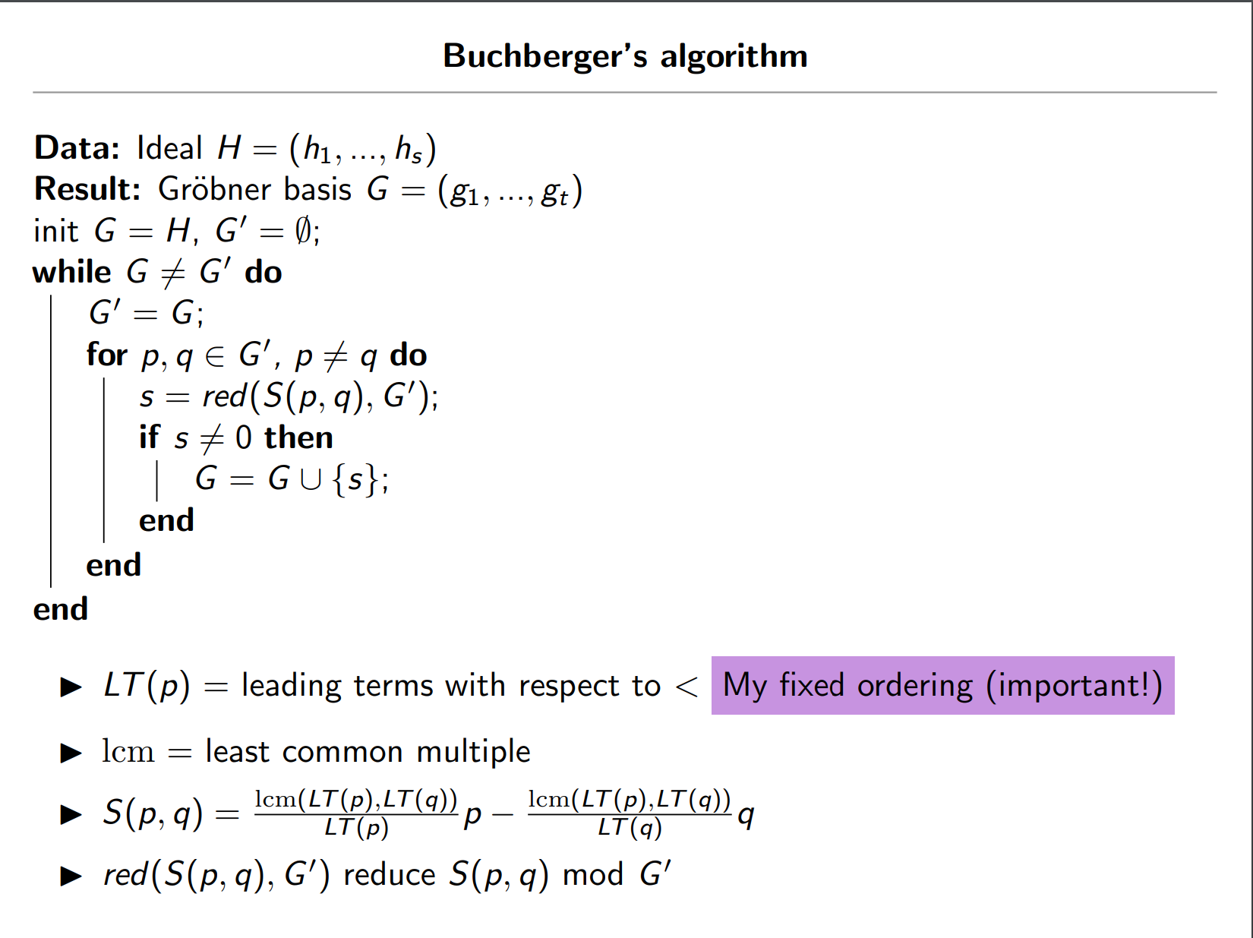
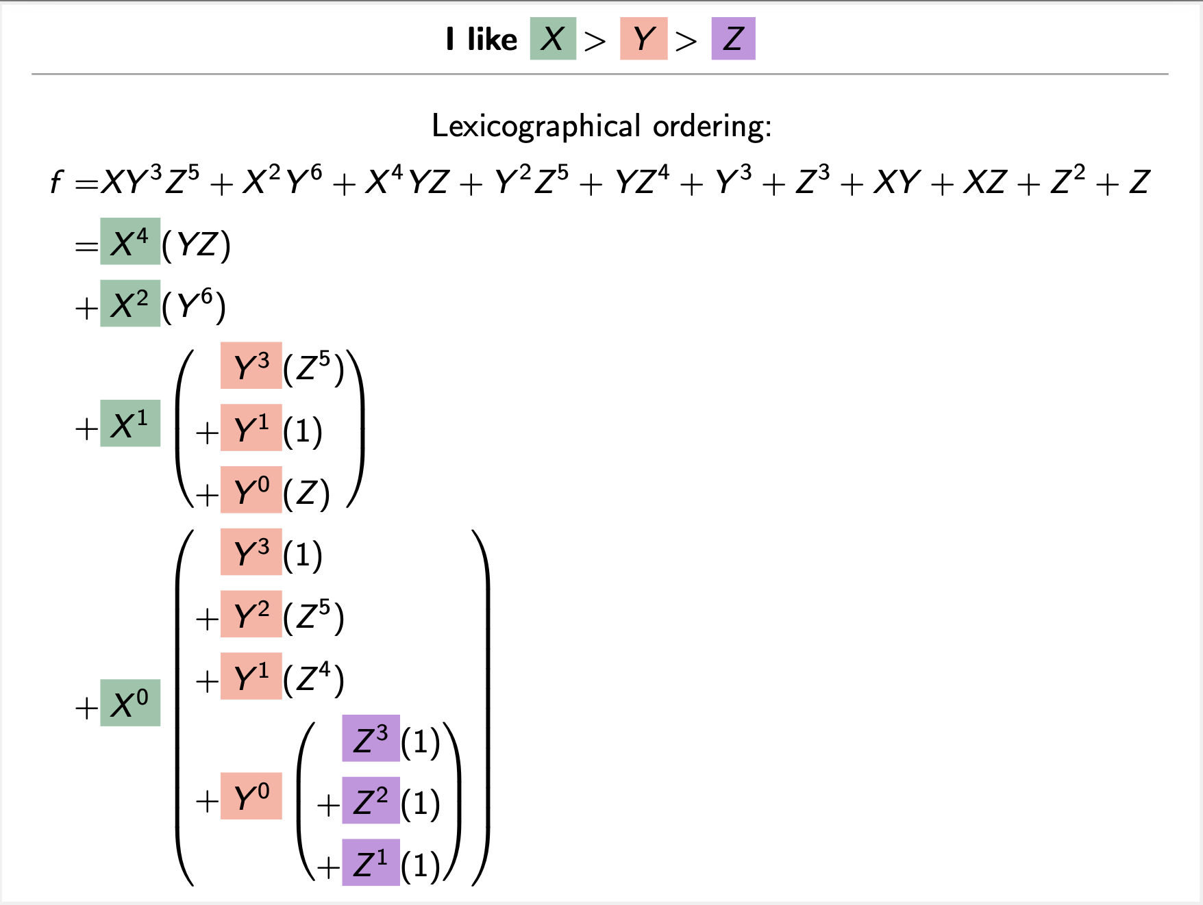
Buchberger’s algorithm
https://www.dtubbenhauer.com/slides/my-favorite-theorems/26-groebner.pdf

Slide 9
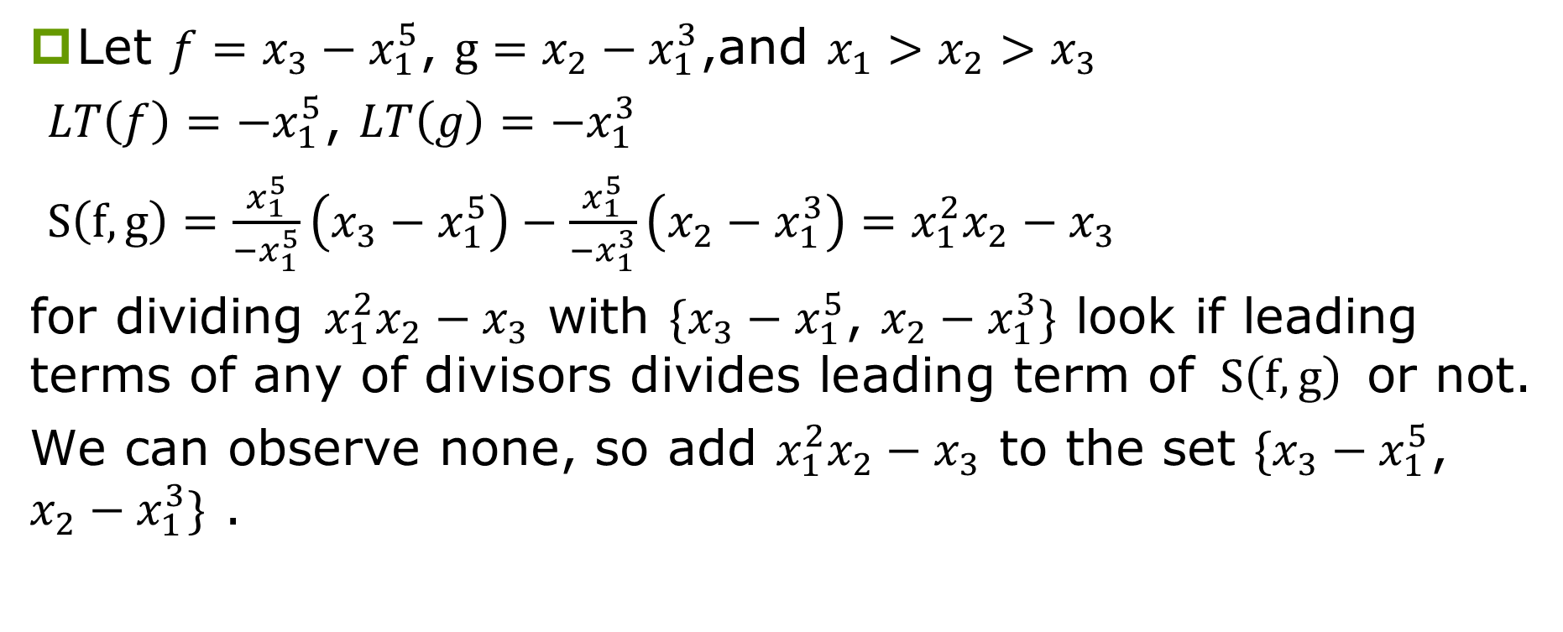
Gröbner Basis Example
Let $f=x_{3}−x_{1}^{5}$, $g=x_{2}−x_{1}^{3}$,and $x_{1}>x_{2}>x_{3}$
$LT\left(f\right)=−x_{1}^{5}$, $LT\left(g\right)=−x_{1}^{3}$
$S\left(f,g\right)=\frac{x_{1}^{5}}{{−x}_{1}^{5}}\left(x_{3}−x_{1}^{5}\right)−\frac{x_{1}^{5}}{{−x}_{1}^{3}}\left(x_{2}−x_{1}^{3}\right)=x_{1}^{2}x_{2}−x_{3}$
for dividing $x_{1}^{2}x_{2}−x_{3}$ with $\{x_{3}−x_{1}^{5}$, $x_{2}−x_{1}^{3}\}$ look if leading terms of any of divisors divides leading term of $S\left(f,g\right)$ or not.
We can observe none, so add $x_{1}^{2}x_{2}−x_{3}$ to the set $\{x_{3}−x_{1}^{5}$, $x_{2}−x_{1}^{3}\}$ .

Slide 10
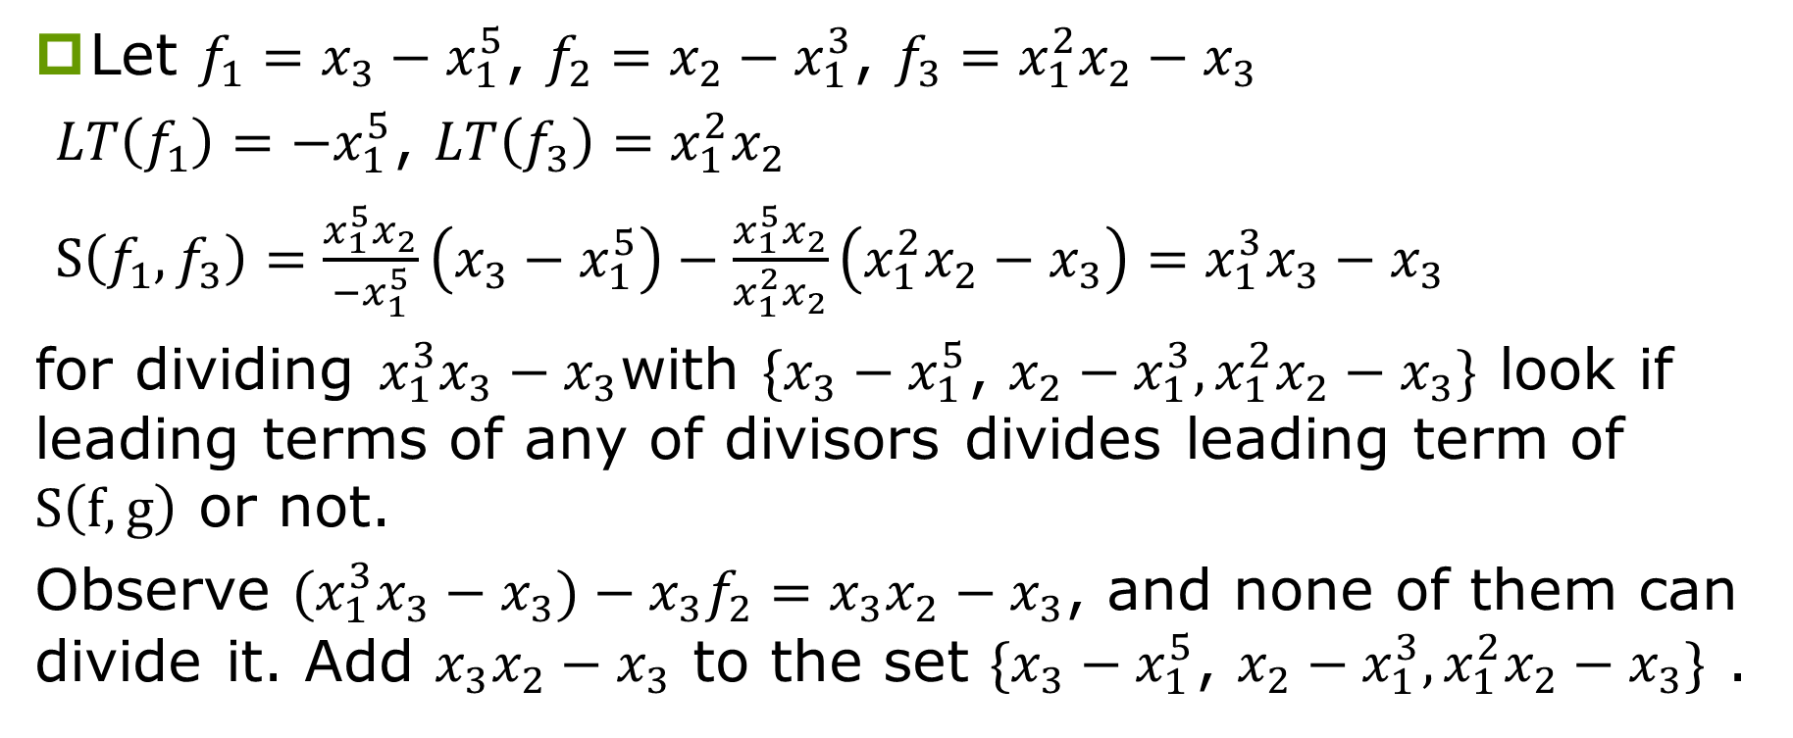
Gröbner Basis Example
Let $f_{1}=x_{3}−x_{1}^{5}$, $f_{2}=x_{2}−x_{1}^{3}$, ${f_{3}=x}_{1}^{2}x_{2}−x_{3}$
$LT\left(f_{1}\right)=−x_{1}^{5}$, $LT\left(f_{3}\right)=x_{1}^{2}x_{2}$
$S\left(f_{1},f_{3}\right)=\frac{x_{1}^{5}x_{2}}{{−x}_{1}^{5}}\left(x_{3}−x_{1}^{5}\right)−\frac{x_{1}^{5}x_{2}}{x_{1}^{2}x_{2}}\left(x_{1}^{2}x_{2}−x_{3}\right)=x_{1}^{3}x_{3}−x_{3}$
for dividing $x_{1}^{3}x_{3}−x_{3}$with $\{x_{3}−x_{1}^{5}$, $x_{2}−x_{1}^{3}, x_{1}^{2}x_{2}−x_{3}\}$ look if leading terms of any of divisors divides leading term of $S\left(f,g\right)$ or not.
Observe ${(x}_{1}^{3}x_{3}−x_{3})−x_{3}f_{2}=x_{3}x_{2}−x_{3}$, and none of them can divide it. Add $x_{3}x_{2}−x_{3}$ to the set $\{x_{3}−x_{1}^{5}$, $x_{2}−x_{1}^{3}, x_{1}^{2}x_{2}−x_{3}\}$ .

Slide 11
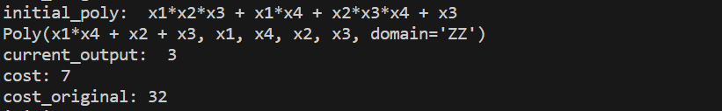

Gröbner Basis
Gröbner Bases for Boolean Function Minimization, N. Faross
Given a target ESOP with n variables, we can transform it to a polynomial f and construct an ideal $I=\{f, x_{1}^{2}+x_{1}, …, x_{n}^{2}+x_{n}\}$ and find its Gröbner Basis that minimizes the polynomial expressions.
We can iteratively reduce the terms of the polynomial by noticing the following facts in F_2:
x^n = x
n*x = 0 for n even, x for n odd
Speedup the calculation of Gröbner Basis.

Slide 12
Experimental Result
https://reversiblebenchmarks.github.io/definitions.html
Special thanks to b10901076 Brian Chen for offering the circuit to ESOP tool
Use RevLib Benchmark circuit and Quantum Cost from Reversible Logic Synthesis Benchmark Page.
circuit | inputs | outputs | init_cost | cost_org | min_cost
4mod7 | 4 | 3 | 38 | 71 | 64
3_17_13 | 3 | 3 | 14 | 44 | 36
f2_232 | 4 | 4 | 279 | 160 | 92
wim_266 | 4 | 7 | 229 | 336 | 31
cm83a | 5 | 3 | 166 | 103 | 81
init_cost: cost of the initial reversible circuit
cost_org: total cost of the original functions without minimization
min_cost: total cost after minimization

Slide 13
Future Work
Apply factorization and other techniques for multilevel ESOP minimization.
Use expansion methods to first reduce the variable size for better calculation.
Optimize runtime.

Slide 14
Thanks for Listening

