Slide 1
Sentiment Intelligence for Mountain Bike Product Reviews: Data Collection, Cleaning, and Preprocessing
DS 785
Austin Engstrom
June 2026

Slide 2
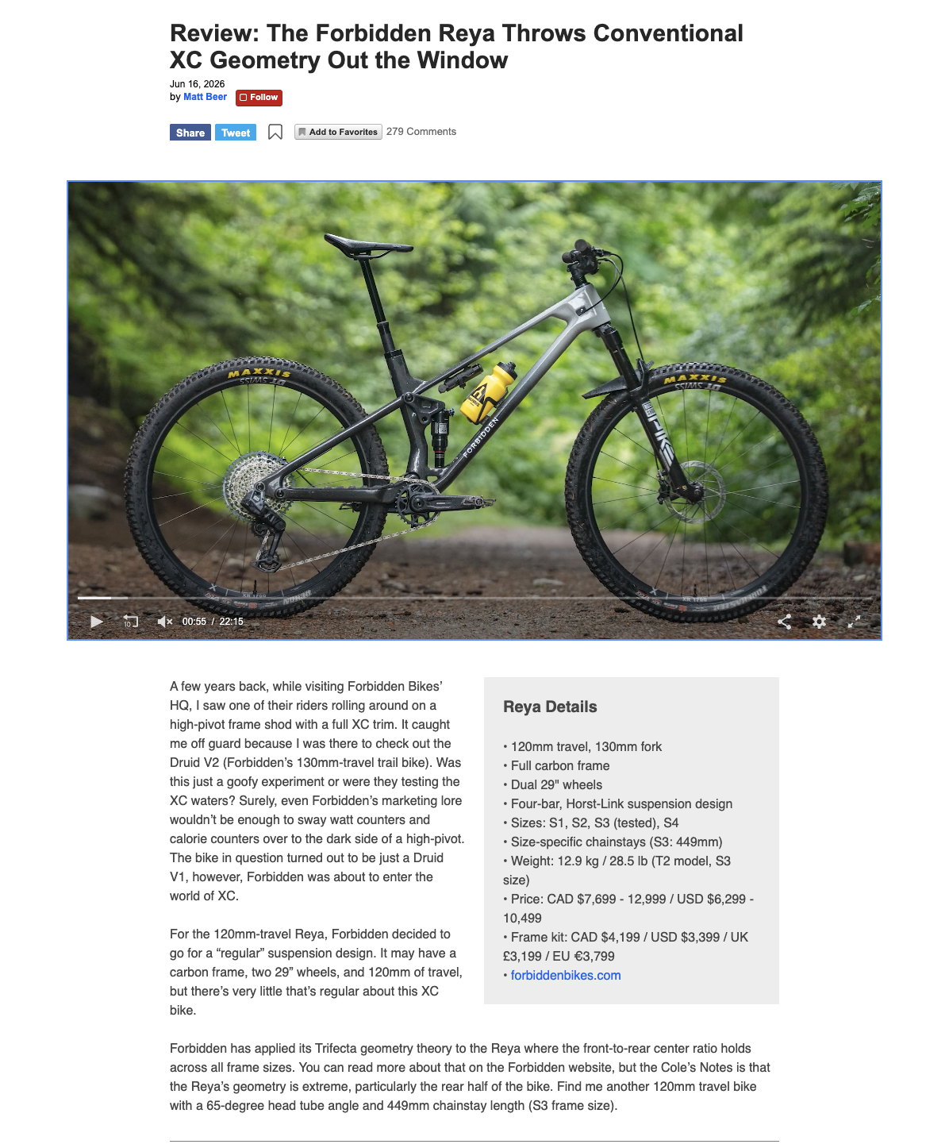
Data Source Identification
Primary Data Source
Pinkbike Review Articles
https://www.pinkbike.com/news/tags/reviews/
~300 review article URLs identified
One of the largest mountain bike media outlets
Publicly accessible review content
Data Collected
Article metadata
Full review text
Product information
Pricing data
Product categories and tags
Use Considerations
Publicly available content
Educational and non-commercial research use
No collection of personal user data

Slide 3
ETL Process
BeautifulSoup (Transform)
Parse HTML content
Remove page formatting
Extract review text
Extract article metadata
Structured Feature Generation (Transform)
Classify product categories
Extract brand names
Extract product names
Normalize pricing data
Playwright (Extract)
Access review archive
Collect article URLs
Retrieve webpage content
Structured Dataset (Load)
Load into Pandas DataFrame
Integrate text, metadata, and product attributes
Export to CSV
Create analysis-ready dataset

Slide 4
Initial Data Profiling
Dataset Characteristics
~300 review article URLs identified
Long-form review content
Structured and unstructured variables
Multiple product categories
Profiled Attributes
Completeness of extracted fields
Text length distribution
Product category distribution
Missing pricing information
Dataset Component | Example Fields
Metadata | title, author, publish_date
Product Info | brand, product_name
Classification | product_category, product_subcategory
Pricing | retail_price, currency
Content Features | article_text_length
Review Text | article_text

Slide 5
Data Cleaning & Preprocessing
Cleaning Activities
Data Cleaning
Removed HTML and page formatting elements
Standardized publication date formats
Normalized retail pricing values
Removed duplicate records
Formatting & Consistency
Extracted product categories and subcategories
Extracted brand and product names
Normalized currency values
Standardized publication dates
Preprocessing Activities
Missing Data Handling
Missing price retained as null values
Missing values identified during profiling
Data completeness evaluated by field
Variable Reduction
Removed navigation content
Removed advertising elements
Removed non-review webpage content

Slide 6
Model Preparation Strategy
Encoding & Normalization
Product categories encoded for modeling
Brand information encoded as categorical features
Retail pricing normalized during preprocessing
Class Balance
Evaluated after sentiment labels are assigned
Class weighting considered if needed
Dataset
Sentiment Labeling
Data Splitting
Training Set (70%)
Validation Set (15%)
Test Set (15%)

Slide 7
Conclusion & Next Steps
Completed
✅ Data source identified and validated
✅ ETL pipeline developed and tested
✅ Dataset profiled and structured
✅ Initial preprocessing completed
Next Steps
Complete full dataset collection
Generate sentiment labels
Train and evaluate NLP models
Perform exploratory data analysis

