Slide 1

Sentiment Intelligence for Mountain Bike Product Reviews: A Comparative NLP Case Study
DS 785 - Capstone Austin Engstrom June 2026

Slide 2
Business Use Case
The Challenge
Valuable product feedback exists primarily as unstructured text
Hundreds of reviews make manual analysis difficult and time-consuming
Product strengths, weaknesses, and trends can be difficult to identify consistently
Business Need
Support product development decisions
Inform marketing strategy
Enable competitive product analysis
Identify recurring strengths and weaknesses
Key Business Question
Can data science techniques transform mountain bike product reviews into actionable business insights?

Slide 3
Industry Context
Mountain bike product reviews influence purchasing decisions and brand perception.
Why it Matters
Riders rely on professional reviews when evaluating products.
Manufacturers use feedback to guide product development.
Retailers benefit from understanding consumer preferences and market trends.
Growing review volume creates opportunities for data-driven analysis.
Product Insights | Business Value
Performance | Product Development
Durability | Quality Improvement
Value | Pricing Strategy
Rider Experience | Marketing Messaging

Slide 4
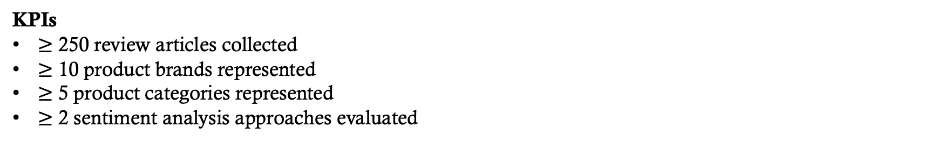
Success Criteria & Deliverables
Deliverable | Success Criteria
Structured Review Dataset | 250+ reviews collected across multiple brands and product categories
Comparative Sentiment Analysis | Identify and quantify sentiment trends across products, brands, and categories
NLP Model Evaluation | Compare at least two sentiment analysis approaches and evaluate model performance
Business Recommendation Report | Deliver actionable findings related to product strengths, weaknesses, and market trends
KPIs
$≥$ 250 review articles collected
$≥$ 10 product brands represented
$≥$ 5 product categories represented
$≥$ 2 sentiment analysis approaches evaluated

Slide 5
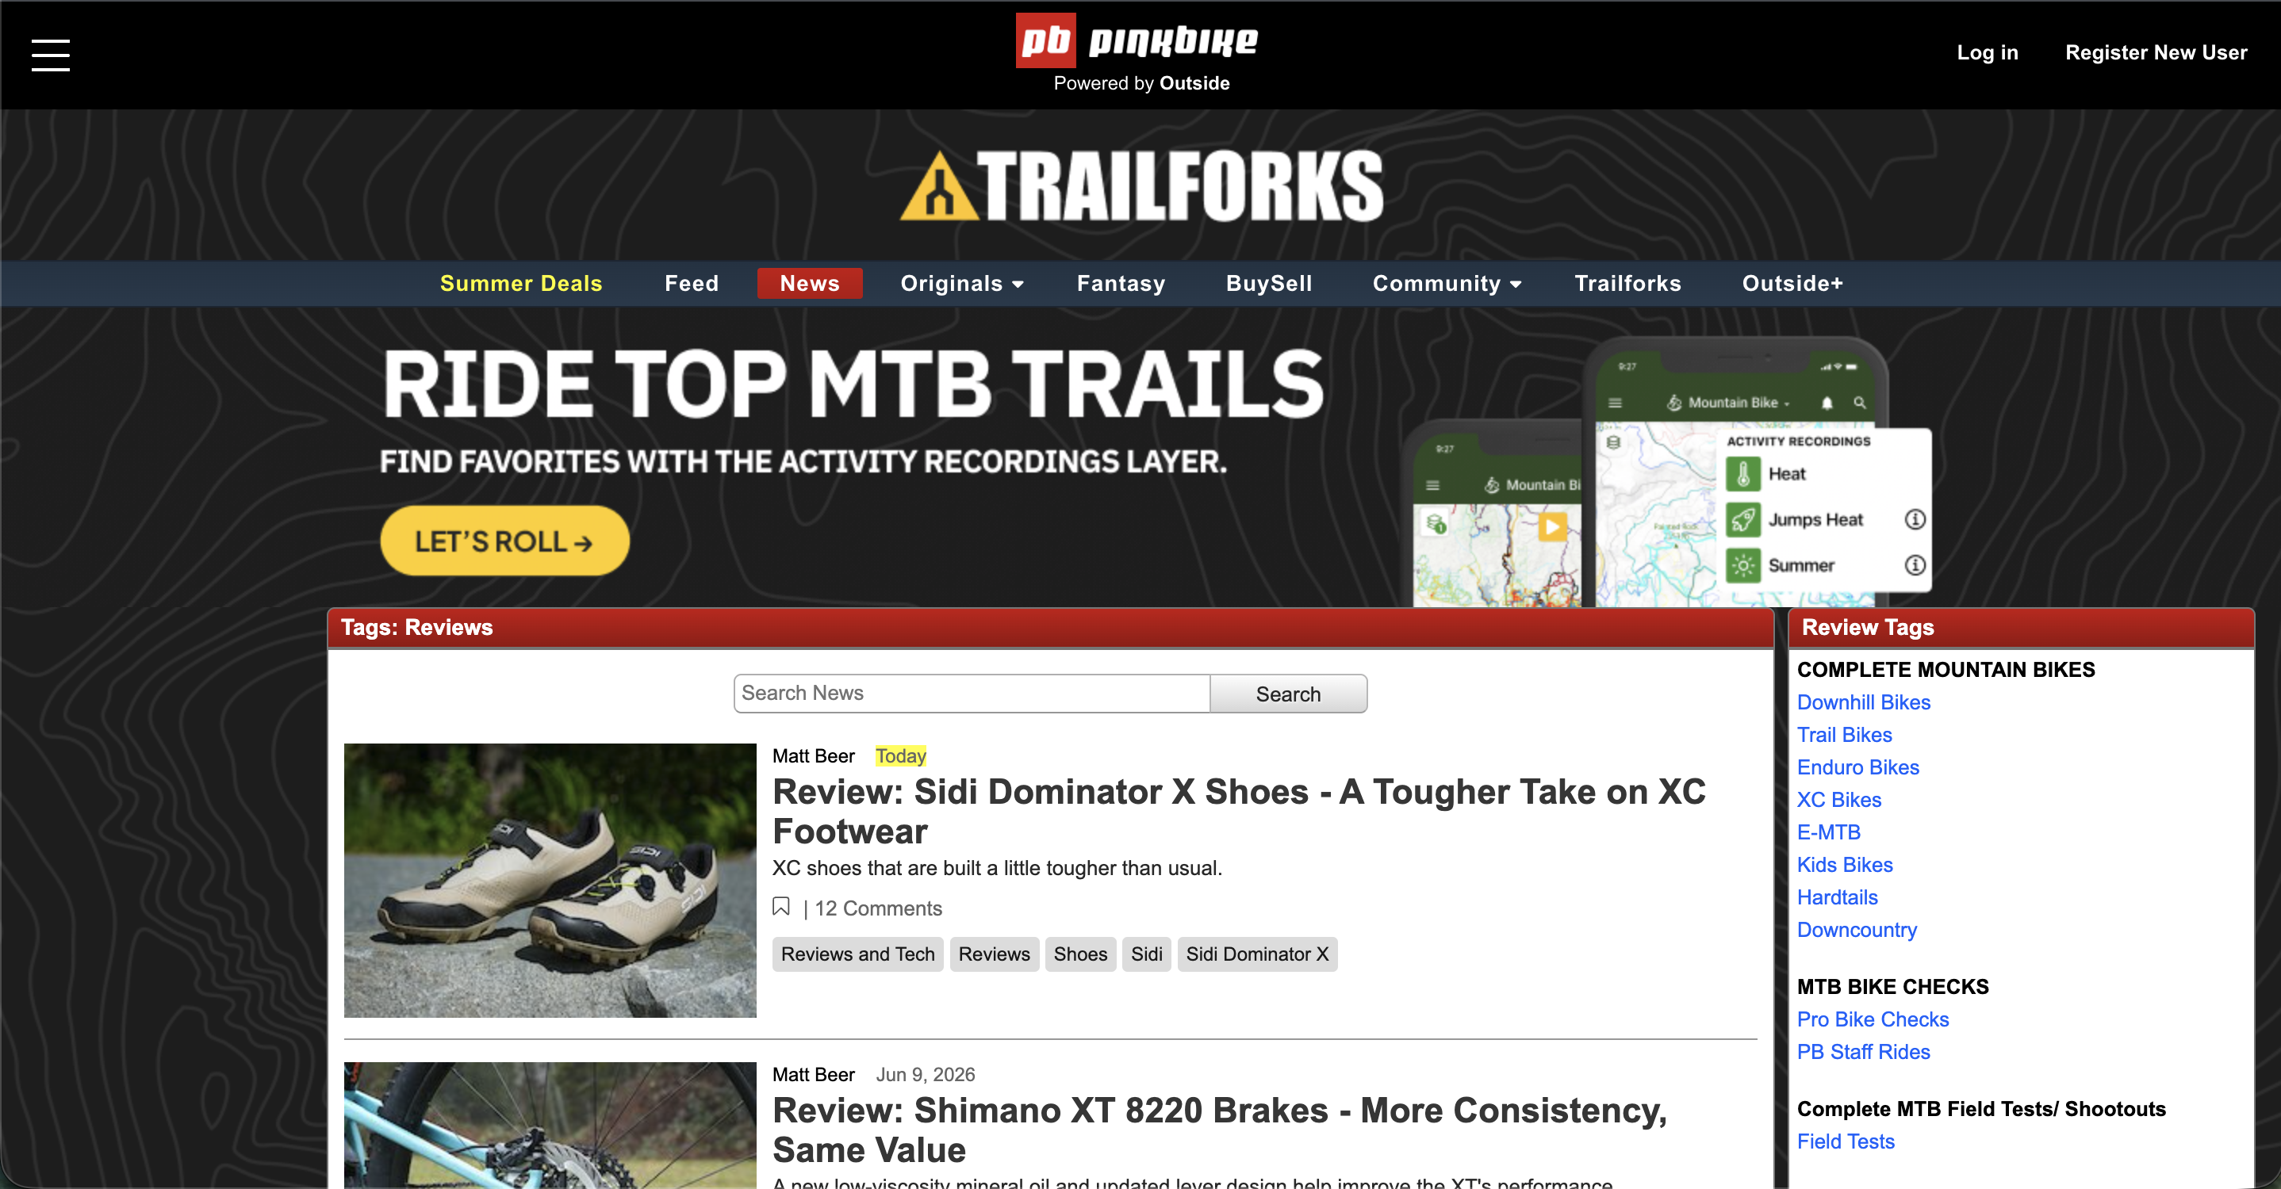
Resources
Data Sources
Pinkbike Review articles
Tools & Technologies
Python
Playwright
Pandas
NLP
Hugging Face Transformers
NLTK
spaCy
Version Control
GitHub
Project Resources
Scraper prototype
~ 300 reviews identified
Project Timeline
MTB Domain Knowledge

Slide 6
Constraints & Assumptions
Constraints | Assumptions
Limited to publicly available review content | Professional reviews provide meaningful product feedback
Review volume depends on available published articles | Sentiment models can identify useful patterns in review text
Professional reviews may differ from consumer sentiment | Sufficient review volume exists across brands and categories
Project must be completed within the capstone timeline | Product classifications and extracted entities are accurate

Slide 7
Risk Assessment
Risk | Impact | Mitigation
Website structure changes | Data collection disruptions | Use backup source and maintain scraper
Limited review volume in some categories | Reduced comparison opportunities | Expand timeframe, include additional product categories, or combine closely related categories when appropriate
Entity extraction errors | Reduced data quality and inaccurate comparisons | Validate entities through manual review
Sentiment model performance is weaker than expected | Less reliable sentiment insights | Compare multiple approaches and establish baseline performance
Project timeline constraints | Delayed milestones or reduced scope | Prioritize core deliverables and maintain milestone schedule

Slide 8
Project plan & Timeline
Milestone | Target Date
Project Idea & Proposal | ✅ Complete
Presentation 1: Problem Definition & Planning | June 17
Presentation 2: Data Collection & Preparation | June 24
Data Collection Complete | June 28
Code Check-In | July 1
Presentation 3: Preliminary Findings | July 9
Business Recommendations & Final Reporting | July 20 – July 31
Final Report & Presentation | August 6

