Slide 1
Sentiment Intelligence for Mountain Bike Product Reviews: Model Building and Evaluation
DS 785
Austin Engstrom
July 2026
Notes:
Hello everyone. Welcome to presentation 4. In the previous presentation, I focused on exploratory data analysis and feature engineering. Building on that work, this presentation covers the model development phase of the project. I'll discuss the modeling strategy, explain why three different sentiment analysis approaches were selected, describe the hyperparameter tuning and cross-validation process, compare model performance using multiple evaluation metrics, and review the results through error analysis and model interpretability.
I'll conclude by discussing the business and research implications of the modeling results and outline the next steps as I move toward the final phase of the capstone project.

Slide 2
Model Strategy & Evaluation Framework
301 Manually Labeled Reviews
Binary Sentiment Classification
80/20 Train-Test Split
5-Fold Stratified Cross-Validation
Hyperparameter Tuning
(Positive vs Not Positive)
Model Performance Evaluation
Ground Truth
240 Positive
61 Not Positive
(GridSearchCV)
Accuracy - F1 - AUC
Model Development Approach
301 manually labeled mountain bike product reviews served as the ground truth for supervised learning.
Because only one review was labeled Negative, sentiment was modeled as a binary classification problem (Positive vs. Not Positive).
Data were split into training (80%) and testing (20%) sets using stratified sampling to preserve class balance.
Five-fold stratified cross-validation with GridSearchCV was used to optimize model hyperparameters while reducing the risk of overfitting.
All models were evaluated using a common set of performance metrics to enable consistent comparison.
Notes:
Before comparing individual algorithms, it is important to establish the modeling workflow used throughout the project. The manually labeled review dataset created during the previous phase served as the ground truth for supervised learning and model evaluation. Because only one review was labeled as negative, the sentiment labels were consolidated into a binary classification problem consisting of Positive and Not Positive reviews. This allowed the models to be trained on a more balanced target while still distinguishing clearly favorable reviews from those containing meaningful criticism or mixed opinions. The dataset was divided into an 80 percent training set and a 20 percent held-out test set using stratified sampling to preserve the class distribution. During training, five-fold stratified cross-validation and GridSearchCV were used to optimize model hyperparameters while reducing the risk of overfitting. All models were evaluated using the same performance metrics to provide a consistent basis for comparison. This common evaluation framework was applied to every modeling approach so that differences in performance reflect the algorithms themselves rather than differences in the evaluation methodology.

Slide 3
Model Selection
 | Vader | Pretrained RoBERTa Transformer | TF-IDF + Logistic Regression
Approach | Rule-based sentiment analysis | Pretrained transformer | Supervised machine learning
Training Required | No | No (pretrained) | Yes
Strengths | Fast, interpretable baseline | Contextual language understanding | Learns domain-specific vocabulary with interpretable coefficients
Limitations | Limited contextual understanding | Not trained on mountain bike reviews | Requires labeled training data
Purpose in this study | Baseline comparison | Evaluate transfer learning | Final supervised model
Three complementary modeling approaches were selected to compare rule-based, pretrained, and supervised methods using the same manually labeled review dataset. This progression evaluates whether increasing model complexity improves sentiment classification for long-form technical mountain bike reviews. This progression evaluates whether increasing model complexity improves sentiment classification for long-form technical mountain bike reviews while providing actionable business insights into product sentiment.
Notes:
Three complementary approaches were selected to evaluate sentiment classification from different machine learning perspectives. VADER was chosen as the rule-based baseline because it requires no training data and is widely used for general sentiment analysis. RoBERTa represents a modern pretrained transformer that captures contextual language relationships but was not trained specifically on mountain bike reviews. Finally, TF-IDF with logistic regression was selected as the supervised approach because it learns directly from the manually labeled review dataset while remaining computationally efficient and highly interpretable. Comparing these three models allows us to determine whether greater model complexity improves sentiment classification for this specialized domain.

Slide 4
Baseline model Comparison
VADER
Pretrained RoBERTa Transformer
Review Text
Sentiment Scores
Final Sentiment
Lexicon & Rules
Review Text
RoBERTa Sentiment Model
Aggregate Article Prediction
Chunk Long Articles
Final Sentiment
Rule-based sentiment analysis
No model training required
Fast and computationally efficient
Common sentiment analysis baseline
Context-aware language model
Pretrained on general sentiment data
No domain-specific fine tuning
Better captures contextual language relationships
Both baseline approaches required no supervised training on the project dataset. VADER provided a traditional rule-based benchmark, while the pretrained RoBERTa transformer evaluated how well a modern contextual language model transferred to long-form technical mountain bike reviews.
Notes:
Before developing the supervised model, two baseline approaches were evaluated. VADER served as the rule-based baseline, using a predefined sentiment lexicon and heuristic rules to classify text without requiring labeled training data. The second baseline was a pretrained RoBERTa transformer, which analyzes sentiment using contextual language representations. Because the review articles exceeded the transformer's maximum input length, each article was divided into overlapping text chunks and the predictions were aggregated into a single article-level sentiment. These baseline models provided reference points for determining whether a supervised model trained on the manually labeled mountain bike reviews could achieve stronger classification performance.

Slide 5
Supervised model Development
Model Components
TF-IDF Feature Extraction
Converts review text into weighted numerical feature vectors
Weights informative terms while reducing the influence of common words
Unigram vocabulary selected during hyperparameter tuning
Logistic Regression Classifier
Supervised binary classifier trained on manually labeled reviews
Produces class probabilities for each review article
Coefficients provide interpretable feature importance
Review Article
TF-IDF Vectorization
TF-IDF Feature Matrix
Logistic Regression Model
Positive / Not Positive
TF-IDF with logistic regression provides an interpretable supervised model that can learn domain-specific language directly from the manually labeled mountain bike review dataset while remaining computationally efficient.
Notes:
After evaluating the baseline approaches, a supervised machine learning model was developed using the manually labeled review dataset. Each review article was converted into a TF-IDF feature vector, representing the importance of terms across the review collection. These feature vectors served as input to a logistic regression classifier trained to distinguish Positive from Not Positive reviews. Unlike the baseline approaches, this model learns directly from the labeled data, allowing it to recognize domain-specific mountain bike terminology. Logistic regression was selected because it performs well with high-dimensional text data while providing interpretable feature coefficients. The architecture shown here defines the model, and the next step was optimizing its performance through hyperparameter tuning and cross-validation.

Slide 6
Hyperparameter Tuning & Cross-Validation
Model Optimization Workflow
Best Hyperparameters
TF-IDF Logistic Regression
Parameter Grid
5-Fold Stratified Cross-Validation
Select Optimal Model
120 Parameter Combinations
Highest Macro F1
Parameter | Selected Value
C | 0.1
Class Weight | Balanced
N-gram Range | (1,1)
Minimum Document Frequency | 2
Maximum Document Frequency | 0.85
Macro F1 was selected because it balances precision and recall across both sentiment classes while reducing the influence of class imbalance.
Cross-Validation Results
5 Stratified Folds
120 Parameter Combinations
600 Model Fits
Best Cross-Validation Macro F1 = 0.543
Notes:
After defining the supervised model, the next step was hyperparameter tuning. GridSearchCV evaluated 120 combinations of TF-IDF vectorization and logistic regression parameters using five-fold stratified cross-validation, resulting in 600 total model fits. Stratification preserved the proportion of Positive and Not Positive reviews in each fold, providing a reliable estimate of model performance despite the class imbalance. Macro F1 was selected as the optimization metric because it balances precision and recall across both classes. The best-performing configuration used a regularization parameter of 0.1, balanced class weights, unigram features, and document frequency thresholds of two and 0.85, achieving a cross-validation Macro F1 score of 0.543. With the optimal model selected, the final step was to evaluate its performance on the held-out test set and compare it with the baseline models.

Slide 7
Model Performance Evaluation
Model | Accuracy | Balanced Accuracy | Macro F1 | ROC AUC
VADER | 0.784 | 0.492 | 0.440 | 0.549
RoBERTa TRansformer | 0.269 | 0.511 | 0.261 | 0.558
TF-IDF + Logistic Regression | 0.656 | 0.597 | 0.564 | 0.665
Evaluation Metrics
Accuracy
Percentage of correctly classified reviews
Balanced Accuracy
Accounts for class imbalance by averaging recall across both classes.
Macro F1
Balances precision and recall equally across classes
Used as the optimization metric during GridSearchCV
ROC AUC
Measures how well the model distinguishes Positive from Not Positive across all decision thresholds
Key Finding:
☑️ TF-IDF + Logicistic Regression selected as the final model
Highest Balanced Accuracy (0.597)
Highest Macro F1 (0.564)
Highest ROC AUC (0.665)
Notes:
This slide compares the performance of the three sentiment-analysis approaches using the same manually labeled test dataset. Although VADER achieved the highest overall accuracy at 78.4 percent, accuracy alone is misleading because the dataset is heavily imbalanced toward Positive reviews. For that reason, Balanced Accuracy, Macro F1, and ROC AUC were used to provide a more meaningful comparison across both sentiment classes. Using these metrics, the TF-IDF logistic regression model consistently outperformed both baseline approaches, achieving the highest Balanced Accuracy of 0.597, Macro F1 score of 0.564, and ROC AUC of 0.665. These results demonstrate that training directly on the manually labeled mountain bike review dataset enabled the supervised model to better capture domain-specific sentiment than either the rule-based VADER baseline or the pretrained RoBERTa transformer.

Slide 8
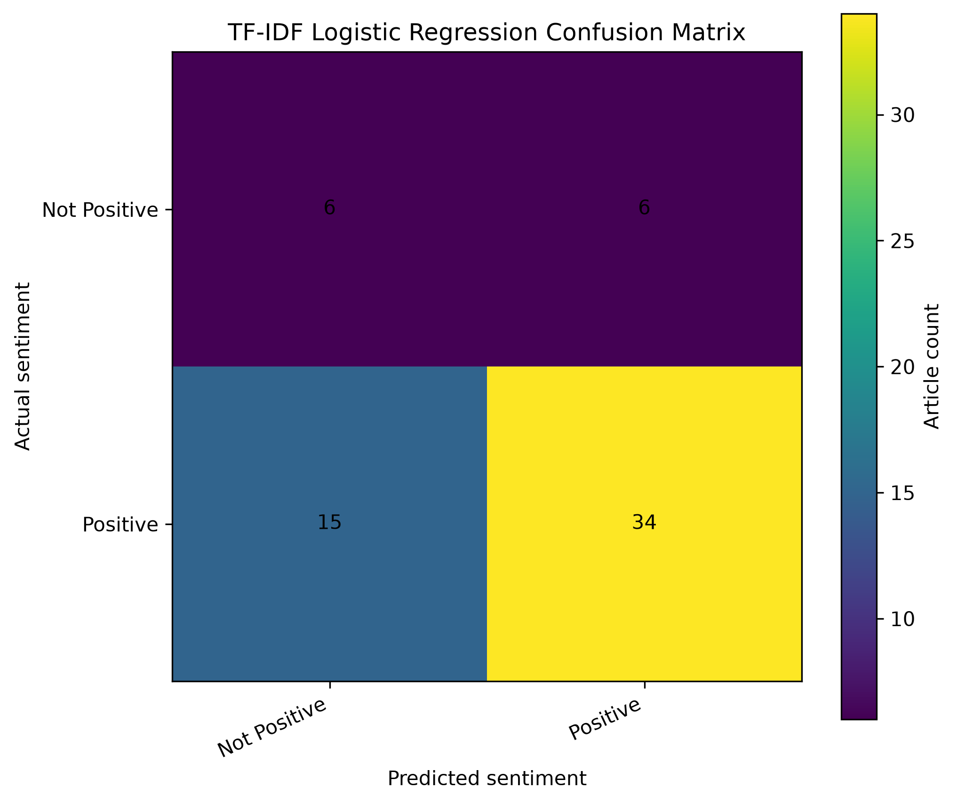
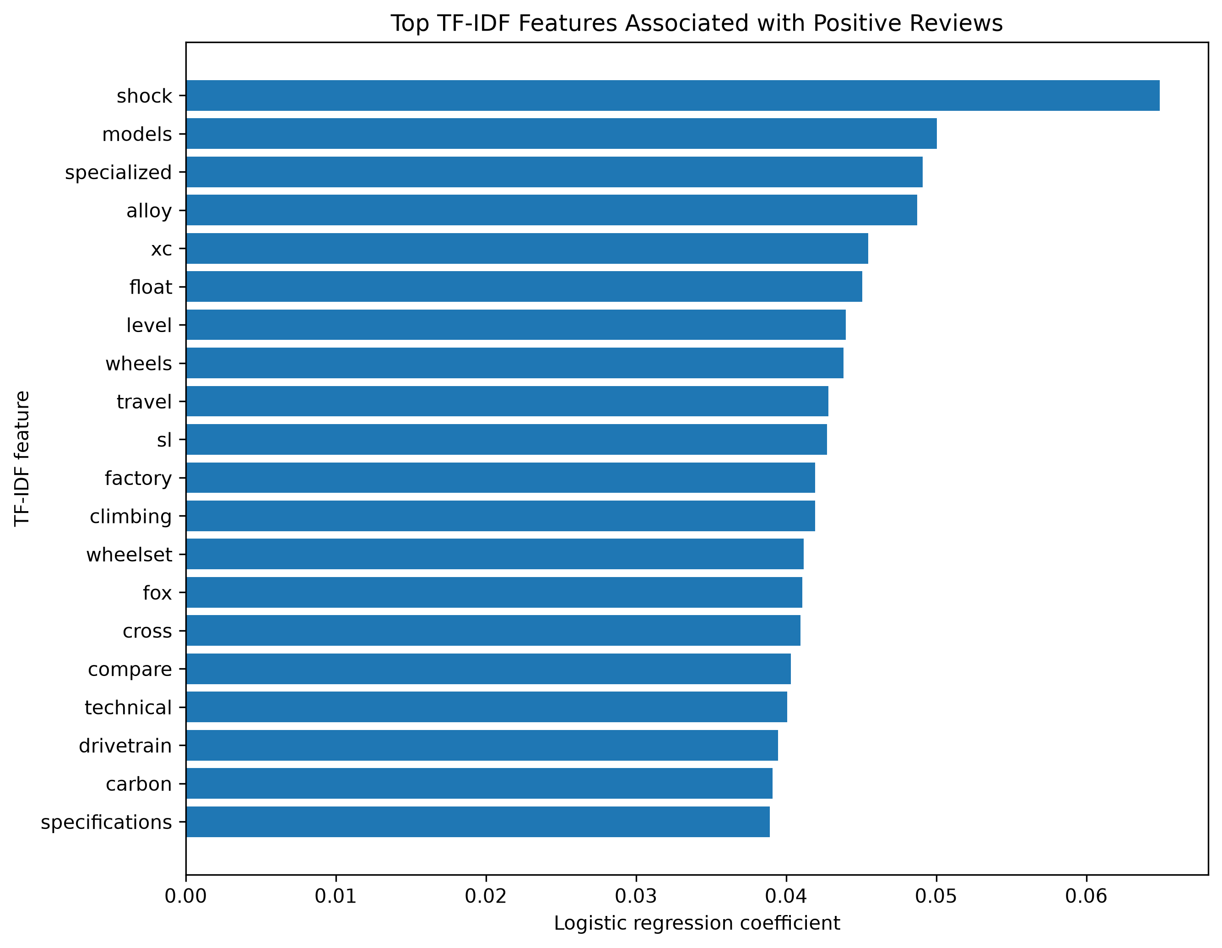
Error Analysis & Model Interpretability
Held-Out Test Results
61 test articles
21 misclassified reviews
Most errors occurred when Positive reviews were classified as Not Positive, reflecting the difficulty of separating mixed sentiment from clearly positive reviews.
Key Observations
Mixed reviews frequently contained both positive and critical language
Technical product vocabulary became predictive features
Small training dataset increased reliance on domain-specific words
Feature importance reflected highly domain-specific terminology, reducing generalizability beyond mountain bike reviews
Most misclassifications occurred in mixed reviews where positive product descriptions and meaningful criticism appeared within the same article, creating ambiguous sentiment signals.
Notes:
After selecting the final supervised model, the confusion matrix and feature importance were examined to better understand its behavior. The confusion matrix shows that the model correctly classified most Positive reviews, while the majority of errors occurred when distinguishing clearly Positive reviews from reviews containing mixed sentiment. These mixed reviews often combined strong praise with meaningful criticism, making the overall sentiment inherently more difficult to classify.
Feature importance showed that the model relied heavily on technical product vocabulary rather than traditional opinion words. This reflects the nature of professional mountain bike reviews, where sentiment is commonly expressed through discussions of suspension performance, component quality, climbing efficiency, and ride characteristics instead of explicitly positive or negative language.
These findings also highlight a limitation of the project. With only 301 manually labeled reviews, the model learned to associate domain-specific terminology with sentiment, reducing overall interpretability. Increasing the size of the labeled dataset or fine-tuning a domain-specific transformer would likely improve the model's ability to distinguish nuanced mixed sentiment while maintaining strong predictive performance.

Slide 9
Business & Research Implications
Business Insights
Supervised learning more effectively captured domain-specific review language than general-purpose sentiment models.
Sentiment classification enables comparisons across brands, product categories, and review types.
Automated sentiment analysis provides a scalable alternative to manually reviewing long-form product articles.
Interpretable models help explain why sentiment differs across products.
Research Insights
Generic sentiment models transferred poorly to long-form technical reviews.
Manual labeling enabled effective supervised model training.
Class imbalance required combining Mixed and Negative reviews into a single Not Positive class, limiting the ability to model nuanced sentiment
Domain-specific transformer fine-tuning remains a promising future direction.
Key Takeaway
The results demonstrate that domain-specific supervised learning provides more actionable sentiment insights than general-purpose NLP methods for technical mountain bike product reviews.
Notes:
Beyond selecting the best-performing model, this project provides practical insights for both business applications and future NLP research. From a business perspective, the supervised model demonstrated that sentiment analysis can summarize long-form product reviews at scale while supporting comparisons across brands, product categories, and review types. Because the logistic regression model is interpretable, it also provides transparency into the language influencing predictions, making the results easier to explain to business stakeholders.
From a research perspective, the comparison showed that greater model complexity alone did not guarantee better performance. Although the pretrained RoBERTa transformer represents a more advanced architecture, it was not trained specifically on mountain bike reviews and therefore transferred poorly to this specialized domain. In contrast, the supervised TF-IDF logistic regression model benefited from project-specific labeled data and achieved the strongest balanced performance.
These findings reinforce the importance of combining domain knowledge with appropriate modeling techniques when developing practical NLP solutions for specialized technical text.

Slide 10
Conclusions & Next Steps
Conclusions
Three sentiment-analysis approaches were successfully developed and evaluated using a common validation framework.
TF-IDF + Logistic Regression achieved the strongest balanced performance, outperforming both baseline approaches on Balanced Accuracy, Macro F1, and ROC AUC.
Manual labeling enabled supervised learning tailored to long-form technical mountain bike reviews.
Model interpretation and error analysis identified opportunities to improve future sentiment classification.
Next Step
Expand the manually labeled review dataset to improve model generalization.
Evaluate domain-specific transformer fine-tuning using the expanded dataset.
Apply the final sentiment model to compare brands, product categories, and review types.
Integrate sentiment predictions into exploratory business reporting and visualization.
This project demonstrates that domain-specific supervised learning provides an effective and interpretable framework for sentiment analysis of long-form technical mountain bike product reviews.
Notes:
This presentation focused on developing, optimizing, and evaluating multiple sentiment-analysis models using the manually labeled mountain bike review dataset. Three complementary sentiment-analysis approaches were evaluated using a common validation framework. TF-IDF with Logistic Regression achieved the strongest balanced performance and was selected as the final model. While VADER provided a useful rule-based baseline and the pretrained RoBERTa transformer demonstrated the potential of transfer learning, the supervised TF-IDF logistic regression model achieved the strongest overall balanced performance and was selected as the final model.
Looking ahead, the next phase of the project will focus on expanding the manually labeled dataset, exploring domain-specific transformer fine-tuning, and applying the final sentiment model to compare sentiment across brands, product categories, and review types. These analyses will provide the foundation for the final capstone deliverable and demonstrate how NLP can generate actionable insights from long-form technical product reviews.

