Slide 1
Sentiment Intelligence for Mountain Bike Product Reviews: Exploratory Data Analysis & Feature Engineering
DS 785
Austin Engstrom
July 2026
Notes:
Hello everyone. Hope you all had a great and safe 4th of July. Welcome to the third presentation for my project, Sentiment Intelligence for Mountain Bike Product Reviews. In the previous presentation, I focused on collecting and preprocessing the review data. Today, I'll discuss the exploratory data analysis I performed to better understand the dataset, the statistical patterns I identified, and the engineered features that will support the NLP models in the next phase of the project.

Slide 2
Dataset Overview
Metric | Value
Reviews | 297
Features | 17
Brands | 151
Review Type | 6
Publication Range | 2017 - 2026
Avg. Review Length | 2,241 words
Raw HTML
Cleaned Dataset
Exploratory Analysis
Feature Engineering
Model Development
Notes:
Before beginning statistical analysis, I first examined the overall structure of the dataset. The cleaned dataset contains 297 professional mountain bike product reviews, 17 original features, and metadata representing 151 manufacturers across six review types published between 2017 and 2026. During exploratory analysis, I engineered several additional features, such as article word count, average word length, publication year, and publication month, to support statistical analysis and downstream NLP modeling. One characteristic that immediately stands out is the average review length of more than 2,200 words, indicating these are detailed editorial reviews rather than short customer comments.

Slide 3
Statistical Analysis
Metric | Retail Price | Review Length
Mean | $3,429 | 2,241
Median | $1,250 | 1,972
Skewness | 0.83 | 0.48
Retail prices show a moderately right-skewed distribution due to high-end bicycle and component reviews
Review lengths are relatively consistent, simplifying text preprocessing and tokenization
No missing values were identified in the review text used for NLP
Missing values are primarily limited to product_name for multi-product and editorial articles, with a small number remaining due to metadata extraction limitations.
Notes:
After understanding the overall structure of the dataset, I performed descriptive statistical analysis to identify patterns that could influence model development. Two variables were particularly informative: retail price and review length.
Retail prices exhibited a moderately right-skewed distribution, with a mean of approximately $3,400 compared to a median of $1,250. This indicates that a relatively small number of premium bicycles and components increase the average price, making the median a more representative measure of a typical reviewed product.
Review length was much more consistent. Reviews averaged just over 2,200 words with only mild positive skew, confirming that the dataset consists of detailed, professionally written articles rather than short customer comments. This consistency will simplify text preprocessing because most reviews fall within a similar length range.
I also evaluated data completeness. Every record contains the full review text, which is the primary input for the NLP models. The largest source of missing values is the product name field. Remaining missing product names are largely associated with multi-product reviews or editorial articles rather than missing source data, so they are not expected to affect the downstream NLP modeling.

Slide 4
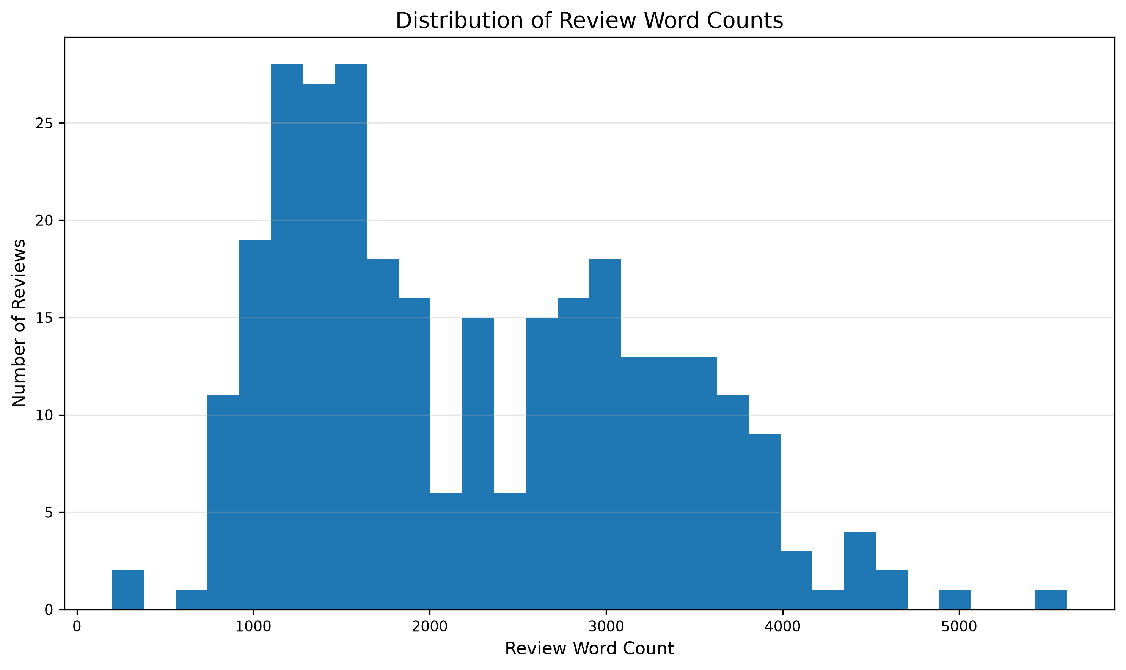
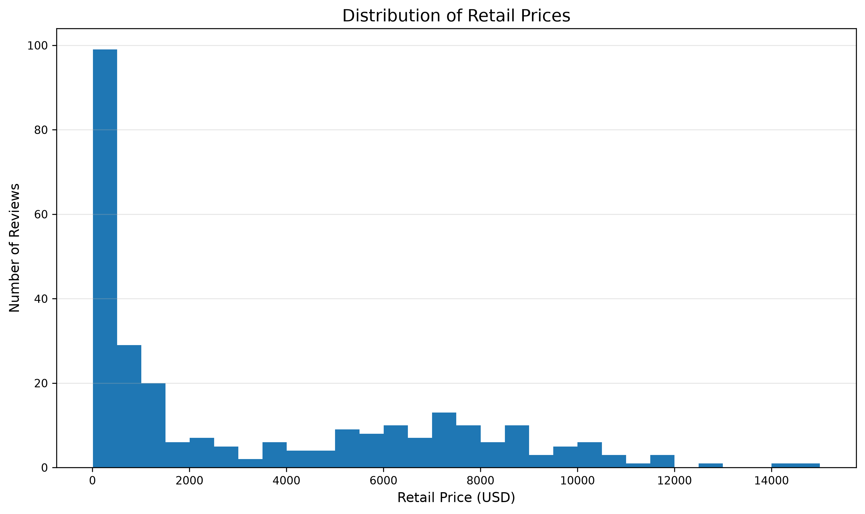
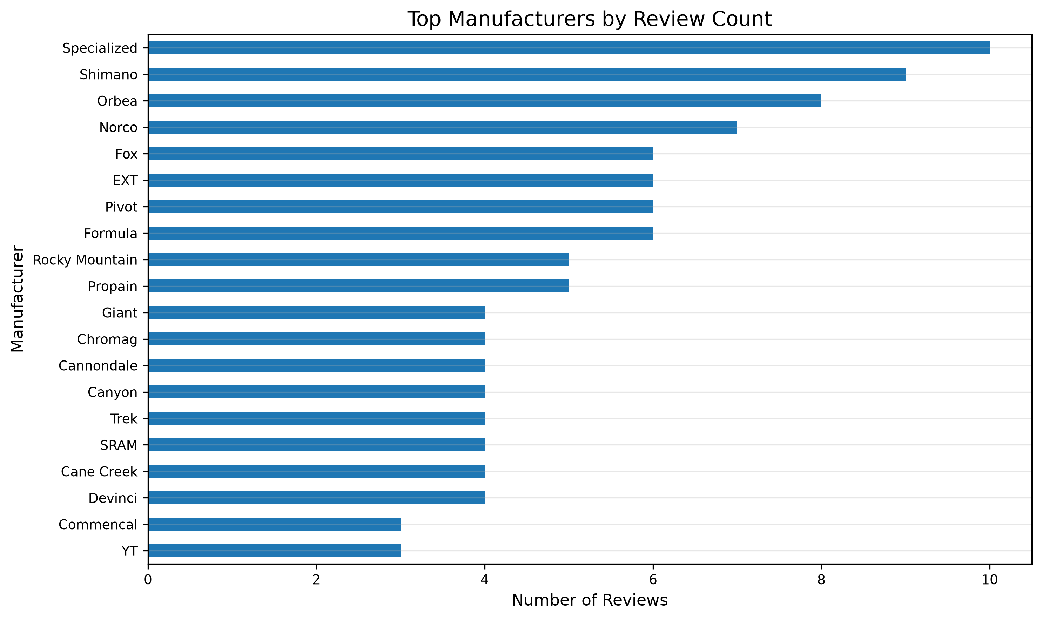
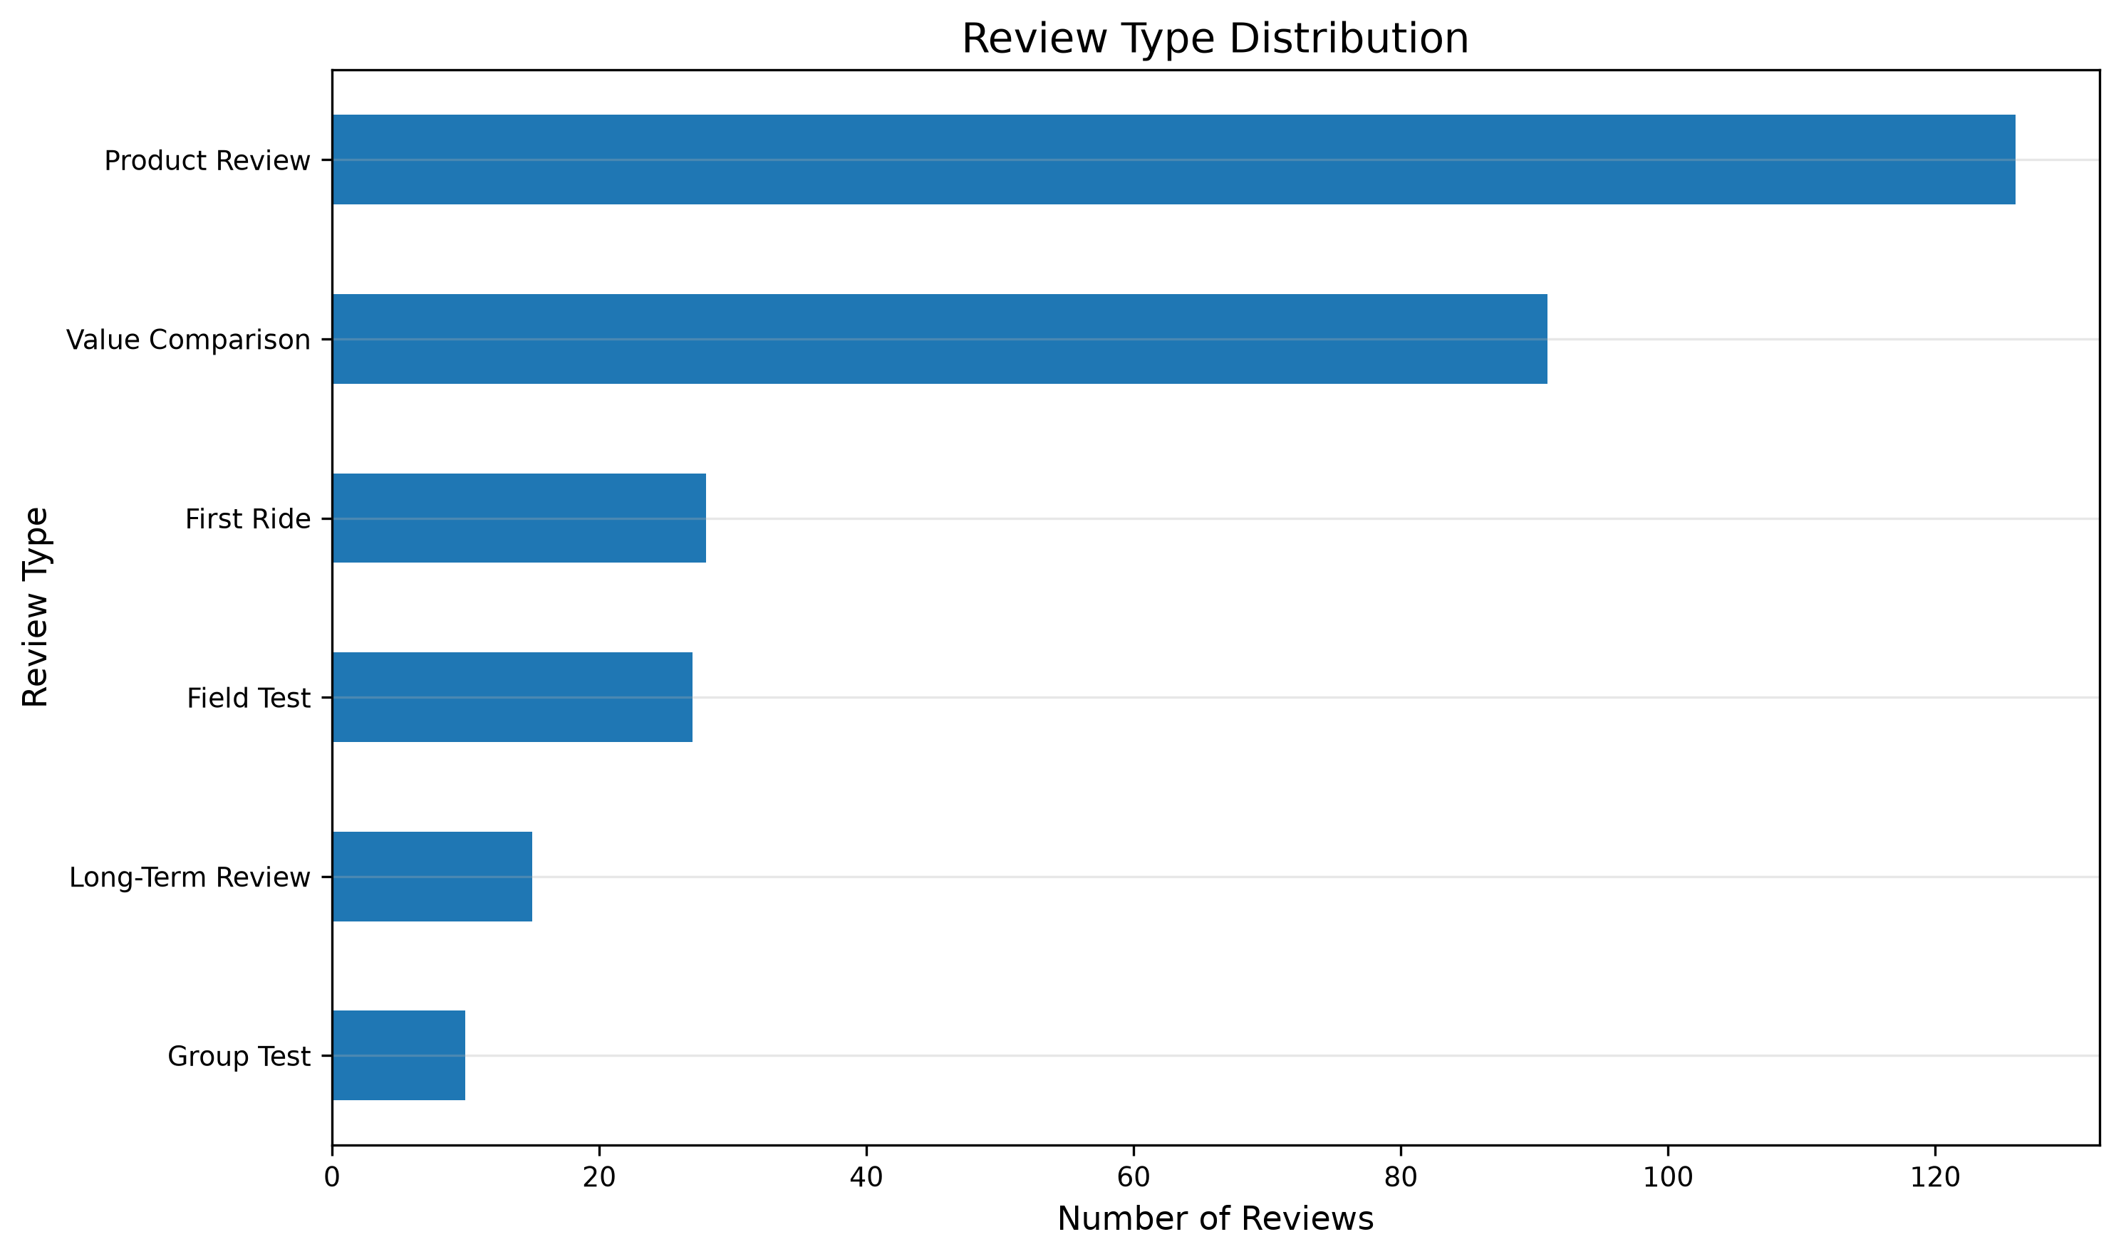
Exploratory Visualizations
Visual exploration confirmed consistent review lengths, broad brand representation, and structured review types, supporting feature engineering, text preprocessing, and downstream NLP model development.
Notes:
In addition to descriptive statistics, I created several visualizations to better understand the structure of the dataset and identify patterns that could influence model development.
The article word count histogram shows that most reviews fall within a relatively consistent range of approximately two thousand words. This supports a standardized preprocessing approach because there are very few unusually short or unusually long articles.
The retail price distribution reinforces the statistical findings from the previous slide. Most reviewed products are concentrated at lower price points, while a smaller number of premium bicycles and components create the right-skewed distribution.
The manufacturer frequency chart demonstrates broad manufacturer representation. Although brands such as Specialized and Shimano appear more frequently, no single manufacturer dominates the dataset, reducing the likelihood of brand-specific bias during modeling.
Finally, the review type distribution highlights a variety of editorial formats, including product reviews, value comparisons, first rides, and long-term tests. This structured metadata provides additional categorical information that can be incorporated into feature engineering alongside the review text.

Slide 5
Feature Engineering Results
Primary Modeling Inputs
Brand
Review Type
Retail Price
Publication Date
Article Title
Article Text
Engineered Feature | Purpose
Article Word Count | Standardize text preprocessing and analyze review complexity
Average Word Length | Quantifying writing characteristics across reviews
Publication Year | Evaluate changes in reviews over time
Publication Month | Support temporal trend analysis
Has Price | Identify reviews containing structured pricing information
Has Product Name | Evaluate metadata completeness and support future ETL quality improvements
Feature engineering transformed raw review data into structured variables that support exploratory analysis, preprocessing, and downstream NLP model development.
Notes:
After completing the exploratory analysis, I engineered several new features from the original review data to provide additional structure for analysis and model development. While the original dataset contained metadata such as brand, review type, publication date, and the review text itself, feature engineering derived variables that summarize characteristics of the text and improve analytical flexibility.
For example, article word count and average word length quantify the size and writing style of each review, supporting preprocessing decisions and exploratory comparisons. Publication year and publication month enable future analysis of trends over time, while the price availability indicator identifies reviews containing structured pricing information.
It's important to note that these engineered variables are not intended to replace the review text. Instead, they provide structured context that complements the raw text, while the transformer model will learn the semantic meaning directly from the article title and review content.
I also created a product name availability indicator during exploratory analysis. Although this feature is not intended as a predictive input, it serves as a useful measure of metadata completeness and highlights an opportunity to further improve the ETL pipeline before the final stages of the project.
Overall, these engineered features provide structured context that complements the unstructured review text and prepares the dataset for downstream NLP modeling.

Slide 6
Text Representation for NLP
Raw Review Text
Cleaning & Tokenization
Transformer Embeddings
Sentiment Classification
Why no PCA?
Review text is converted into contextual token embeddings
Transformer models learn dense semantic representations automatically
Transformer embeddings eliminate the need for traditional dimensionality reduction techniques, such as PCA
Rather than manually reducing dimensionality, transformer models generate contextual embeddings that preserve semantic meaning while converting raw text into dense numerical representations for machine learning.
Notes:
The final step in preparing the data was determining how the review text would be represented for machine learning. Traditional machine learning workflows often rely on dimensionality reduction techniques such as Principal Component Analysis, or PCA, to reduce the number of features before model training. However, because this project uses transformer-based language models, that additional step is unnecessary.
Instead, each review is first cleaned and tokenized before being converted into contextual embeddings by the transformer model. These embeddings are dense numerical representations that capture the semantic meaning of the text while reducing the complexity of the original language into a format suitable for machine learning.
As a result, my feature engineering efforts focused on creating structured metadata that complements these learned text representations, rather than manually reducing the dimensionality of the review text itself.

Slide 7
Business Interpretability
Feature | Business Insight
Brand | Compare brand perception across manufacturers
Review Type | Compare sentiment across review formats
Retail Price | Analyze sentiment by product price range
Publication Date | Identify changes in sentiment over time
Review Text | Extract overall sentiment and common discussion themes
Business Applications
Monitor brand perception over time
Identify strengths and weaknesses discussed in professional reviews
Compare sentiment across product segments and price ranges
Support product development and marketing decisions
Track competitive positioning across manufacturers
Combining structured metadata with transformer-based text analysis enables actionable business insights beyond simple positive or negative sentiment classification.
Notes:
The purpose of exploratory analysis and feature engineering is not simply to prepare data for modeling, but also to ensure that the resulting models produce insights that are meaningful to business users. While transformer models will classify sentiment from the review text, the structured metadata provides the context needed to interpret those predictions.
Features such as brand, review type, retail price, and publication date allow organizations to compare sentiment across manufacturers, product segments, and time periods. Rather than simply predicting sentiment, these features help explain why sentiment differs across manufacturers, product segments, price ranges, and time periods.
These structured features also allow sentiment results to be segmented by manufacturer, review type, publication date, and price range, making the model outputs more actionable for business decision-making.
By combining structured metadata with transformer-based text analysis, this project aims to deliver interpretable business insights that extend beyond basic sentiment classification.

Slide 8
Conclusion & Next Steps
Key Conclusions
Exploratory analysis confirmed a clean, well-structured dataset for NLP
Statistical analysis identified consistent review lengths and a moderately right-skewed retail price distribution
Feature engineering created structured variables to support preprocessing and business interpretation
Transformer embeddings provide an effective text representation without requiring PCA
Next Steps
Finalize the NLP training dataset
Generate sentiment labels for model training
Train and compare transformer-based NLP models
Evaluate model performance and business insights
The project now transitions from preparing the data to building and evaluating transformer-based sentiment models capable of generating actionable business insights.
Notes:
This exploratory analysis demonstrated that the dataset is well prepared for the modeling phase of the project. The review text is complete across all records, review lengths are consistent, and the engineered features provide additional context for both analysis and business interpretation.
Although exploratory analysis identified a small number of remaining metadata limitations, the review text itself is complete across all records, providing a strong foundation for transformer-based sentiment modeling. The next phase of the project will focus on generating review-level sentiment labels, training and comparing transformer-based NLP models, and evaluating both predictive performance and the business insights that can be derived from the resulting classifications.

