Slide 2
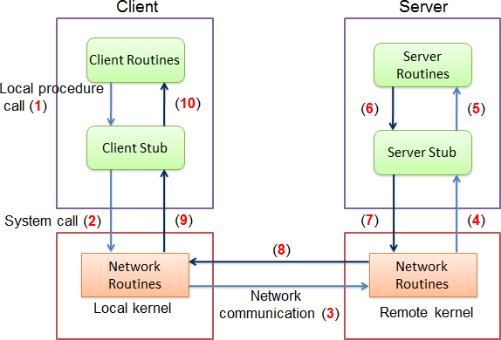
RPC: Remote Procedure Call
http://dist-prog-book.com/chapter/1/rpc.html

Slide 3
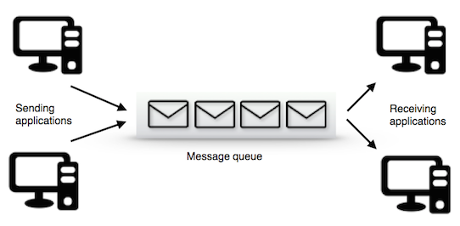
Message Queue
https://www.cloudamqp.com/blog/2014-12-03-what-is-message-queuing.html

Slide 4

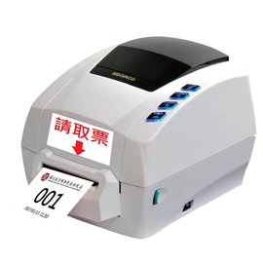
http://www.pcstore.com.tw/twbrother/M16787099.htm

Slide 5
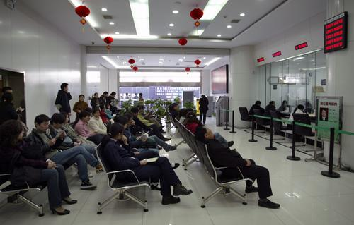
http://news.ifeng.com/a/20161229/50494665_0.shtml

Slide 6
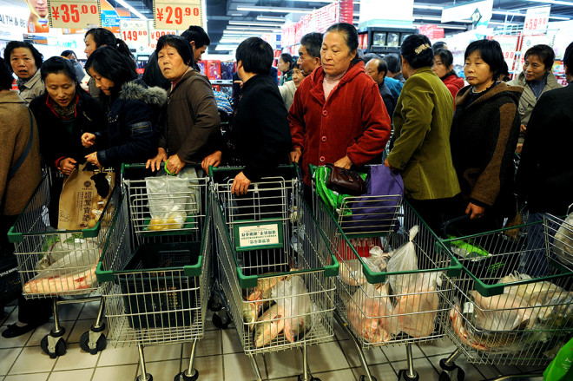
好衰，為什麼我每次排隊都排到最慢的那列？
https://buzzorange.com/2014/08/13/whats-up-with-the-other-line-is-always-faster/

