Slide 1



微服務基礎建設 – Message Queue
Andrew Wu, Chief Architect @ 91APP
Jan 23, 2019

Slide 2

Andrew Wu 是誰?
經歷: 91APP, Chief Architect
Microsoft MVP
曾任: 一宇數位科技 技術長
資策會 雲端系列課程 Azure PaaS 講師
Microsoft Azure Cafe, TechDays, TechEd 講師
專欄作家
談論各種軟體開發與設計的大小事，有 20 年的大型與雲端服務的開發經驗。喜歡研究各種技術背後的原理與實作細節，期許自己做個優秀的架構師。研究主題以: .NET / C# / OOP / Container / Microservices / Distributed System 為主軸，同時在部落格上也持續分享相關主題的一系列文章。期許能將這些領域的實作經驗分享到社群。

Slide 3
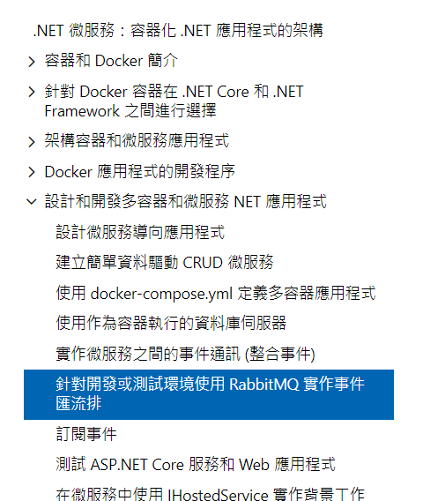
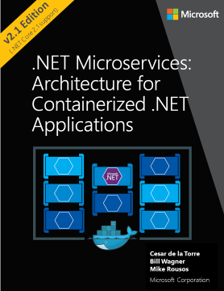
.NET Microservices

Slide 4
AGENDA
Message Queue Concepts
NineYi.Msa.Infra.Messaging.*
Inside Messaging:
Thread Sync Basic
Cloud Native Concept: Auto Scaling
Auto Scaling In Infra Way, Not In Developer Way
DEMO

Slide 5
References:
Web-Queue-Worker architecture style
Messaging patterns
Microservices communications. Why you should switch to message queues.
Benefits of Message Queues
What is a Message Queue?
https://docs.microsoft.com/en-us/azure/architecture/guide/architecture-styles/web-queue-worker
https://docs.microsoft.com/en-us/azure/architecture/patterns/category/messaging
https://dev.to/matteojoliveau/microservices-communications-why-you-should-switch-to-message-queues--48ia
https://aws.amazon.com/message-queue/benefits/
https://aws.amazon.com/message-queue/

Slide 7
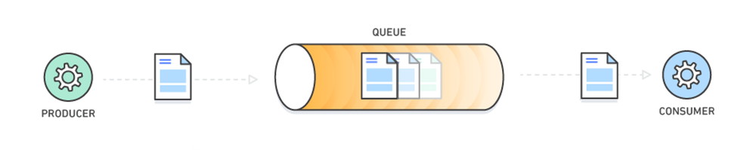
What is a Message Queue?
https://aws.amazon.com/message-queue/
Notes:
Notes:
Cloud Service / Cloud native / Container / Microservices ….
線上服務的複雜度越來越高，服務數量變多，服務的 instance 也變多
管理的挑戰也變大

Slide 8
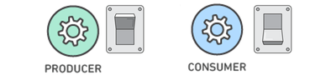
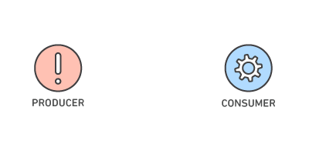
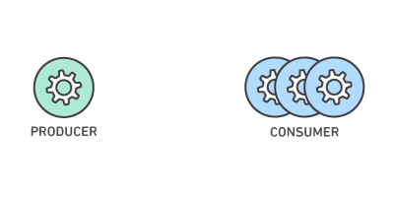
Benefits of Message Queues
Better Performance
Increased Reliability
Granular Scalability
Asynchronous communication, optimizing data flow.
Consumers process messages only when they are available.
Queues make your data persistent, and reduce the errors
that happen when different parts of your system go offline.
Message queues make it possible to scale precisely where
you need to. Producers, consumers and the queue itself can
all grow and shrink on demand.
https://aws.amazon.com/message-queue/benefits/
Notes:
Granular 粒狀的

Slide 9
Benefits of Message Queues
Simplified Decoupling
Break Up Apps
Migrate to Microservices
Shift to Serverless
Message queues remove dependencies between components and significantly simplify
the coding of decoupled applications. Message queues are an elegantly simple way to decouple
distributed systems, whether you're using monolithic applications, microservices or serverless architectures.
Microservices integration patterns that are based on events and asynchronous messaging
optimize scalability and resiliency. Use message queuing services to coordinate multiple
microservices, notify microservices of data changes, or as an event firehose to process IoT,
social and real-time data.

Slide 10
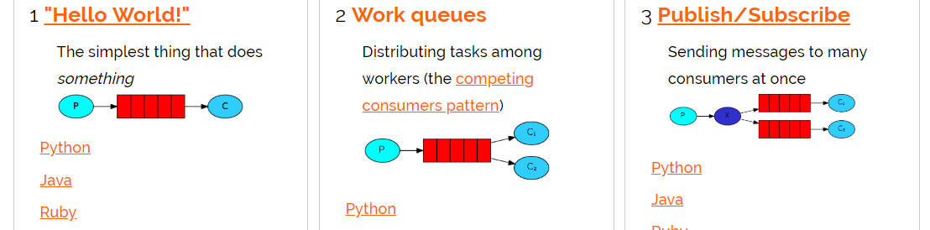
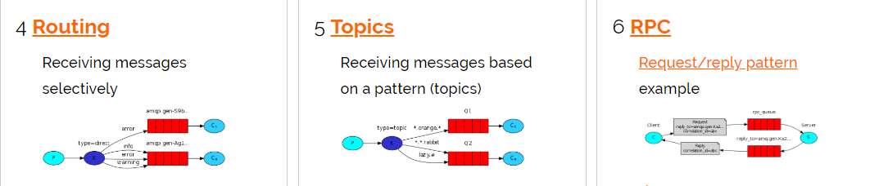
Rabbit MQ: Queue + Exchange
http://www.rabbitmq.com/getstarted.html

Slide 11
DEMO
NineYi.Msa.Infra.Messaging.*

Slide 12
Design Concept (One-Way Async)
MessageClient<Message>
MessageWorker<Message>
Serialization Data Of Message

Slide 13
Design Concept (Two-Way RPC)
MessageClient<Input, Output>
MessageWorker<Input, Output>
Serialization Data Of Input Message
Serialization Data Of Output Message

Slide 14
除了這些，其他都抽象化封裝起來…
Developer Must Know:
Input Message
Output Message
Worker Process
Misc:
Multi-Threads
Async / Await
Serialization, TrackContext Transform
Notes:
除了數量之外，複雜度也隨之升高。
每個服務 (service) 及每個個體 (instance) 都必須更精準的掌握其他服務的狀態 (availability, endpoitns)
服務之間的通訊也越來越複雜

Slide 15
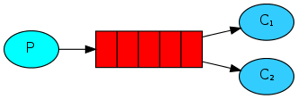
DEMO #1
Basic Work Queue(s)

Slide 16
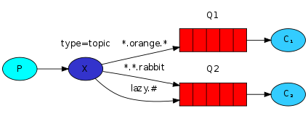
DEMO #2
Exchange Usage: Topic

Slide 17
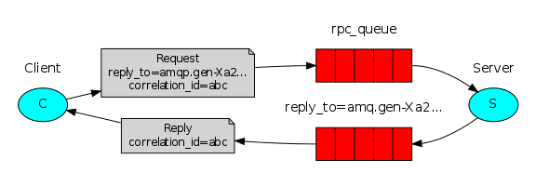
DEMO #2
RPC: Remote Procedure Call

Slide 19
Inside Messaging…

Slide 20
Async / Await & Parallel Process…
Basic Skill: Thread Sync
ManualResetEvent
AutoResetEvent
C# Async Wrap

Slide 21
Auto Scaling In Infra Way
Basic Concept: Scale In / Out Automation
Your Application Must (when Scale Out):
Self Host
Pull Config
Pull Message
Your Application Must (when Scale In):
Handle OS Shutdown Event / Signal
Do Graceful Shutdown

Slide 22
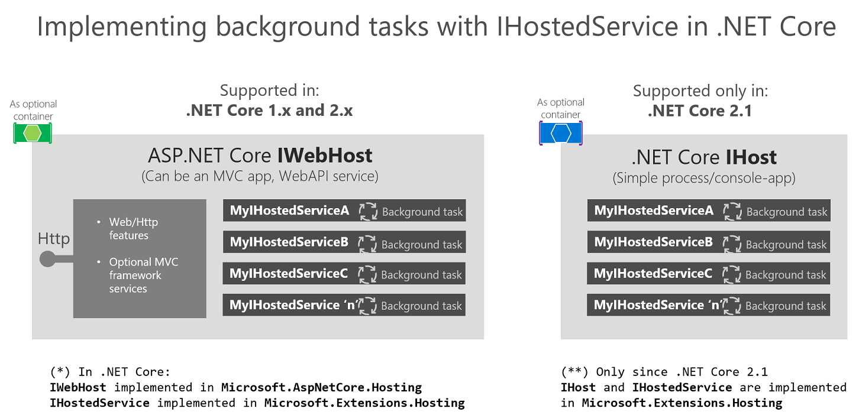

Slide 23
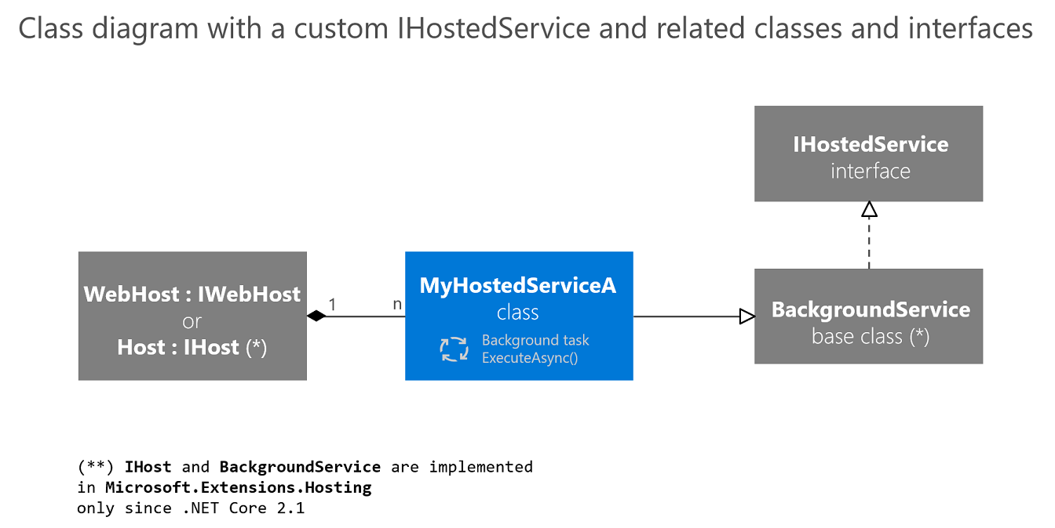

Slide 28



謝謝大家 ☺
歡迎到大會共筆頁面提問
或是蒞臨 91APP 攤位分享心得
請支持 安德魯的部落格 ~
https://www.facebook.com/andrew.blog.0928
http://columns.chicken-house.net/

