Slide 1
COSA+ and Dynamic Regime Adaptation
Time-Series Test-Time Adaptation under Distribution Shift
Research Question
Can output-space adaptation stay useful when deployed time-series streams suddenly change?
COSA+ stronger online correction
Dynamic Regime Adapter zero-shot, no backprop
Compare trade-offs not a universal winner
CPS3830 Course Project | 7-minute presentation
Notes:
Start with the research question. Our project is about test-time adaptation for time-series forecasting. We compare two directions beyond COSA: COSA+ keeps online adaptation and Dynamic Regime Adapter moves adaptation offline. The key message is trade-offs, not one universal best method.

Slide 2
Motivation: Forecasting Streams Do Not Stay Clean
Clean train/test splits miss abrupt real-world regime changes.
Training regime
Deployed stream
Sudden shift
Sensor faults
Weather anomalies
Demand spikes
Structural changes
Problem
A model can look accurate on a clean test split, but fail exactly when the stream enters a new regime.
Notes:
This slide motivates the problem. In deployment, time series can change because of sensors, weather, demand, or structural changes. Standard evaluation assumes the test distribution is stable. Our project asks what happens when that assumption breaks.

Slide 3
Baseline: COSA Online Output-Space Adaptation
Frozen backbone + lightweight adapter optimized during test time.
Context Ct
Base forecast Y0
Output adapter H = W[Y0 || Ct] + b
Adapted forecast Y = Y0 + tanh(g)H
Frozen DLinear
Strength
Cost
Question
Small module; no full model retraining
Still needs online gradient updates
What helps under abrupt shifts?
Notes:
COSA is our baseline. It freezes the forecasting backbone and adapts a small output-space module online. This is lighter than updating the full model, but it still requires test-time backpropagation.

Slide 4
Our Two Directions
One stays online; one moves adaptation offline.
COSA+
Dynamic Regime Adapter
RegimeEncoder z
GateGenerator g
Context X
Mean + std context
Vector gate g ∈ R^T
Step-wise correction
Online: adapts during evaluation
Zero-shot: single forward pass at test time
Trade-off axis: robustness behavior vs. inference cost
Notes:
We explored two directions. COSA+ keeps COSA’s online adaptation but adds richer context and a horizon-wise vector gate. Dynamic Regime Adapter learns a latent regime representation offline, then generates a correction gate in one forward pass.

Slide 5
Core Experimental Design
Clean forecasting + black-swan robustness tests.
Datasets Weather, ETTh1
Backbone Frozen DLinear
Horizons 96, 720
Metric MSE / MAE
Black-Swan shift protocol
Original stream
Shift point Tshift
Shifted stream x't = S(xt; α)
Evaluate mse_after_50
Level
Variance
Trend
Spike
Notes:
The experiments use Weather and ETTh1 with a frozen DLinear backbone. We evaluate clean test performance and black-swan shifts. The black-swan protocol transforms the stream after a shift point using level, variance, trend, or spike shifts, then measures recovery with mse_after_50.

Slide 6
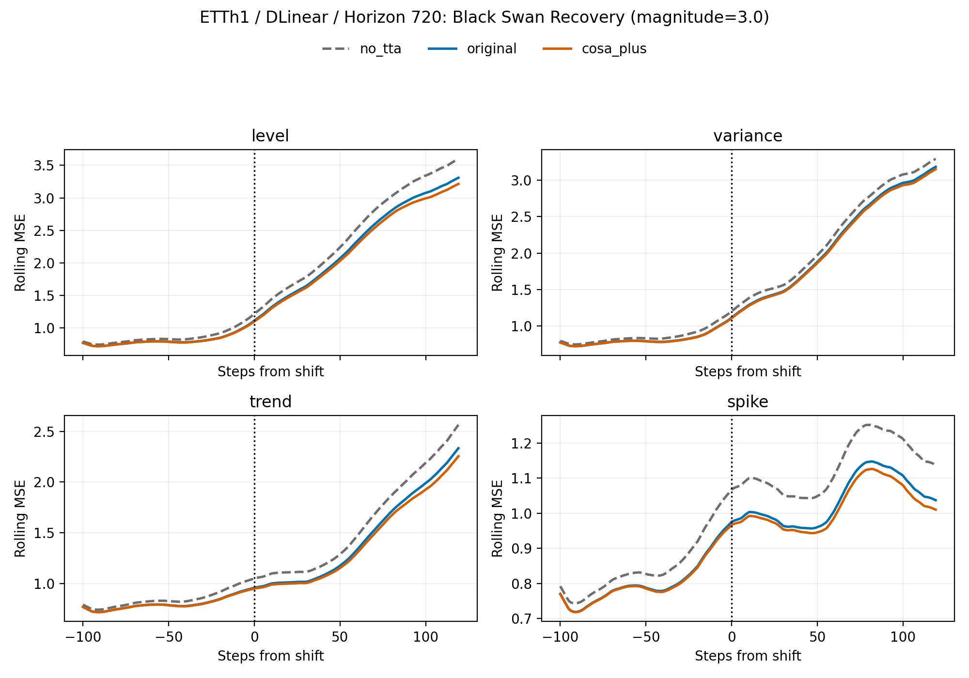
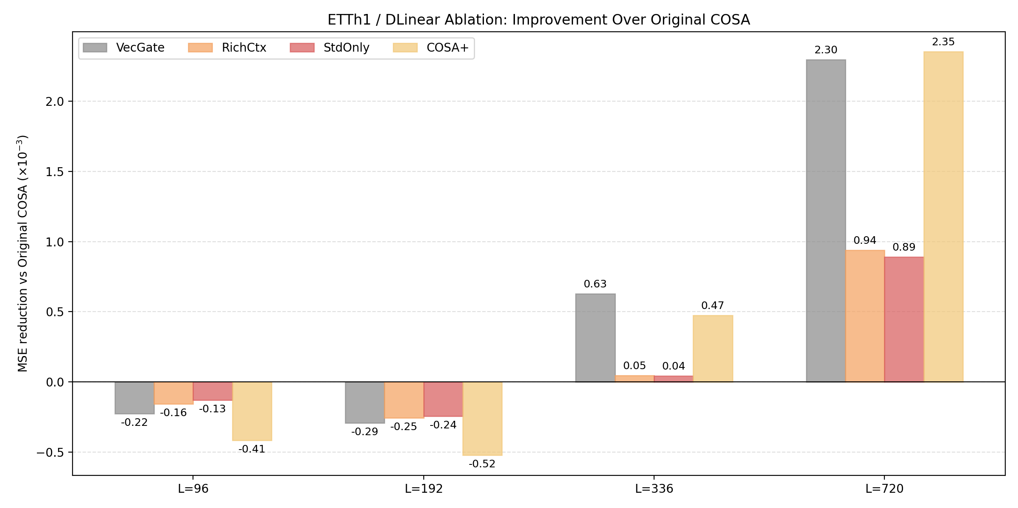
Main Results
Clean-test gains are similar; abrupt-shift behavior differs.
Weather / h=96 Best clean MSE
Dynamic mixed loss +2.48% MSE
ETTh1 / h=720 Best clean MSE
COSA+ +4.86% MSE
ETTh1 / DLinear / h=720 black-swan recovery
Ablation: vector gate helps most at long horizons
Notes:
The main results show the trade-off. On Weather horizon 96, the Dynamic Regime Adapter with mixed loss gives the best MSE without test-time backpropagation. On ETTh1 horizon 720, COSA+ gives the strongest clean and black-swan correction. The recovery plot shows COSA+ is consistently below original COSA after abrupt shifts.

Slide 7
Takeaways, Limitations, Future Work
The answer is conditional, which is the useful result.
What worked
Limitations
Next steps
COSA+ improves long-horizon post-shift recovery
Dynamic adapter gives zero-shot adaptation
Vector gate explains most COSA+ gains
Only Weather and ETTh1
Black-swan shifts are synthetic
Weather h=720 shows vector gate can hurt
Dynamic black-swan test still open
Gate regularization
Shift detection
Huber / robust losses
More datasets and horizons
Final message: COSA+ is stronger online under abrupt long-horizon shifts; Dynamic Regime Adapter is cheaper at inference with no test-time backpropagation.
Notes:
Close with what we learned. COSA+ is useful in a specific robustness regime, especially long-horizon abrupt shifts. Dynamic Regime Adapter is attractive when inference cost matters. We do not claim a universal best method; the project compares trade-offs and identifies limitations.

