Slide 1


Slide 2
What is it?
Web framework

Slide 3
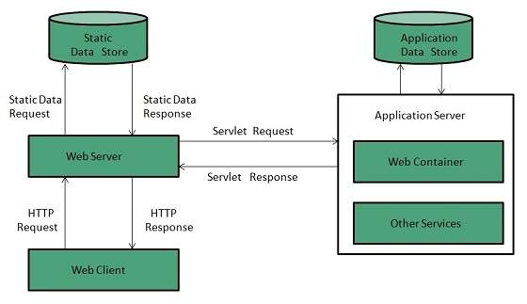

Slide 4
What is a web framework
It’s a package that is made to support construction of dynamic web applications (dynamic websites). It helps the web developer or designer to design and develop a website from bit to scratch or edit an existing website.

Slide 5
Examples of web framework
Content managements system
Joomla
Drupal
WordPress

Slide 6
Examples of web framework
Language specific framework
Java : Spring, JSF, Struts
JavaScript : AngularJS, Express, Meteor
PHP : Laravel, CodeIgniter, Symfony
Python : Django, Flask, Bottle
Ruby : Ruby on Rails, Sinatra, Cuba

Slide 7
Components of flask

Slide 8
WSGI(Web Server Gateway interface)
Werkzeug
jinja2

Slide 9
WSGI(Web Server Gateway interface)
It’s a standard for web development.
WSGI is a specification for a universal interface between the web server and the web applications.

Slide 10
Werkzeug
It is a WSGI toolkit, which implements requests, response objects, and other utility functions. This enables building a web framework on top of it.
The Flask framework uses Werkzeug as one of its bases

Slide 11
Jinja2
It is templating engine for Python
A web templating system combines a template with a certain data source to render dynamic web pages.

