Slide 1


Seitz-Invariant Prediction of Electron Localization Functions from Superposed Atomic Densities via a 3D-Convolutional Network
Austin Ellis, Maosheng Miao
Department of Chemistry & Biochemistry
California State University, Northridge

Slide 2
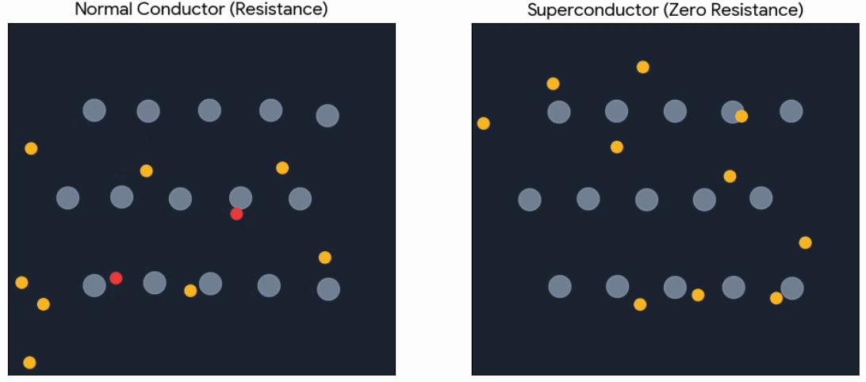
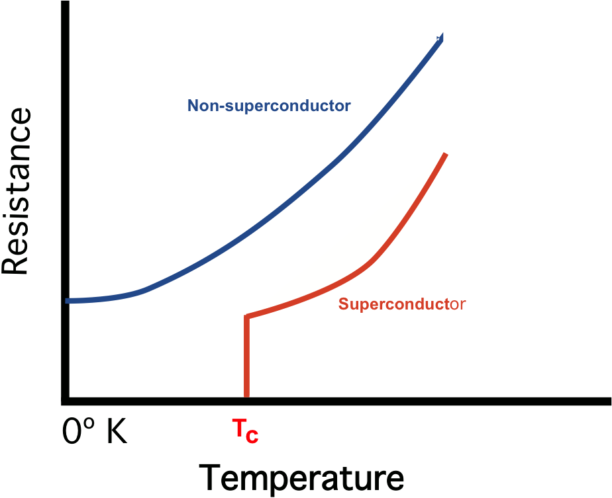
What are superconductors?
Some materials can conduct electricity with no resistance!
Atom vibrations scatter electrons at high temperature, but help electrons pair and flow with no resistance at low temperature

Slide 3
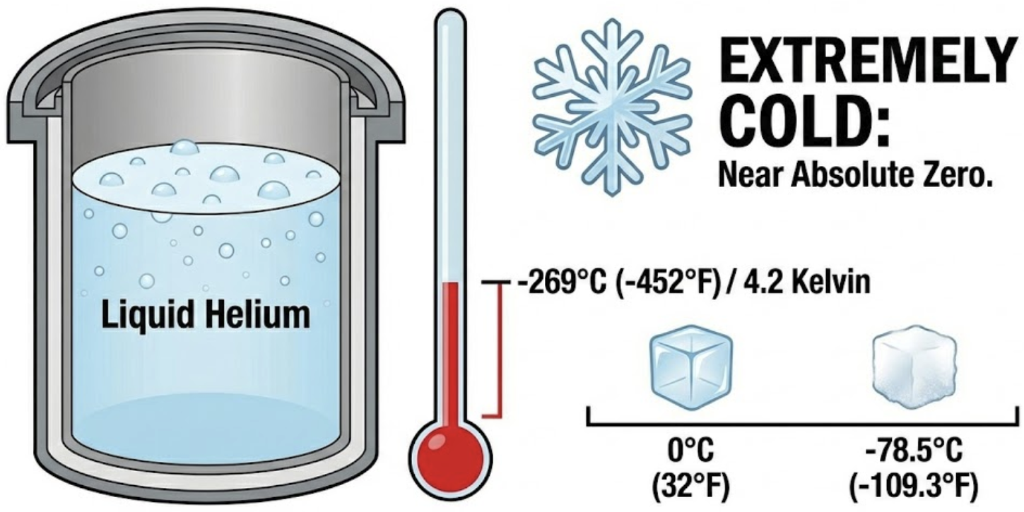

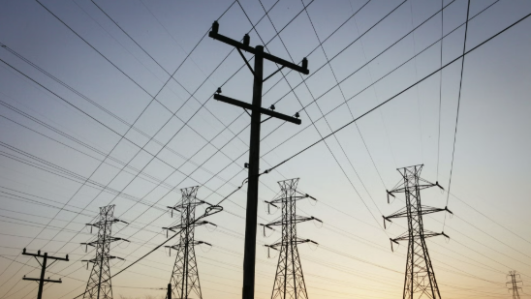

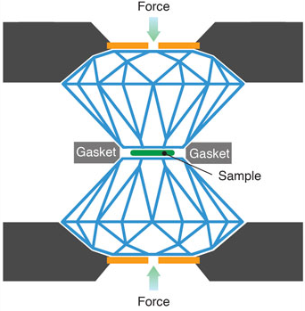

Superconductors are not science-fiction!
High pressure

Slide 4
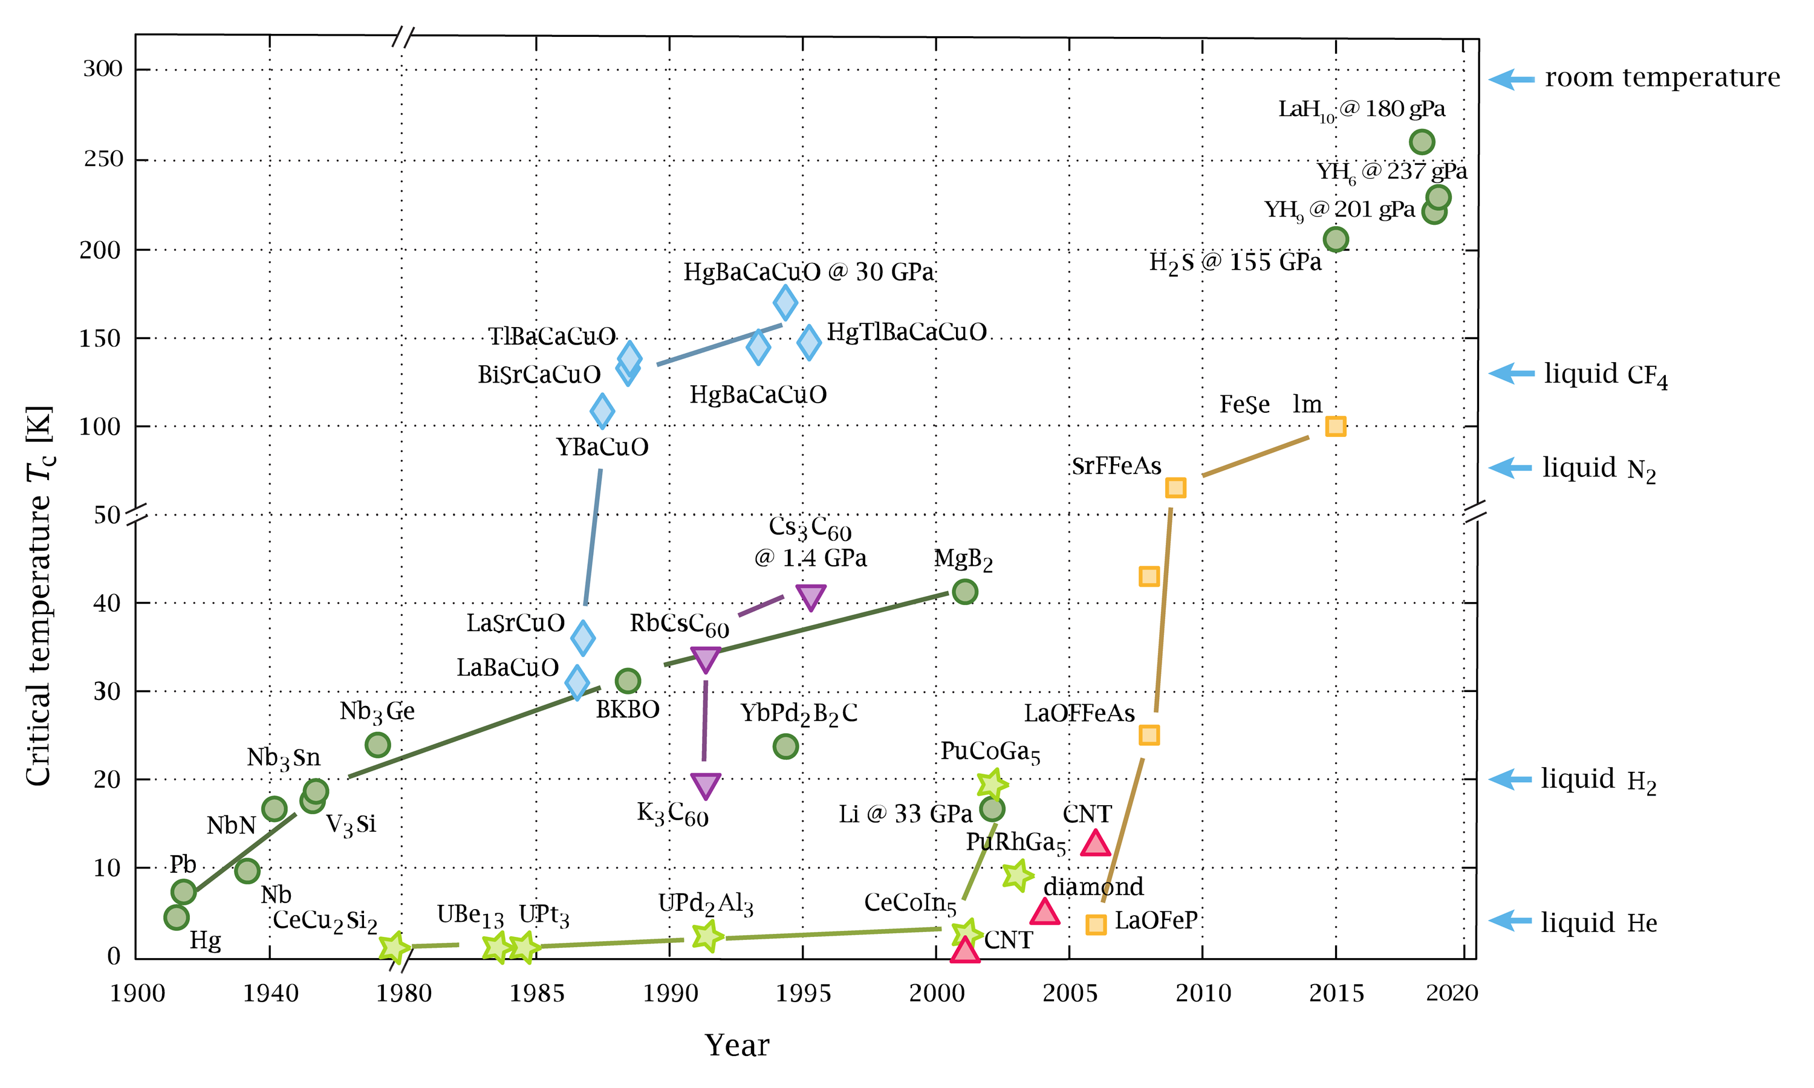
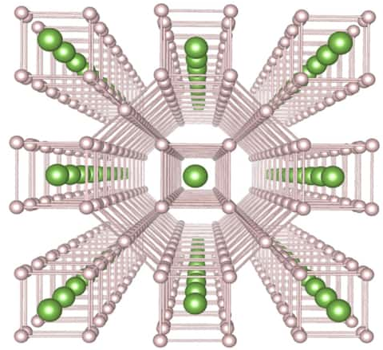
Superhydrides seem promising…
High-pressure chemistry unveils unique material structures leading to discoveries like unusual stoichiometries

Slide 5
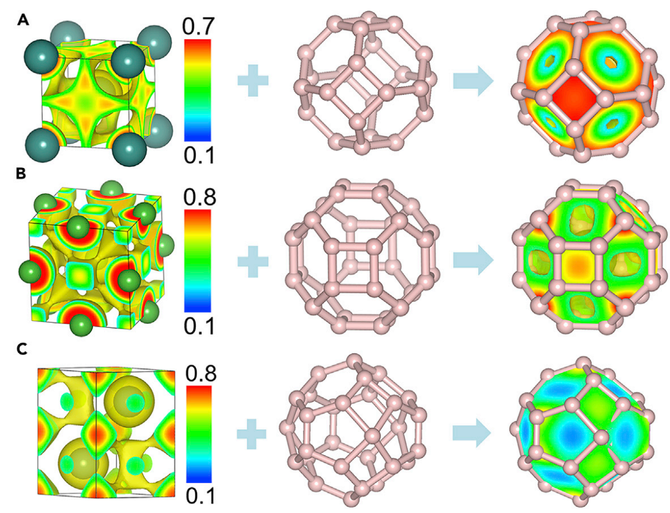
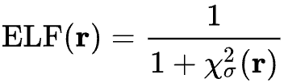
The ELF predicts superhydride formation
Electron localization function (ELF) compares local kinetic energy density to a homogeneous gas
High value = localized electrons
Low value = delocalization
Hydrogen atoms assemble in interstitial sites with high localization
Sun & Miao, Chem 2023, 9, 443–459.

Slide 6
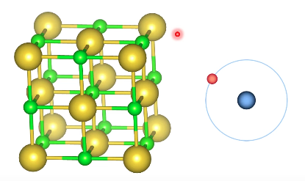
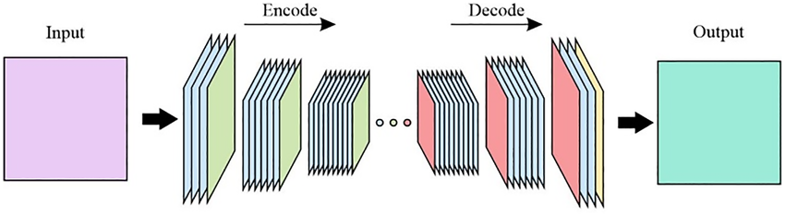

The ELF can be expensive to calculate
First Principles (QM)
Machine Learning (ML)
$$−{\frac{ℏ^{2}}{2m}}∇^{2}Ψ+VΨ=EΨ$$
Solution: We can treat the ELF as a 3D image and train a model to predict it directly
Problem: How do we represent our structure?
The time required to run a quantum mechanics-based calculation scales cubically with electron count (N)

Slide 7
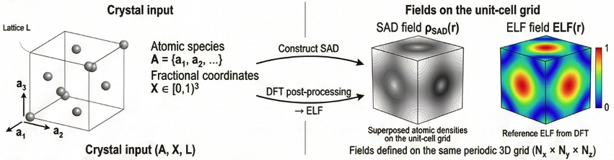
Crystal structure representation
SAD is the electron density obtained by freezing atomic charge density at each atom center without allowing their electron clouds to hybridize or relax into bonded states
Since the SAD and ELF have the same grid size, the problem is now an image transformation

Slide 8
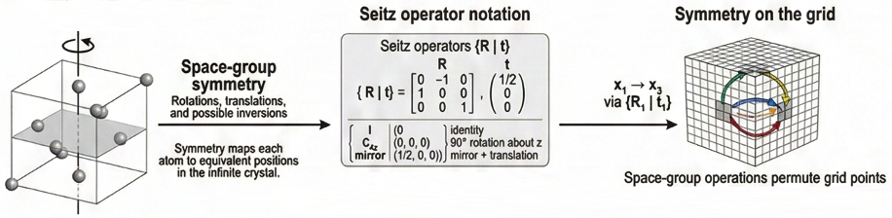
Making the model Seitz-Invariant
Seitz symmetry – Standard notation system for describing the symmetry operations of crystal structures in 3D space groups
Invariance – Property that guarantees the model makes the same prediction even if the crystal structure is rotated or translated according to its symmetry group

Slide 9
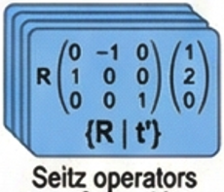

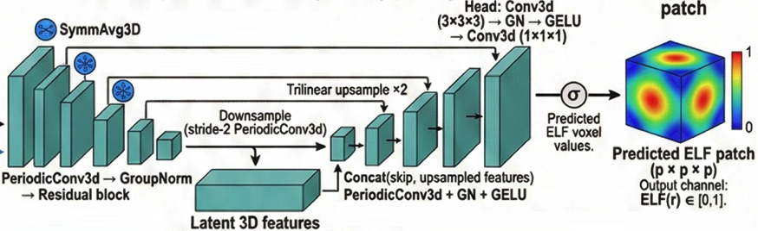
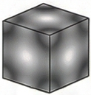

Architecture for a symmetry-aware image transform
+

Slide 10
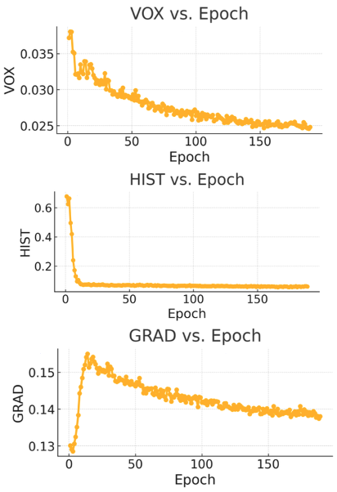
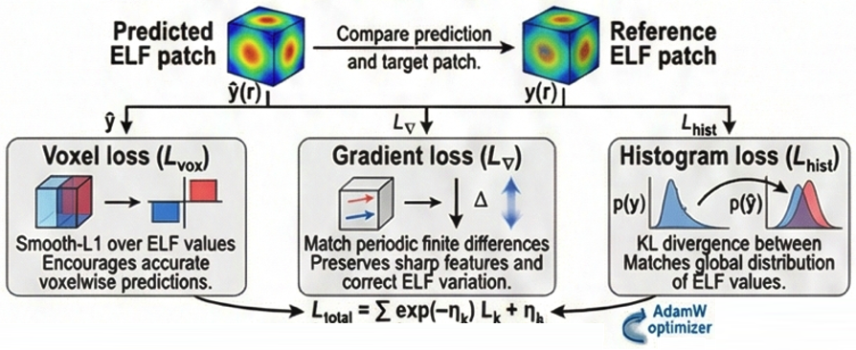

Physics-aware loss function
Kendall Loss: An adaptive weighting scheme that automatically learns how to balance the voxel, gradient, and histogram objectives during training, eliminating the need to manually tune loss weights.

Slide 11
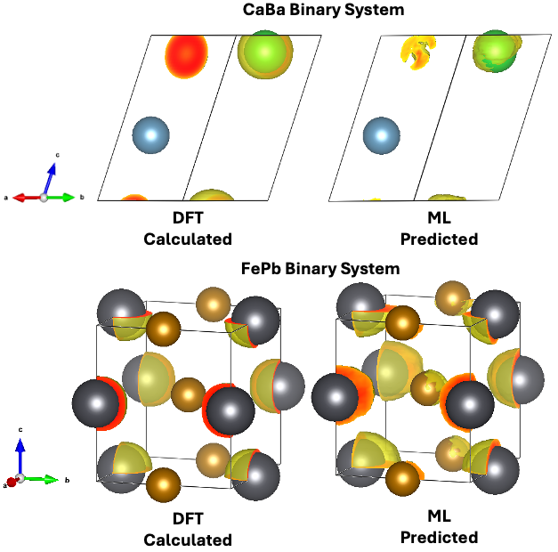
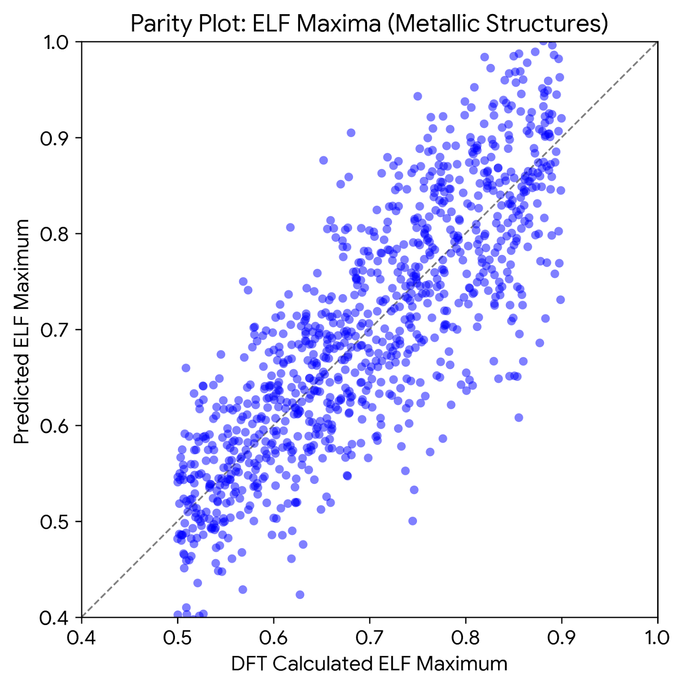
Successful ELF Prediction
Model tested on subset of metal lattices
Maxima most relevant to prediction of superhydride structures

Slide 12
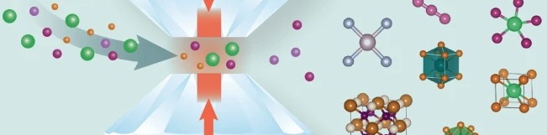
Conclusion
Novel Contributions
Next Steps
3D image transformation bypasses quantum mechanics calculations
SAD representations are used to represent 3D crystals
Seitz-Invariance guarantees predictions respect crystal symmetry
Physics-aware optimization via Kendall loss automatically balances training objectives
Extend training set beyond metals so the SAD→ELF operator supports more chemical space
Generate compressed ELFs to train model on high‑pressure regimes
Use high-pressure model to rapidly evaluate metal lattice ELFs to discover novel superconductors

Slide 13
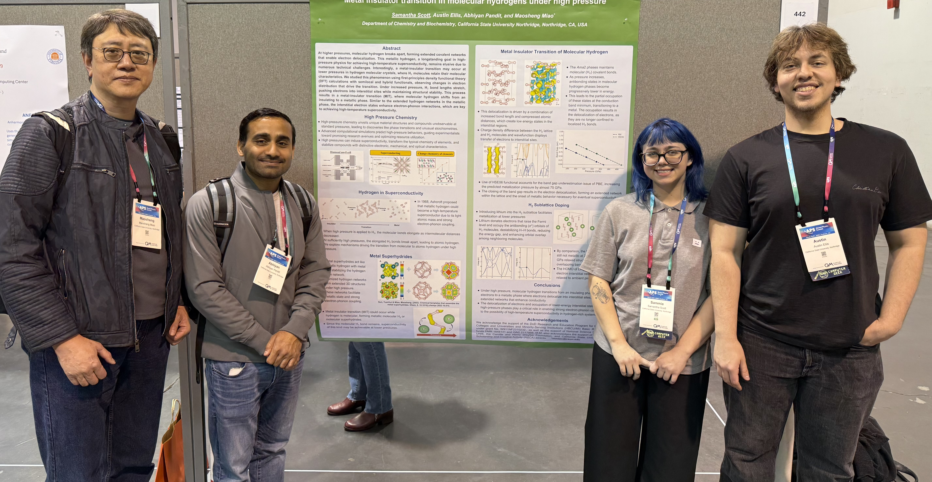






Acknowledgements
Check out the paper!
Team
Dr. Maosheng Miao
Dr. Abhiyan Pandit
Samantha Scott

