Slide 1
Linear Regression
ACM Sigkdd Advanced ML Series
Ashish Srivastava (ansrivas@gmail.com)

Slide 2
Outline
Linear Regression
Different perspectives
Issues with linear regression
Addressing the issues through regularization
Adding sparsity to the model/Feature selection
Scikit options

Slide 3
Regression
Modeling a quantity as a simple function of features
The predicted quantity should be well approximated as continuous
Prices, lifespan, physical measurements
As opposed to classification where we seek to predict discrete classes
Python example for today: Boston house prices
The model is a linear function of the features
House_price = a*age + b*House_size + ….
Create nonlinear features to capture non-linearities
House_size2 = house_size*house_size
House_price = a*age + b*House_size + c*House_size2 + …..

Slide 4
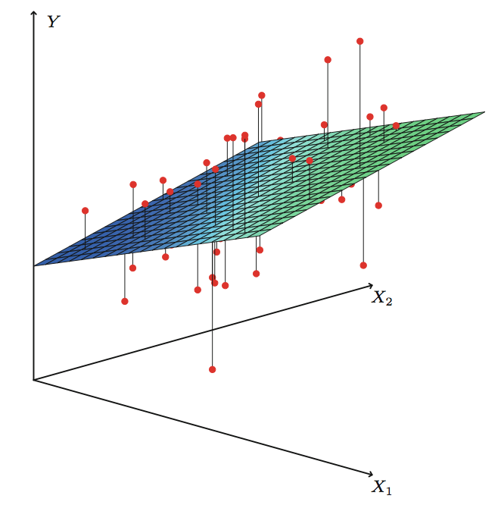


Case of two features
$$\left[\begin{matrix}\begin{matrix}y1 \\ y2 \\ y3\end{matrix} \\ ⋮ \\ yn\end{matrix}\right]≈\left[\begin{matrix}\begin{matrix}\begin{matrix}1 & x11 & x21\end{matrix} \\ \begin{matrix}1 & x12 & x22\end{matrix} \\ \begin{matrix}1 & x13 & x23\end{matrix}\end{matrix} \\ \begin{matrix}⋮ & ⋮ & ⋮\end{matrix} \\ \begin{matrix}1 & x1n & x2n\end{matrix}\end{matrix}\right]\left[\begin{matrix}β0 \\ β1 \\ β2\end{matrix}\right]$$
$$β0$$
Residuals
Image from http://www.pieceofshijiabian.com/dataandstats/stats-216-lecture-notes/week3/

Slide 5

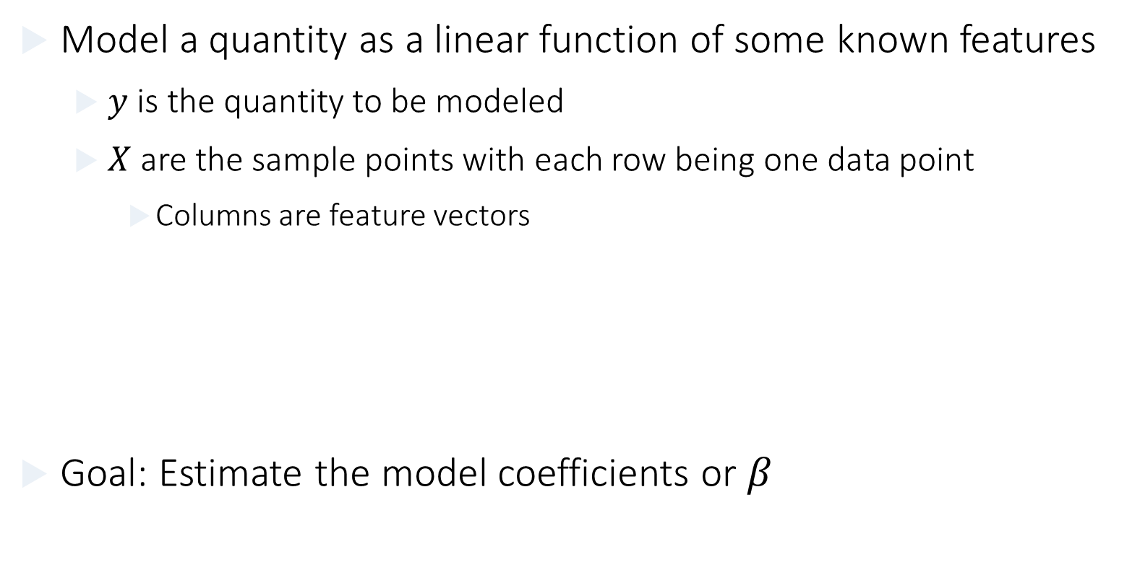
Linear Regression
Model a quantity as a linear function of some known features
$y$ is the quantity to be modeled
$X$ are the sample points with each row being one data point
Columns are feature vectors
Goal: Estimate the model coefficients or $β$
$$y≈Xβ$$

Slide 6
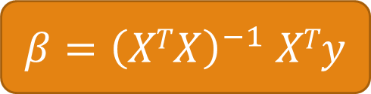
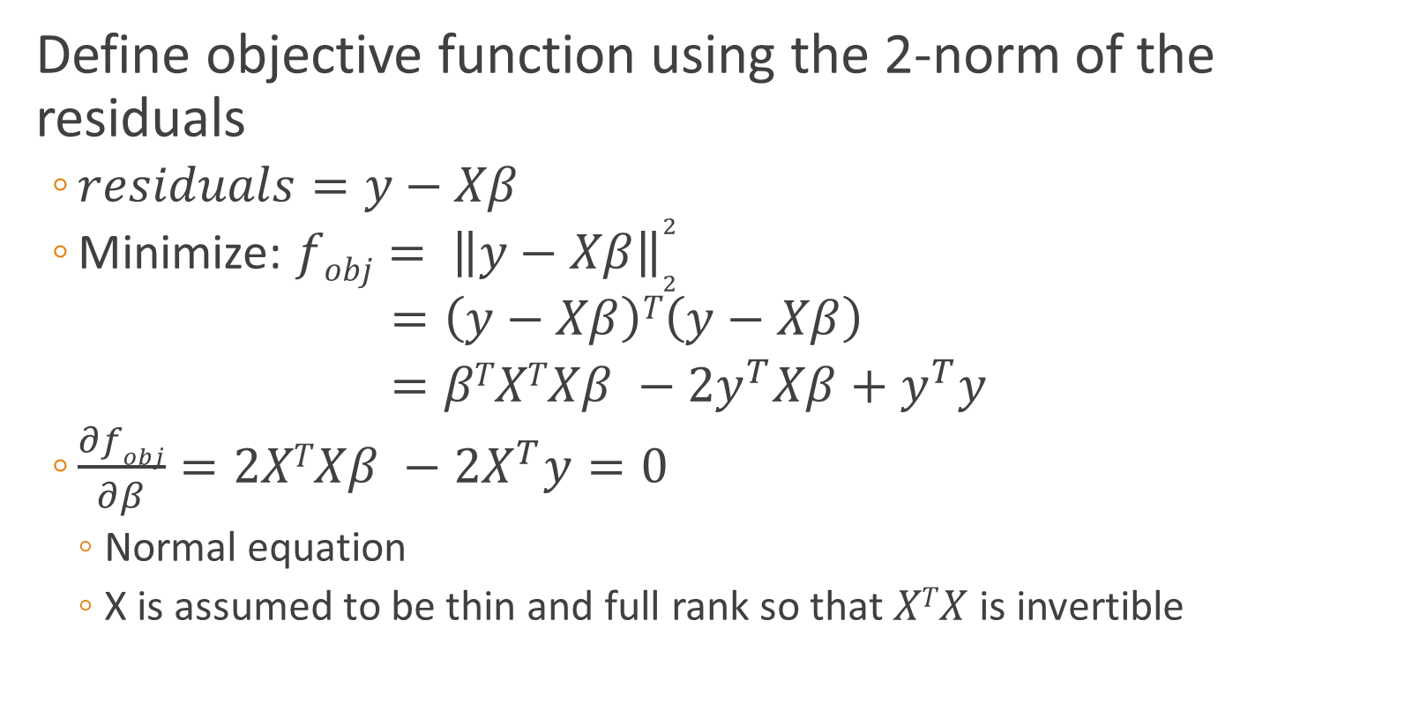
Least squares: Optimization perspective
Define objective function using the 2-norm of the residuals
$residuals=y−Xβ$
Minimize: ${fobj= \left\|y−Xβ\right\|}_{2}^{2}$
$=\left(y−Xβ\right)T\left(y−Xβ\right)$
$=βTXTXβ −2y^{T}Xβ+y^{T}y$
$\frac{∂fobj}{∂β}=2XTXβ −2X^{T}y=0$
Normal equation
X is assumed to be thin and full rank so that $XTX$ is invertible
$β{=\left(XTX\right)}^{−1}$ $XTy$

Slide 7
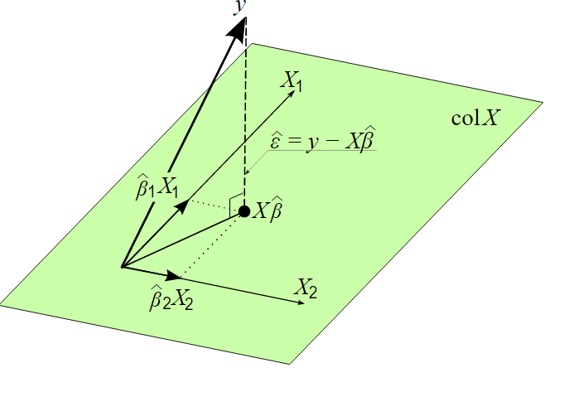


Geometrical perspective
We are trying to approximate y as linear combinations of the column vectors of X
Lets make the residual orthogonal to the column space of X
We get the same normal equation ☺
A Defines a left inverse of a rectangular matrix X
$XT\left(y−Xβ\right)$ = 0
$β{=\left(XTX\right)}^{−1}$ $XTy=Ay$
Image from http://www.wikiwand.com/en/Ordinary_least_squares

Slide 8
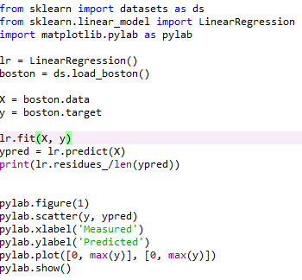
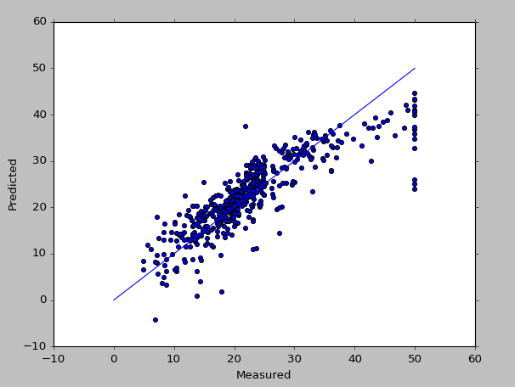
Python Example

Slide 9
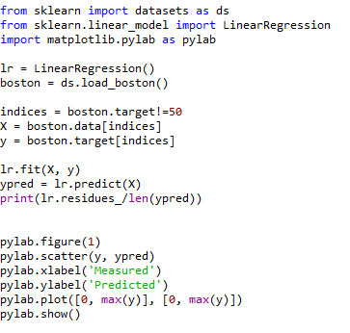
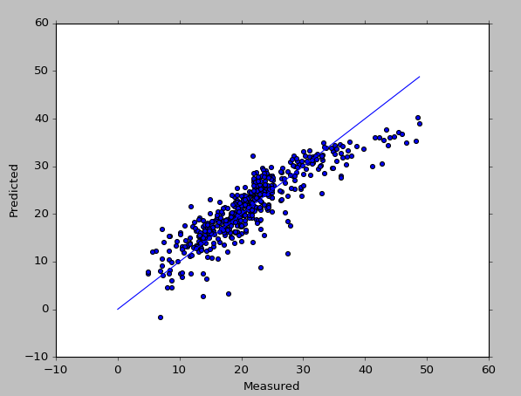
Python example

Slide 10
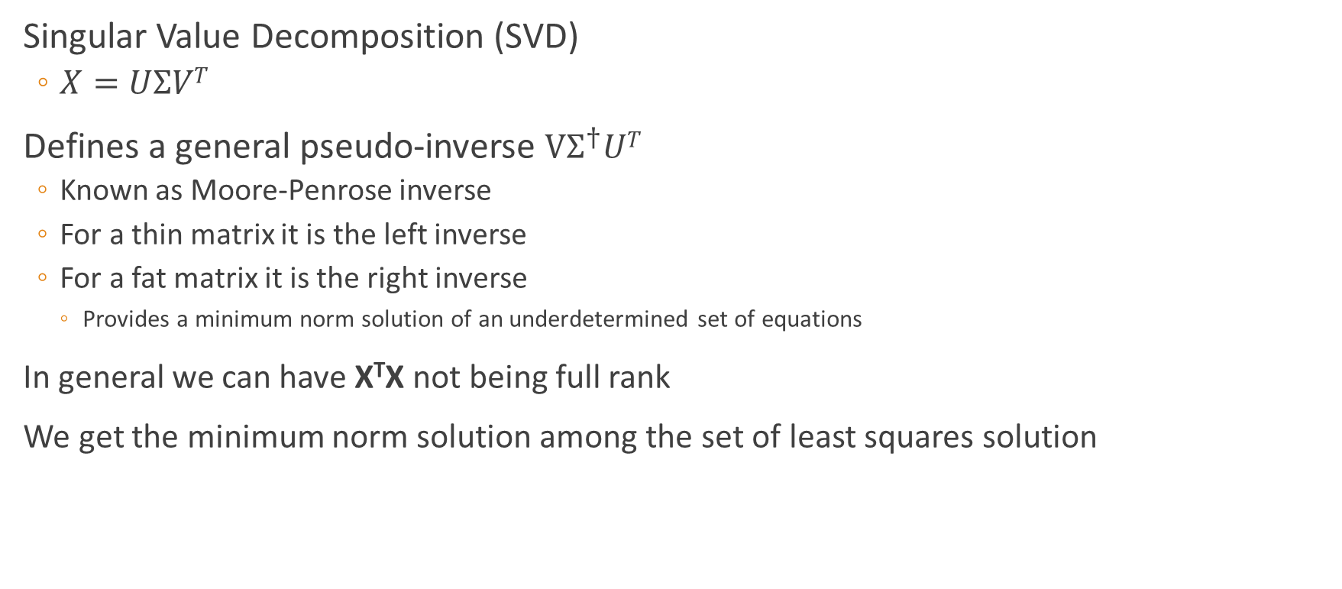
What is Scikit doing?
Least norm
Singular Value Decomposition (SVD)
$X=UΣVT$
Defines a general pseudo-inverse $VΣ^{†}UT$
Known as Moore-Penrose inverse
For a thin matrix it is the left inverse
For a fat matrix it is the right inverse
Provides a minimum norm solution of an underdetermined set of equations
In general we can have X^{T}X not being full rank
We get the minimum norm solution among the set of least squares solution
Set of all solutions having the smallest residual norm
http://www.mathworks.com/company/newsletters/articles/professor-svd.html
Notes:
Complexity O(nm²) where X is n x m and for n>m

Slide 11
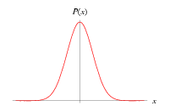
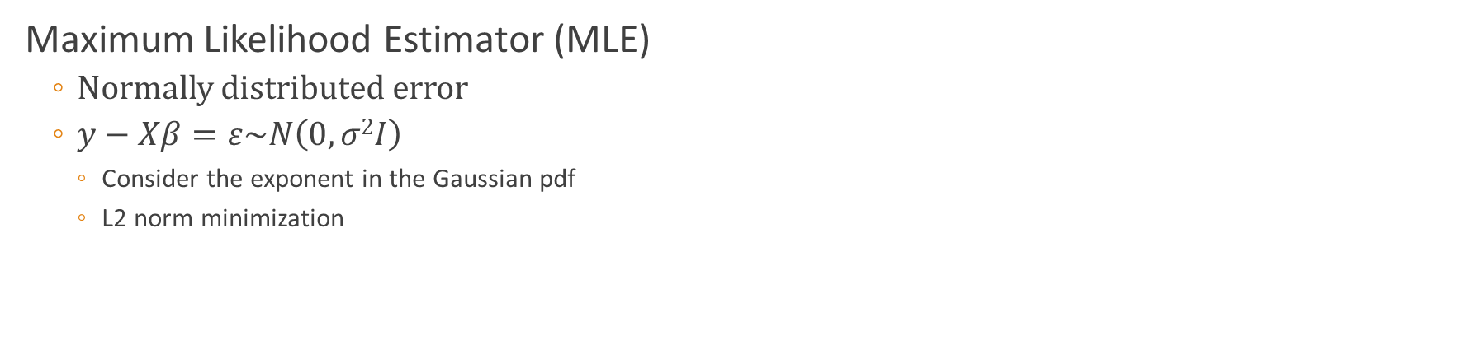
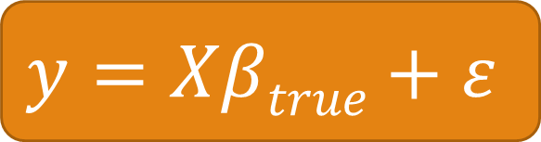

Stats perspective
$$y≈Xβ$$
$$y=Xβtrue+ε$$
Maximum Likelihood Estimator (MLE)
Normally distributed error
$y−Xβ=ε\sim N\left(0,σ2I\right)$
Consider the exponent in the Gaussian pdf
L2 norm minimization
$${\left(2π\right)}^{−k/2}{\left|Σ_{ε}\right|}^{−1/2}a_{0}e^{−1/2{\left(ε−μ_{ε}\right)}^{T}{Σ_{ε}^{−1}\left(ε−μ_{ε}\right)}^{}}$$
$${\left(2π\right)}^{−k/2}{\left|Σ_{ε}\right|}^{−1/2}a_{0}e^{−1/2σ^{2}{\left(y−Xβ\right)}^{T}{\left(y−Xβ\right)}^{}}$$

Slide 12
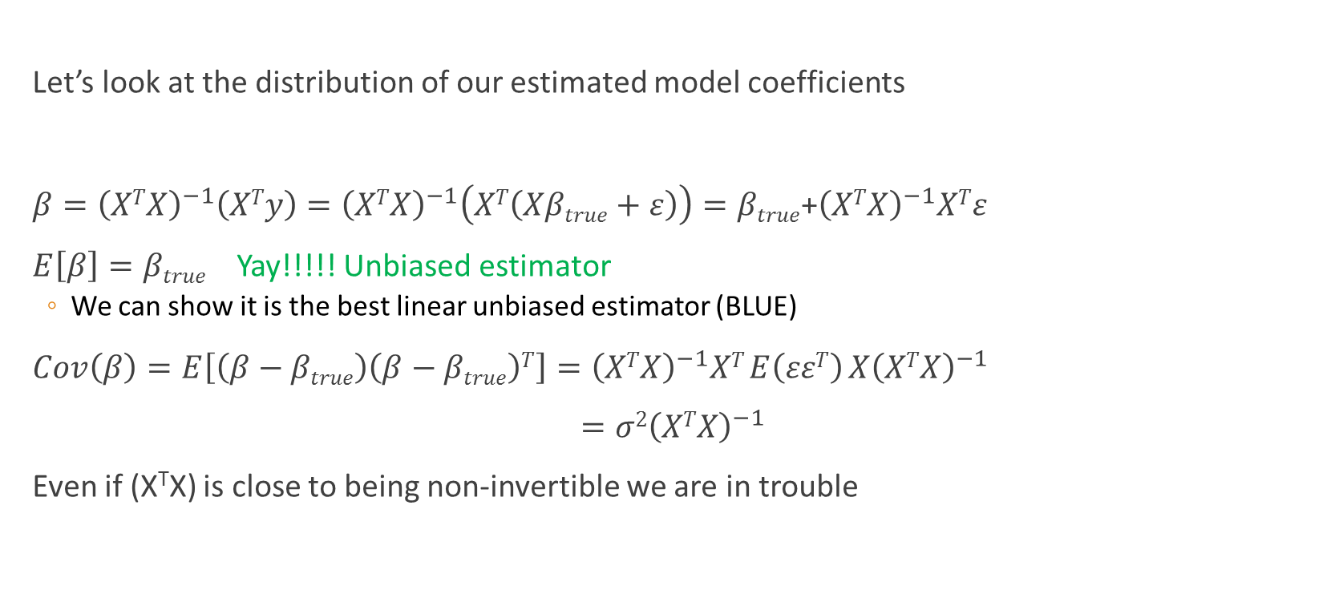
Problem I: Unstable results
Let’s look at the distribution of our estimated model coefficients
$β={\left(XTX\right)}^{−1}\left(XTy\right)={\left(XTX\right)}^{−1}\left(XT\left(Xβtrue+ε\right)\right)=βtrue$+${\left(XTX\right)}^{−1}XTε$
$E\left[β\right]=βtrue$ Yay!!!!! Unbiased estimator
We can show it is the best linear unbiased estimator (BLUE)
$Cov\left(β\right)=E\left[\left(β−βtrue\right)\left(β−βtrue\right)T\right]={\left(XTX\right)}^{−1}XT E\left(εεT\right) X{\left(XTX\right)}^{−1}$
$={σ2\left(XTX\right)}^{−1}$
Even if (X^{T}X) is close to being non-invertible we are in trouble

Slide 13
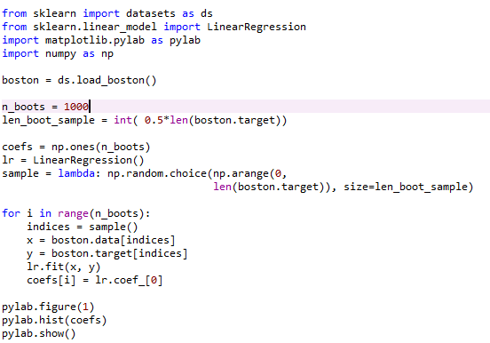
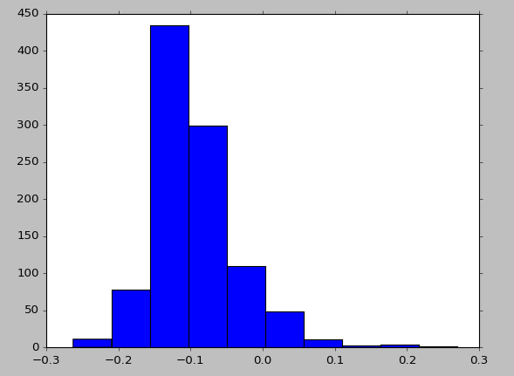
Estimate parameter variance Bootstrapping

Slide 14
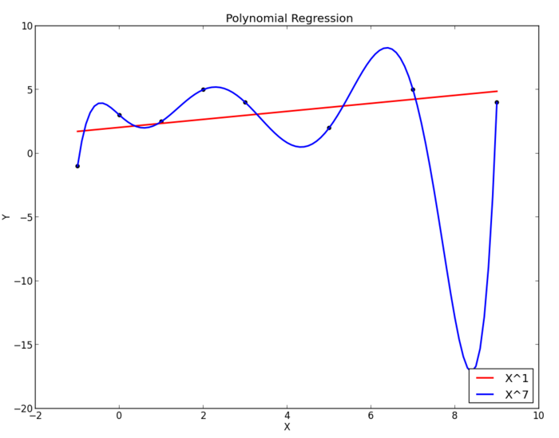
Problem II: Over fitting
Model describes the training data very well
Actually “too” well
The model is adapting to any noise in the training data
Model is very bad predicting at other points
Defeats the purpose of predictive modeling
How do we know that we have overfit?
What can we do to avoid overfitting?
Image from http://blog.rocapal.org/?p=423

Slide 15
Outline
Linear Regression
Different perspectives
Issues with linear regression
Addressing the issues through regularization
Ridge regression
Python example: Bootstrapping to demonstrate reduction in variance
Optimizing the predictive capacity of the model through cross validation
Adding sparsity to the model/Feature selection
Scikit options

Slide 16
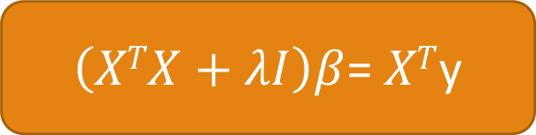


Ridge Regression / Tikhonov regularization
A biased linear estimator to get better variance
Least squares was BLUE so we cant hope to get better variance while staying unbiased
Gaussian MLE with a Gaussian prior on the model coefficients
Minimize: ${||y−Xβ||}_{2}^{2}+λ{||β||}_{2}^{2}$
Minimize: ${||y−Xβ||}_{2}^{2}$
$\left(XTX+λI\right)β$= $XT$y

Slide 17

Python example: Creating testcases
make_regression in scikit.datasets
Several parameters to control the “type” of dataset we want
Parameters:
Size: n_samples and n_features
Type: n_informative, effective_rank, tail_strength, noise
We want to test ridge regression with datasets with a low effective rank
Highly correlated (or linearly dependent) features

Slide 18
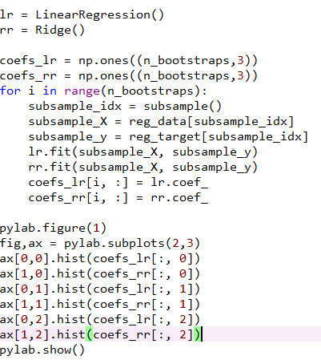
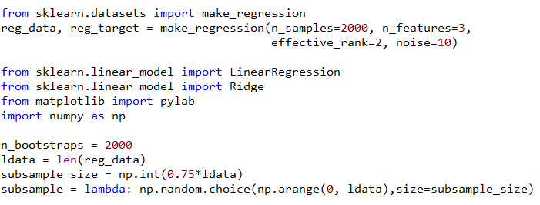
Python: Comparing ridge with basic regression

Slide 19
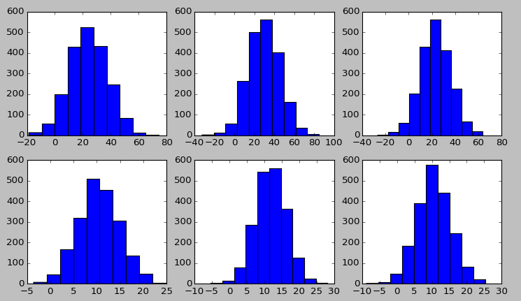
Comparison of variances
Linear regression
Ridge regression

Slide 20
Scikit: Ridge solvers
The problem is inherently much better than the LinearRegression() case
Several choices for the solver provided by Scikit
SVD
Used by the unregularized linear regression
Cholesky factorization
Conjugate gradients (CGLS)
Iterative method and we can target quality of fit
Lsqr
Similar to CG but is more stable and may need fewer iterations to converge
Stochastic Average Gradient – Fairly new
Use for big data sets
Improvement over standard stochastic gradient
Convergence rate linear – Same as gradient descent
Notes:
CGLS Slight rewrite of the standard CG as A’A will have worse numerical properties (Condition number of A’A is squared of
Condition number of A)
LSQR uses Golub-Kahan bidiagonalization and QR decomposition

Slide 21
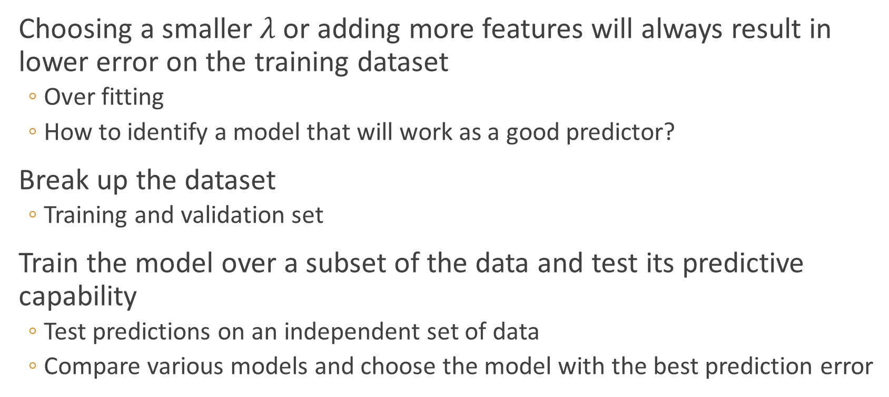

How to choose $λ$: Cross validation
Choosing a smaller $λ$or adding more features will always result in lower error on the training dataset
Over fitting
How to identify a model that will work as a good predictor?
Break up the dataset
Training and validation set
Train the model over a subset of the data and test its predictive capability
Test predictions on an independent set of data
Compare various models and choose the model with the best prediction error

Slide 22
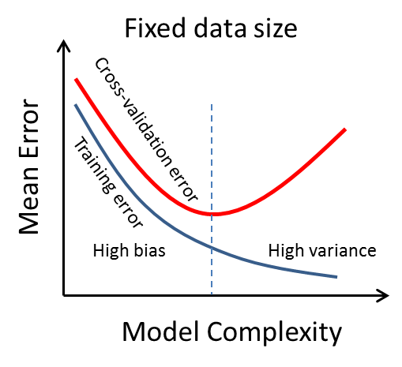
Cross validation: Training vs Test Error
Image from http://i.stack.imgur.com/S0tRm.png

Slide 23

Leave one out cross validation (LOOCV)
Leave one out CV
Leave one data point as the validation point and train on the remaining dataset
Evaluate model on the left out data point
Repeat the modeling and validation test for all choices of the left out data point
Generalizes to leave-p-out
$$\left[\begin{matrix}\begin{matrix}y1 \\ y2 \\ y3\end{matrix} \\ ⋮ \\ yn\end{matrix}\right]≈\left[\begin{matrix}\begin{matrix}\begin{matrix}1 & x11 & x21\end{matrix} \\ \begin{matrix}1 & x12 & x22\end{matrix} \\ \begin{matrix}1 & x13 & x23\end{matrix}\end{matrix} \\ \begin{matrix}⋮ & ⋮ & ⋮\end{matrix} \\ \begin{matrix}1 & x1n & x2n\end{matrix}\end{matrix}\right]\left[\begin{matrix}β0 \\ β1 \\ β2\end{matrix}\right]$$

Slide 24

K-Fold cross validation
2-fold CV
Divide data set into two parts
Use each part once as training and once as validation dataset
Generalizes to k-fold CV
May want to shuffle the data before partitioning
Generally 3/5/10-fold cross validation is preferred
Leave-p-out requires several fits over similar sets of data
Also, computationally expensive compared to k-fold CV
$$\left[\begin{matrix}\begin{matrix}y1 \\ y2 \\ y3\end{matrix} \\ ⋮ \\ yn\end{matrix}\right]≈\left[\begin{matrix}\begin{matrix}\begin{matrix}1 & x11 & x21\end{matrix} \\ \begin{matrix}1 & x12 & x22\end{matrix} \\ \begin{matrix}1 & x13 & x23\end{matrix}\end{matrix} \\ \begin{matrix}⋮ & ⋮ & ⋮\end{matrix} \\ \begin{matrix}1 & x1n & x2n\end{matrix}\end{matrix}\right]\left[\begin{matrix}β0 \\ β1 \\ β2\end{matrix}\right]$$

Slide 25
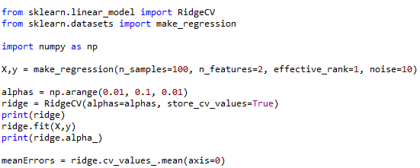
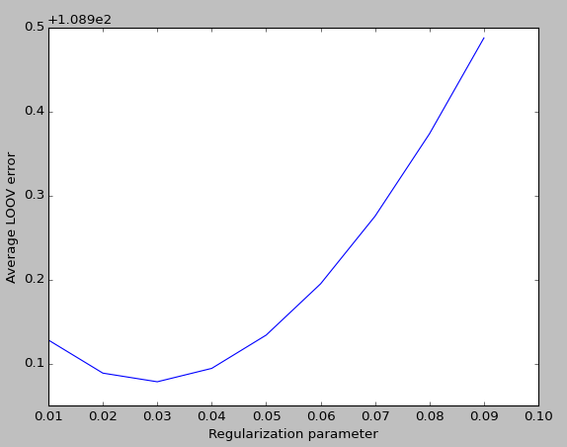
RidgeCV: Scikit’s Cross validated Ridge Model

Slide 26
Outline
Linear Regression
Different perspectives
Issues with linear regression
Addressing the issues through regularization
Ridge regression
Python example: Bootstrapping to demonstrate reduction in variance
Optimizing the predictive capacity of the model through cross validation
Adding sparsity to the model/Feature selection
LASSO
Basis Pursuit Methods: Matching Pursuit and Least Angle regression
Scikit options

Slide 27


LASSO
The penalty term for coefficient sizes is now the l1 norm
Gaussian MLE with a laplacian prior distribution on the parameters
Can result in many feature coefficients being zero/sparse solution
Can be used to select a subset of features – Feature selection
Minimize: ${||y−Xβ||}_{2}^{2}+λ{||β||}_{1}^{}$
Minimize: ${||y−Xβ||}_{2}^{2}$

Slide 28
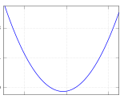
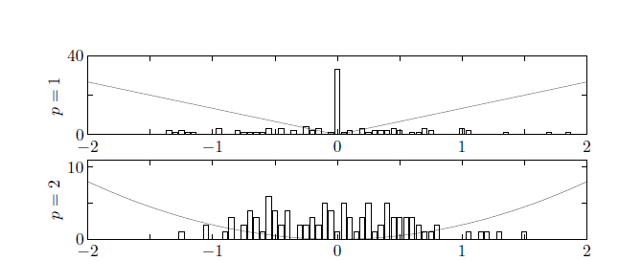
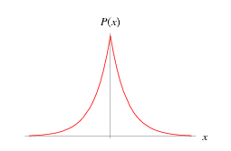
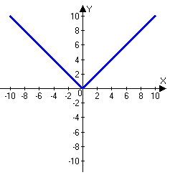
How does this induce sparsity
Penalty function
Prior

Slide 29
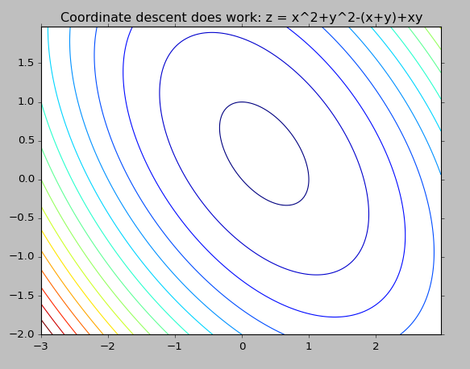
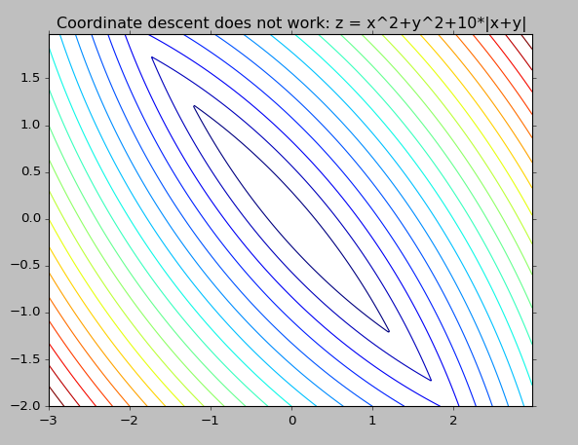
Scikit LASSO: Coordinate descent
Minimize along coordinate axes iteratively
Does not work for non-differentiable functions

Slide 30
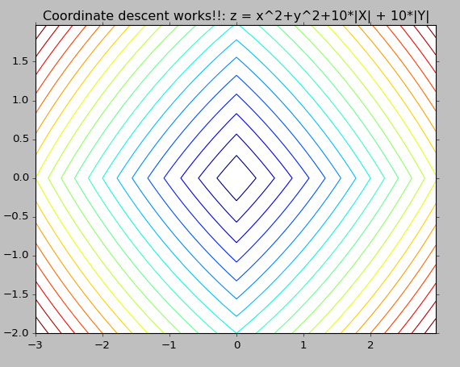
LASSO objective Non-differentiable part is separable
h(x₁, x₂, …., x_{n})
Separable
f₁(x₁)+f₂(x₂)+ … + f_{n}(x_{n})
Option in scikit to choose the direction either cyclically or at random called “selection”

Slide 31
Matching Pursuit (MP)
Select feature most correlated to the residual
f₂
f₁

Slide 32
Orthogonal Matching Pursuit (OMP)
Keep residual orthogonal to the set of selected features
(O)MP methods are greedy
Correlated features are ignored and will not be considered again
f₂
f₁

Slide 33
LARS (Least Angle regression)
Move along most correlated feature until another feature becomes equally correlated
f₂
f₁
Notes:
Simple modification will generate a L1 optimal result
Can use MP with a very small step size

Slide 34
Outline
Linear Regression
Different perspectives
Issues with linear regression
Addressing the issues through regularization
Ridge regression
Python example: Bootstrapping to demonstrate reduction in variance
Optimizing the predictive capacity of the model through cross validation
Adding sparsity to the model/Feature selection
LASSO
Basis Pursuit Methods: Matching Pursuit and Least Angle regression
Scikit options

Slide 35
Options
Normalize (default false)
Scale the feature vectors to have unit norm
Your choice
Fit intercept (default true)
False: Implies the X and y already centered
Basic linear regression will do this implicitly if X is not sparse and compute the intercept separately
Centering can kill sparsity
Center data matrix in regularized regressions unless you really want a penalty on the bias
Issues with sparsity still being worked out in scikit (Temporary bug fix for ridge in 0.17 using sag solver)

Slide 36

RidgeCV options
CV - Control to choose type of cross validation
Default LOOCV
Integer value ‘n’ sets n-fold CV
You can provide your own data splits as well
$$\left[\begin{matrix}\begin{matrix}y1 \\ y2 \\ y3\end{matrix} \\ ⋮ \\ yn\end{matrix}\right]≈\left[\begin{matrix}\begin{matrix}\begin{matrix}1 & x11 & x21\end{matrix} \\ \begin{matrix}1 & x12 & x22\end{matrix} \\ \begin{matrix}1 & x13 & x23\end{matrix}\end{matrix} \\ \begin{matrix}⋮ & ⋮ & ⋮\end{matrix} \\ \begin{matrix}1 & x1n & x2n\end{matrix}\end{matrix}\right]β$$

Slide 37

RidgeCV options
CV - Control to choose type of cross validation
Default LOOCV
Integer value ‘n’ sets n-fold CV
You can provide your own data splits as well
$$\left[\begin{matrix}\begin{matrix}y1 \\ y2 \\ y3\end{matrix} \\ ⋮ \\ yn\end{matrix}\right]≈\left[\begin{matrix}\begin{matrix}\begin{matrix}1 & x11 & x21\end{matrix} \\ \begin{matrix}1 & x12 & x22\end{matrix} \\ \begin{matrix}1 & x13 & x23\end{matrix}\end{matrix} \\ \begin{matrix}⋮ & ⋮ & ⋮\end{matrix} \\ \begin{matrix}1 & x1n & x2n\end{matrix}\end{matrix}\right]β_{new}$$

Slide 38

RidgeCV options
CV - Control to choose type of cross validation
Default LOOCV
Integer value ‘n’ sets n-fold CV
You can provide your own data splits as well
$$\left[\begin{matrix}\begin{matrix}y1 \\ β_{new}^{T}x_{2} \\ y3\end{matrix} \\ ⋮ \\ yn\end{matrix}\right]≈\left[\begin{matrix}\begin{matrix}\begin{matrix}1 & x11 & x21\end{matrix} \\ \begin{matrix}1 & x12 & x22\end{matrix} \\ \begin{matrix}1 & x13 & x23\end{matrix}\end{matrix} \\ \begin{matrix}⋮ & ⋮ & ⋮\end{matrix} \\ \begin{matrix}1 & x1n & x2n\end{matrix}\end{matrix}\right]β_{new}$$

Slide 39
Lasso(CV)/Lars(CV) options
Positive
Force coefficients to be positive
Other controls for iterations
Number of iterations (Lasso) / Number of non-zeros (Lars)
Tolerance to stop iterations (Lasso)

Slide 40
Summary
Linear Models
Linear regression
Ridge – L2 penalty
Lasso – L1 penalty results in sparsity
LARS – Select a sparse set of features iteratively
Use Cross Validation (CV) to choose your models – Leverage scikit
RidgeCV, LarsCV, LassoCV
Not discussed – Explore scikit
Combing Ridge and Lasso: Elastic Nets
Random Sample Consensus (RANSAC)
Fitting linear models where data has several outliers
lassoLars, lars_path

Slide 41
References
All code examples are taken form “Scikit-Learn Cookbook” by Trent Hauck with some slight modifications
LSQR -> C. C. Paige and M. A. Saunders, LSQR: An algorithm for sparse linear equations and sparse least squares. 1982.
Ridge SAG -> Mark Schmidt, Nicolas Le Roux, Francis Bach: Minimizing Finite Sums with the Stochastic Average Gradient. 2013.
Ridge CV LOOCV -> Rifkin, Lippert: Notes on Regularized Least Squares, MIT Technical Report. 2007.
BP Methods1 -> Bradley Efron, Trevor Hastie, Iain Johnstone, and Robert Tibshirani: Least Angle Regression. 2004.
BP Methods2 -> Hameed: Comparative Analysis of Orthogonal Matching Pursuit and Least Angle Regression, MSU MS Thesis. 2012.

Slide 42
BACKUP

Slide 43
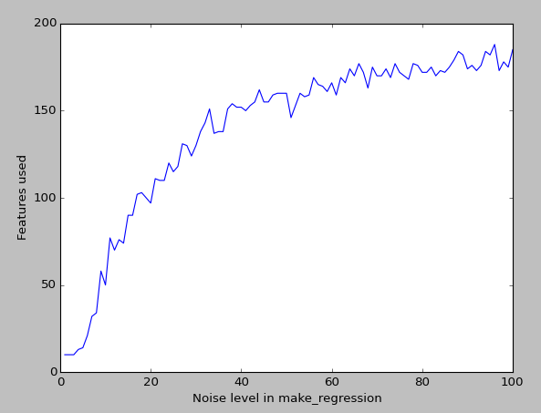
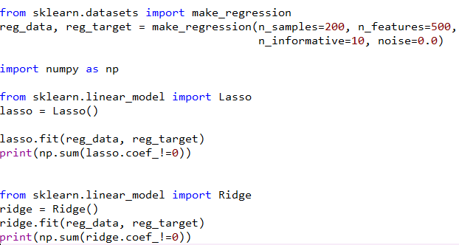
Python example

Slide 44
Stochastic Gradient Descent
When we have an immense number of samples or features SGD can come in handy
Randomly select a sample point and use that to evaluate a gradient direction in which to move the parameters
Repeat the procedure until a “tolerance” is achieved
Normalizing the data is important

Slide 45

Recursive least squares
Suppose a scenario in which we sequentially obtain a sample point and measurement and we would like to continually update our least squares estimate
“Incremental” least squares estimate
Rank one update of the matrix X^{T}X
Utilize the matrix inversion lemma
Similar idea used in RidgeCV LOOCV

