Slide 1
ELEC 374
Digital Systems Engineering
Winter 2017
Iman Faraji
Course web site
https://onq.queensu.ca/d2l/le/calendar/95107

Slide 2
Course Administration
Instructor: Iman Faraji (WLH-706)
Email: <i.faraji@queensu.ca>
Office hours: TBA
TAs: Chaoyu (Patrick) Wu < 14cw16@queensu.ca> Office Hours: TBA
Priya Balasubramaniam < 16rb25@queensu.ca> Office Hours: TBA
Nicholas Petrelli <13np8@queensu.ca>
Chris Cartwright <0cc22@queensu.ca>
Ryan Dick <12rjd6@queensu.ca>
Lectures – Section 001 (Miller 210): Mondays 2:30 - 3:30pm, Tuesday 4:30 - 5:30pm, and Thursdays 3:30 - 4:30pm
Lectures – Section 004 (Jeffery 225): Mondays 1:30 - 2:30pm, Wednesdays 12:30 - 1:30pm, and Thursdays 10:30 - 11:30pm
Tutorials (Walter Light 210): Wednesdays 3:30 - 4:30pm - there will be 6 tutorials –
4 quizzes will be held in the tutorials

Slide 3
Labs for Section 001 (BMH-314): Monday 8:30am – 11:30 am, starting week 3
Students that are enrolled in Section 001 can only participate this lab*
Labs for Section 004 (BMH-214): Tuesday 6:30pm – 9:30 pm, starting week 3
Students that are enrolled in Section 003 can only participate this lab*
*Conditions may apply
Problem Sets: 6 sets; no marking
Quizzes: 4 quizzes, tentatively set for week 4, 7/8, 10/11 and 12
Prerequisites: ELEC-271, ELEC-274 and ELEC-252 or with instructor permission

Slide 4
Course Administration (Cont’d)
Textbook: Course Reader (required) available at campus bookstore.
Lecture slides: will be available on the course website as the term progresses. You should use them as an aid to note taking in class and for studying, but you should not see them as a substitute for attending the lectures. Additional course material and examples will be covered in the lectures, therefore attendance and active class participation is highly recommended.
Grading:
Labs 25% plus up to 5% bonus
Machine Problems: 10%
Quizzes 20% (or 10%) - 4 quizzes, 5% (or 2.5%) each
Final Exam 45% (or 55%)
Quizzes and final exam together is worth 65% of the course grade: quizzes 20% and final 45%, or quizzes 10% and final 55%, whichever yields the better result.

Slide 5
Course Outline
High-performance logic design for arithmetic circuits
Hardware description languages (VHDL, Verilog)
GPU architectures and computing
Fault testing, design for testability, built-in self-test, memory testing, and boundary-scan architecture
Asynchronous digital systems design
Static, dynamic, and read-mostly memory system design
Computer bus protocols and standard I/O interfaces (PCI, PCIe, QPI, HyperTransport, InfiniBand, NVLink, USB, etc.)
Mass storage technologies
The course is supplemented by a term-length CPU design project that allows students to become proficient with Field Programmable Gate Array (FPGA) devices and associated CAD tools. Students will also work with a 4-node GPU cluster, consisting of NVIDIA Tesla C2075 cards, for their GPU computing.

Slide 6
ELEC 374
Digital Systems Engineering
Winter 2016
Computer Arithmetic

Slide 7
Outline
Addition/Subtraction (HA, FA, RCA, serial, CLA, Carry-Select, memory-based)
Multiplication
of positive numbers (array multipliers, sequential multipliers)
of Signed-operand (Booth algorithm)
Fast multiplication
Bit-pair recoding of multipliers, Carry Save addition of summands
Other methods: Table lookup, memory-based
Division
Integer Division (Restoring and non-restoring algorithms, array division)
Division by Convergence
Floating-point numbers and operations
Errors in floating-point representation
IEEE-754 floating-point standard
Implementing floating-point operations
References: Hamacher et al., Cavanagh (Part I);
as well as Murdocca, and Heuring (ch. 2), and Parhami

Slide 8

Addition/Subtraction
Half-adder (binary addition)
Carry
Sum
x
0
0
1
1
x
y
c
s
+
y
+
0
+
1
+
0
+
1
0
0
0
0
c
s
0
0
0
1
0
1
1
0
0
1
0
1
1
0
0
1
Carry
Sum
Four possible cases
1
1
1
0
x
s
y
x
s
y
HA
c
c
Graphical symbol
Half-adder Circuit

Slide 9
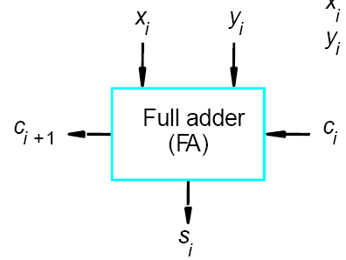
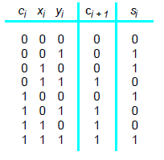
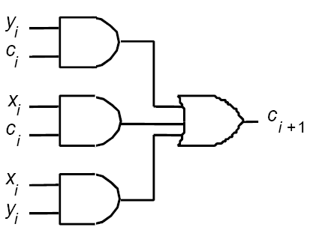
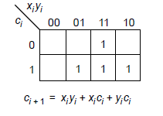
Addition/Subtraction (Cont’d)
Full-adder

Slide 10
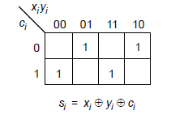
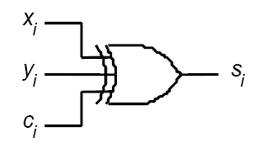
Addition/Subtraction (Cont’d)
Full-adder (cont’d)
Proof:

Slide 11
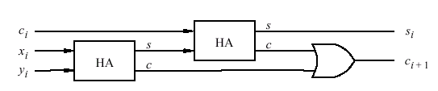
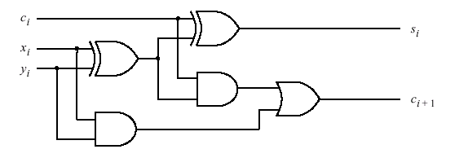
Addition/Subtraction (Cont’d)
Decomposed implementation of a full-adder circuit

Slide 12
Addition/Subtraction (Cont’d)
Decomposed implementation of a full-adder circuit (cont’d)
Proof:

Slide 13
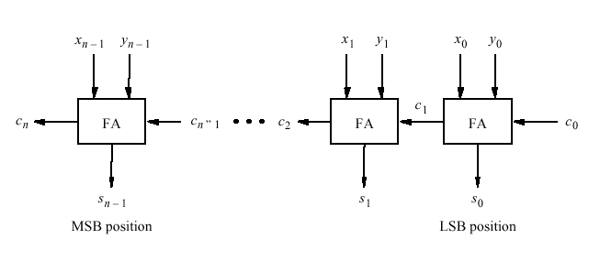
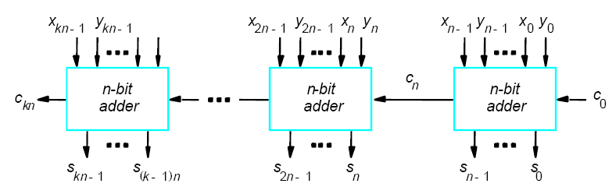
Addition/Subtraction (Cont’d)
An n-bit Ripple-Carry Adder (RCA)
Cascade of k n-bit adder
Problem: long delay
Let delay_{FA} = 10ns
➔ a 32-bit addition takes 320ns

Slide 14
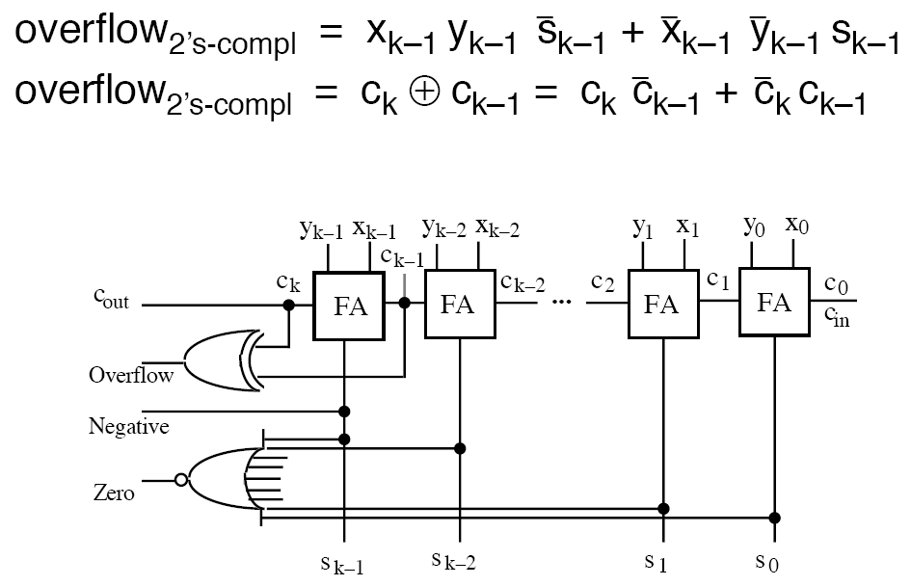
Addition/Subtraction (Cont’d)
2’s complement addition with provision for detecting conditions and exceptions
Why?

Slide 15
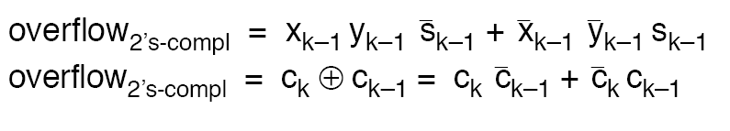
Addition/Subtraction (Cont’d)
2’s complement addition with provision for detecting conditions and exceptions (cont’d)
Proof:

Slide 16
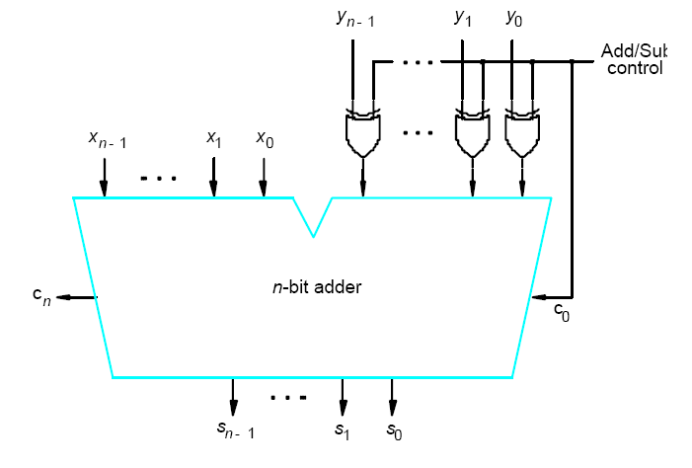
Addition/Subtraction (Cont’d)
Adder-subtractor unit
Why?

Slide 17
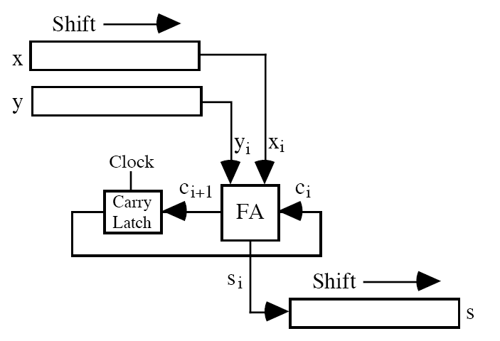
Addition/Subtraction (Cont’d)
Bit-serial adder
FF

Slide 18
Addition/Subtraction (Cont’d)
Fast Adder: Carry-Lookahead Adders (CLA) - we want to evaluate quickly for each stage whether the carry-in from the previous stage in a RCA will have a value of 0 or 1.
Recall for a full-adder:
and
We can re-write it as
where
The function G_{i} is equal to 1 when both x_{i} and y_{i} are equal to 1, regardless of the value of the incoming carry to this stage, c_{i}. Since in this case, stage i is guaranteed to generate a carry-out C_{i+1}, G_{i} is called the Generate function.
The function P_{i} is equal to 1 when at least one of the inputs x_{i} and y_{i} is equal to 1. In this case, a carry-out is produced if c_{i} = 1. The effect is that the carry-in of 1 is propagated through stage i, hence P_{i} is called the Propagate function.

Slide 19
Addition/Subtraction (Cont’d)
Carry-lookahead adders (cont’d):
Expanding the expression in terms of stage i - 1
Continuing so ➔
Carry out delay:
Sum delay:
when expanded: 6 gate delay; three for C_{i}, one for inverting carry, and two for AND-OR
Problem: gate fan-in constraint
3 gate delay
4 gate delay

Slide 20
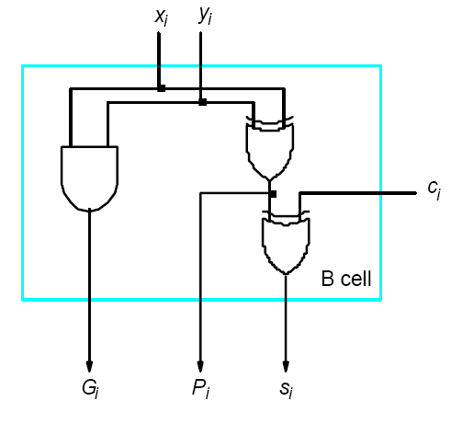
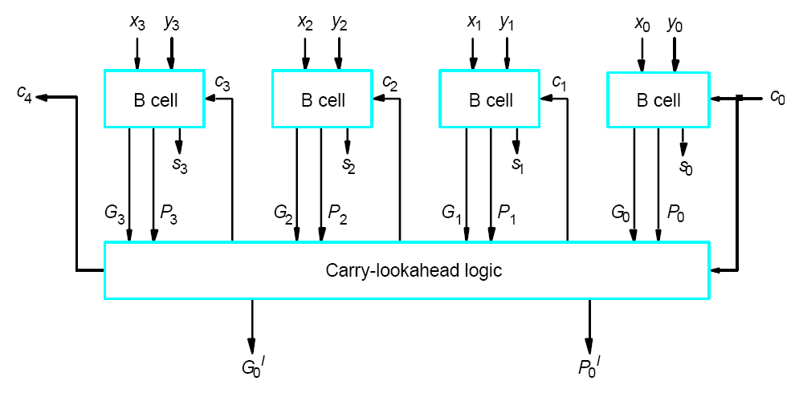
Addition/Subtraction (Cont’d)
Bit-stage cell
➔
4-bit Carry-lookahead adder
➔ Compare this with a
4-bit ripple-carry adder

Slide 21
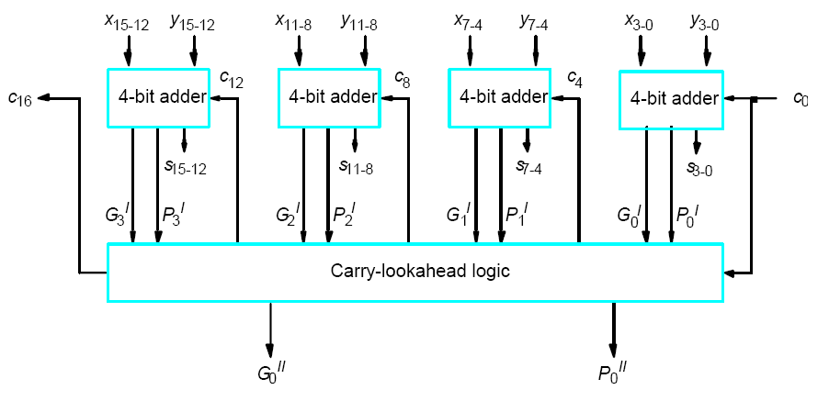
Addition/Subtraction (Cont’d)
One can design a hierarchical carry-lookahead adder with ripple-carry between the blocks, to reduce the complexity of designing a large CLA.
Improved version - 16-bit hierarchical carry-lookahead adder with a second-level carry-lookahead: to produce the carry signals between blocks in parallel.
➔ C₁₆ =
Carry-lookahead adder

Slide 22
Addition/Subtraction (Cont’d)
Carry-Select Adders: is not as fast as the carry lookahead adder, however it has a unique organization that is interesting.
Each section of the adder is partitioned into, for example, two 4-bit groups consisting of identical 4-bit adders (e.g., CLAs) to which the same 4-bit operands are applied.
Since the low-order stage of an adder does not usually have a carry-in, the low-order section consists of only one 4-bit adder with a carry-in of 0.
The carry-select principle produces two sums that are generated simultaneously. One sum assumes that the carry-in to that group was a 0; the other sum assumes that the carry-in was a 1.
The logic diagram for a carry-select adder to add two 12-bit operands is shown in the next page.

Slide 23
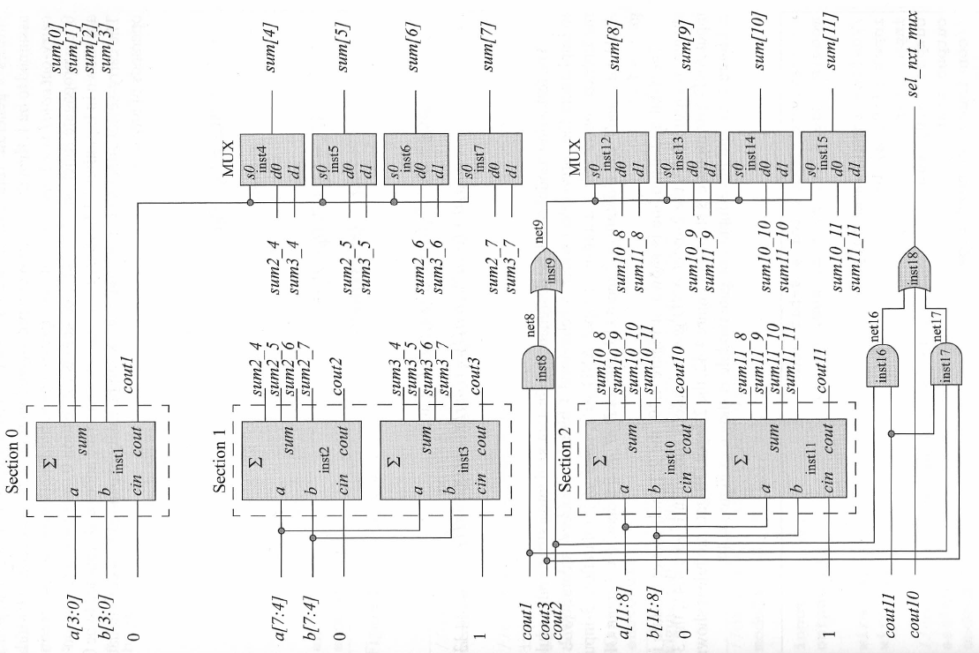
Addition/Subtraction (Cont’d)
Carry-Select Adders (cont`d):
Why?
Why?

Slide 24
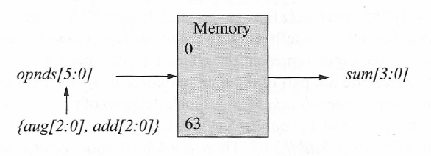
Addition/Subtraction (Cont’d)
Memory-based Adders: With the advent of high-density, high-speed memories, addition can be easily accomplished by applying the augend and addend as address inputs to the memory – the outputs are the sum.
Block diagram of a memory adding two 3-bit operands:
The contents of the memory is shown in the next page.

Slide 25
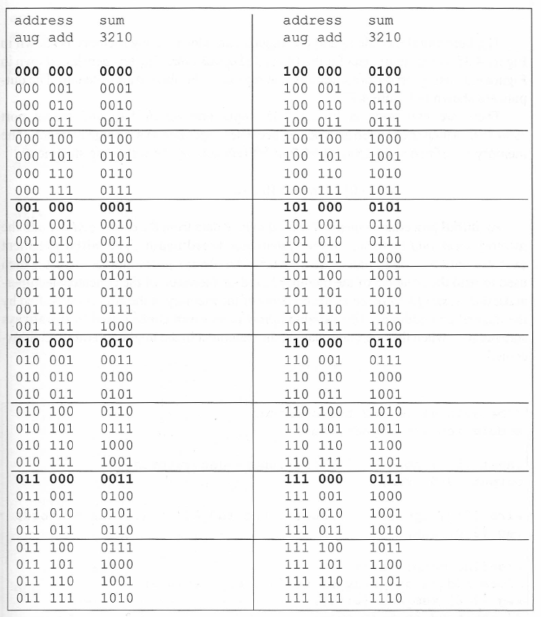
Addition/Subtraction (Cont’d)
Memory-based Adders (cont`d):

Slide 26
Multiplication of Positive Numbers
Multiplicand M
(14)
1 1 1 0
Multiplier Q
(11)
×
1 0 1 1
1 1 1 0
Array multipliers
1 1 1 0
0 0 0 0
Partial product 0
0 0 0 0
1 1 1 0
Multiplicand M
(14)
1 1 1 0
Product P
(154)
1 0 0 1 1 0 1 0
Multiplier Q
(11)
×
1 0 1 1
Manual multiplication algorithm
Partial product 1
1 1 1 0
+
1 1 1 0
Partial product 2
1 0 1 0 1
+
0 0 0 0
If q_{i} = 1, add the multiplicand
(appropriately shifted) to the incoming
partial product, PPi, to generate the
outgoing partial product, PP(i+1). If
q_{i} = 0, PPi is passed vertically
downward unchanged.
Partial product 3
0 1 0 1 0
+
1 1 1 0
Product P
(154)
1 0 0 1 1 0 1 0
Combinational array multiplication

Slide 27
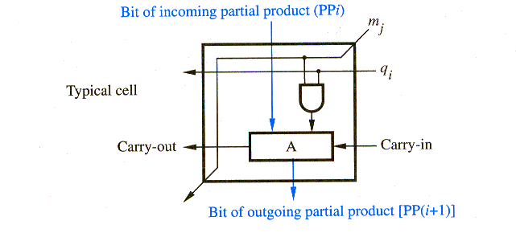
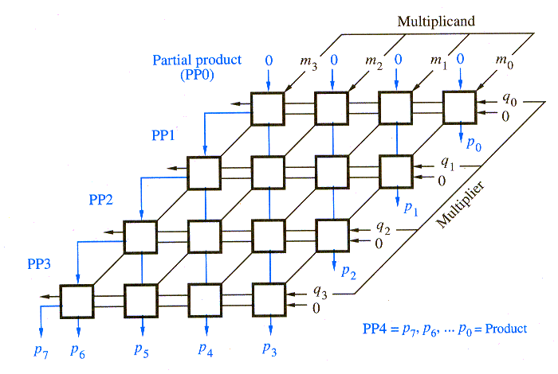
Multiplication of Positive Numbers (Cont’d)
Array multipliers
Partial product 0
0 0 0 0
Multiplicand M
(14)
1 1 1 0
Multiplier Q
(11)
×
1 0 1 1
Partial product 1
1 1 1 0
+
1 1 1 0
Partial product 2
1 0 1 0 1
+
0 0 0 0
Partial product 3
0 1 0 1 0
+
1 1 1 0
Product P
(154)
1 0 0 1 1 0 1 0
Combinational array multiplication
Using ripple-carry adder

Slide 28
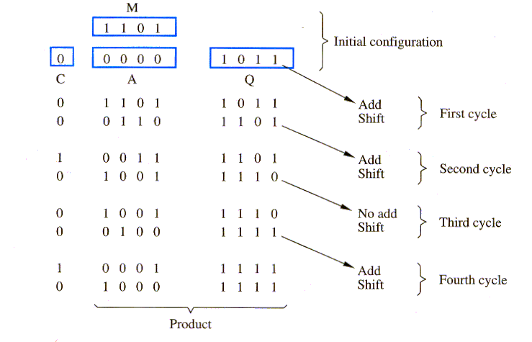
Multiplication of Positive Numbers (Cont’d)
Multiplicand M = 1101 = 13
Multiplier Q = 1011 = 11
Product P = 10001111 = 143
Sequential circuit multiplier:
P

Slide 29
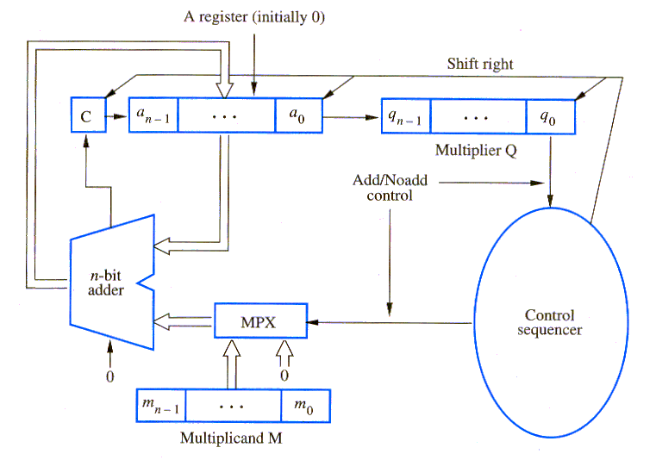
Multiplication of Positive Numbers (Cont’d)
Sequential circuit multiplier implementation: takes a long time (uses the adder in CPU).
(at the end of each cycle)
Leftmost
Bit of PP(i+1)
PPi
PP(i+1)

Slide 30
Multiplication of Positive Numbers (Cont’d)
Example

Slide 31
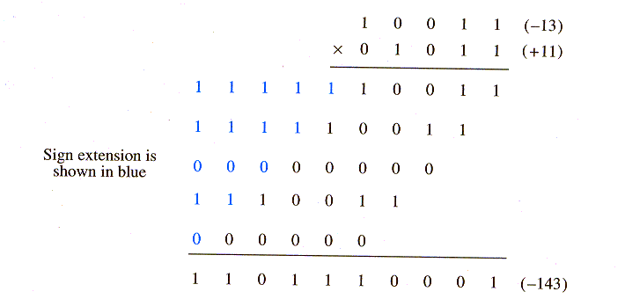
Signed-Operand Multiplication
Sign extension of negative multiplicand: accumulate partial products by adding versions of the multiplicand as selected by the multiplier bits.
Positive multiplier, negative multiplicand
Rule: when adding a negative multiplicand to a partial product, extend the sign-bit value to the left as far as the product will extend. The same hardware discussed can be used if sign extension is supported.
Negative multiplier, negative multiplicand ➔ 2’s complement and do the same algorithm
Multiplicand
Multiplier

Slide 32
Signed-Operand Multiplication (Cont’d)
Example
What about a negative multiplier and a positive multiplicand?

Slide 33
Signed-Operand Multiplication (Cont’d)
Booth algorithm: works well for both positive and negative multipliers.
Consider a positive multiplier with a block of 1s such as 0011110.
Instead of adding 4 shifted versions of multiplicand, as in the standard procedure, multiplier can be regarded as: 0 +1 0 0 0 –1 0
0100000 (32)
- 0000010 (2)
---------------
0011110 (30)
➔ less number of operations
Skipping over 1s: one can describe the sequence of
required operations as:
0 +1 0 0 0 –1 0

Slide 34
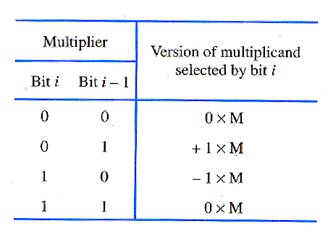
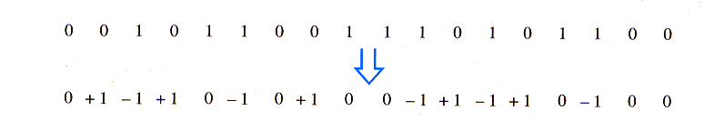
Signed-Operand Multiplication (Cont’d)
Booth algorithm: with a one-to-one comparison, the Booth multiplier recoding table is
Example: Booth recoding of a multiplier

Slide 35
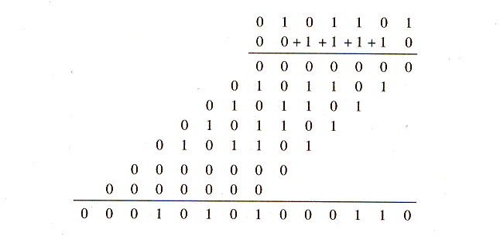
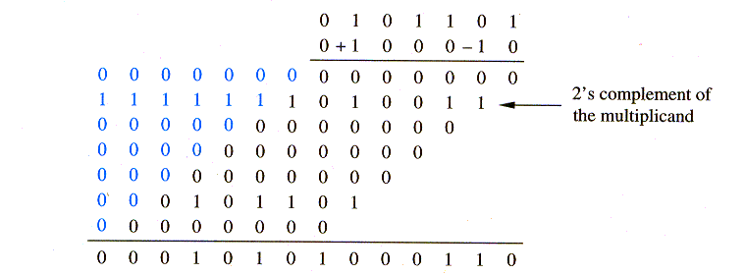
Signed-Operand Multiplication (Cont’d)
Booth algorithm: example
Note that only a few version of multiplicand (summands) are added in reality. This makes the Booth algorithm fast (in best case).
(45) Multiplicand
(30) Multiplier
Normal multiplication algorithm
(45) Multiplicand
(30) Multiplier
Booth multiplication algorithm

Slide 36
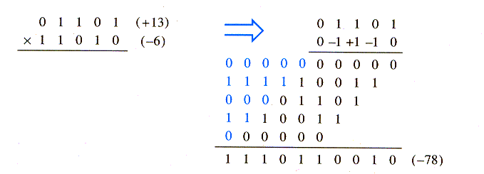
Signed-Operand Multiplication (Cont’d)
Booth algorithm (with a negative multiplier)
Can you revise the circuit on slide 28
for the Booth algorithm?

Slide 37
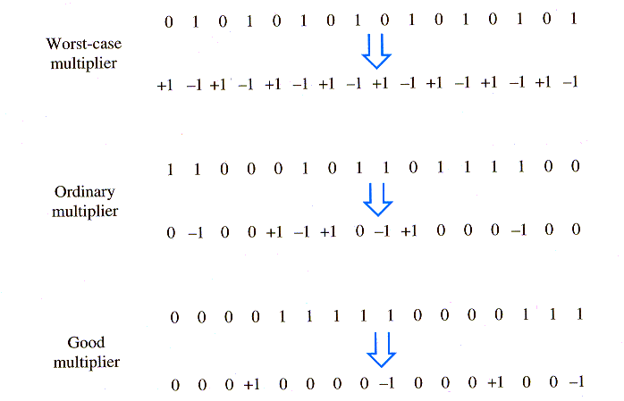
Signed-Operand Multiplication (Cont’d)
Booth algorithm
Booth recorded multipliers

Slide 38
Signed-Operand Multiplication (Cont’d)
Example

Slide 39
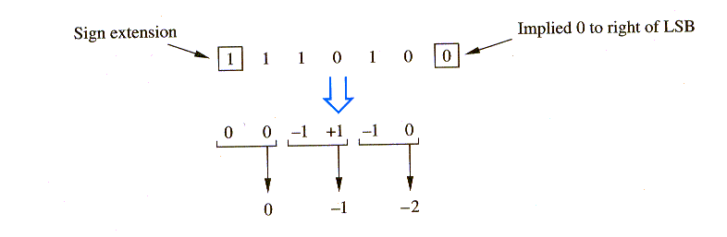
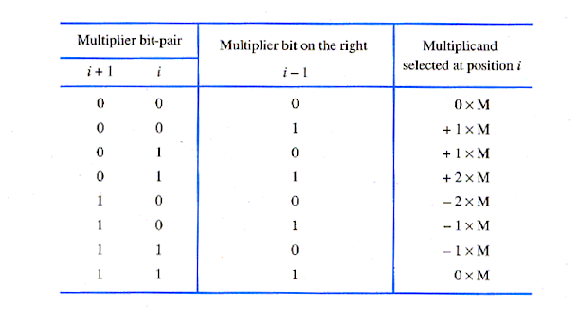
Fast Multiplications
Bit-Pair Recoding of Multipliers: reduces the number of summands (versions of summands) by half by examining Booth-recoded multiplier two bits at a time.

Slide 40
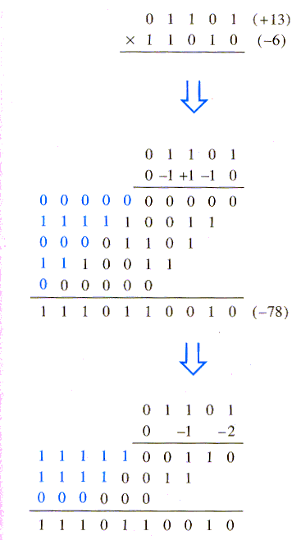
Fast Multiplications (Cont’d)
Bit-Pair Recoding of Multipliers: example
Booth algorithm
Multiplication requires only half
the number of summands as a
normal algorithm.
Bit-pair recoding algorithm

Slide 41
Fast Multiplications (Cont’d)
Example

Slide 42
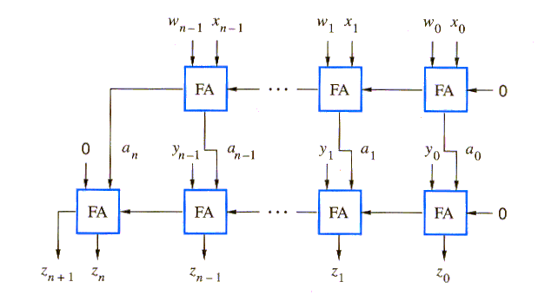
Fast Multiplications (Cont’d)
Carry-Save addition of summands: multiplication requires the addition of several summands. Carry-save addition speeds up the addition process.
Example: Z = W + X + Y = (W + X) + Y = A + Y using normal addition
Part (a)
Using two ripple-carry adders

Slide 43
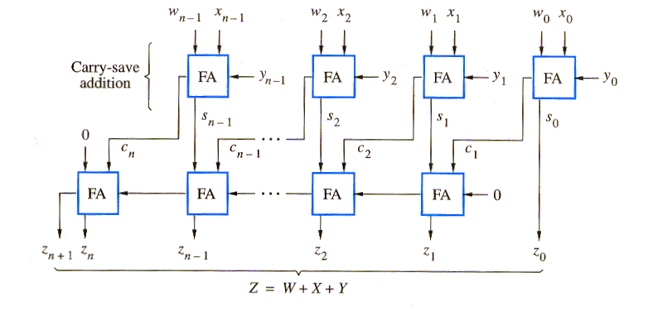
Fast Multiplications (Cont’d)
Carry-Save addition of Summands: instead of adding W and X to produce A, introduce the bits of Y into the carry inputs. This generates the vector S, and the saved (stored) carries, C. Then add S and C using a ripple-carry adder.
Done in a short
fixed time (one
FA Delay)
Carry-lookahead can be used instead
Part (b)

Slide 44
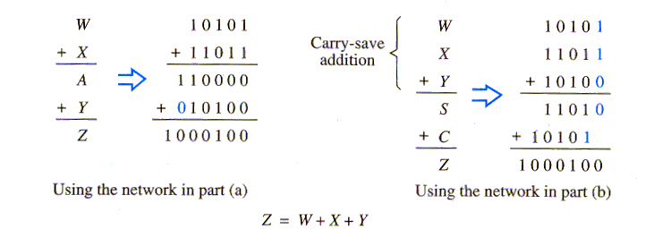
Fast Multiplications (Cont’d)
Carry-Save addition of Summands: example

Slide 45
Fast Multiplications (Cont’d)
Carry-Save addition of Summands: Wallace tree
CSA
CSA
CSA
CSA
CSA
CSA
CSA
CSA
7 numbers
CSA
9 numbers
CSA
CSA
CSA
CPA
CPA
Tree of carry-save adders

Slide 46
Fast Multiplications (Cont’d)
Example

Slide 47
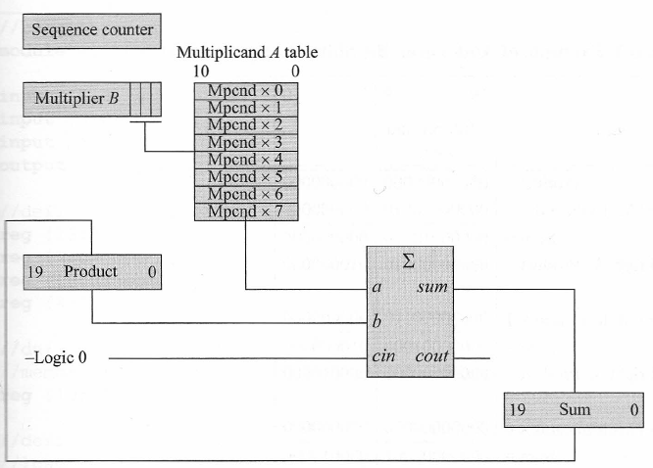
Fast Multiplications (Cont’d)
Table Lookup Multiplication: multiplication can be accomplished using a memory that contains different versions of the multiplicand to be added to the partial products. This method is faster than the sequential add-shift algorithm, because it shifts the partial products three bit positions after the add operation.
Sequential Add-Three-Bit-Shift multiplier: for 8-bit multiplicands and multipliers
Firmware loads the multiplicand table in memory
9-bit parallel-in,
parallel-out shift
register, 3 bits at a time
(divisible by 3 – high-order
bit is the sign extension)
Initially,
Sum = Product = 0
M
8 0
20-bit parallel-in,
parallel-out shift register,
shift right 3-bit positions
after addition
Q
20-bit adder
Connected to a₉₋₁₉
a₀₋₈ = 0
Sum is a 20-bit register to contain the 11-bit multiplicand table entries plus 9 bits to accommodate the three right
shift operations of three bits per shift.

Slide 48
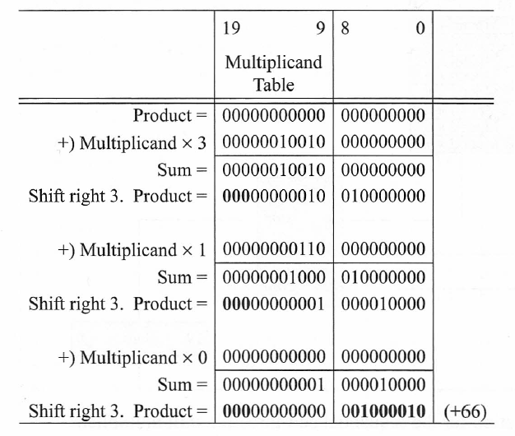
Fast Multiplications (Cont’d)
Multiplicand M = 0000 0110 = 6
Multiplier Q = 0 0000 1011 = 11
Product P = 00000000000 001000010 = 66
Example:
8 0
Multiplier
000001011
000000001 Multiplier shifted
right 3 times
000000000 Multiplier shifted
right 3 times
Product

Slide 49
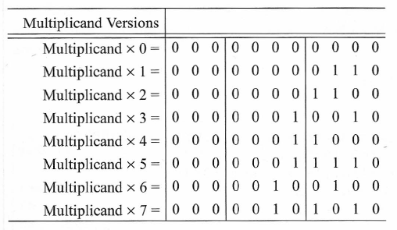
Fast Multiplications (Cont’d)
Example (cont’d): Multiplicand table for a Multiplicand of +6

Slide 50
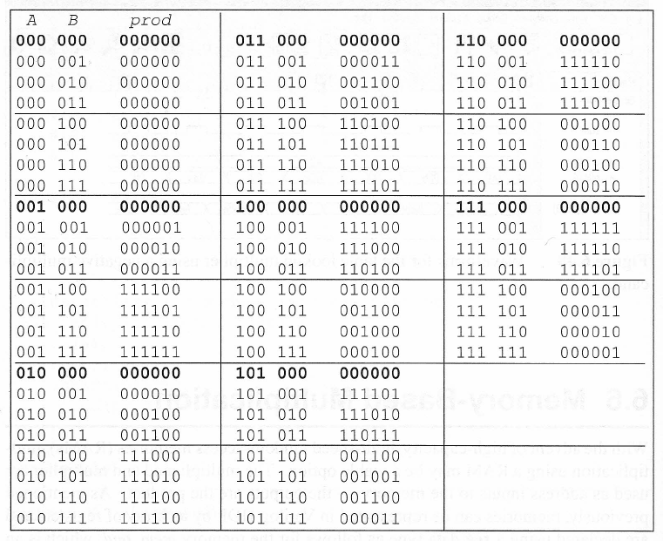
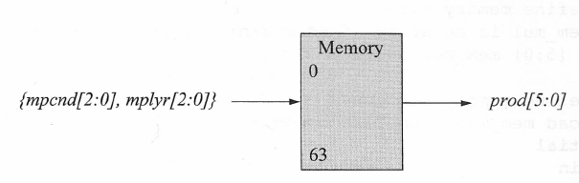
Fast Multiplications (Cont’d)
Memory-based Multiplication: With the advent of high-density, high-speed memories, multiplication using a RAM may be a viable option. The multiplicand and multiplier are used as address inputs to the memory - the outputs are the product.

Slide 51
Integer Division
Positive number division
Binary Division
Quotient
q₅ to q₀
000111
Divisor M
016
Dividend Q
110
101010
110 > 1 → q₅ = 0
8
128
- 0
- 0
10
- 0
110 > 10 → q₄ = 0
12
- 8
101
- 0
110 > 101 → q₃ = 0
48
- 48
1010
- 110
110 < 1010 → q₂ = 1
0
Remainder
1001
- 110
110 < 1000 → q₁ = 1
Example of Division Algorithms:
Restoring Division
Non-Restoring Division
00110
- 110
110 = 110 → q₀ = 1
0

Slide 52
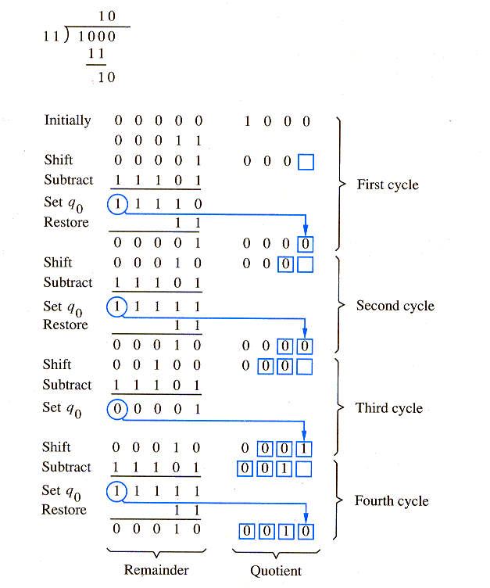
Integer Division (Cont’d)
Restoring division algorithm:
Do the following n times:
Shift A and Q left one binary position
Subtract M from A, and place the result in A
If A is negative, set q₀ to 0 and restore A (add M back to A); otherwise, set q₀ to 1.
8/3 = 2 R 2
A Q
M
- M
- M
- M
- M

Slide 53
Integer Division (Cont’d)
Example

Slide 54
Integer Division (Cont’d)
Non-restoring division algorithm:
Do the following n times (calculate Quotient):
Shift A and Q left one binary position; If A ≥ 0, subtract M from A; otherwise, add M to A.
Now, If A ≥ 0, set q₀ to 1; otherwise, set q₀ to 0.
Final Step (Calculate Remainder): If A < 0, add M to A (this is to make sure that the positive remainder is in A at the end of n cycles).

Slide 55
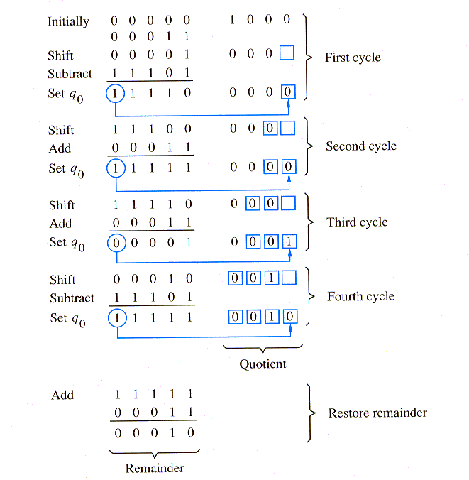
Integer Division (Cont’d)
Non-restoring division algorithm: example
A Q
M
8/3 = 2 R 2
- M
M
M
For signed division,
transform dividend/divisor into
positive numbers, use one
of the algorithms above and
then change the sign of the result.
- M
M

Slide 56
Integer Division (Cont’d)
Example

Slide 57
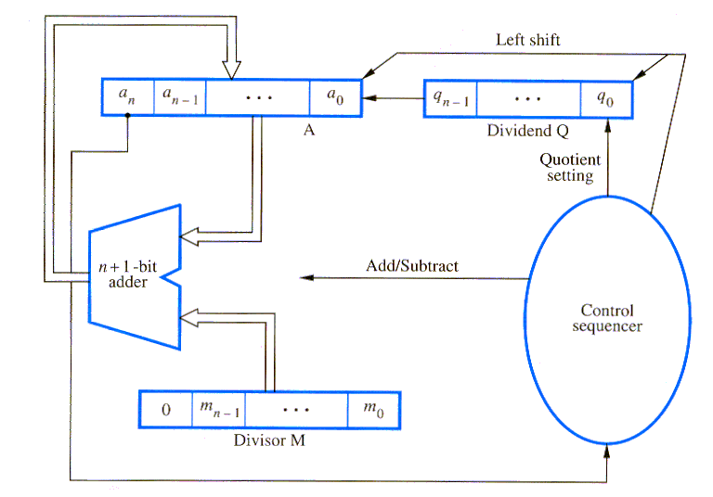
Integer Division (Cont’d)
Restoring division circuit
Initially zero
Remainder
Accommodate
the sign bit
for subtraction

Slide 58
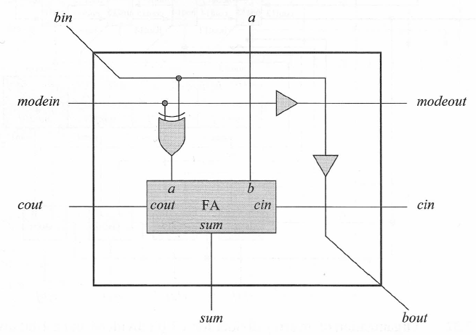
Integer Division (Cont’d)
Array Division (using non-restoring algorithm): extremely fast, and in principle, it is similar to array multiplication. Recall that only two operations are required in the shift-subtract/add non-restoring method: 2A – M and 2A + M.
The array consists of rows of identical cells incorporating a full adder in each cell with the ability to add or subtract. Subtraction or addition is determined by the state of the Mode input; if it is a logic 1, then the operation is subtraction; otherwise, it is addition.
Shifting is accomplished by the placement of cells along the diagonal of the array. This is done by moving the divisor to the right, thus providing the requisite shift of the divisor relative to the previous partial product.

Slide 59
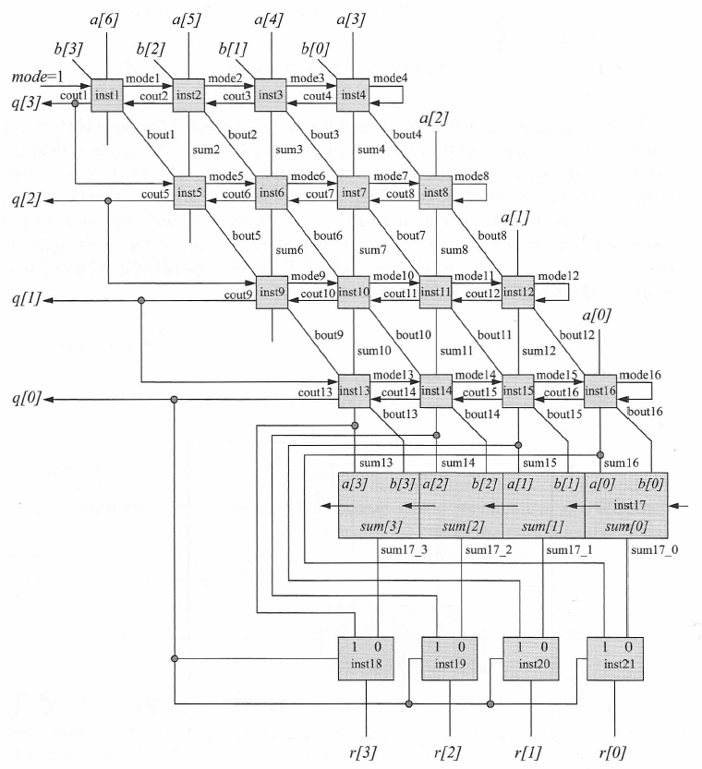
Integer Division (Cont’d)
Array Division
C_{out} = 0 ➔ addition at the next lower level
C_{out} = 1 ➔ subtraction at the next lower level
Taking care of the Final step of the non-restoring
algorithm, in case it is needed.
Note: in this figure,
Q: dividend/quotient, B: divisor, R: remainder
MUX – selecting the
right remainder

Slide 60
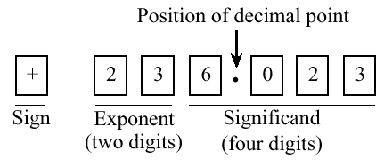
Floating-Point Numbers
Review: A fixed-point representation may need a great number of digits to represent a practical range of numbers. Also, a great deal of hardware is needed for manipulations.
Using only a few digits, floating-point representation can represent very large and very small numbers at the expense of precision.
Example: + 6.023 × 10²³

Slide 61
Floating-Point Numbers (Cont’d)
Review: Many different ways to represent a number such as 345.1:
345.1 × 10⁰,
34.51 × 10¹,
3.451 × 10²,
0.3451 × 10³,
0.03451 × 10⁴
This creates a problem when making comparisons.
Normalize the number such that the radix point is located in only one possible position. Normally, the radix point is placed immediately to the right of the leftmost, nonzero digit in the fraction, as in 3.451 × 10².
Hidden bit: in base 2, the leading “1” in the normalized mantissa (or significand) is not stored in memory. This adds an additional bit of precision to the right of the number due to removing the bit on the left.
More on that later

Slide 62
Floating-Point Numbers (Cont’d)
Review: Excess representation
The idea is to assign the smallest numerical bit pattern, all zeros, to the negative of the bias, and assigning the remaining numbers in sequence as the bit patterns increase in magnitude. Positive and negative representations of a number are obtained by adding a bias (excess value) to the two’s complement representation, ignoring any carry out from the most significant digit.
➔Numerically smaller numbers have smaller bit patterns, simplifying comparisons for floating-point exponents.
Example: Excess-127
+25 = 10011000₂
-25 = 01100110₂
One representation for zero: +0 = 01111111₂; –0 = 01111111₂
Largest positive number is +128 = 11111111₂
Largest negative number is –127 = 00000000₂

Slide 63
Floating-Point Numbers (Cont’d)
Review: 3-bit Integer Representation
Decimal | Unsigned | Sign-Mag. | 1’s Comp. | 2’s Comp. | Excess-4 | Excess-3
7 | 111 | - | - | - | - | -
6 | 110 | - | - | - | - | -
5 | 101 | - | - | - | - | -
4 | 100 | - | - | - | - | 111
3 | 011 | 011 | 011 | 011 | 111 | 110
2 | 010 | 010 | 010 | 010 | 110 | 101
1 | 001 | 001 | 001 | 001 | 101 | 100
+0 | 000 | 000 | 000 | 000 | 100 | 011
-0 | - | 100 | 111 | 000 | 100 | 011
-1 | - | 101 | 110 | 111 | 011 | 010
-2 | - | 110 | 101 | 110 | 010 | 001
-3 | - | 111 | 100 | 101 | 001 | 000
-4 | - | - | - | 100 | 000 | -

Slide 64
Floating-Point Numbers (Cont’d)
Review: floating-point example - Represent 254₁₀ in a normalized base 8 floating-point format with a sign bit, followed by a 3-bit excess-3 exponent, followed by four base 8 digits.
Step 1: Convert to the target base using the remainder method.
254/8 = 31 R 6; 31/8 = 3 R 7; 3/8 = 0 R 3, thus
254₁₀ = 376₈ = 376 × 8⁰
Step 2: Normalize the number in the target base.
376 × 8⁰ = 3.76 × 8²
Step 3: Fill in the bit fields, with a sign bit = 0 (positive), an exponent of 5 (2 + 3) in excess-3, and 4-digit fraction = 3.760
0 101 011 . 111 110 000
(spaces are shown for clarity, and base point is not stored in the computer)

Slide 65
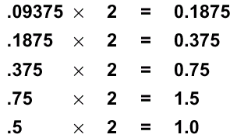
Floating-Point Numbers (Cont’d)
Review: conversion example - Convert (9.375 × 10⁻²)₁₀ to base 2 scientific notation.
Step 1: Convert from base 10 floating-point to base 10 fixed-point.
➔ (9.375 × 10⁻²)₁₀ = .09375₁₀
Step 2: Convert from base 10 fixed-point to base 2 fixed-point using multiplication method.
➔ Thus, .09375₁₀ = .00011₂
Step 3: Convert to normalized base 2 floating-point.
➔ .00011₂ = .00011₂ × 2⁰ = 1.1 × 2⁻⁴

Slide 66
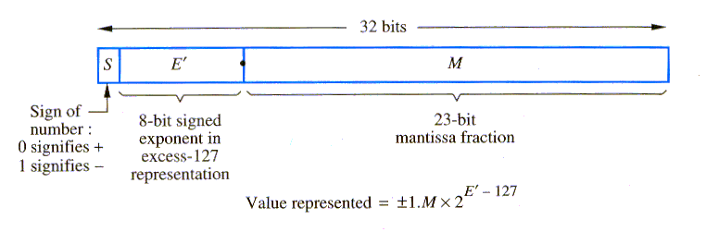


IEEE-754 Floating-Point Standard
Review - Developed in 1985. It can be supported in hardware, or a mixture of hardware and software.
Single precision
0<E’<255
2⁻¹²⁶ to 2⁺¹²⁷
Hidden bit
Double precision
0<E’<2047
2⁻¹⁰²² to 2¹⁰²³

Slide 67

IEEE-754 Floating-Point Standard (Cont’d)
Review - Examples in the IEEE-754 Format
denormalized
Double-precision
Clean zero

Slide 68
IEEE-754 Floating-Point Standard (Cont’d)
Review - IEEE-754 conversion example: Represent -12.625₁₀ in single precision IEEE-754 format.
Step 1: Convert to the target base 2.
-12.625₁₀ = -1100.101₂
Step 2: Normalize the number in base 2.
-1100.101₂ = -1.100101 × 2³
Step 3: Fill in bits.
Sign bit = 1 (negative)
Exponent is 3 + excess-127 ➔ 3 + 127 = 130 = 10000010₂
Leading 1 of fraction is hidden, thus the final bit pattern is:
1 1000 0010 1001 0100 0000 0000 0000 000

Slide 69

IEEE-754 Floating-Point Standard (Cont’d)
Effect of Loss of Precision

Slide 70
Floating-Point Arithmetic Operations
IEEE-754 single-precision rules:
Add/Subtract Rule:
Choose the number with the smaller exponent and shift its mantissa right a number of steps equal to the difference in exponents.
Set the exponent of the result equal to the larger exponent.
Perform addition/subtraction on the mantissas and determine the sign of the result.
Normalize the resulting value, if necessary.
Multiply Rule:
Add the exponents and subtract 127.
Multiply the mantissas and determine the sign of result.
Normalize the resulting value, if necessary.
Divide Rule:
Subtract the exponents and add 127.
Divide the mantissas and determine the sign of the result.
Normalize the resulting value, if necessary.

Slide 71

Floating-Point Arithmetic Operations (Cont’d)
Floating-point addition/subtraction unit
1
2
3
2
4

Slide 72
Floating-Point Arithmetic Operations (Cont’d)
Truncation methods: in the preceding algorithms, the mantissas of initial operands and final results are limited to 24 bits, including the implicit leading 1. However, it is important to retain extra bits, often called guard bits, during the intermediate steps. This yields maximum accuracy in the final results.
In generating a final result, the extended mantissa bits (guard bits) need to be truncated such that the new 24-bit mantissa approximates the longer version. There are three different truncation methods.
Suppose we want to truncate a fraction from six to three bits:
Chopping: where all fractions in the range 0.b₋₁b₋₂b₋₃000 to 0. b₋₁b₋₂b₋₃111 are truncated to 0. b₋₁b₋₂b₋₃.
Von Neumann rounding: if the three bits to be removed are all 0s, they are simply dropped. However, if any of the bits to be removed is 1, the least significant bit of the retained bits is set to 1. Thus, in our example, all 6-bit fractions with b₋₄b₋₅b₋₆ not equal to 000 are truncated to 0. b₋₁b₋₂1.

Slide 73
Floating-Point Arithmetic Operations (Cont’d)
Rounding: a 1 is added to the LSB position of the bits to be retained if there is a 1 in the MSB position of the bits being removed.
Thus, 0. b₋₁b₋₂b₋₃1 . . . Is rounded to 0. b₋₁b₋₂b₋₃ + 0.001, and 0. b₋₁b₋₂b₋₃0 . . . is rounded to 0. b₋₁b₋₂b₋₃.
This provides the closest approximation to the number being truncated, except for the case in which the bits to be removed are 10…0. This is a tie situation; the longer value is halfway between the two closest truncated representations. To break the tie in an unbiased way, one possibility is to choose the retained bits to be the nearest even number (similar to the default mode of IEEE-754). In this regard, the value 0.b₋₁b₋₂0100 is truncated to the value 0.b₋₁b₋₂0, and 0.b₋₁b₋₂1100 is truncated to 0.b₋₁b₋₂1+ 0.001. This technique is referred to as “round to the nearest number or nearest even number in case of a tie”.
This method is the most difficult to implement because it requires an addition operation and a possible renormalization.

Slide 74
Floating-Point Arithmetic Operations (Cont’d)
IEEE-754 Guard bits: rounding method (the default mode: rounding to the nearest representable number) is used using three guard bits to be carried along during the intermediate steps in performing the operations. The first 2 guard bits are the two most significant bits of the section of the mantissa to be removed. The third bit (sticky bit) is the logical OR of all bits beyond these first two bits in the full representation of mantissa.
Floating-point arithmetic example: Consider a shortened version of the IEEE floating-point format that fits into 12 bits, including the sign bit. The scale factor has an implied base of 2 and a 5-bit excess-15 exponent, with the two end values of 0 and 31 used to signify the special values exact zero and infinity, respectively. The 6-bit mantissa is normalized as in the IEEE format, with an implied 1 to the left of the binary point.

Slide 75
Acknowledgment
Some of the slides have been provided and adapted from previous course instructor, Dr. Ahmad Afsahi.

