Slide 1
MLB Player Statistic Prediction
Austin Amann Vaughan
Michael Spiering

Slide 2
Statistics
Most MLB teams use some form of statistics to predict player and team performance
Sabermetrics are used by teams in order to analyze and project various statistics
Statistical analysis was popularized in the early 2000s and has been documented in films such as Moneyball

Slide 3
Offense
Offensive stats are very important when assessing the value of a player
We determined the most important offensive stats as:
Hits
Runs Batted In
HomeRuns
Batting Average
On Base Percentage

Slide 4
DataSet
Player data was pulled for various years from the official MLB statistics API
Players that participated in each of the seasons were kept and others were discarded
Data was pulled for years 2014-2018 for the approximately 500 players that participated in each of those seasons

Slide 5
Data Preprocessing
Various statistics were plotted against each other in order to familiarize us with any trends that may be present in the data
Each year is colour coded on each plot

Slide 6
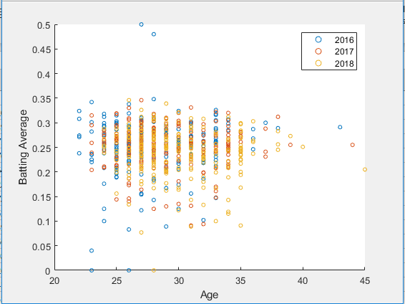
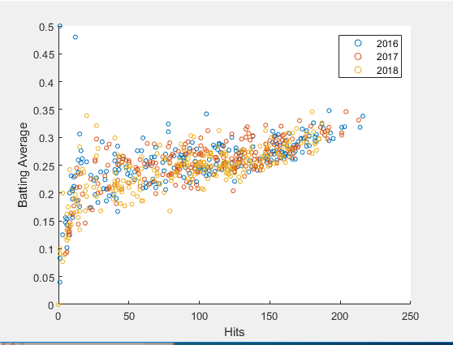
Data Preprocessing

Slide 7
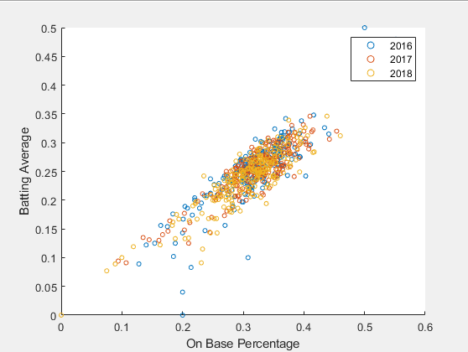
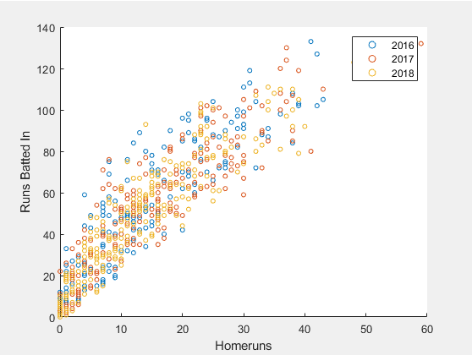
Data Preprocessing

Slide 8
K Means Clustering
The aim of K Means Clustering is to divide the dataset into K Clusters
Assigns each datapoint to its closest cluster centroid by calculating Euclidean distance
Cluster centroids are then updated to be the mean of each cluster
This is then repeated until the dataset converges and the final clusters are found

Slide 9
Clustering DataSet
K means clustering was applied to each of the original plots in order to categorize the players
Players were split into 4 categories:
Below Average
Average/Replacement Level
Above Average
Elite

Slide 10
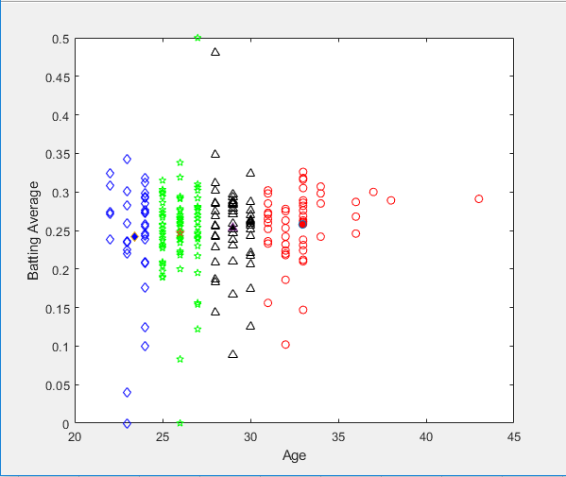
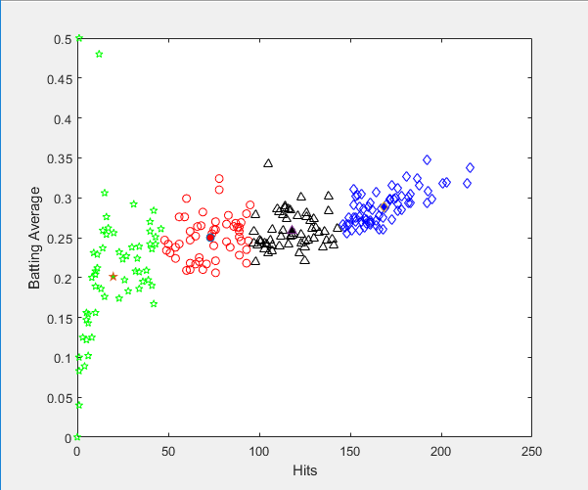
K Means Clustering

Slide 11
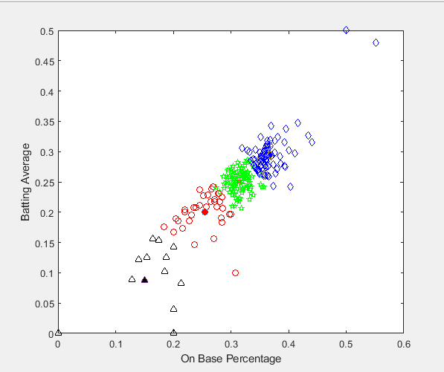
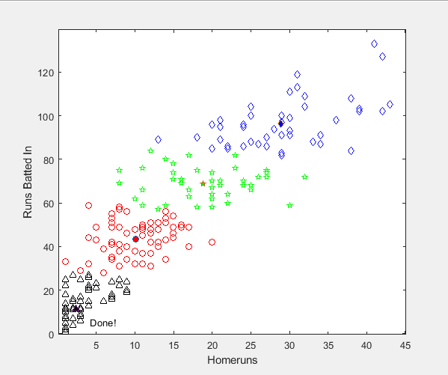
K Means Clustering

Slide 12
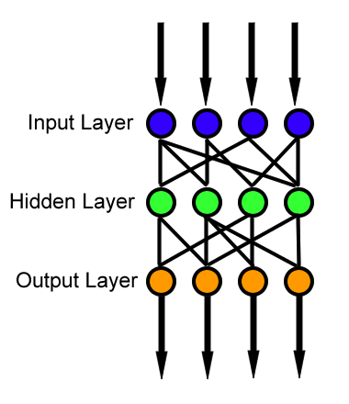
Backpropagation
Used standard FF BPNN design, with various approaches searching for an optimal model

Slide 13
Backpropagation
Created numerous feed forward backpropagation networks to attempt to find correlation
Varied input and output nodes from 2 to 6 parameter’s over 1 to 5 years
In general only found weak correlation, and converged to averages of the league rather than strong connection to inputs
Averages in output tended to match league averages on better models (such as batting average converging to about 0.255 for most designs)

Slide 14
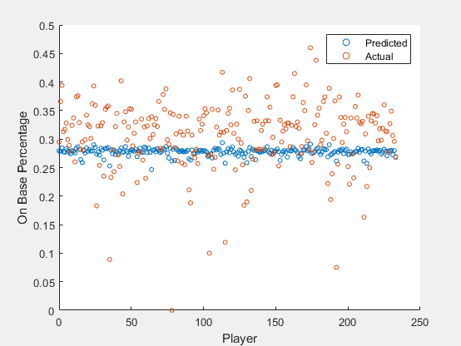
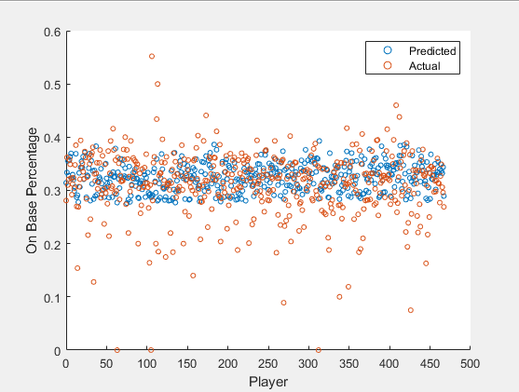
Backpropagation Results

Slide 15
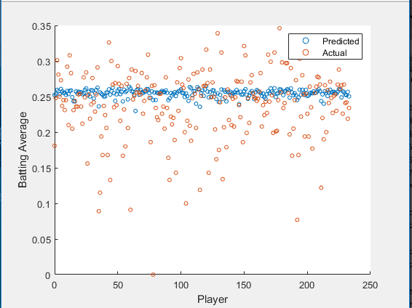
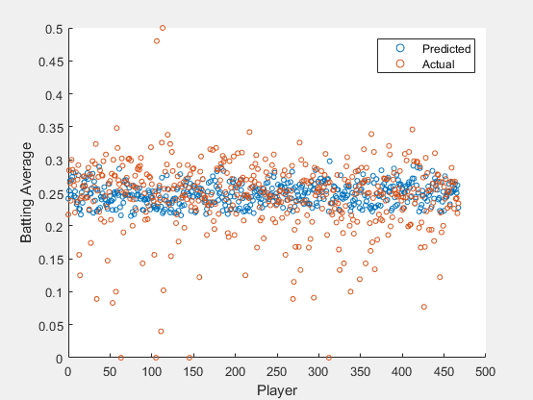
Backpropagation Result

Slide 16
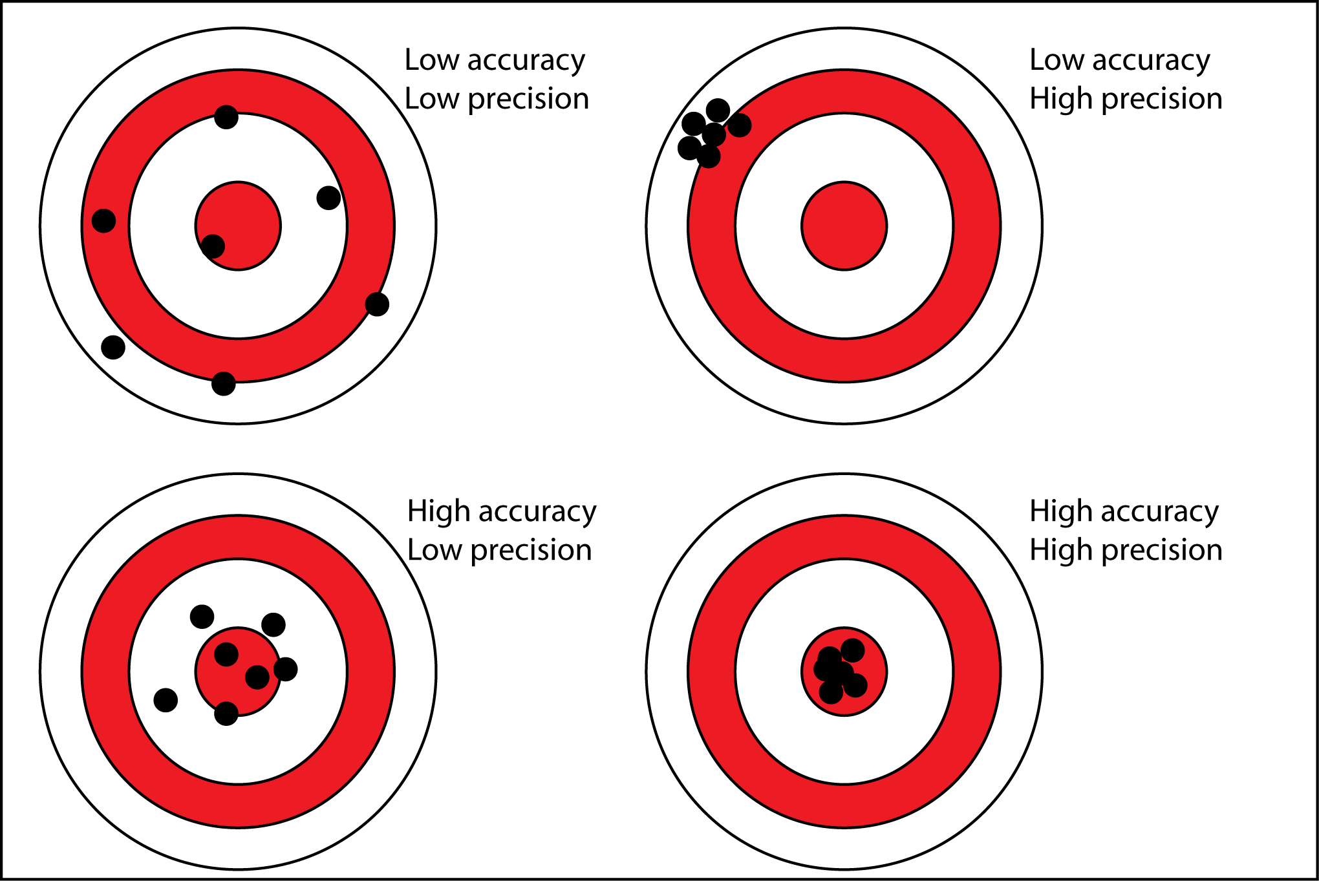

Slide 17
Year to Year Stat Correlation
Typically, there is not a very strong correlation between a players offensive statistics year to year
On Base Percentage has the most correlation at 0.62
All of the other stats looked at have correlation coefficients at or below 0.5
This means that most players will not achieve what statistics predict from year to year
This makes it harder to accurately predict a players performance

Slide 18
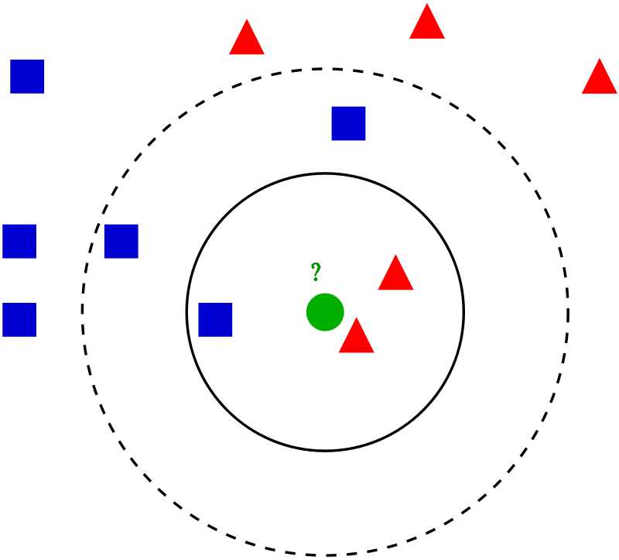
K Nearest Neighbour
K Nearest Neighbour is used to identify what cluster a predicted players performance will fall into
K Nearest Neighbour samples the K closest points in a dataset in order to identify what cluster the provided new point belongs to
Euclidean distance is calculated to identify the K closest points

Slide 19
K Nearest Neighbour
Once the Backpropagation network made a prediction KNN was used in order to determine what cluster of players the prediction would fall into
This would help teams project what type of season a player is expected to have
This will also help teams determine if a player is improving or regressing from their last seasons statistics

Slide 20
Next Steps
Analyze defensive and pitching statistics to see if there is less variance in those statistics
Pull data from more years to increase the size of the dataset, baseball data has been around since the early 1900s
Add more clusters to increase the accuracy when predicting the type of player
Improve accuracy of backpropagation network
Use a more efficient classifying algorithm or improve the efficiency of K Nearest Neighbour

Slide 21
Summary
The average error in predicted batting average was 0.029
The average error in predicted on base percentage was 0.013
Of the 5 players statistics that were analyzed for 2017, their predicted 2018 statistics fell into the same clusters as their actual performance

Slide 22
Questions

