Slide 1
Air Fryer Market Analysis
Rex, Samai, Austin, Anish, Alex, Kenny

Slide 2
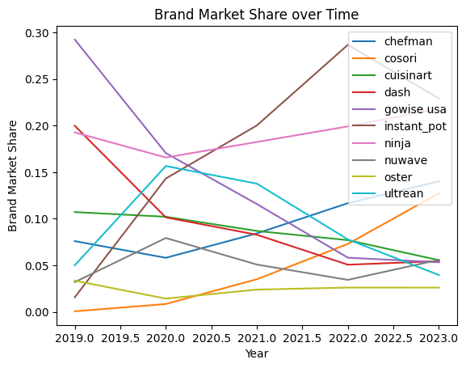
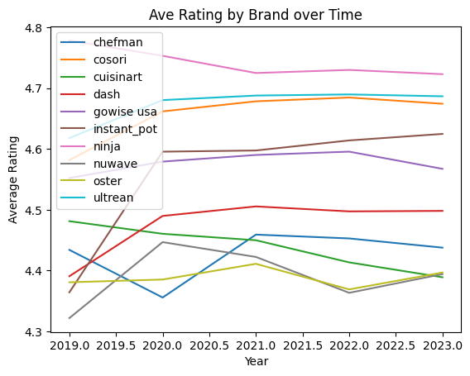
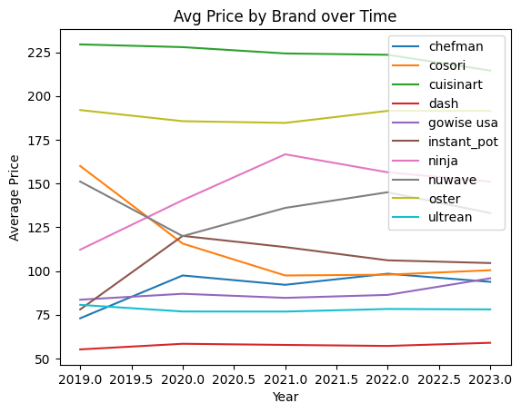
Market Overview
Market is dominated by mass brands (Ninja, Instant Pot), with premium brands like Cuisinart and Oster occupying a smaller share due to high prices and low ratings
Ninja dominates with strong ratings + share
Explosive growth for Instant Pot by lowering prices and improving ratings
High ratings does not mean low prices, with highest-rated Ninja being above all other highly-rated brands in price
Appeal depends on more than just price

Slide 3
Demand Model
We estimate demand using a multinomial logit model:
log(sbt) = α + β(price pbt) + β(rating rbt) + features + brand dummies + year dummies
We model how market share depends on price, ratings, and product features
Brand and year dummies are interpreted relative to the dropped reference categories (Chefman and 2019, respectively)
Estimated price coefficient: β_price = -0.0377
As expected, higher prices translate to lower demand
Market share is price-sensitive

Slide 4
Price and Features
Top demand drivers (brands with these features tend to have greater market share):
Viewing windows
Compact designs
Oven-style models
Compact and oven-style are both the most common features across brands and the top demand drivers, indicating that consumers commonly expect these features in an air fryer.
On the flipside, brands with dual-basket designs and rotisserie-capable models tend to have smaller market share.

Slide 5
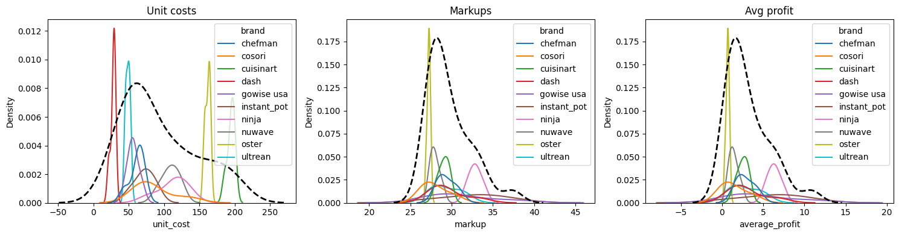
Costs, Markups, Profits
Using our demand model, we estimated unit costs, markups, and share-weighted profits:
Premium brands show higher markups but lower market share
Mass-market brands (e.g., Ninja) achieve higher share-weighted profits
Cost and price differences reflect product positioning strategy

Slide 6
Conclusion
Air fryer market is competitive and price-sensitive
Mid-priced brands dominate demand, balancing quality and affordability
Based on our model, a brand's winning strategy includes:
Competitive pricing
Strong consumer ratings
Practical, in-demand, high-value features
Ninja occupies the strongest overall position
Instant Pot exhibits the fastest growth trajectory
Premium brands like Cuisinart and Oster face declining market share in the face of price decreases, rating drops, and profit losses

