Slide 1
Equilux
Pay, proven equal.
No salary revealed.
The first employee-verifiable pay-transparency reporting protocol. A company proves its legally required gender pay gap report was computed from its complete payroll — every salary the payroll provider's own figure, confirmed by the employee it belongs to — while every salary stays in Midnight's private state.
Midnight Buildathon · Wave 2
Compact · TypeScript · Apache 2.0
github.com/AustinChris1/Equilux
EQUILUX
01 / 12

Slide 2
THE MANDATE · DIRECTIVE (EU) 2023/970
The law now demands a number companies cannot prove.
7 June 2027
250+
≥ 5%
FIRST REPORTS DUE
FROM 2026 PAY DATA
EMPLOYEES, ANNUAL
150+ TRIENNIAL, SAME DATE
UNJUSTIFIED CATEGORY GAP
TRIGGERS A JOINT ASSESSMENT
Article 9 requires seven indicators. Article 7 gives every employee the right to ask what their category earns. And today every one of those reports is self-declared: nobody can verify the numbers without seeing everyone's salary.
EQUILUX
02 / 12

Slide 3
THE PROBLEM
Trust me, or prove it.
Today
With Equilux
HR exports payroll to a spreadsheet, computes a gap, publishes a PDF. An employee cannot check they were counted. A works council cannot check nobody was dropped. A regulator can only audit by subpoenaing the whole payroll — the data the law is trying to protect.
The payroll provider commits every payroll row, hashed. The works council opens every row before anyone enrolls. Each employee seals their own record and proves it matches an unclaimed row. The circuits then check all seven Article 9 figures. Only the figures and the proof go public.
Equilux does not replace the HRIS. Payroll stays in Personio, DATEV or Workday. Equilux is the notary on top: it proves the set was complete and the published figure matches it.
EQUILUX
03 / 12

Slide 4
SINCE WAVE 1 · WHAT THE JUDGE ASKED FOR
The works council opens the payroll. All seven Article 9 figures are proven.
 | WAVE 1 | WAVE 2
Who checks the payroll | the employer, on its own data | the provider commits each row; the works council opens every one
A salary that is not payroll's | the employer could vouch for it | rejected — the record must open an unclaimed payroll row
Figures proven | the mean gap | all seven Article 9 indicators, including variable pay and quartiles
Small groups | designed | published only at k = 3; smaller groups stay suppressed
Where the proof ran | a local Midnight node | Midnight preprod, blocks 2,787,450–2,787,556
What a judge can open | the site, after installing Docker | /verify reads the chain; 11 cheats on the public site, no install
Tests on the compiled circuits | 9 | 45 (55 tests in all)
EQUILUX
04 / 12

Slide 5
WHAT THE CIRCUIT PROVES
Trust neither side. Verify both.
Completeness
Every salary is payroll's
The payroll provider commits every payroll row before anyone enrolls; the report must cover exactly those rows. Leaving someone out — even by never enrolling them — is rejected.
A record counts only if it opens to an unclaimed payroll row. The employer cannot invent a person or change anyone's pay; an employee cannot inflate their own.
No small-group leaks
Exact figures
A category's pay is published only when both groups have at least three people. Smaller groups show headcounts only.
All seven Article 9 indicators are claims the circuit recomputes: mean, median, category gaps, variable-pay gaps, who receives variable pay, and quartile bands. One basis point off fails.
Plus an inclusion receipt for every employee: a Merkle path proving their record is inside the numbers, revealing nothing about anyone.
EQUILUX
05 / 12

Slide 6
THE PROTOCOL · SIX PROVING CIRCUITS · FOUR PARTIES
The council opens every row. Then the employee. Then both reports.
01 · declareRoster
02 · confirmPayroll
03 · enroll
Commit
Council
Bind
The payroll provider commits a hiding hash of every row, in one transaction.
The works council opens every committed row. Enrollment stays closed until it does.
The employee seals their record and proves it opens an unclaimed payroll row.
04 · publishReport
05 · publishVariablePay
06 · checkReceipt
Basic pay
The rest
Receipt
Mean gap, median gap, and each category's gap, suppressed below k = 3.
Variable-pay gaps, who receives it, and the gender mix of each pay quartile.
An employee proves their record is in the tree, against the on-chain root.
EQUILUX
06 / 12

Slide 7
MIDNIGHT'S DUAL LEDGER · WHY THIS ONLY WORKS HERE
Private state holds the payroll. Public state holds the proof.
Private state · witnesses
Public ledger
salary, variable pay, gender marker, category
employee secret and the payslip nonce
employer, provider, and works-council keys
the full 16-slot payroll witness
every claimed figure, including each quartile band
commitments — a depth-5 Merkle tree
payroll-row hashes, nullifiers, bound commitments
three role keys, headcount, council confirmation
both reports: all seven Article 9 indicators
the zero-knowledge proof for every transition
Every witness that reaches the ledger passes an explicit disclose(). The compiler refuses anything else.
EQUILUX
07 / 12

Slide 8
WAVE 2 EVIDENCE · REAL PROOFS ON A MIDNIGHT NETWORK
Fourteen people. Two reports. On public preprod.
6
45
0
PROVING CIRCUITS
PROVER + VERIFIER KEYS
OF 55 TESTS
ON THE COMPILED CIRCUITS
SALARIES ON CHAIN
EVER
preprod contract 598b346e…d1cb
declareRoster · 14 payroll-row hashes (block 2,787,454)
confirmPayroll · works council opens every row (block 2,787,463)
14 enrollments, each bound to its own row (blocks 2,787,468–2,787,529)
publishReport proven · mean 9.69% · median 1.81% (block 2,787,543)
publishVariablePay proven · variable-pay mean gap 27.50% (block 2,787,556)
Engineering 13.88% flagged · Sales 3.70% · Operations suppressed · same figures as /verify
MIDNIGHT PREPROD · PREPROD.MIDNIGHTEXPLORER.COM
08 / 12

Slide 9
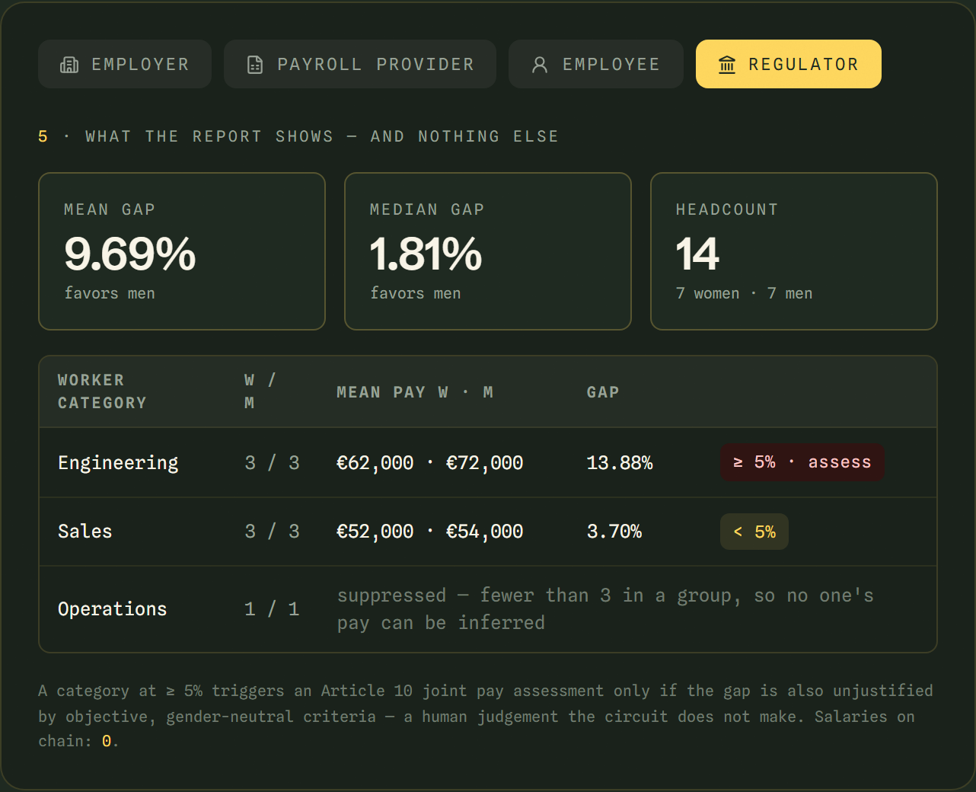
THE LIVE SITE · THE COMPILED CONTRACT, RUNNING IN THE BROWSER
No Docker. No install. The real circuits, on the public URL.
EQUILUX-LAC.VERCEL.APP/APP · PLAY THE WHOLE STORY · BASIC-PAY REPORT
09 / 12

Slide 10
THREAT MODEL · SCOPE
Honest about what a proof can prove.
IT DOES NOT CLAIM | WHAT IS TRUE INSTEAD
Salaries hidden from HR | HR still holds payroll. Hidden from the public, colleagues, the regulator and Equilux — and the employer can no longer supply its own figures.
An honest payroll by itself | The works council must open every row. A provider, employer and council who collude could still commit false rows. Each employee sees their own.
Judging what is justified | Category gaps ≥ 5% are proven and flagged. Whether a gap is justified is a human judgement.
A finished legal filing | All seven Article 9 indicators are proven. The instance is 16 records and 4 categories, not a 250-person employer.
Any visitor can write on preprod | The 14-person run is on preprod. Connecting Lace is enough to read; a write from that wallet needs tDUST.
A model of identity | Binary gender markers, as the Directive's reporting annex is written today.
EQUILUX
10 / 12

Slide 11
THREE WAVES
Built in the open, wave by wave.
WAVE 1 · DELIVERED
WAVE 2 · THIS WAVE
WAVE 3
Prove it works
The product
A named pilot
Contract with private state. Proven end to end on a Midnight network. Employer, employee and regulator workspace. Honest scope.
Works council. Payroll-row binding. All seven Article 9 indicators. The 14-person flow on preprod. /verify and the filing pack. Connect wallet. Personio / DATEV import.
One EU employer and its works council, on their own payroll export. A real Personio sandbox. The first full write from a visitor's wallet.
EQUILUX
11 / 12

Slide 12
WHO BUYS · WHAT WE ASK
The notary for Directive 2023/970.
Buyers
A plugin, not a rival
Why Midnight
Works councils that don't trust the numbers. GDPR-sensitive employers. Regulators who want completeness without holding payroll.
Workday, Personio, DATEV compute pay. Equilux imports their export, the provider commits its rows, and the report is proven — next to them, not instead of them.
A forced legal deadline plus a problem only dual-ledger selective disclosure solves honestly. Incumbents can copy a dashboard; they cannot copy the proof.
youtu.be/AmFv_UKSj4A
Equilux
github.com/AustinChris1/Equilux
Apache License 2.0 · #midnightntwrk
EQUILUX
12 / 12

