Slide 1

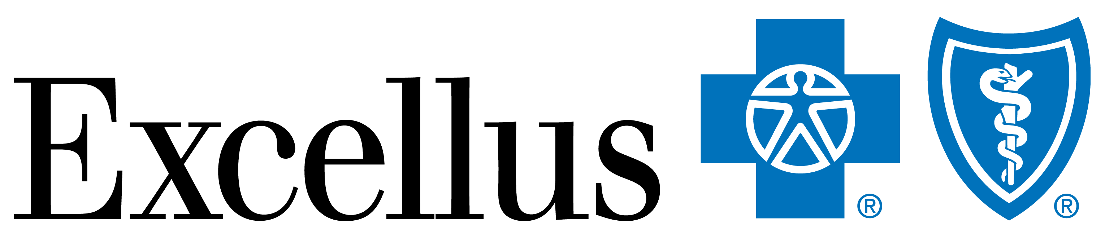
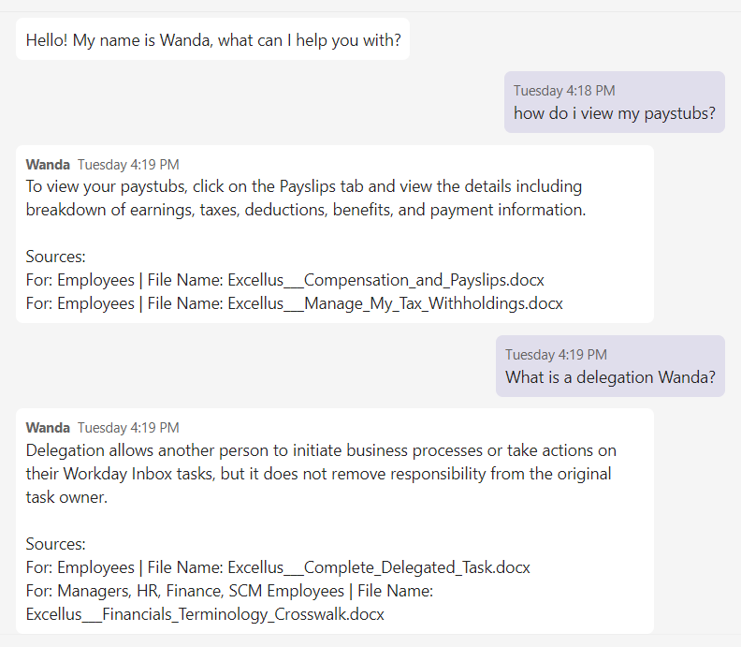
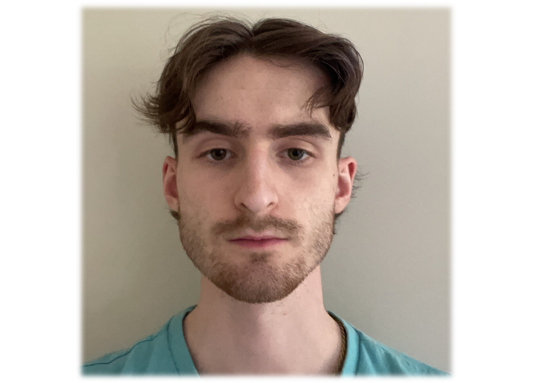
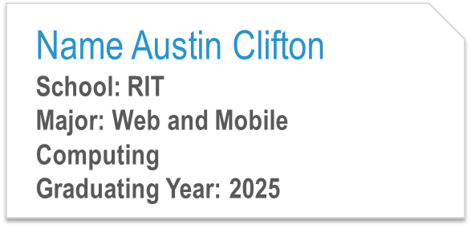
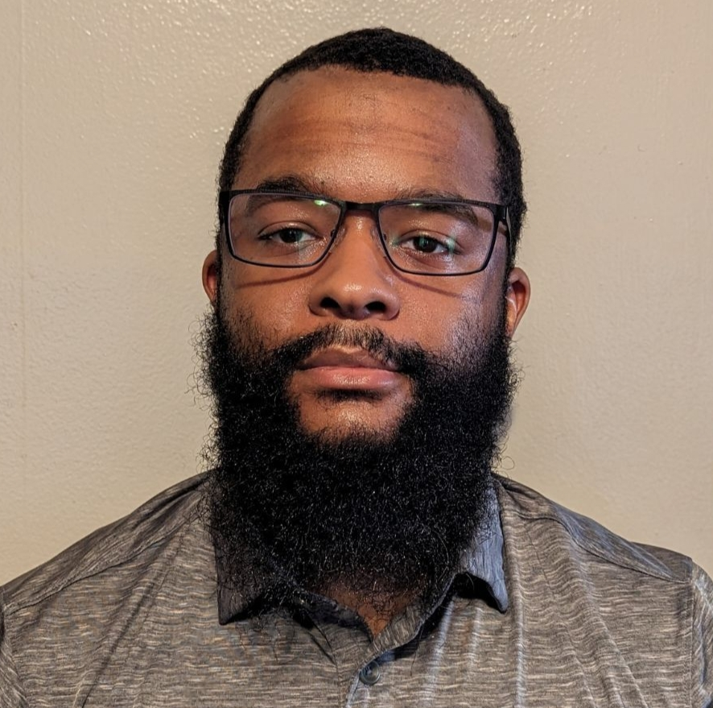
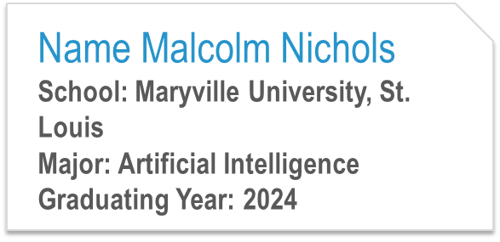
Workday Bot
AD&T Data Science Team
Technologies:
We aim to bridge the gap between UKG and Workday for all Excellus employees by revolutionizing real-time assistance that utilizes an
AI-powered MS Teams app to deliver timely and accurate information about the Workday application.
Microsoft Teams.
iNode.jsi
Python.
NLP.
iDatabricks
iLangChain
iMLFlow
iHuggingFace
iOverview:i
Add image here
User asked a question regarding workday. Bot responds with relevant information.
Bot is hosted in Microsoft Teams to ensure accessibility across the org.
A way for machines to understand, interpret, and generate human language.
Help simplify the process of manually searching larger documents.

