Slide 1
FPGA: Blink Message
Austin FPGA Meetup
July 13, 2020
Michelle Guardabascio

Slide 2
Question Last Meeting: Assertions
I haven’t been using them and I asked around and others aren’t either.
One resource says, despite the common perception that they’re not worth it, they can cut your simulation time by half.
Resources:
  https://verificationacademy.com/news/improving-fpga-debugging-assertions
  https://www.mentor.com/products/fv/multimedia/modelsim-to-questa-core--adopting-assertion-based-verification-to-improve-your-fpga-debug-and-design-quality

Slide 3
Software, Hardware Used
DE1-SoC Evaluation Board/ User Manual
ModelSim Altera Starter Edition 10.1d
Microsoft Windows 10 Pro
Cygwin (CYGWIN_NT-10.0)
Terasic Board Device Drivers
Quartus II 64-bit Version 13.1.0 (Web Edition)
Quartus Cyclone V Support File

Slide 4
Blink LED :: Do This Lab First
The first lab, “Blink LED” is the Hello Word exercise of the FPGA world.
To see the details of the Hello World/Blink The LED, get the slides here:
https://github.com/AustinFPGA/EducationalResources/blob/master/HelloWorldFPGA.odp
Today’s lab, “Blink Message” with an LED in Morse Code, builds upon the introductory Hello World/“Blink LED” lab. So if you haven’t already done the Hello Word lab, you should do that first and then come back here.

Slide 5
Summary
Build on lessons learned in the “Blink LED” lab
Blink a message in Morse Code using the LED on the evaluation board.
Directory structure recommendations
Project overview
Code review
The TestBench
Introduction to ModelSim
Introduction to debugging
Run on Hardware

Slide 6
Recommended Directory Structure
Project Name
rtl
scripts
synth
Functional
Block 1
Functional
Block n
output_files
testbench
sh_scripts
do_scripts
logs

Slide 7
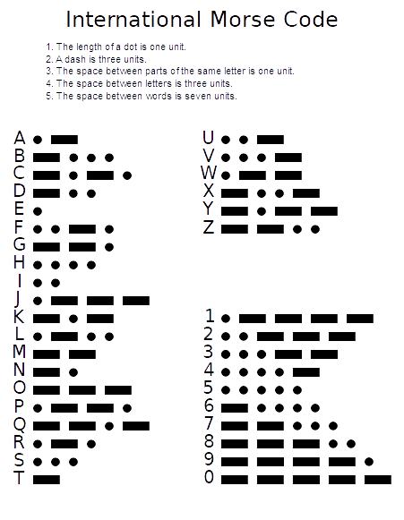
Morse Code
By Rhey T. Snodgrass & Victor F. Camp, 1922 - Image:Intcode.png and Image:International Morse Code.PNG, Public Domain, https://commons.wikimedia.org/w/index.php?curid=3902977

Slide 8
Implement Morse Code Encoding
Morse Code encodes: A -> Z (26 chars) and digits 1 -> 0 (10 chars).
  - 36 characters to encode.
Morse Code char length varies from 1 to 5 characters.
We will use an end of sequence character.
6 characters (max) per Morse Code representation.
36 * 6 = 216; So, we need 216 memory locations.
Due to varying encoding lengths (2 - 6)), we will simplify by
beginning each character on an address which is a multiple of 8.
36 * 8 = 288, need to have 0 -> 287 memory locations.
Use 0 -> 511 because 512 is the next power of 2.
Memory size will be 9 bits, because this is what is required to express our
0 -> 511 addresses. (288 + padding to fill out to 512)

Slide 9
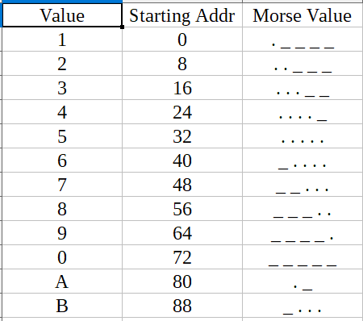
Encode The Morse Code (1 of 4 )

Slide 10
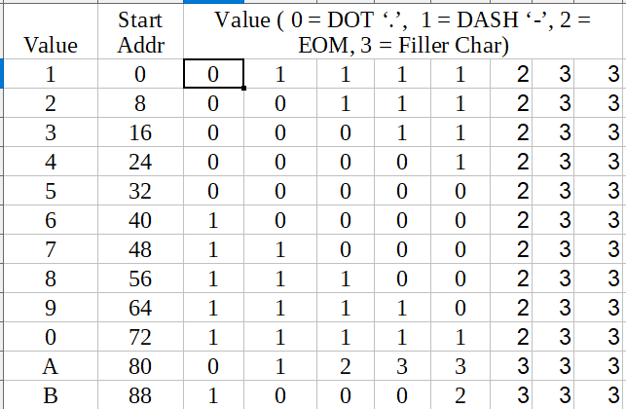
Encode The Morse Code (2 of 4 )

Slide 11
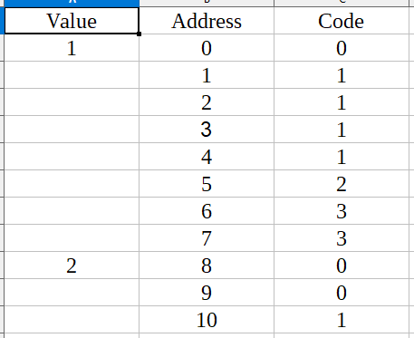
Encode The Morse Code (3 of 4 )
Flatten the previous table

Slide 12
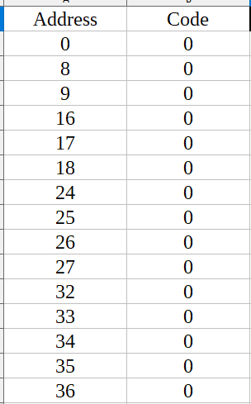
Encode The Morse Code (4 of 4 )
Previous Slide Sorted By Code

Slide 13
Module morse_code_table_lookup
module morse_code_table_lookup (
input logic clock,
input logic [ 8 : 0 ] address, // address we're reading from
output logic [ 1 : 0 ] data_out // value we're returning from the address
);
import encoding::*;
logic [ 1 : 0 ] data_out_next;
always @*
begin
unique case ( address )
9'd0,
9'd8,
...
begin
data_out_next = DOT;
end
9'd1,
9'd2,
...
begin
data_out_next = DASH;
end
9'd5,
9'd13,
...
begin
data_out_next = EOS;
end
default:
begin
data_out_next = PADDING;
end
endcase
end // always @*
always @ ( posedge clock ) begin
data_out <= data_out_next;
end
endmodule

Slide 14
Project Organization
Main Module
blink_message()
(state machine)
encoded_value * 8 = address
1. index
4. dot or dash
2. encoded_value
3. address
msg_table_lookup()
morse_code_table_
lookup()

Slide 15
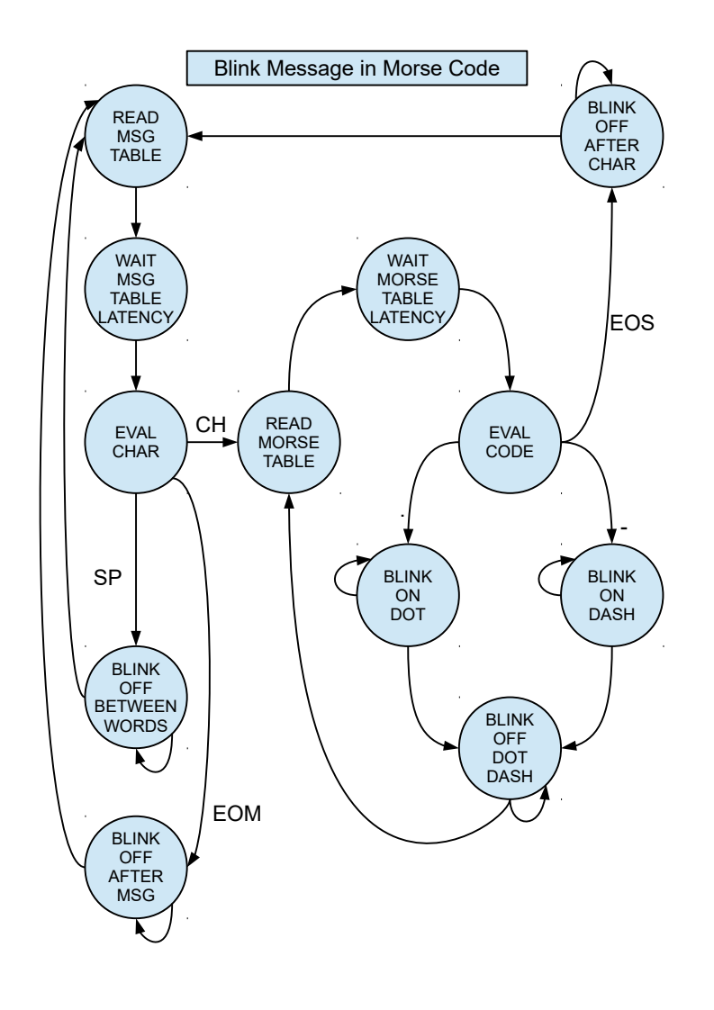
The State Machine

Slide 16
The Code Review
Code is available on GitHub here:
    https://github.com/AustinFPGA/EducationalResources/blob/master/blink_message.7z
Code in the “rtl” directory (.sv) files
  encoding.sv – package; contains typedefs and local params for information used by the modules
  blink_message.sv – the main module; contains the state machine
  msg_table_lookup.sv; module implements the message table. Contains the message to blink in Morse Code. Given an index into the table, returned the encoded value of the letter at the index.
  morse_code_table_lookup.sv; module implements the Morse Code table. Given an address, return the value (dot, dash, ...)

Slide 17
Debugging Overview
Have a copy of the state machine nearby for reference
Follow the changing states and the signal values as code advances through the state machine.
When bug discovered, the general approach is:
    Code inspection
    Simulation
    Signal Tap (outside scope of this presentation)

Slide 18
Testbench Introduction
Required Elements
    Timescale directive; first line in testbench
    Stimulus generation; create a clock
    Instantiate the main module
Note
    Testbench code is 0.5 – 2 x amount of synthesizeable code

Slide 19
Building For Simulation in Win10
Install ModelSim
Install Cygwin
Create script for building (on upcoming slide)
Create script for running (on upcoming slide)
Run Cygwin
    $cd “yourRTL_path”
    $dos2unix *.sh

Slide 20
Script For Building
#!/bin/bash
#!/usr/bin/bash
touch work
rm -rf work
vlib work
vlog -work work -file compile_tb_file_list.txt | tee compile.log

Slide 21
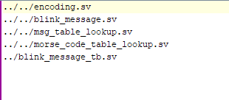
Create The File List
Used by the build script
compile_tb_file_list.txt

Slide 22
Script For Running
#!/bin/bash
#!/usr/bin/bash
set -e
vsim -L work -voptargs=+acc -t ps -i blink_message_tb

Slide 23
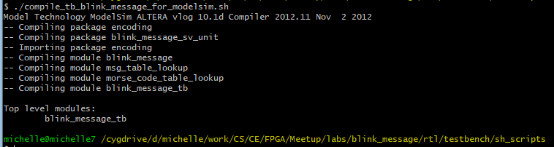
Compiling In ModelSim
In Cygwin,
    $ ./compile_tb_blink_message_for_modelsim.sh

Slide 24
Running In ModelSim
In Cygwin,
    $ ./run_tb_blink_message.sh
The ModelSim GUI opens
You may find it helpful to open the wave form viewer in a separate window. Do this by selecting the Dock/Undock icon in the Wave Form Viewer pane. This is the center icon in the image below.

Slide 25
Saving Signals To .do File
Save signals for future ModelSim runs
This saves time so don’t have to do manually each run
Steps:
    Navigate to the Main Window:
      Select the signals you want to view from “Objects” Pane
      Right click; select “Add Wave”
    Navigate to the Wave Form Viewer Window:
      Select File/Save Format...

Slide 26
Executing A .do File
Use previously saved signals
Steps, to execute .do file
    Navigate to the Main Window:
    Select Tools/Tcl/Execute Macro…
    Select desired .do file
    Select “Open” button
Can also execute .do file in the run script

Slide 27
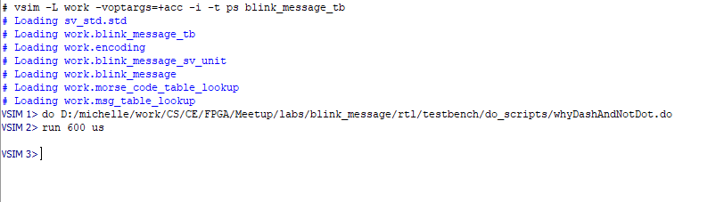
Running Code :: Method 1
Enter the following command at the ModelSim prompt
    Example, run 600 us
      600 is the duration to run
      us is the unit of time; micro-seconds
ModelSim will run the code for the specified duration

Slide 28
Running Code :: Method 2
Enter the following command at the ModelSim prompt
      run -all
Runs the testbench until the “$stop” statement is encountered.

Slide 29
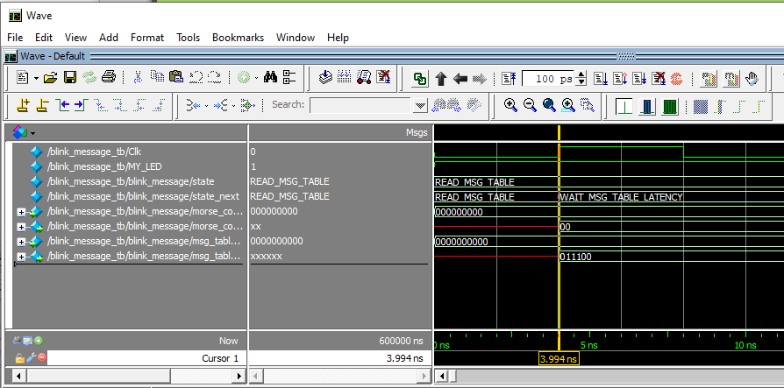
Wave Form Viewer Introduction

Slide 30
Wave Form Viewer Demo
Execute .do file
“run -all” and “run 200 us” explanation
Components and controls summary
    Cycle – note time at bottom
    signals/current value at cursor, multiple cursors, ...
    Zoom in/out and center
    Clock, MY_LED, state,
Introduce error; demo results in WFV, and correct

Slide 31
Run on Hardware
Play video

