Slide 1
Timing Constraints and Pipelining
Austin FPGA Meetup
August 9th, 2021
Michelle Guardabascio

Slide 2

It’s Time!
Previous beginner labs: “Don’t worry about timing. We’ll deal with that later”.
It’s later!
We’re going to learn about timing constraints, timing failures, and how to fix them with pipelines!
We finally get to see timing warnings like this!

Slide 3
Objectives
Review example project design and code
Understand basics of pipelining
How to create a timing constraints file using Quartus; observe that timing fails
Understand Quartus timing report information
Implement pipelining in our designs to resolve timing failures; observe that timing passes

Slide 4
Software/Hardware Used
DE1-SoC Evaluation Board
DE1-SoC User Manual
Quartus Tool & Quartus Cyclone V Support File
Terasic Board Device Drivers

Slide 5
DE1-SoC
Available from Terasic
https://www.terasic.com.tw/cgi-bin/page/archive.pl?Language=English&No=836
$249 ($175 Academic)
64-bit OS and Quartus II 64-bit are required to compile projects

Slide 6
Project Modules Overview
Example project for pipeline lesson:
    Reads values from device
    Apply FIR filter to data we read
    Write filtered data to memory
Modules for our example project:
    SPI – from previous labs
    A2D – from previous labs
    Inferred memory – new to this lab
    FIR Filter – new to this lab

Slide 7
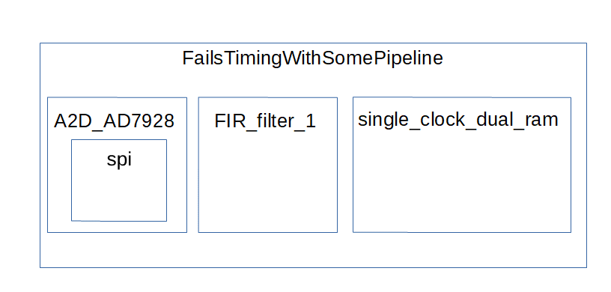
Project Module Hierarchy

Slide 8
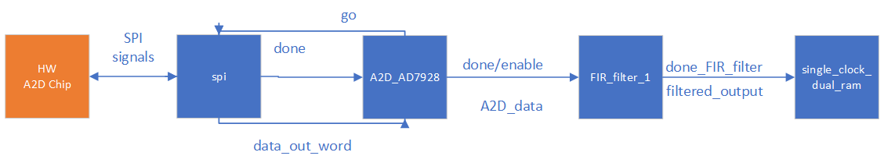
Project Module Data Flow

Slide 9
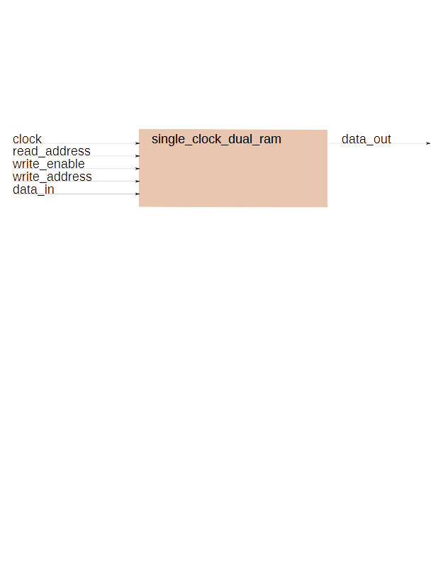
Inferred Memory Module
Synchronous; single clock
Dual port RAM; Can read and write and the same time
I/O

Slide 10
Inferred Memory Port Signals
module single_clock_dual_ram
#( // port parameters
parameter int ADDRESS_LEN = 8,
parameter int RAM_WIDTH = 8,
parameter int RAM_DEPTH = (2 ** ( ADDRESS_LEN )) // Do not override this
)
( // port signals
input logic clock,
// no resets on memory
input logic [ADDRESS_LEN - 1:0] read_address,
output logic [RAM_WIDTH - 1:0] data_out,
input logic write_enable,
input logic [ADDRESS_LEN - 1:0] write_address,
input logic [RAM_WIDTH - 1:0] data_in
);

Slide 11
Inferred Memory Implementation
// Implementation
always_comb
begin
if ( write_enable == 1'b1 )
begin
mem_next [ write_address ] = data_in;
end
data_out_next = mem [ read_address];
end
// Register the output of combinational logic
always @ (posedge clock)
begin
mem <= mem_next;
data_out <= data_out_next;
end

Slide 12
FIR Filter Module
We will use pipelining to implement this module
This module will fail to meet the timing requirements when we build the project
We will learn how to do additional pipelining after the timing failure so that the project will meet timing requirements
Background items to discuss before we discuss the FIR Filter Module:
    Introduction to pipelines
    Introduction to the FIR Filter.
Then we’ll look at the FIR Filter Module’s code

Slide 13
What Is a Pipeline?
A technique to improve throughput by dividing the project’s work up into individual tasks
This works something like an assembly line
An individual item will not be completed faster – maybe even a little slower
Overall, the system will complete more work for a given amount of time

Slide 14
Pipeline: Laundry Example (1 of 2)
There are 3 steps in the process
    (W) Washing – 35 minutes
    (D) Drying – 45 minutes
    (F) Folding – 20 minutes
The washer accommodates 20 items of clothing per load
We have 200 items to wash
If we do laundry sequentially; no pipelining, it looks like this: W D F W D F ...
    10 loads
    Each has a latency of 100 minutes
    1000 minutes to wash all the laundry
    We process about 12 items of clothing per hour

Slide 15
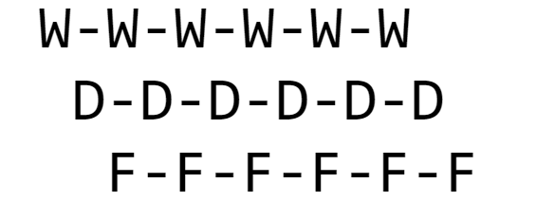
Pipeline: Laundry Example (2 of 2)
While washing, dryer idle; while drying, washer idle; while folding, both washer and dryer are idle.
So, let’s operate in parallel
The drying phase is the longest at 45 minutes. With 10 loads, that’s 450 minutes.
Add time for the first wash, 35 minutes, and the last fold, 20 minutes, the total time is 505 minutes.
We process about 23.76 items per hour.
This is about twice as fast as our non-pipelined example.
    Note that the time taken to launder one shirt remains the same.
    The system throughput is improved.
This example taken from: http://hpca23.cse.tamu.edu/taco/utsa-www/cs5513-fall07/lecture3.html

Slide 16
FIR Filter Introduction
Finite Impulse Response (FIR) filters use only delayed versions of the input signal to filter the input to the output
Finite: no feedback (IIR have feedback)
A basic and common Digital Signal Processing (DSP) filter
Removes noise
Pro: simple to implement
Con: require many math calculations
A tap is a coefficient/delay pair
Delay line is the implementation of the delay part of the filter algorithm

Slide 17
FIR Filter – How We Will Use It
16 taps
Low pass: low frequencies pass through the filter and high frequencies are attenuated; this is how noise is removed
The coefficients can be obtained from MATLAB or similar tools.

Slide 18
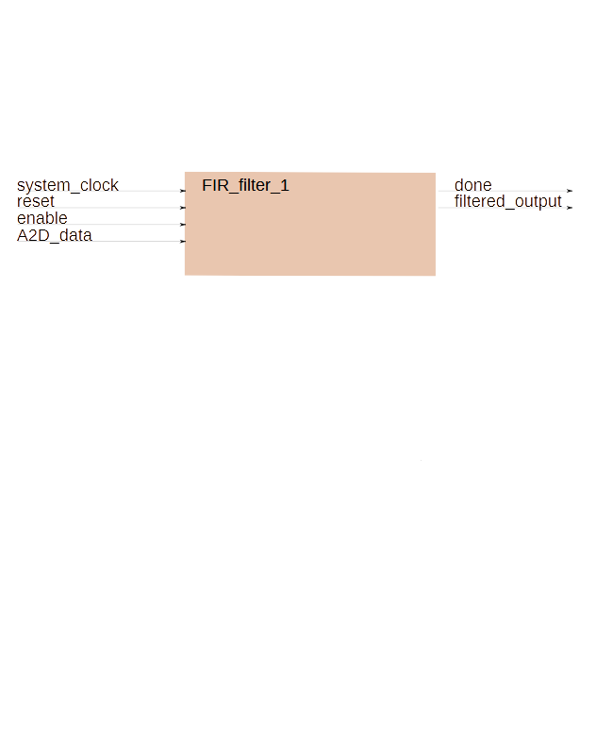
FIR Module I/O

Slide 19
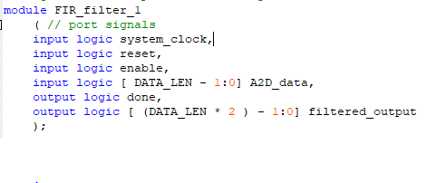
FIR Filter Module Port Signals

Slide 20
FIR Module Steps
Like the laundry example, our FIR filter has 3 steps:
    Move data through the delay line
    Multiply the values by their per-calculated coefficient
    Sum the products to create the filtered_output
The coefficients can be computed with MATLAB or one of several online FIR Filter tools

Slide 21
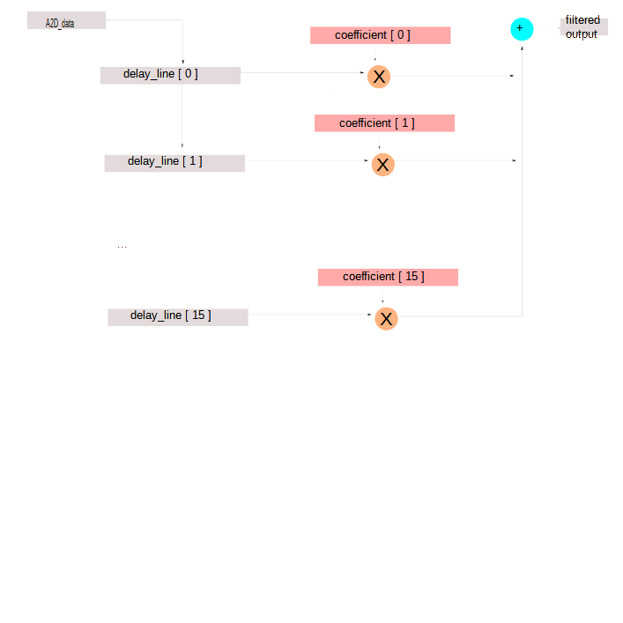
FIR Module FPGA Implementation

Slide 22
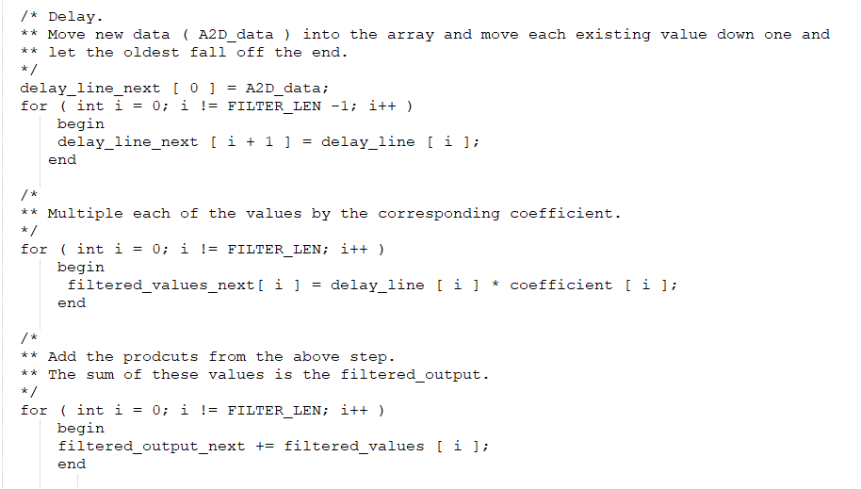
FIR Module –The 3 Steps Verilog

Slide 23
Pipeline – The FIR Filter Module
We anticipate that this module is the one that’s going to cause us to not meet our timing requirements.
Why?
Because it’s does many math calculations.
There are 16 32-bit integer additions.
There are 16 16-bit integer multiplications

Slide 24
Adding Timing Constraints
We’re done with coding
We’re going to add our timing constraints to the Quartus tool
We need to add timing constraints for
    Each clock
    Each I/O path (ports of the top level module)
We have one clock:
    system clock
    it’s a 50MHz clock that we are using on our evaluation board
    we’re going to lie and say it’s 200 MHz (a medium FPGA speed) so that we will be able to demonstrate timing constraints failure and resolution
    Timing will actually pass at 50 MHz
Each I/O path – these are the ports of the top level module
    We have the SPI signals; these are implemented in I/O flip-flops which don’t require timing restraints because these are implemented with timing constraints for us in the I/O flip-flop
        Because IO flops have dedicated, fixed routing, so timing is ensured/guaranted by construction/design
        Therefore timing failures on IO flops are impossible
        You would specify timing constraints for an IO buffer if a clock buffer drives an IO pin
            Often done in high speed protocols. One example is PCI express
            This is the exception; you’re usually adding timing constraints for clocks
    We have the reset signal; this is also implemented in an I/O flip-flop.
    Finally we have the filtered value that we wrote to memory. For now, it is a dummy signal. It will remain there until we read the memory in an upcoming lab.
As such, the only signal that we will add a timing constraint for is the system_clock.

Slide 25
Add Timing Constraints to Project
We’re going to use the TimeQuest Timing Analyzer Wizard
In Quartus, select Tools> TimeQuest Timing Analyzer
The TimeQuest Timing Analyzer will open in a separate window. In it, select Tools > TimeQuest Timing Analyzer Wizard ...
The Wizard will open in a new window

Slide 26
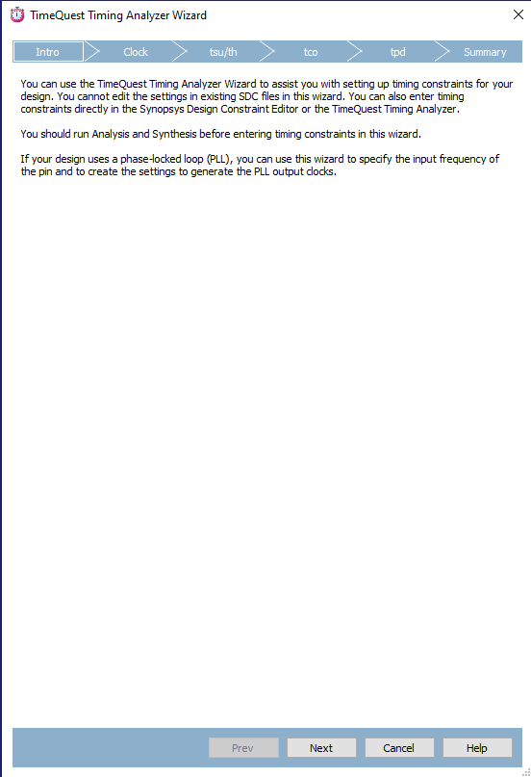
TimeQuest Analyzer Wizard

Slide 27
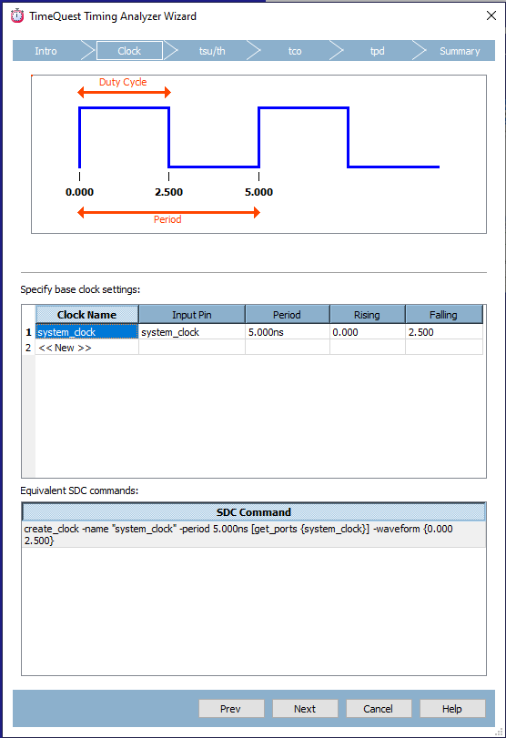
TimeQuest Analyzer Wizard Data
We are specifying a 200 MHz system_clock:
  5 ns Period
  0 Rising
  2.5 Falling
Note that we enter “system_clock” in both the Clock_Name field as well as the “Input_Pin” field and we do not enter the actual input pin.
The input pin for the system_clock is specified in the .qsf file

Slide 28
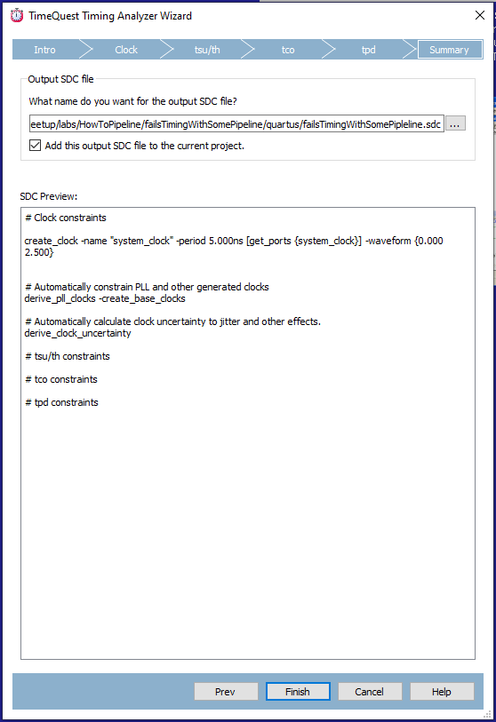
TimeQuest Analyzer Wizard Finish
Select “Next” four more times
Accept the default name for the timing constraints .sdc file
Select “Finish”

Slide 29
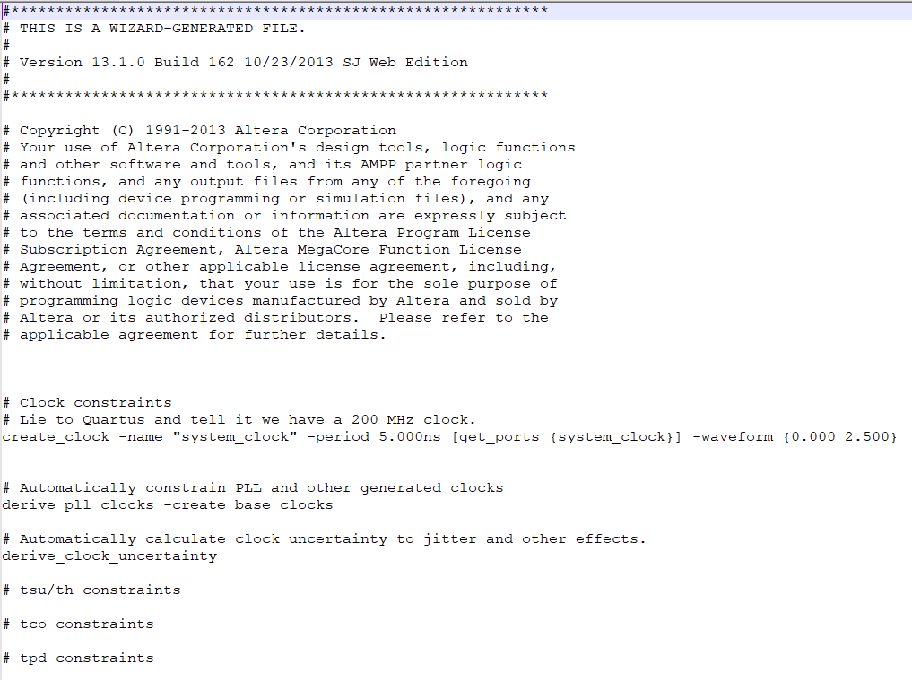
Timing Constraints (.sdc) file

Slide 30
Build Project – Timing Fails
Build project and observe that there are warnings about timing not meeting specifications.
This is because we created a timing constraints (.sdc) file and the timing requirements specified are not met.
Let’s look at the timing report information to see what the problem is and what we should do about it.

Slide 31
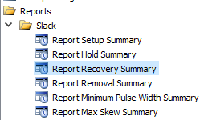
Access Timing Reports (1 of 4)
In Quartus, select Tools> TimeQuest Timing Analyzer
The TimeQuest Timing Analyzer will open in a separate window.
Double-click the “Create Timing Netlist” option.
In Tasks/Menu/slack, double-click the “Report Setup Summary” (the first option under “Slack”)

Slide 32
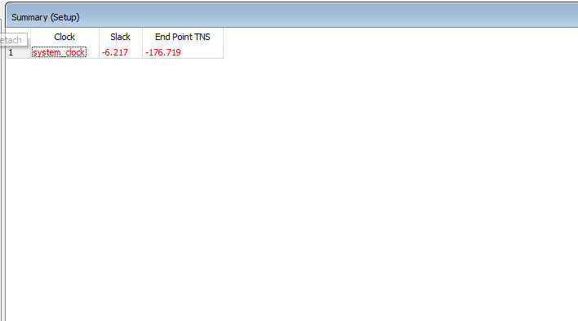
Access Timing Reports (2 of 4)
Right click the row

Slide 33
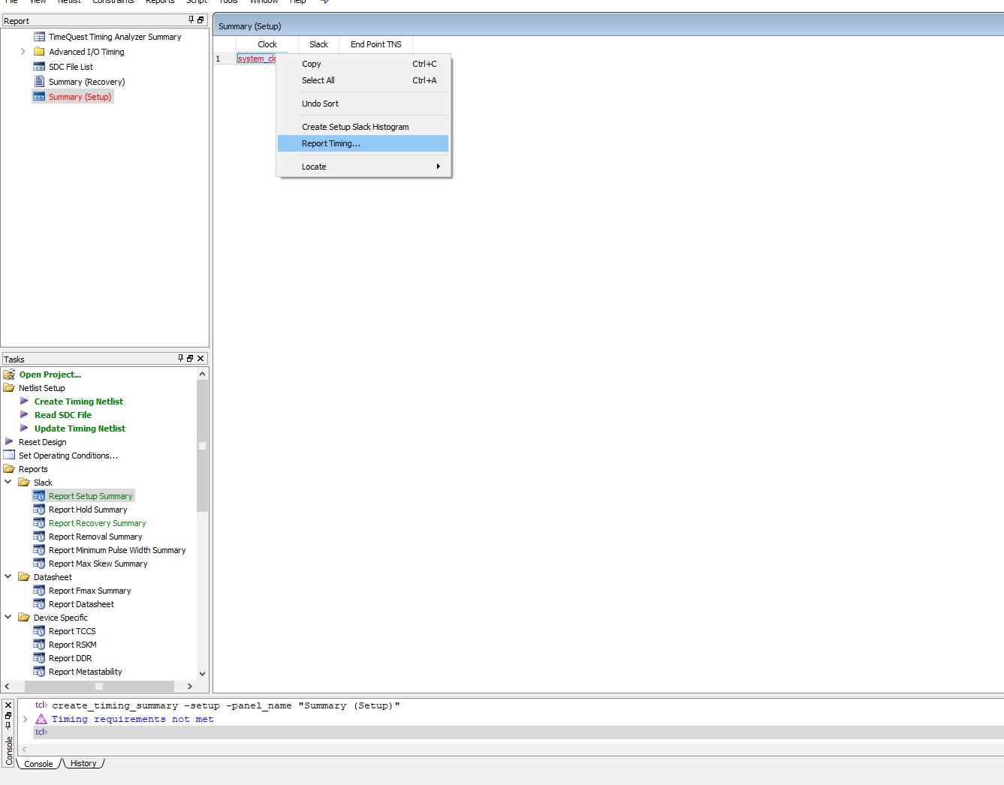
Access Timing Reports (3 of 4)
Then select “Report Timing...”

Slide 34
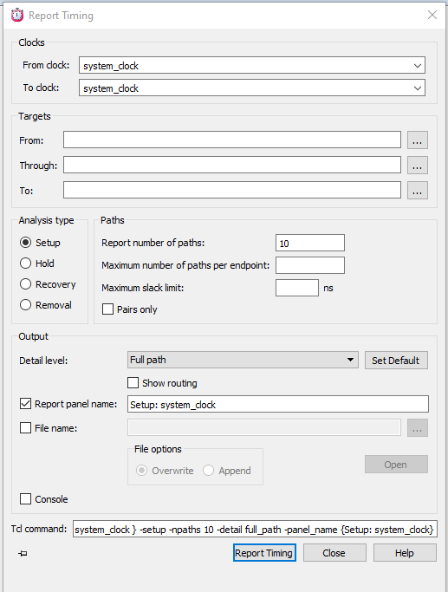
Access Timing Reports (4 of 4)
Then this window opens
Add “system_clock”
Select the “Report Timing” button

Slide 35
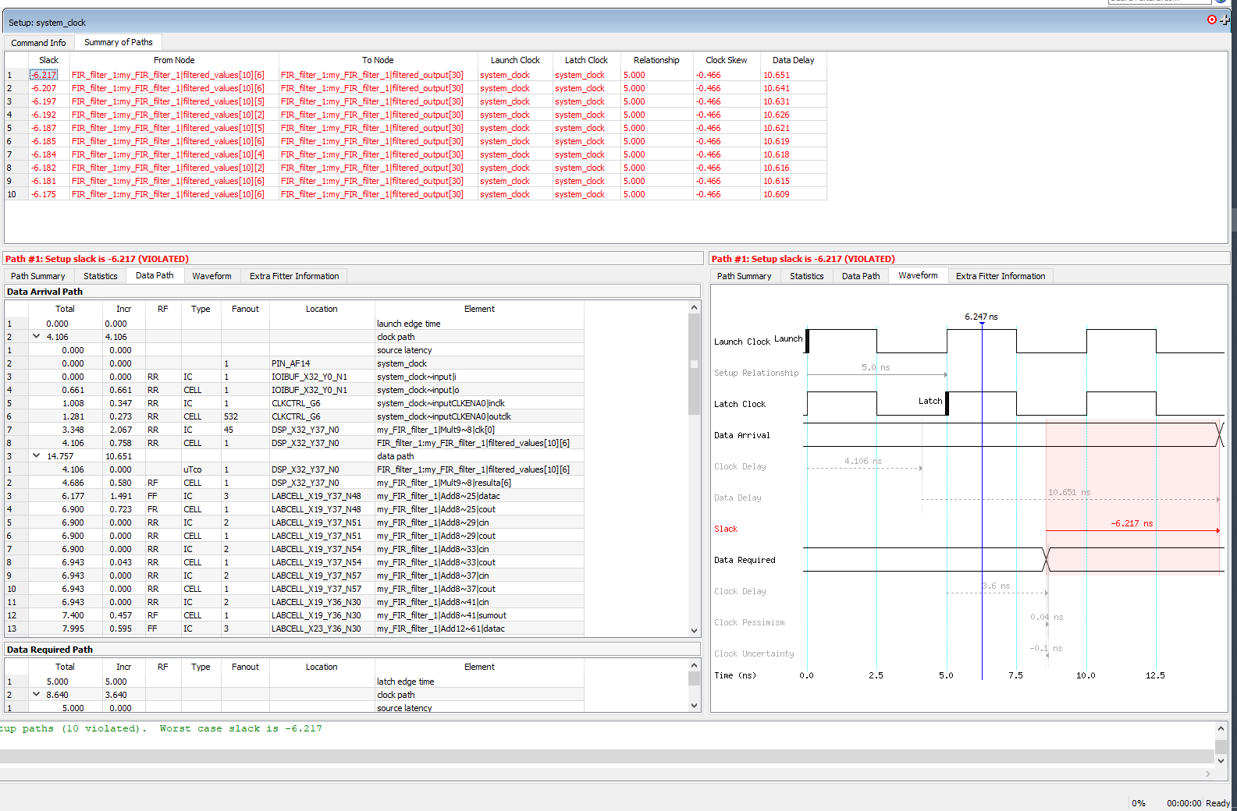
Timing Report Information

Slide 36
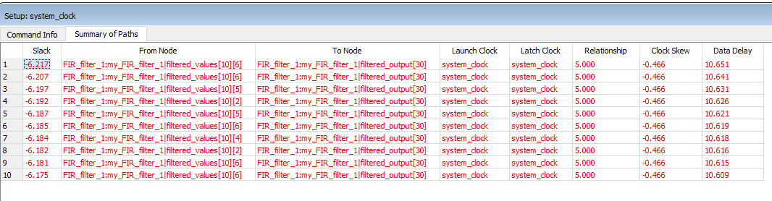
Worst Negative Slack Summary
Study the top section: worst negative slack summary
The top 10 rows show an issue in module FIR_filter_1
All of them show a problem going from filter_values to filtered_output, we know the addition is the problem:
    filtered_output_next += filtered_values [ i ];

Slide 37
Additions Cause Timing Failure
There are 16 32-bit integers
16 * 32 = 512
Therefore 512 LUT inputs
We are asking for too much work to be done in one 200 MHz clock cycle.
This is why timing fails in the additions
The solution: more pipelining!
    We will break up the work of doing the additions into more steps.
    Then timing should pass.

Slide 38
Pipeline The Additions

Slide 39
Additional Pipelining:The Additions
/*
** Break up the work of doing the additions so that timing
** constraints will be met.
*/
for ( int i = 0; i!= NUM_ADDERS_STAGE1; i++) // 8
begin
for ( int j =0; j!= NUM_ADDER_INPUTS; j++)
begin
intermediate_add_stage1_next [ i ] = intermediate_add_stage1_next [ i ] + filtered_values [ (i * NUM_ADDER_INPUTS) + j ];
end
end
for ( int i = 0; i!= NUM_ADDERS_STAGE2; i++) // 4
begin
for ( int j =0; j!= NUM_ADDER_INPUTS; j++)
begin
intermediate_add_stage2_next [ i ] = intermediate_add_stage2_next [ i ] + intermediate_add_stage1 [ (i * NUM_ADDER_INPUTS) + j ];
end
end
for ( int i = 0; i!= NUM_ADDERS_STAGE3; i++) // 2
begin
for ( int j =0; j!= NUM_ADDER_INPUTS; j++) // 2
begin
intermediate_add_stage3_next [ i ] = intermediate_add_stage3_next [ i ] + intermediate_add_stage2 [ (i * NUM_ADDER_INPUTS) + j ];
end
end
/*
** Add the final two sums; the final sum is the filter output – the value that will be written to memory
*/
filtered_output_next = intermediate_add_stage3 [ 0 ] + intermediate_add_stage3 [ 1 ];

Slide 40
Timing passes!
Build the project again
Observe that timing requirements are met due to the absence of timing constraint warnings.

Slide 41
Timing Didn’t Fail In Multiplication
Why?
Dedicated DSP blocks were probably used
Multiplication implemented in hardware
This is faster
As such, timing requirements were not violated by the multiplication code

Slide 42
Another Pipeline Example
This is not needed to meet timing requirements in our example project.
This example is being presented because it’s a common technique used to resolve timing constraint warnings.
Let’s look at a timer from the SPI code.
localparam int TIMER_LEN = 16;
logic [ TIMER_LEN:0 ] end_sclk_to_disable_ss_wait_timer = '0;
logic [ TIMER_LEN:0 ] end_sclk_to_disable_ss_wait_timer_next = '0;

Slide 43
Timer Code Before Pipeline
END_SCLK_TO_DISABLE_SS_WAIT:
begin
end_sclk_to_disable_ss_wait_timer_next =
end_sclk_to_disable_ss_wait_timer – 1'b1;
if ( end_sclk_to_disable_ss_wait_timer == '0 )
begin
SS_n_next = 1'b1;
state_next = SS_DEASSERT_WAIT;
end
end

Slide 44
Timer Code After Pipeline
END_SCLK_TO_DISABLE_SS_WAIT:
begin
end_sclk_to_disable_ss_wait_timer_next =
end_sclk_to_disable_ss_wait_timer - 1'b1;
end_sclk_to_disable_ss_wait_timer_elapsed_next =
(end_sclk_to_disable_ss_wait_timer == 1);
if ( end_sclk_to_disable_ss_wait_timer_elapsed == 1'b1 )
begin
SS_n_next = 1'b1;
state_next = SS_DEASSERT_WAIT;
end
end

Slide 45
Why Does This Help Timing?
Because the before code
    Is doing a 16-bit comparison
    More work
The after code
    Does a 1-bit comparison
    This means fewer LUT inputs
    This helps with timing problems
    As such, this is a common technique to address timing constraint violations

Slide 46
Resource Utilization
You don’t have to be concerned about adding pipeline code from a resource utilization point of view
Be aware that more pipelining will use more power.
However, most FPGA applications are not power sensitive

Slide 47
Other Timing Failure Types
This presentation discussed classic logic levels
    the addition example
    the comparison example
The other common timing failure types are:
    Bad placement - limited resource like a large RAM or DSP multiplier; this is also addressed with pipelining
    High fanout – many LUTs need to access the same signal; addressed with manual replication of that net within the RTL
    Fanout of a signal to fixed resources (a special subcase of bad placement) For example, if we need to send a write enable to 4 different RAMs and they are far apart. This problem can be addressed with either pipelining or manual replication of that net within the RTL.

Slide 48
Timing Errors Going Forward
This presentation has been an introduction to the concept
With complex projects,
    Correcting timing errors is an ongoing, iterative process
    Projects are built using multiple builds executed at the same time with the expectation that some will fail and some will pass
    It’s not uncommon to expect 25% of builds to pass timing requirements
    It’s not uncommon to run 10 builds simultaneously to get an acceptable build passing timing.

