Slide 1
FPGA: Hello World
Austin FPGA Meetup
March 9, 2020
Michelle Guardabascio

Slide 2
Overview
Quartus Installation/Device Support
Install Device Drivers For The Terasic Evaluation Board
Project Creation & Add Device To Project
System Verilog Introduction, HelloWorld Code, and .qsf File Changes
Compile
Program The Device

Slide 3
Things You Will Need
DE1-SoC Evaluation Board
DE1-SoC User Manual
Quartus Tool & Quartus Cyclone V Support File
Terasic Board Device Drivers
You can adapt this information for a different Quartus-supported FPGA Evaluation Board With LED.

Slide 4
DE1-SoC
Available from Terasic
https://www.terasic.com.tw/cgi-bin/page/archive.pl?Language=English&No=836
$249 ($175 Academic)
64-bit OS and Quartus II 64-bit are required to compile projects

Slide 5
Quartus Installation
Quartus is a synthesis, place, and route tool
Quartus II Web Edition (Free) 13.1
Intel account is required for download
https://fpgasoftware.intel.com/13.1/?edition=web&platform=windows
Download Quartus installer
Download support for Cyclone V
Run installation program

Slide 6

Install Device Drivers
The device drivers are required for the evaluation board
Windows instructions are here:
http://www.terasic.com.tw/wiki/Altera_USB_Blaster_Driver_Installation_Instructions
After successful installation, the Windows device manager will show:

Slide 7
Create Project
Open Quartus
File/New Project Wizard…
Next Button
Provide working directory by navigating to it […]
Provide name of project: HelloWorld
Finish Button

Slide 8
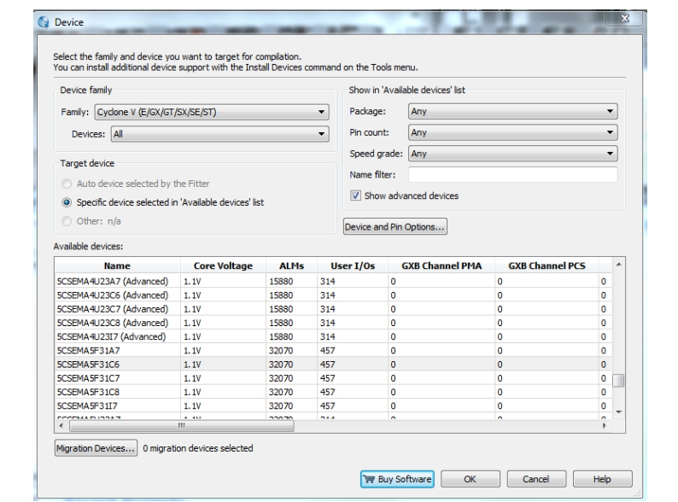
Add Device
Assignments/Device...
Select Family: Cyclone V(E/GX/GT/SX/SE/ST)
Select Device Name from list of Available Devices
Device name on IC: 5CSEMA5F31C6 / OK Button

Slide 9
Our Module - HelloWorld
// filename is HelloWorld.sv
module HelloWorld (
input logic CLOCK_50,
output logic MY_LED
);
...
Endmodule

Slide 10
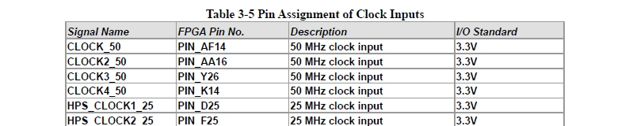
Input
input logic CLOCK_50
See pinout information in the DE1-SoC User Manual
We will use the first one: PIN_AF14
Add to project’s .qsf file:
set_instance_assignment -name IO_STANDARD "3.3-V LVTTL" -to CLOCK_50
set_location_assignment PIN_AF14 -to CLOCK_50

Slide 11
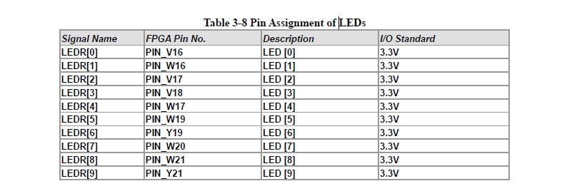
Output
output logic MY_LED
See pinout information in the DE1-SoC User Manual
We will use the first one: PIN_V16
Add to project’s .qsf file:
set_instance_assignment -name IO_STANDARD "3.3-V LVTTL" -to MY_LED
set_location_assignment PIN_V16 -to MY_LED

Slide 12
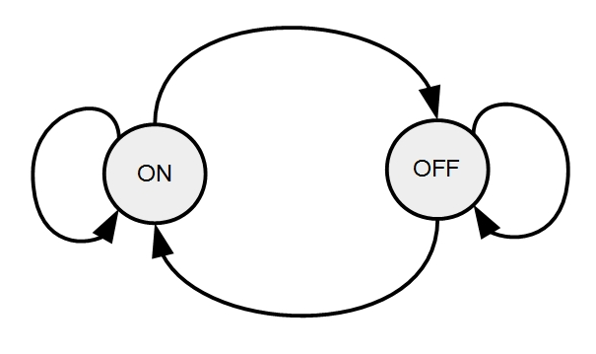
Finite State Machine (FSM)

Slide 13
Implement FSM: Case Statement
unique case ( state )
LED_ON:
begin
timer_next = timer - 1'b1;
MY_LED_next = ON;
if ( timer == '0 )
begin
timer_next = DURATION;
state_next = LED_OFF;
end
end
LED_OFF:
begin
timer_next = timer - 1'b1;
MY_LED_next = OFF;
if ( timer == '0 )
begin
timer_next = DURATION;
state_next = LED_ON;
end
end
endcase

Slide 14
Module Organization
always @* begin
Combinational Logic
The Finite State Machine (FSM)
end
always @( posedge CLOCK_50 ) begin
Registering: output of LUT moved into a flipflop
end // always @posedge

Slide 15
Registering
state <= state_next;
state_next is LUT output
state is flip-flop output
Use <=
Left hand side is always a flip-flop output

Slide 16
always @( posedge CLOCK_50 )
always @( posedge CLOCK_50 ) begin
timer <= timer_next;
state <= state_next;
MY_LED <= MY_LED_next;
end // always @posedge

Slide 17
Always @* (1 of 3)
// Typdef for the finite state machine's (FSM's) state
typedef enum logic {
LED_ON = 1'b0,
LED_OFF = 1'b1
} state_t;

Slide 18
Always @* (2 of 3)
// Local Params
localparam logic ON = 1'b1;
localparam logic OFF = 1'b0;
localparam logic [25:0] DURATION = '1; // (fills 26 bits with 1's) ~1.3 sec w/ 50 MHz clock
// Internal Signal Declarations
state_t state = LED_OFF;
state_t state_next;
logic [ 25:0 ] timer = DURATION;
logic [ 25:0 ] timer_next;
logic MY_LED_next;

Slide 19
Always @* (3 of 3)
always @*
begin
timer_next = timer;
state_next = state;
MY_LED_next = MY_LED;
// FSM goes here
...

Slide 20
Putting It All Together
// Hello FPGA World!
// Let's blink an LED on the DE-1-SoC Evaluation Board
module HelloWorld (
input logic CLOCK_50, // 50 MHz clock; info from board's user manual & written to the .qsf file
output logic MY_LED // 1st LED; info from board's user manual & written to the .qsf file
);
// Typdef for the finite state machine's (FSM's) state
typedef enum logic {
LED_ON = 1'b0,
LED_OFF = 1'b1
} state_t;
// Local Params
localparam logic ON = 1'b1;
localparam logic OFF = 1'b0;
localparam logic [25:0] DURATION = '1; // (fills 26 bits with 1's) ~1.3 sec w/ 50 MHz clock
// Internal Signal Declarations
state_t state = LED_OFF;
state_t state_next;
logic [ 25:0 ] timer = DURATION;
logic [ 25:0 ] timer_next;
logic MY_LED_next;
// Implementation
always @*
begin
timer_next = timer;
state_next = state;
MY_LED_next = MY_LED;
unique case ( state )
LED_ON:
begin
timer_next = timer - 1'b1;
MY_LED_next = ON;
if ( timer == '0 )
begin
timer_next = DURATION;
state_next = LED_OFF;
end
end
LED_OFF:
begin
timer_next = timer - 1'b1;
MY_LED_next = OFF;
if ( timer == '0 )
begin
timer_next = DURATION;
state_next = LED_ON;
end
end
endcase
end // always @*
always @( posedge CLOCK_50 ) begin
timer <= timer_next;
state <= state_next;
MY_LED <= MY_LED_next;
end // always @posedge
endmodule

Slide 21
The Code
Get the code here:
https://github.com/AustinFPGA/EducationalResources/blob/master/HelloWorld.sv
Add file to project

Slide 22
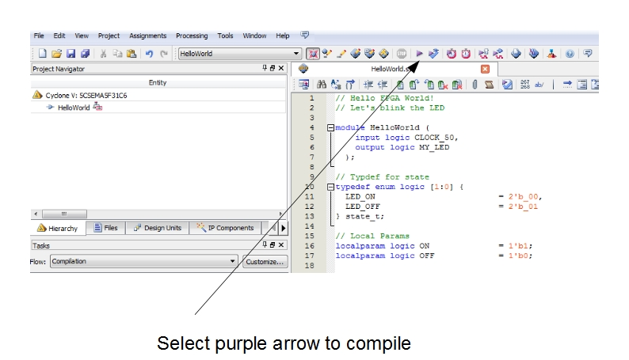
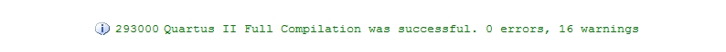
Compile

Slide 23
Program The Device
Tools/Programmer
Hardware Setup…/Select DE-SoC
Select 5CSEMA5F31C6 icon
Select “Change File” (not “Add File”)
Navigate to .sof file/OK
Check “Program/Configure” checkbox
Start button
The LED is now blinking!

