Slide 1
GPA1-B
Austin Cole
5/15/2026

Slide 2
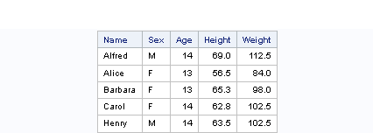
Screenshot 1 from step 9

Slide 3
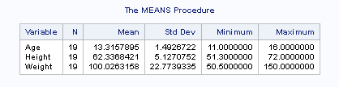
Screenshot 2 from step 13

Slide 4
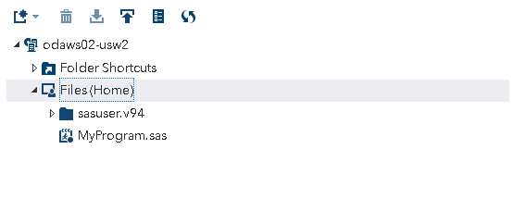
Screenshot 3 from step 17

