Slide 1
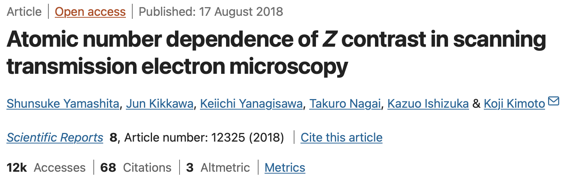
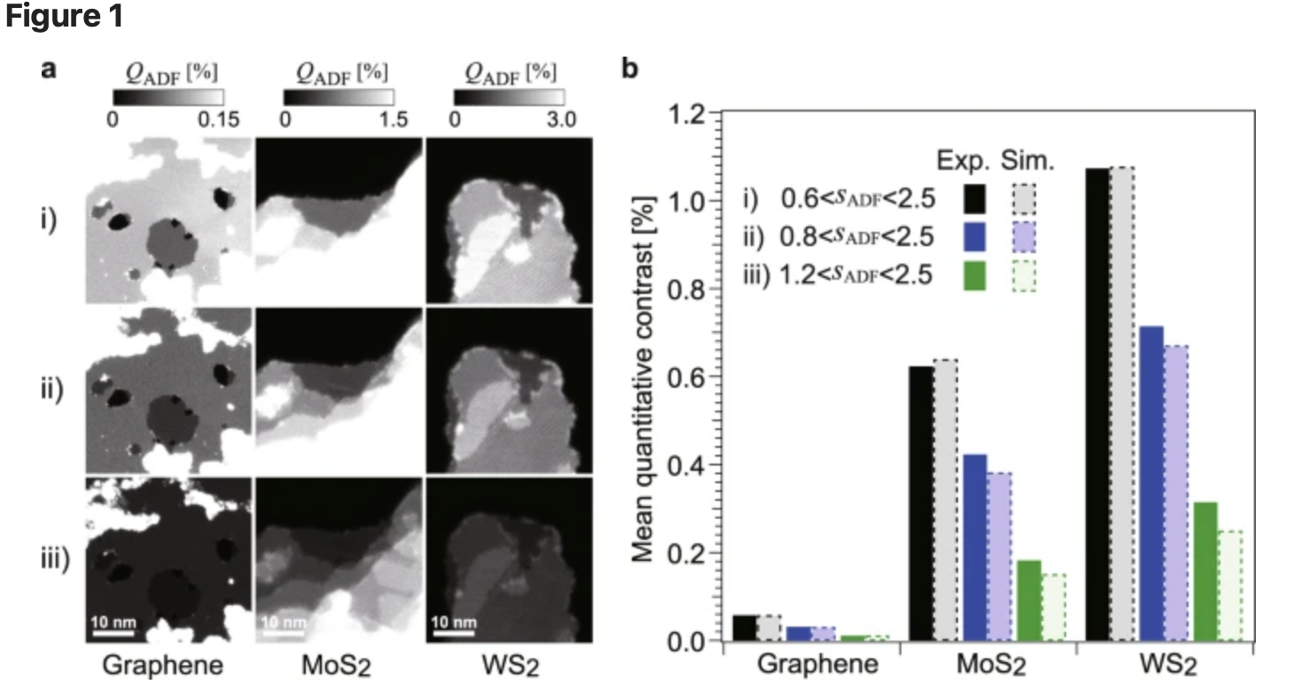
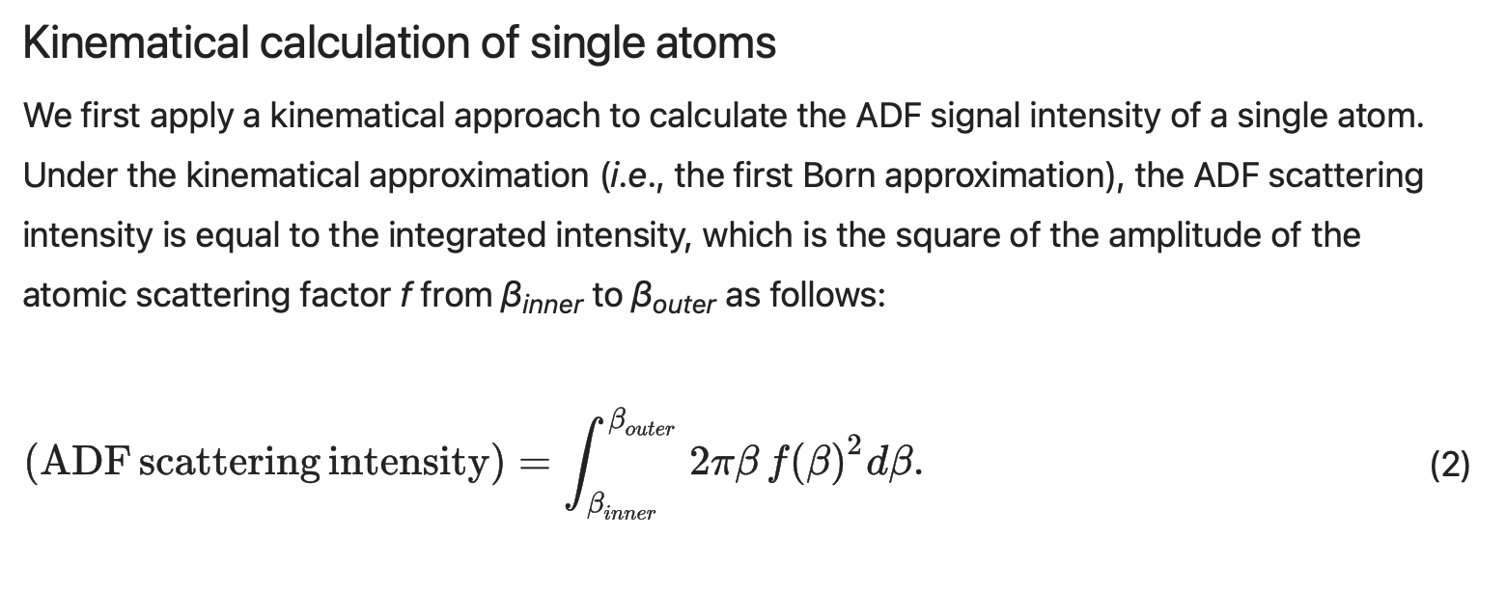
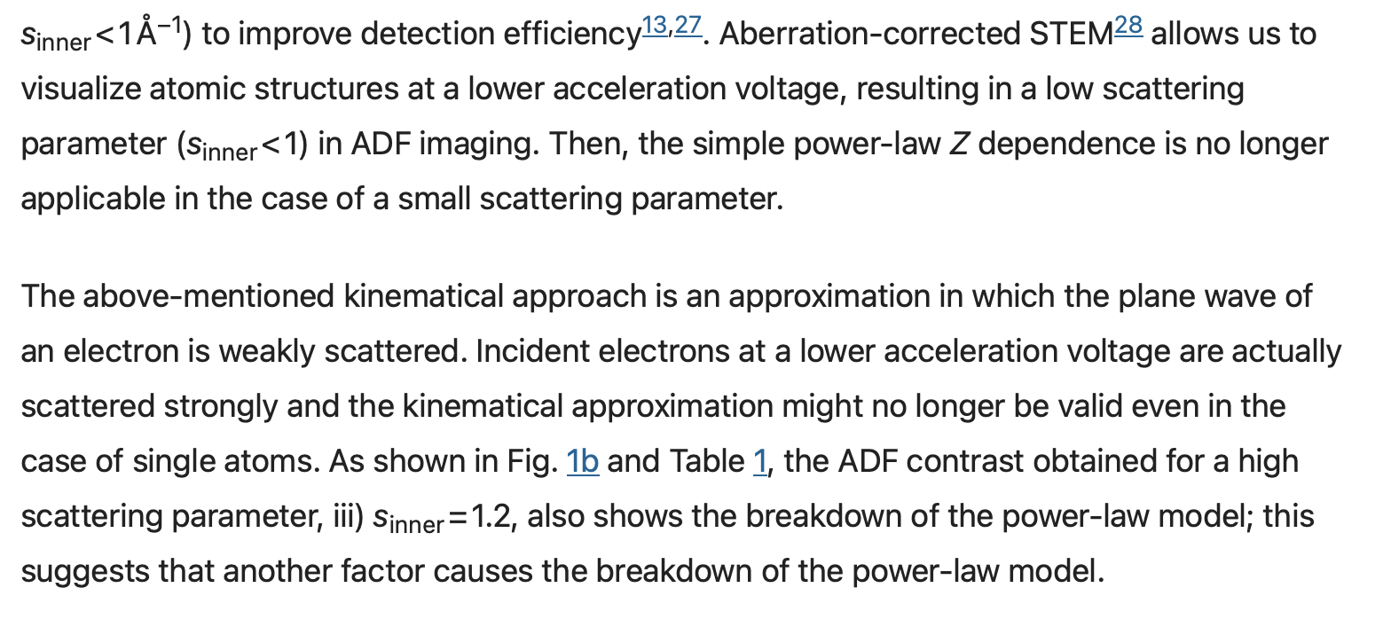
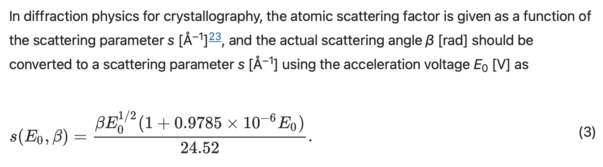
Kinematic approximation breakdown
https://www.nature.com/articles/s41598-018-30941-5

Slide 2
What is Kinematic Scattering approximation?

Slide 3
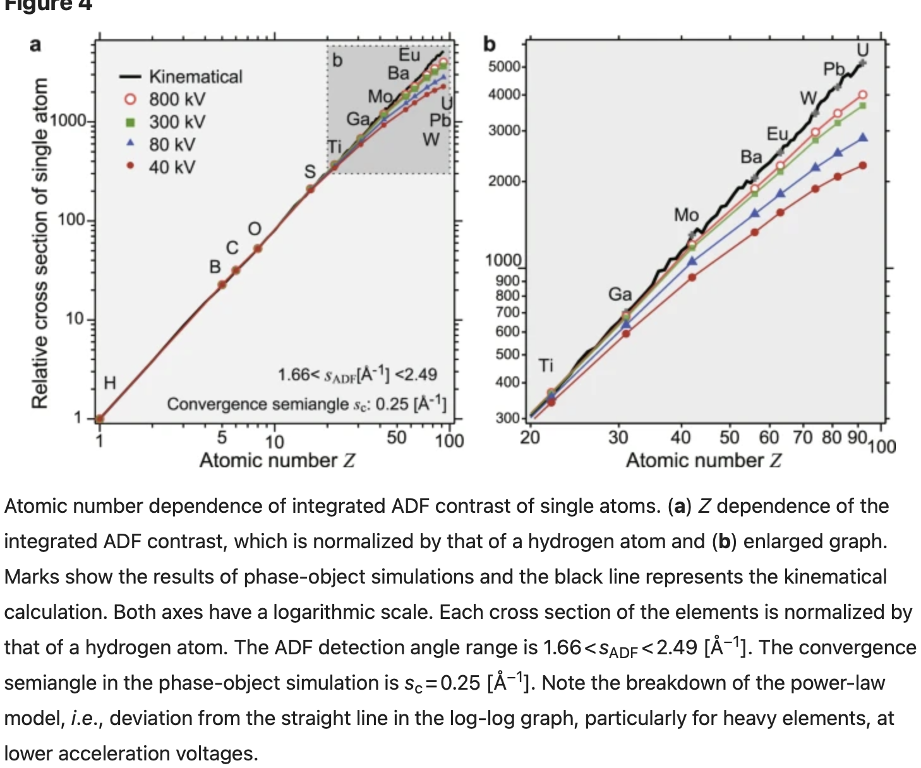
Phase-object simulation of single atoms

Slide 4
Tabularize, fit eq, and use to simulate images

Slide 5
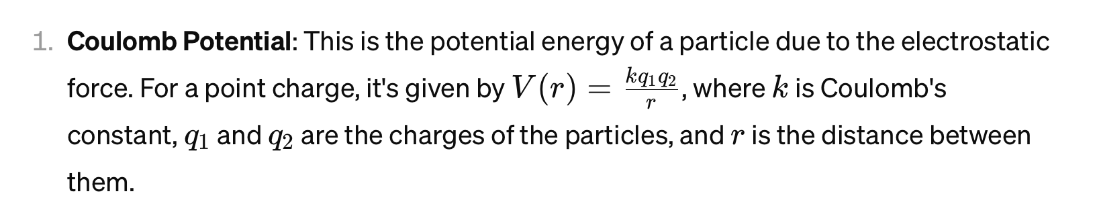
Using Coulomb Potential
(rutheford scattering)

