Slide 1
Liquidity, Activism Disclosure,
and Takeover Premia
When can the market see an activist coming — and who pockets the premium?
Austin Li
University College London
SEMINAR DECK · 40 MINUTES

Slide 2
Agenda
01
Motivation
Activist returns ride the takeover channel; two live policy levers
02
Framework
One trading round, four plays, and a bidder who reads the price
03
Results
The liquidity sweet spot, the premium wedge, the transparency paradox
04
Evidence
The 2024 five-business-day rule as a natural experiment
05
Implications
Policy, investors, and the road ahead
Backup: calibration, equilibrium tables, posterior algebra, certification machinery, data & methods.
LIQUIDITY · ACTIVISM DISCLOSURE · TAKEOVER PREMIA
2

Slide 3
EXECUTIVE SUMMARY
Three things to take away
1
2
3
Liquidity has a sweet spot
Who pockets the premium is tender mechanics
Disclosure law is a market-design lever
Takeover gains for minority shareholders are hump-shaped in market liquidity: noise lets bidders in, but too much noise destroys the market's ability to price activism.
The activist premium is pinned by a free-rider tender game: appropriability λ = 1 − q(1−γ)ψ. Low λ explains why estimated premia can fall when activists show up.
Stake-triggered disclosure attenuates the liquidity effect — and stricter rules can backfire by killing quiet engagement. The 2024 SEC acceleration moved exactly this margin.
LIQUIDITY · ACTIVISM DISCLOSURE · TAKEOVER PREMIA
3

Slide 4
01 · MOTIVATION
Activist returns ride the takeover channel
So the question that prices an activist position is:
does a takeover arrive, and at what premium?
Both depend on what the market can infer about engagement before anything is announced — i.e., on trading conditions and disclosure rules.
Informed trading moves prices ahead of 13D filings (Collin-Dufresne–Fos 2015): the market is watching order flow.
SHARE OF ACTIVIST RETURNS TIED TO M&A
~65%
of activist hedge-fund returns are tied to M&A outcomes (Brav–Jiang–Partnoy–Thomas 2008).
Targets are acquired at significant premia; activists profit primarily through the takeover exit (Greenwood–Schor 2009).
LIQUIDITY · ACTIVISM DISCLOSURE · TAKEOVER PREMIA
4

Slide 5
01 · MOTIVATION
Two policy levers, one information problem
LIQUIDITY — CAN YOU TRADE UNSEEN?
DISCLOSURE — WHEN MUST YOU SHOW YOUR HAND?
Noise trading is camouflage: it lets a blockholder accumulate or exit without moving the price.
But camouflage cuts both ways — it also stops the market from seeing value being created.
Tick sizes, dark pools, retail flow, index churn: all shift this dial. Regulators move it constantly.
Schedule 13D: crossing 5% with intent forces a public filing — engagement becomes observable.
Below the trigger, engagement can only be inferred from order flow. The rule partitions the information regime.
US window: 10 calendar days → 5 business days (Feb 2024). UK: 3% / 2 days. The lever is live.
LIQUIDITY · ACTIVISM DISCLOSURE · TAKEOVER PREMIA
5

Slide 6
01 · MOTIVATION
2024: the SEC halved the clock
1968
2011–22
Oct 2023
Feb 5, 2024
Williams Act: 13D regime born
Petitions & debate: 10-day gap criticized
Rule 33-11253 adopted
5 business days in force
A regulator just compressed the pre-disclosure accumulation window — the exact margin this framework prices.
That makes the theory testable now: filings, returns, and liquidity around 2024-02-05 are the natural experiment.
LIQUIDITY · ACTIVISM DISCLOSURE · TAKEOVER PREMIA
6

Slide 7
01 · MOTIVATION
THE QUESTION
How do market liquidity and disclosure rules shape the takeover premia that minority shareholders receive?
A single equilibrium framework: a blockholder who can exit, hold, or engage — quietly or publicly — a market pricing order flow, and a bidder reading both.
LIQUIDITY · ACTIVISM DISCLOSURE · TAKEOVER PREMIA
7

Slide 8
01 · POSITIONING
Three literatures, one missing piece
EXIT VS VOICE
INFORMED TRADING
TAKEOVER FEEDBACK
Blockholder governance: liquidity both disciplines (cheap accumulation) and tempts exit.
Hirschman 1970; Maug 1998; Edmans 2009
Microstructure: order flow moves prices; noise is camouflage.
Kyle 1985; Glosten–Milgrom 1985
Prices feed back into real decisions — including bids.
Grossman–Hart 1980; Edmans–Goldstein–Jiang 2015
Closest trio: Ordóñez-Calafí & Bernhardt 2022 (threshold design), Corum & Levit 2019 (activists as bidder catalysts), Cetemen et al. 2026 (dynamic trade timing).
This paper: stake-triggered disclosure partitions order-flow inference into disclosed and nondisclosed branches — and that inference feeds endogenous bidder entry.
LIQUIDITY · ACTIVISM DISCLOSURE · TAKEOVER PREMIA
8

Slide 9
02 · FRAMEWORK
The model in one picture
NATURE
TRADING
ENTRY
PAYOFFS
Value v drawn; blockholder sees private signal s
Chooses action; noise traders mix in; market prices order flow
Bidder reads price & disclosure, decides whether to bid
Takeover premium or standalone value
One round of trading, one potential bidder — the cleanest lab for the question. κ = share of noise trades (the liquidity dial).
Crucially, the bidder conditions on the price: information flows from trading to takeover entry. That feedback loop is the engine.
LIQUIDITY · ACTIVISM DISCLOSURE · TAKEOVER PREMIA
9

Slide 10

02 · FRAMEWORK
The blockholder's four plays
EXIT
HOLD
QUIET VOICE
PUBLIC VOICE
Sell the stake
Stay passive
Engage privately
Buy + engage + file
Weakest signals: cash out before bad news
Middling signals: not worth the engagement cost
Good signals: improve the firm below the radar
Best signals: scale up and trigger disclosure
private signal s → cutoff ladder
(a theorem, not an assumption)
LIQUIDITY · ACTIVISM DISCLOSURE · TAKEOVER PREMIA
10

Slide 11

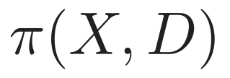
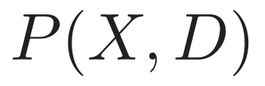

02 · FRAMEWORK
Why liquidity matters twice
ORDER FLOW
MARKET BELIEF
PRICE
BID ENTRY
Noise as cover (+): more noise → lower prices on average → takeovers get cheaper → more bids arrive.
Noise as fog (−): more noise → order flow says less about engagement → the activism premium the market can price erodes.
Disclosure (D = 1) bypasses the fog entirely — engagement is observed, not inferred. That asymmetry drives the policy results.
LIQUIDITY · ACTIVISM DISCLOSURE · TAKEOVER PREMIA
11

Slide 12
02 · FRAMEWORK
What the market sees: two information regimes
QUIET (D = 0) — INFERENCE
PUBLIC (D = 1) — OBSERVATION
Engagement is guessed from order flow.
Liquidity κ governs how good the guess is.
Hold and quiet voice look identical in the tape — by design.
The 13D filing makes engagement public.
Prices stop depending on κ at all.
Disclosure is an information-regime switch, not just paperwork.
The disclosure rule decides how much of the market lives in each regime — that is what makes it a design object.
LIQUIDITY · ACTIVISM DISCLOSURE · TAKEOVER PREMIA
12

Slide 13
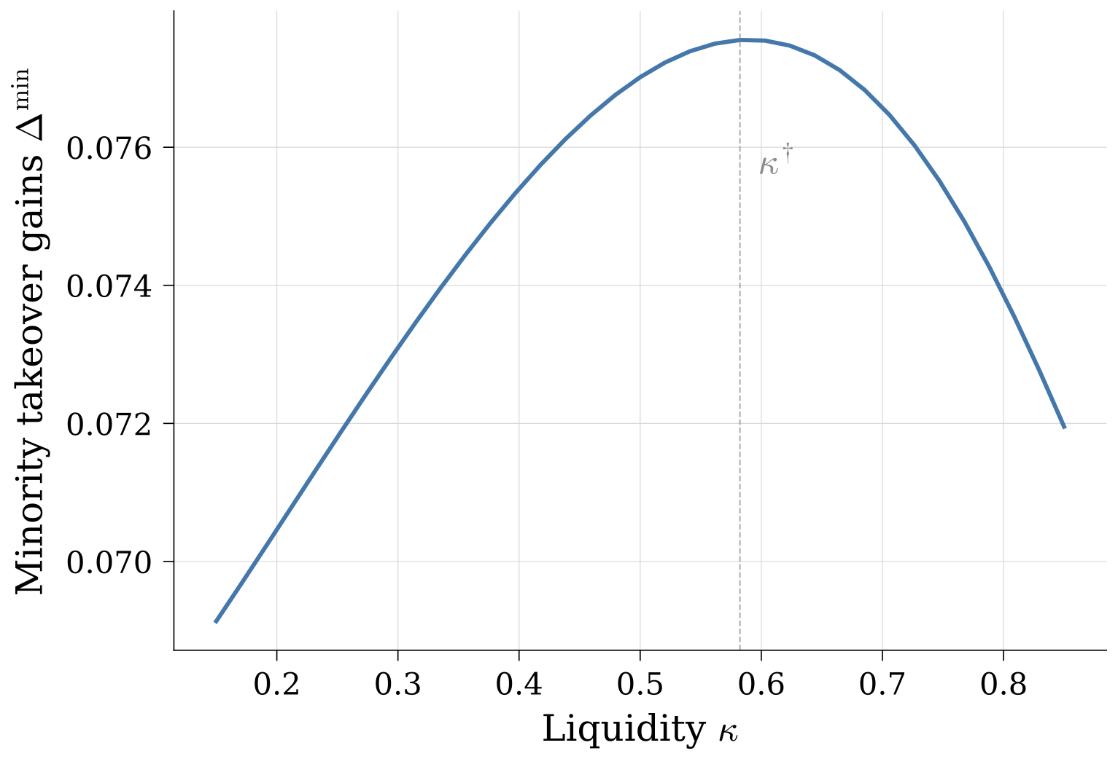
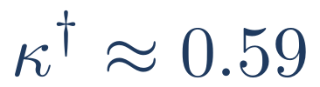
03 · RESULTS · 1
Liquidity has a sweet spot
Expected takeover gains to minority shareholders are hump-shaped in liquidity.
Too little noise: bidders stay away — prices are too informative, deals too expensive.
Too much noise: bids come, but the activism premium the market can price has evaporated.
THE PEAK
cover and visibility in balance
Minority takeover gains Δ-min vs noise-trading intensity κ; baseline calibration.
LIQUIDITY · ACTIVISM DISCLOSURE · TAKEOVER PREMIA
13

Slide 14
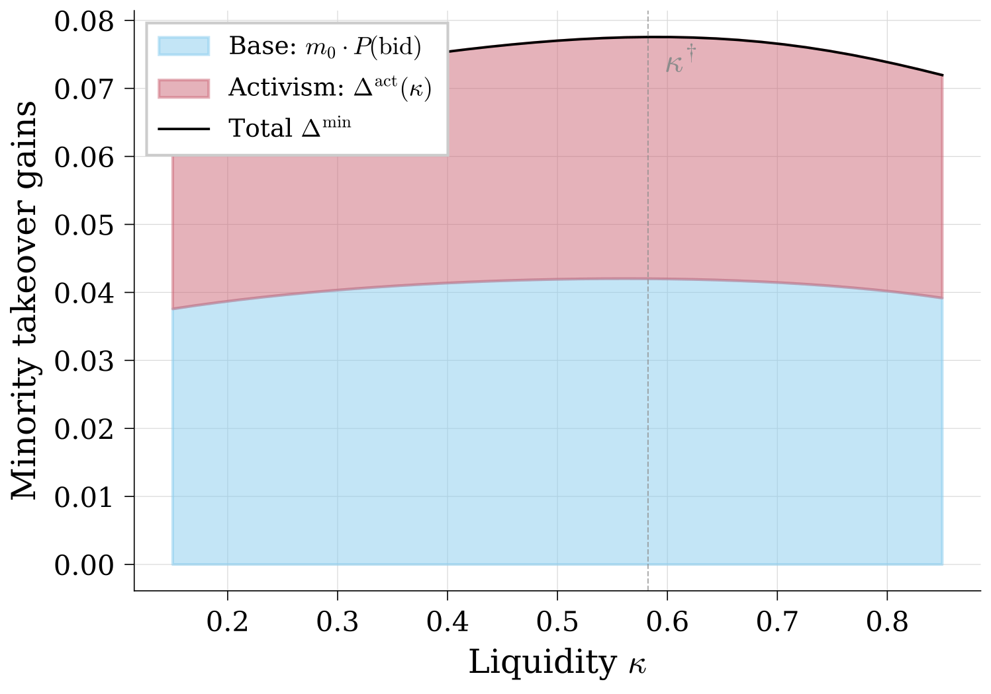
03 · RESULTS · 1
Why: cover vs camouflage, in one split
Split the gains into two books:
Base book — premium that arrives regardless of activism. Rises with noise: cover brings bids.
Activism book — premium tied to the market believing engagement is happening. Hump-shaped: inference dies with noise.
The activism book's peak sets the overall sweet spot.
Decomposition of Δ-min into base and activism components across κ.
LIQUIDITY · ACTIVISM DISCLOSURE · TAKEOVER PREMIA
14

Slide 15
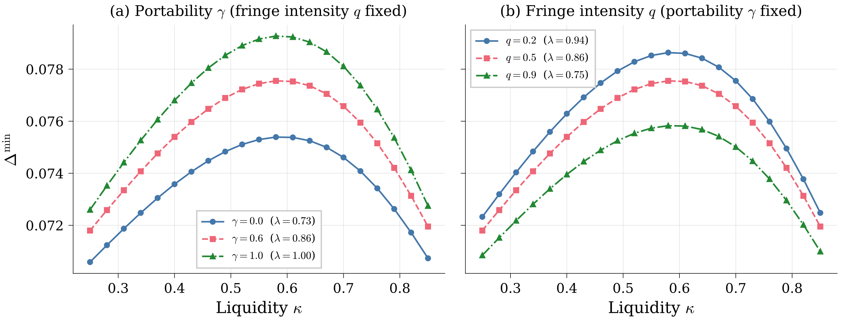




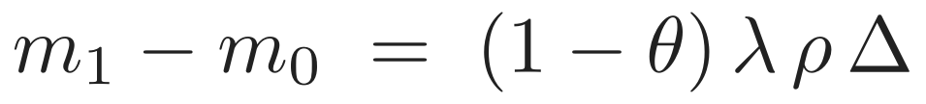
03 · RESULTS · 2
Who captures the prize: tender-game arithmetic
how much of the improvement the activist's side keeps
— chance a rival raider shows up
— does the improvement survive a change of control?
— can the bloc's stake block the raid?
PREMIUM WEDGE
derived from a free-rider tender game — not assumed.
Appropriability λ across game primitives (q, γ, ψ).
LIQUIDITY · ACTIVISM DISCLOSURE · TAKEOVER PREMIA
15

Slide 16
03 · RESULTS · 2
The puzzle this solves: premia that fall on arrival
Structural estimates (Celentano–Levine 2025) find bid premia 13.7% lower with an activist in the deal.
Contradiction with 'activism creates value'? No.
The measured premium divides the offer by a market price that already banks the activist's work (AFS 2022: 13D returns are ~3/4 anticipated treatment).
When appropriability λ is low, the denominator outruns the numerator: measured premia fall even though the true wedge m₁ ≥ m₀ never flips.
What our wedge adds vs the board-bargaining story:
Their effect moves only with activist presence.
Ours is indexed by observables: acquirer type (γ), rival pressure (q), stake pivotality (ψ), liquidity (κ).
→ It predicts where the sign flips: portable improvements, pivotal blocs, cold fringe markets.
Different cross-sections, testable against each other.
LIQUIDITY · ACTIVISM DISCLOSURE · TAKEOVER PREMIA
16

Slide 17
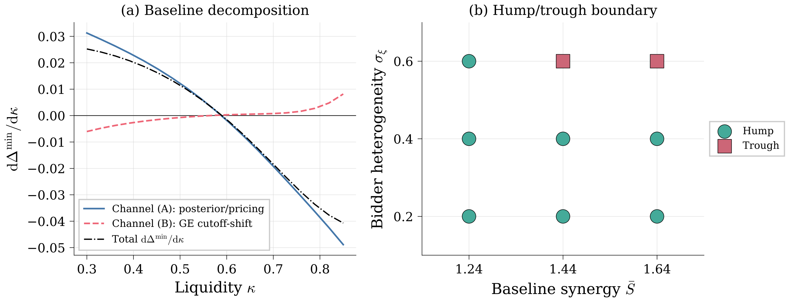
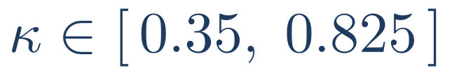
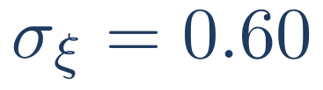
03 · RESULTS · 3
How robust is the sweet spot? Now a theorem — with edges
On a certified range of the liquidity dial, the hump is a theorem: equilibrium feedback provably cannot overturn it.
Outside it, the warning is real: when bidders barely react to premia, the hump inverts into a trough — certified, not hypothetical.
CERTIFIED RANGE
INVERSION CASE
Practical read: the liquidity sweet spot is strongest where takeover entry is most sensitive to expected resistance.
GE channel decomposition; certified region and the σ_ξ = 0.60 inversion.
LIQUIDITY · ACTIVISM DISCLOSURE · TAKEOVER PREMIA
17

Slide 18
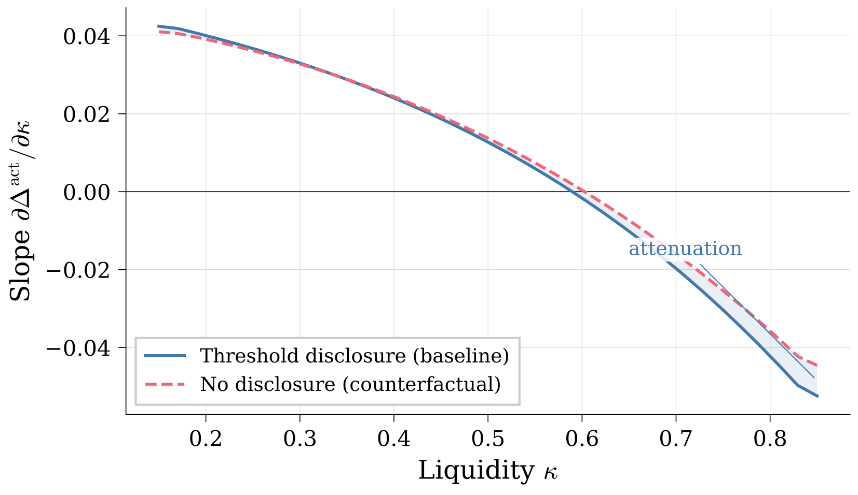
03 · RESULTS · 4
Disclosure turns the liquidity dial down
Disclosed states don't depend on liquidity — so the more engagement happens in public, the flatter the liquidity–premium relationship.
Disclosure and liquidity are substitute information channels.
Cross-market prediction: tighter regimes (UK 3%/2-day) should show muted liquidity sensitivity vs the US.
Sensitivity of activism gains to κ under baseline vs stricter disclosure.
LIQUIDITY · ACTIVISM DISCLOSURE · TAKEOVER PREMIA
18

Slide 19
03 · RESULTS · 4
The transparency paradox
TRANSPARENCY (+)
DETERRENCE (−)
Stricter disclosure reveals engagement → market prices activism → minorities share the gains.
Dominates when engagement is cheap and liquidity moderate.
Forced visibility kills quiet voice: the blockholder exits rather than tip a bidder-deterring hand.
Dominates when engagement is costly — minorities end up worse off.
Disclosure reform that ignores deterrence can destroy the channel it is trying to illuminate — the model says when.
LIQUIDITY · ACTIVISM DISCLOSURE · TAKEOVER PREMIA
19

Slide 20
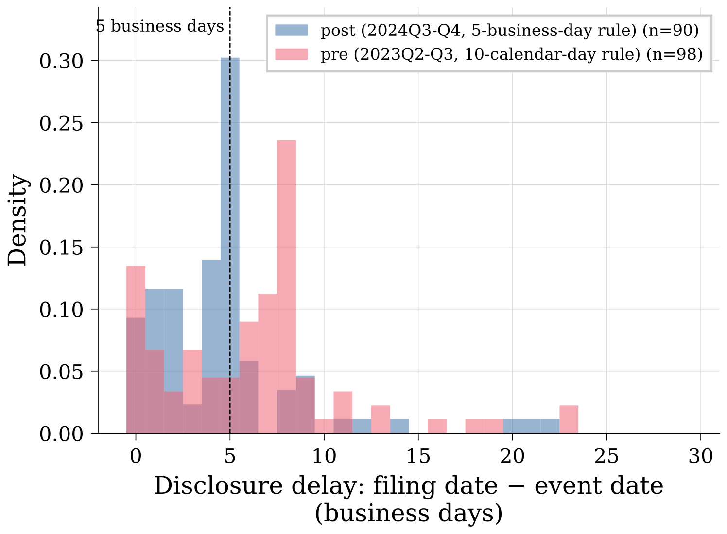
04 · EVIDENCE · 1
The clock bit: filings sped up immediately
MEDIAN FILING DELAY
7 → 5 days
FILED WITHIN 5 BUSINESS DAYS
36% → 76%
Universe of original 13Ds on EDGAR, windows straddling the 2024-02-05 compliance date.
The accumulation window — the model's quiet-trading cover — shrank by force of law.
LIQUIDITY · ACTIVISM DISCLOSURE · TAKEOVER PREMIA
20

Slide 21
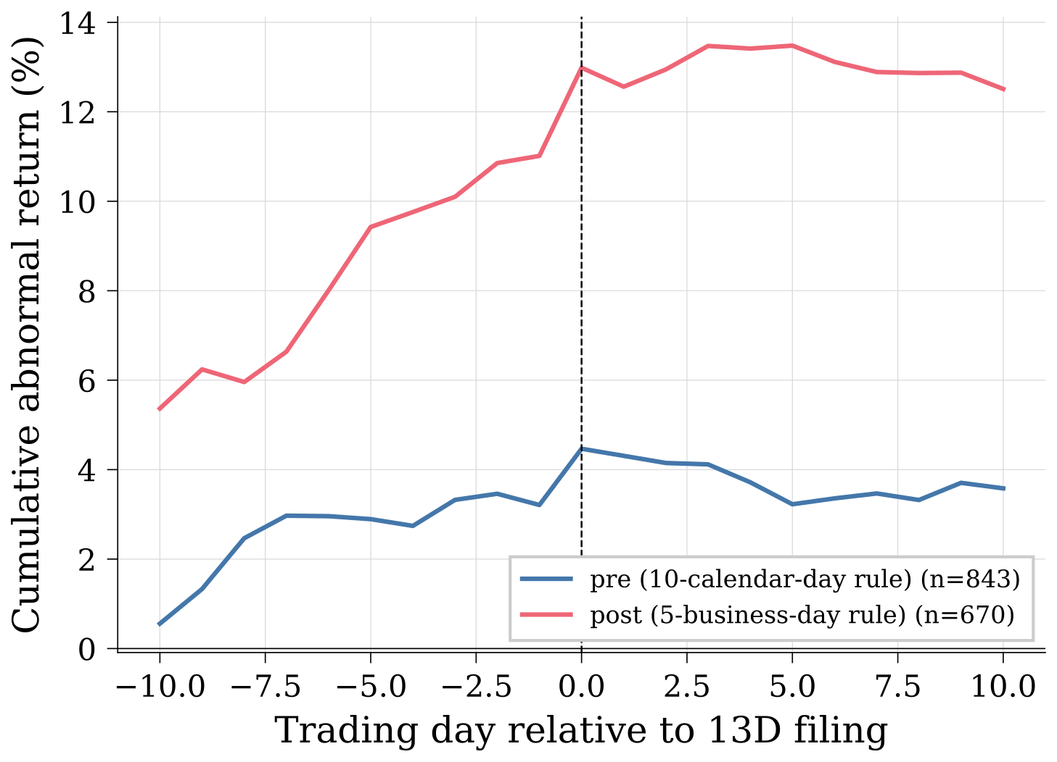
04 · EVIDENCE · 2
The market noticed: announcement returns moved
Market-model CARs around 1,513 original 13D filings, 2022–2025; Post = filed under the 5-day rule.
Mean CAR[−1,+1] doubles post-rule (0.85% → 1.71%; sign as predicted, not significant). Surprises concentrate in liquid names — the camouflage margin is first-order. The Post×illiquidity interaction is a precise null.
β (Post): +1.65pp (t=0.87)
ln Amihud: -1.43pp (t=-3.73)
δ (Post × ln Amihud): +0.17pp (t=0.48)
n = 893 events · two-way clustered SEs
LIQUIDITY · ACTIVISM DISCLOSURE · TAKEOVER PREMIA
21

Slide 22
05 · IMPLICATIONS
For policy: liquidity regulation is governance policy
1
Anything that moves noise trading — tick size regimes, dark-pool rules, PFOF, index flows — also moves takeover discipline. The two rulebooks are one.
2
Disclosure thresholds and windows are not transparency knobs alone: they reallocate engagement between quiet and public — and can deter it outright.
3
The 2024 acceleration traded camouflage for visibility. The model prices that trade; the early data move the predicted way.
Welfare caveat: the κ that maximizes minority gains is not the social optimum — extraction deters some efficient deals.
LIQUIDITY · ACTIVISM DISCLOSURE · TAKEOVER PREMIA
22

Slide 23
05 · IMPLICATIONS
For investors: where activism pays
SCREEN ON LIQUIDITY
Activist targets in mid-liquidity names carry the largest expected takeover kicker — both tails are weak.
READ THE WEDGE
Premium capture is largest with portable improvements (high γ), pivotal blocs (ψ), and few rival raiders (low q).
MIND THE REGIME
Post-2024, filing-day surprises are larger on average — and they are largest in liquid names, where quiet accumulation hides best.
All three are cross-sectional, sign-testable statements — not calibration folklore.
LIQUIDITY · ACTIVISM DISCLOSURE · TAKEOVER PREMIA
23

Slide 24
05 · ROADMAP
Where this goes next
NOW
NEXT
THEN
Theory + certified numerics + two facts from the 2024 natural experiment
Full event-study cross-sections: premia, bid hazards, and liquidity interactions on the 13D universe
Structural leg: estimate the engagement-cost distribution from 13D XML microdata — the white space the structural trio left open
The framework is built so each leg sharpens the same objects: κ, the disclosure rule, and λ.
LIQUIDITY · ACTIVISM DISCLOSURE · TAKEOVER PREMIA
24

Slide 25
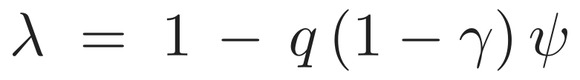
CLOSE
Three things to remember
1
Liquidity has a sweet spot — minority takeover gains peak at moderate noise — and we certified when that's a theorem.
2
Premia follow tender mechanics — appropriability prices who keeps the improvement — and why measured premia can fall.
3
Disclosure is market design — it substitutes for liquidity in pricing activism, and stricter isn't always better.
Thank you · junyu.li.24@ucl.ac.uk
LIQUIDITY · ACTIVISM DISCLOSURE · TAKEOVER PREMIA
25

Slide 26
Backup
Calibration · equilibrium tables · posterior algebra · certification machinery · tender game · data & methods

Slide 27







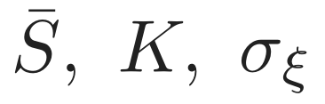
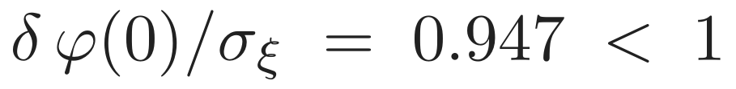
BACKUP
Baseline calibration
SYMBOL
PARAMETER
VALUE
RATIONALE
Prior mean / value vol
1.00 / 0.50
normalization; moderate uncertainty
Signal noise
0.50
signal weight β = 0.5
Discount
0.95
near-term horizon
Liquidity (baseline)
0.50
interior
Engagement cost, slope
0.12, 0.50
moderate, strong-thesis decay
Success prob / value-add
0.90 / 0.25
selective activists
Premia (base / success)
0.10 / 0.30
10% base, 30% on success
Synergy / entry cost / bidder vol
1.44 / 0.15 / 0.40
interior bid probability
Regularity (A5):
— unique pricing fixed point.
LIQUIDITY · ACTIVISM DISCLOSURE · TAKEOVER PREMIA
27

Slide 28





BACKUP
Baseline equilibrium outcomes
disclosure
order flow
price
belief
bid prob
premium
0
−2
0.84
0.00
0.81
0.10
0
−1
1.06
0.41
0.55
0.17
0
0
1.23
0.74
0.33
0.23
0
+1
1.39
1.00
0.17
0.28
1
0/1/2
1.90
1.00
0.01
0.28
Cutoffs: k₁ = k₀ ≈ 0.82, k_D ≈ 2.26 (hold region collapsed at baseline).
Disclosed branch: flat price, belief 1, bid probability collapses to 1% — public activism strongly deters bidders (price run-up plus the full premium m̃ = 0.28).
LIQUIDITY · ACTIVISM DISCLOSURE · TAKEOVER PREMIA
28

Slide 29
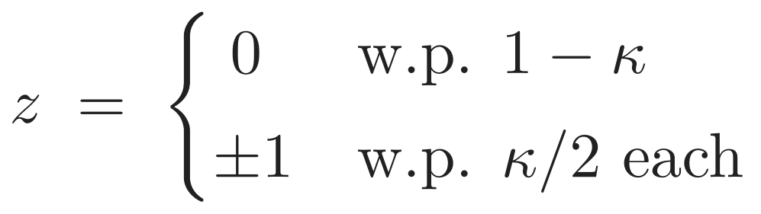
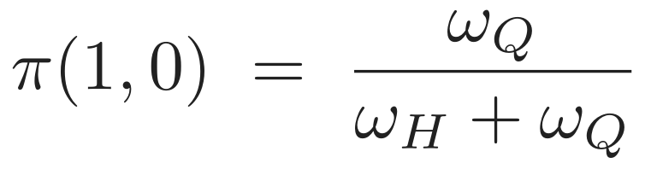
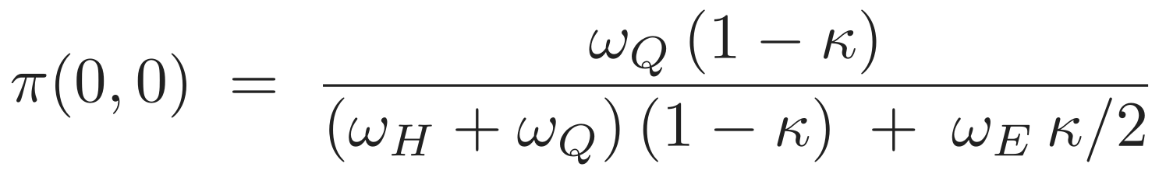
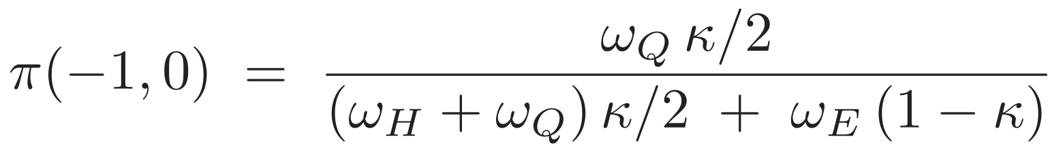
BACKUP
Where κ enters: the posterior algebra
NOISE
ORDER FLOW & DISCLOSURE
κ-free — X = 1 pins q = 0
falls in κ — noise dilutes the good signal
rises in κ — sell-side flow gets excused
Rising κ compresses posteriors toward the prior: the inference channel of the hump. On D = 1, π ≡ 1 regardless of κ.
LIQUIDITY · ACTIVISM DISCLOSURE · TAKEOVER PREMIA
29

Slide 30
BACKUP
Existence and uniqueness
Existence: Brouwer on the compact cutoff simplex — unconditional.
Pricing layer: A5 makes the price map a contraction — unique P* per information set:
Cutoff layer: contraction verified numerically (A6); multi-start search from 4+ initial conditions converges to identical cutoffs; modulus L ≤ 0.836 along the κ path.
The same modulus L powers the inversion-free certification of the hump region (next backup).
LIQUIDITY · ACTIVISM DISCLOSURE · TAKEOVER PREMIA
30

Slide 31
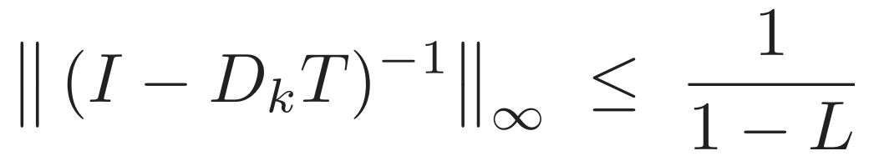
BACKUP
Certifying the hump region without inverting a Jacobian
Threat: equilibrium cutoffs move with κ (GE channel B) and could overturn the fixed-cutoff hump (channel A).
Standard bound needs ‖dk/dκ‖ — the unknown path derivative.
Trick: F = I − T inherits the contraction modulus L of the best-response map, so by the Neumann series:
— computable from one solve plus one finite difference.
Result: |B| bounded below channel A's amplitude on κ ∈ [0.35, 0.825] (inversion-free; [0.30, 0.85] with exact IFT). Margins: ball integral 2.5×10⁻⁵ vs 4.7×10⁻³.
At σ_ξ = 0.60 the same machinery certifies the failure: ∫|B| = 0.021 vs A-amplitude 0.0069 → trough.
LIQUIDITY · ACTIVISM DISCLOSURE · TAKEOVER PREMIA
31

Slide 32
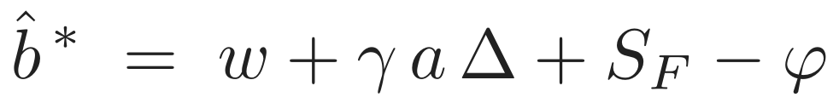
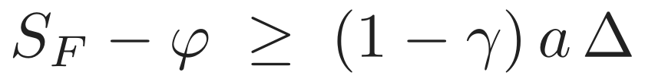
BACKUP
The tender game behind λ
At the bargaining disagreement node: fringe raider (cost c_F ~ H, synergy S_F ~ G) posts a uniform tender for control share τ; atomistic float free-rides; charter allows dilution φ of non-tendering holders (Grossman–Hart).
Free-rider floor — raid pays iff dilution on acquired shares covers entry cost:
Pivotal bloc (1 − α < τ) can block: floor raids fail unless
→ the ψ factor. The equilibrium share the activist's side keeps:
λ > 0 fails only if raids are certain, fully superseding, and unblockable — so the wedge m₁ > m₀ is a theorem on the rest of the parameter space.
LIQUIDITY · ACTIVISM DISCLOSURE · TAKEOVER PREMIA
32

Slide 33
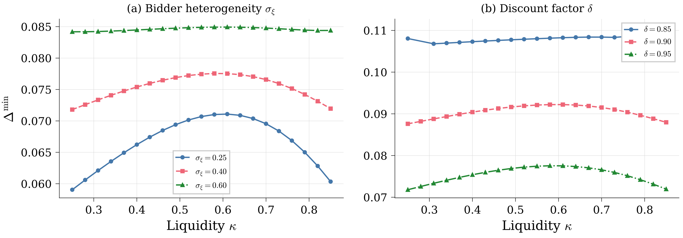
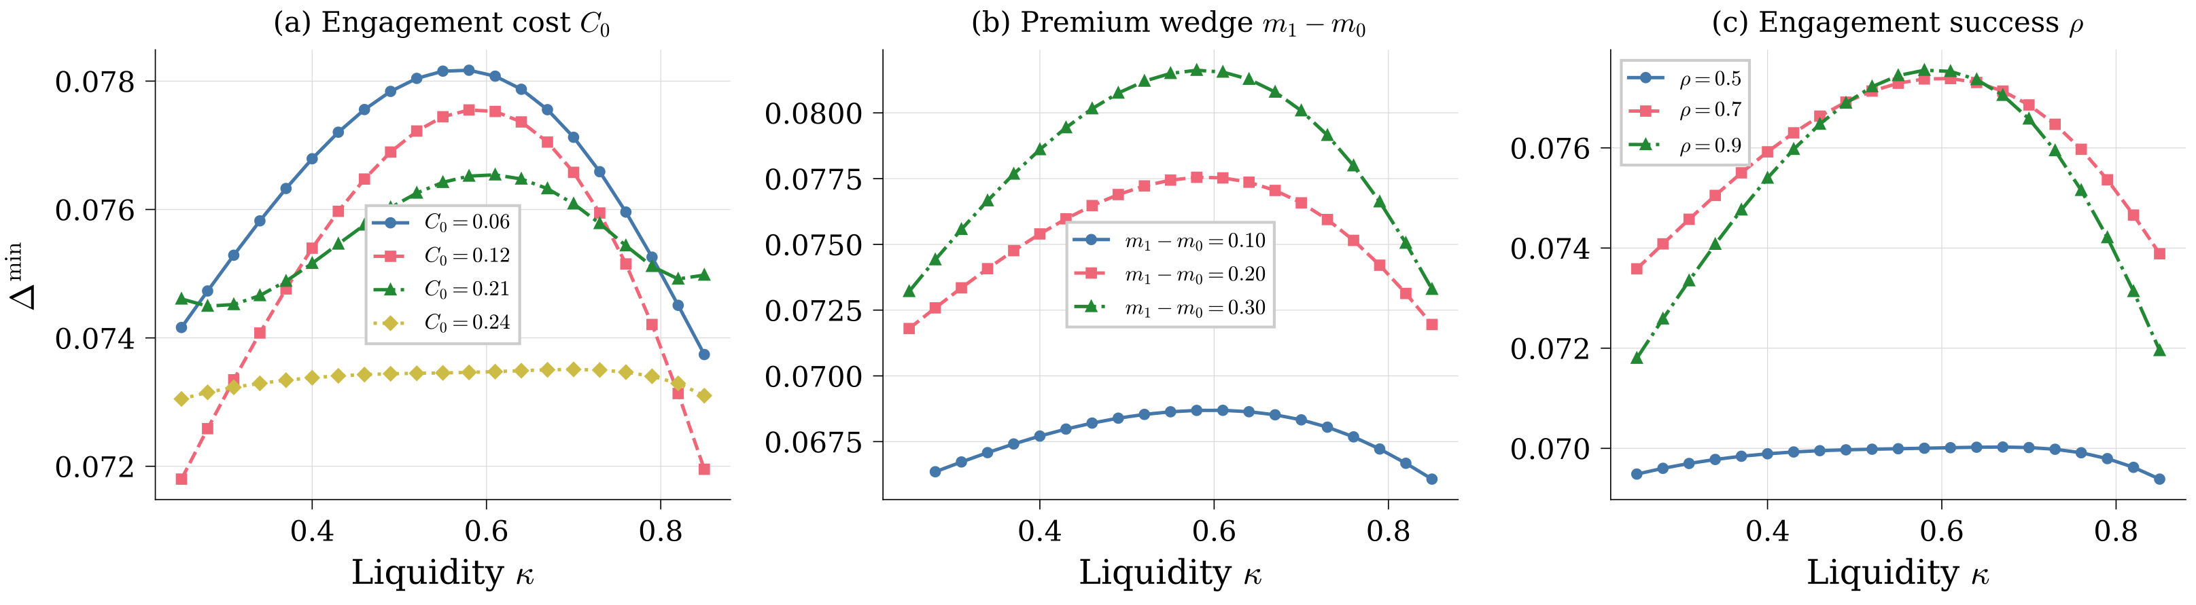
BACKUP
Sensitivity: the hump survives
Left: discount factor δ and bidder vol σ_ξ. Right: engagement cost C₀, premium wedge m₁−m₀, success probability ρ. Peak location κ† marked.
LIQUIDITY · ACTIVISM DISCLOSURE · TAKEOVER PREMIA
33

Slide 34
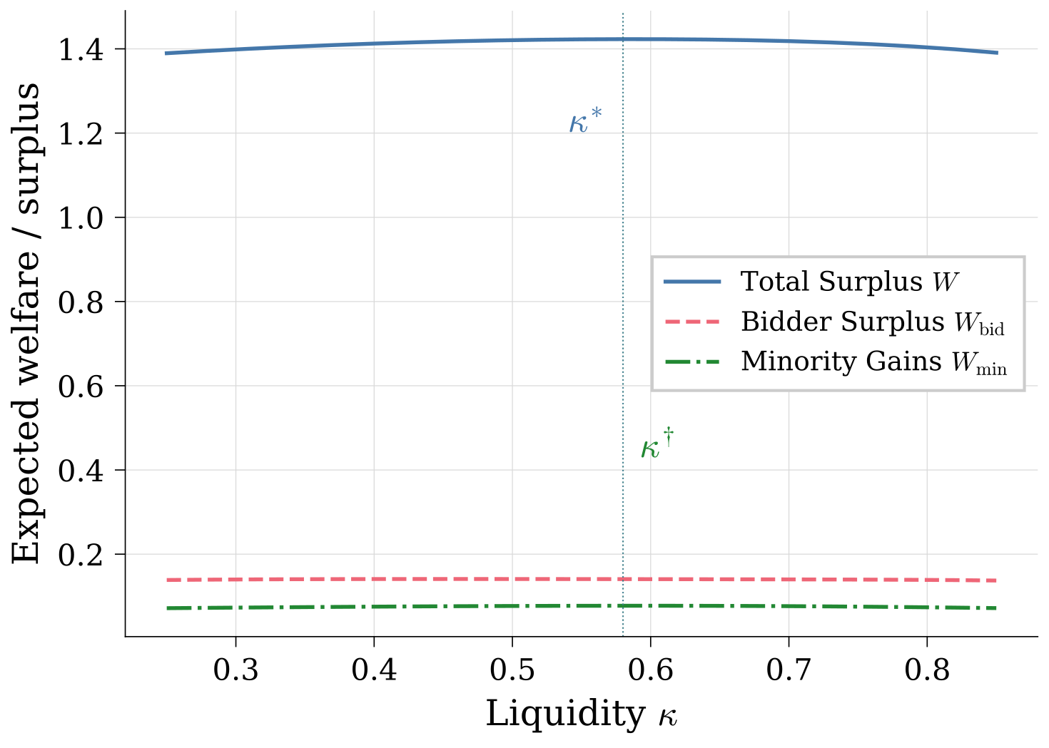
BACKUP
Welfare vs minority gains
Total surplus = synergies + improvements − costs; prices and premia are transfers.
The κ that maximizes minority extraction deters marginal efficient takeovers → κ* ≠ κ†.
Policy read: "more liquidity is good for governance" and "good for welfare" are different claims; the model separates them.
LIQUIDITY · ACTIVISM DISCLOSURE · TAKEOVER PREMIA
34

Slide 35
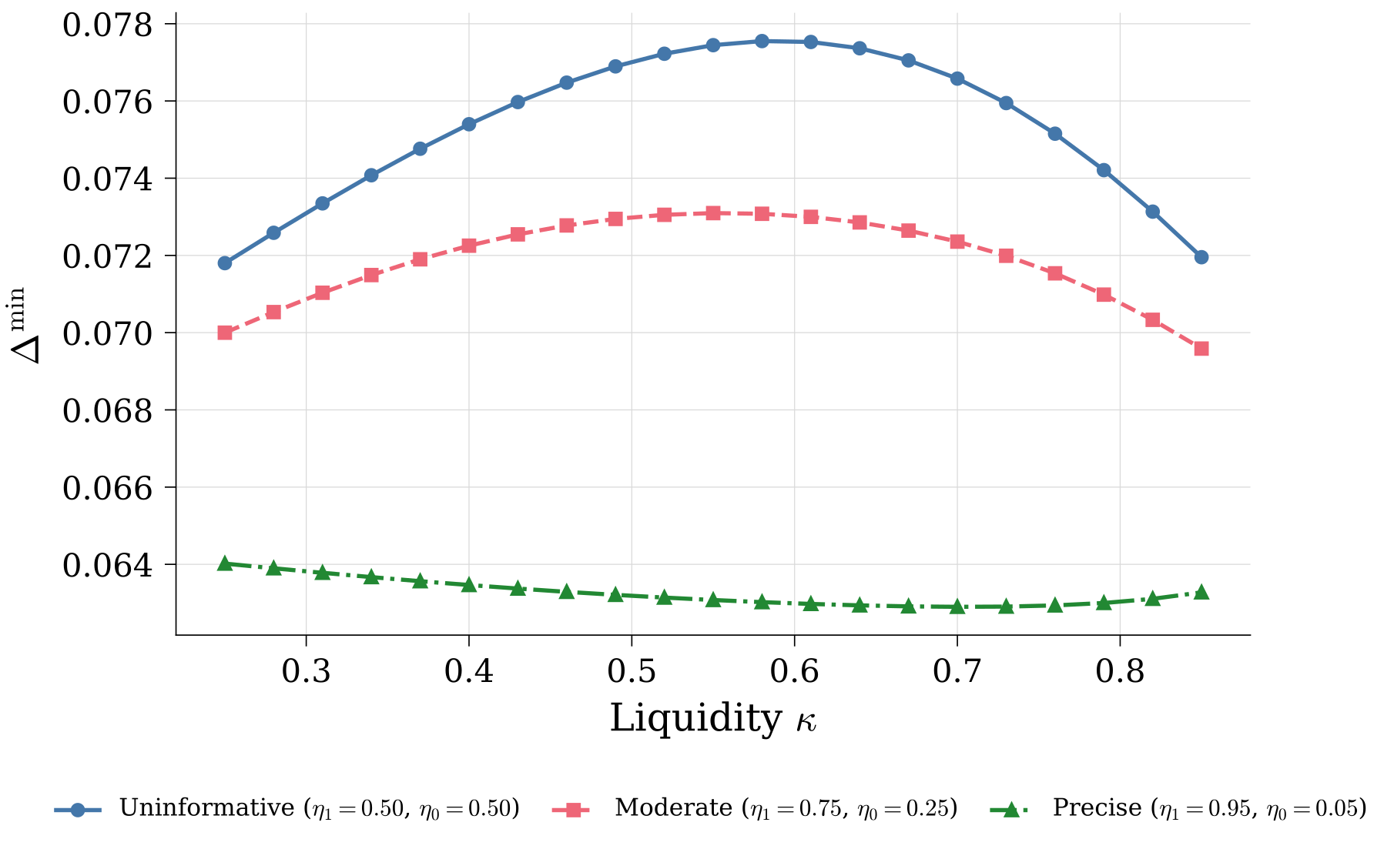
BACKUP
Disclosure benchmarks and rumors
Bounds: full information (κ-invariant) and no disclosure (maximally κ-sensitive) bracket the baseline regime.
Noisy rumors (wolf-pack chatter) interpolate: as rumor precision rises, inference converges to full information and the liquidity effect flattens further.
Same comparative static as tightening the disclosure rule — information substitutes are interchangeable here.
LIQUIDITY · ACTIVISM DISCLOSURE · TAKEOVER PREMIA
35

Slide 36
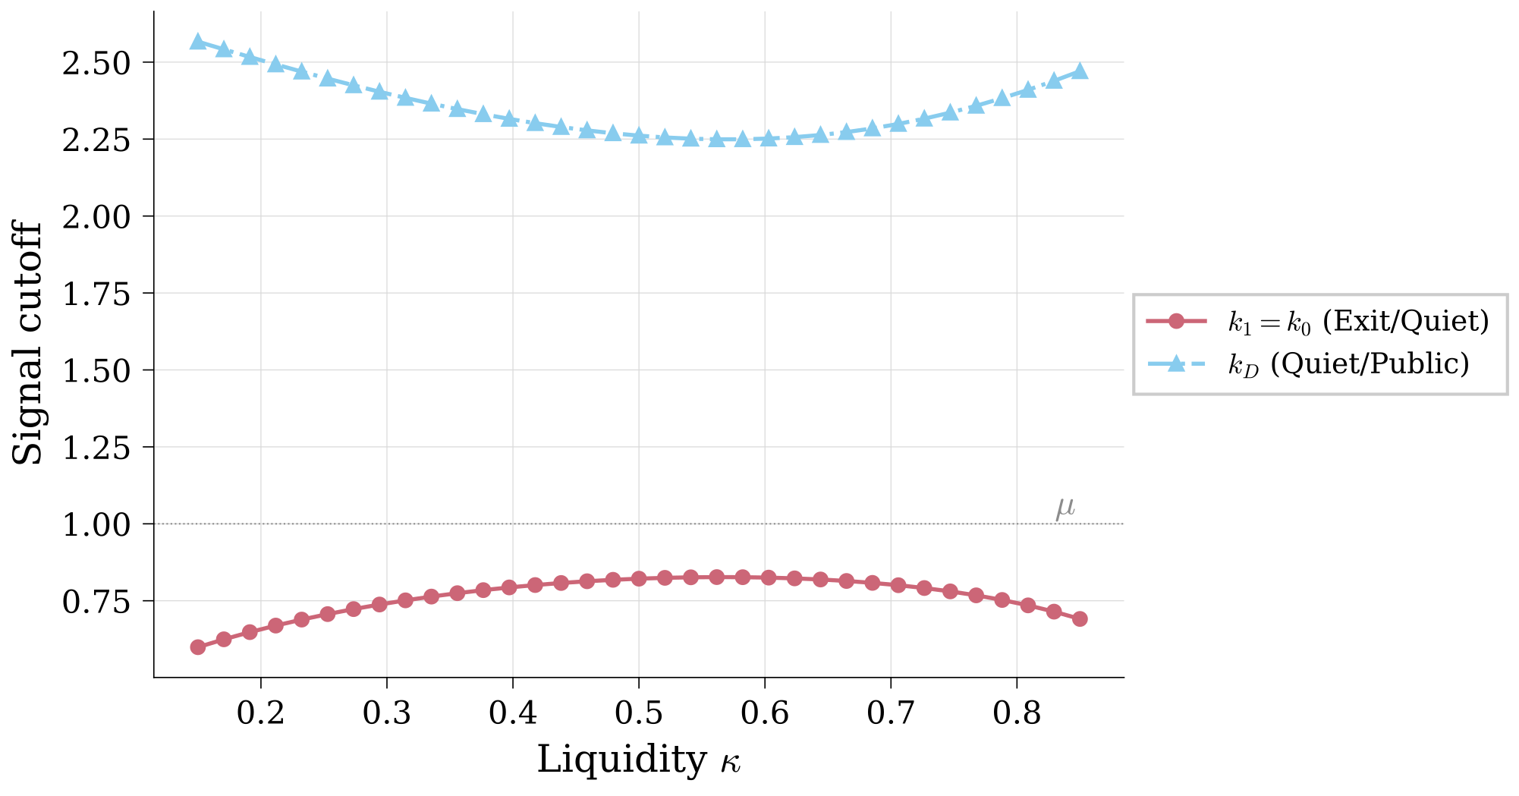
BACKUP
Equilibrium cutoffs across the liquidity dial
Exit/hold boundary k₁ = k₀ throughout (hold collapsed); public threshold k_D tracks the quiet/public margin.
Ordering k₁ ≤ k₀ ≤ k_D preserved across all κ — the GE channel moves cutoffs smoothly, no regime jumps.
LIQUIDITY · ACTIVISM DISCLOSURE · TAKEOVER PREMIA
36

Slide 37
BACKUP
Evidence: data & methods
Universe: every original Schedule 13D on EDGAR 2022Q1–2025Q4 (amendments excluded; boundary-aware form matching — EDGAR renamed the form "SCHEDULE 13D" in Dec 2024).
CUSIPs parsed from cover pages with check-digit validation (~80–90% coverage); after-16:00 ET acceptances shifted to the next trading day.
CARs: market model, estimation 220 trading days ending 30 before the event (min 100 obs), windows [−1,+1] and [−10,+1].
Covariates: Amihud illiquidity [−250,−30], run-up [−60,−11], ln market cap at −30; US common stock only; two-way clustered SEs (firm × month); year-quarter FE absorb Post in the saturated spec.
LIQUIDITY · ACTIVISM DISCLOSURE · TAKEOVER PREMIA
37

