Slide 1



Austin Lowey
Predicting Survivor Winners with Machine Learning
LinkedIn: Linkedin.com/in/Austin-Lowey
Portfolio: AustinLowey.github.io

Slide 2

Predicting Survivor Winners with Machine Learning
Leveraged supervised learning techniques to predict the winner of the competition TV show, Survivor, based on historical performance data.
Part 1 - Data Engineering
Data ETL to build SQL database of contestant features for 45 Survivor seasons
Part 2 - Machine Learning
Trained multiple ML models using my database to predict contestant placements
Tools Used:
Python: scikit-learn, pandas, NumPy, psycopg2, Beautiful Soup/requests, OpenAI LLM API
Databases: PostgreSQL, pgAdmin

Slide 3
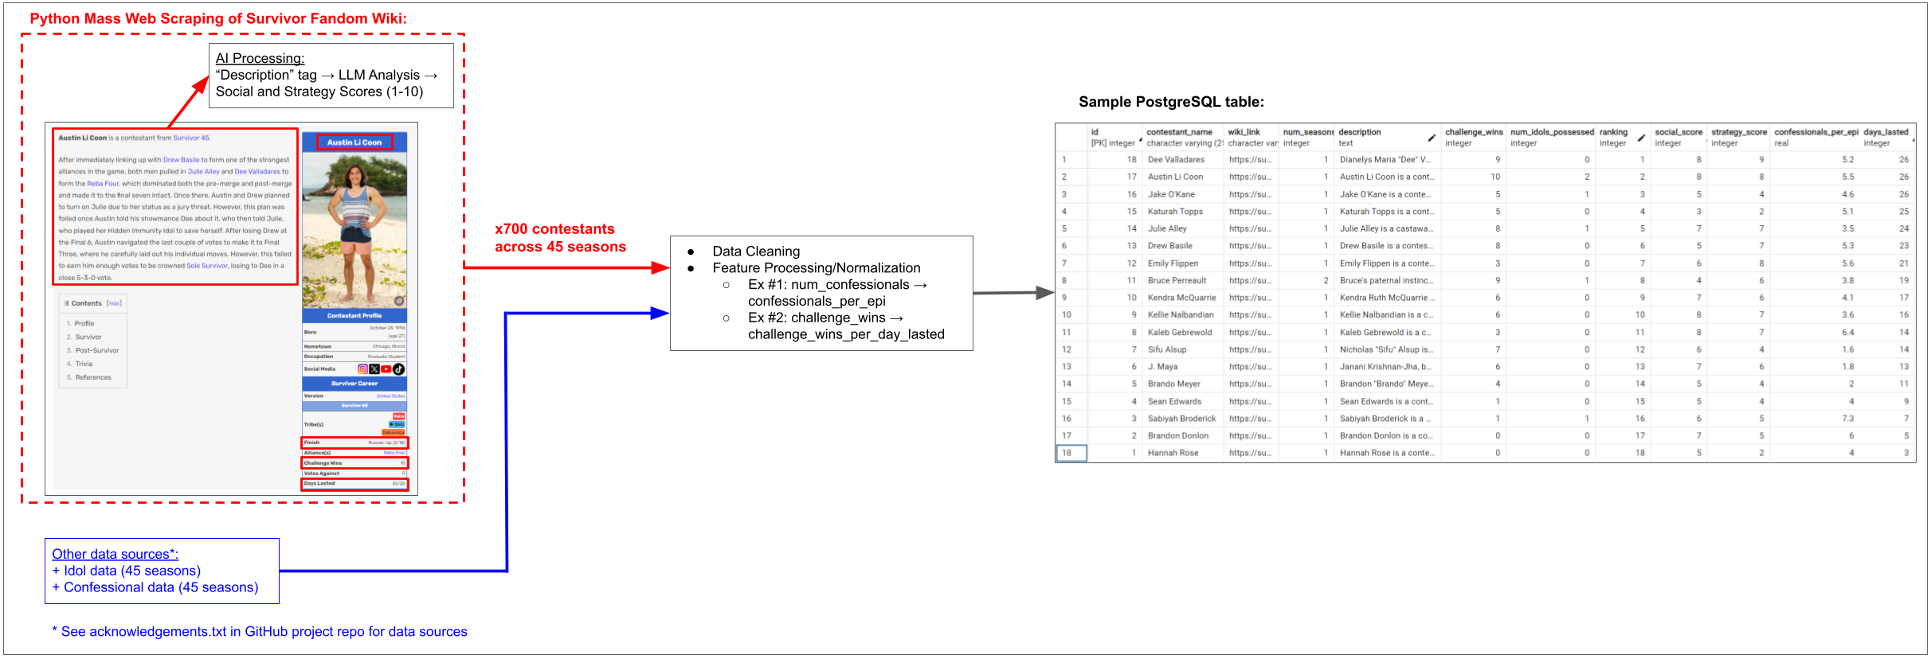
Part 1: Data Engineering
Populated a database with contestant data features for ML modeling.
Planned ML model features and researched potential data sources
Data ETL, including mass web scraping/parsing of the Survivor Wiki
Integrated OpenAI’s LLM API to conduct automated AI-analysis on contestant descriptions, generating social and strategy scores on pre-defined criteria

Slide 4
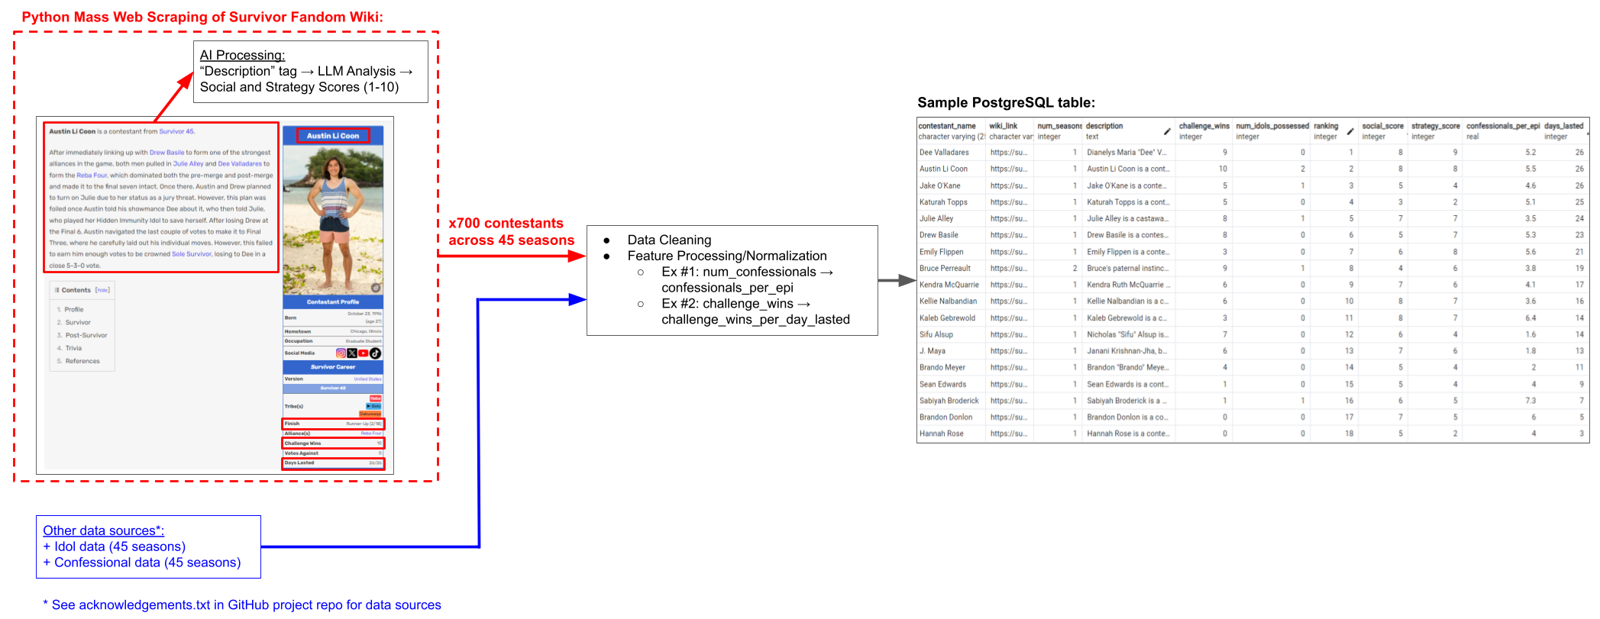
Part 1: Data Engineering

Slide 5
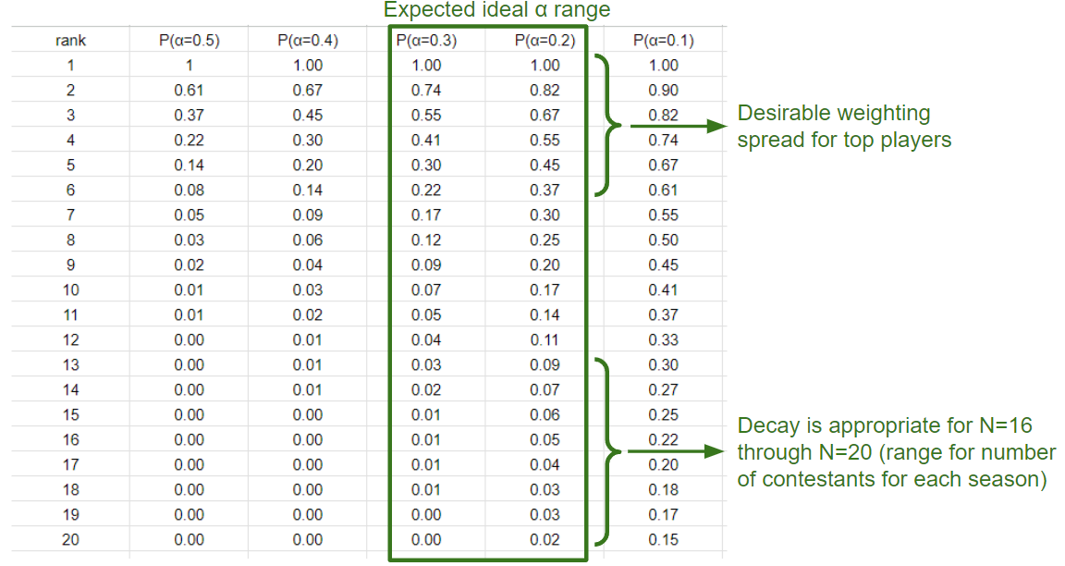
Part 2: Machine Learning
Explored multiple ML and mathematical modeling techniques, with Random Forest Regression ML model yielding great results.
Data split into 60/20/20% Train/Validation/Test
Mathematical modeling: Continuous probability transformation function of contestant placement – Linear vs. Exponential Decay
Linear Regression baseline model (v1)
Random Forest Regression successor model (v2)
Good at handling noisy data
Captures non-linear feature relationships
Feature importance values useful for model interpretability

Slide 6
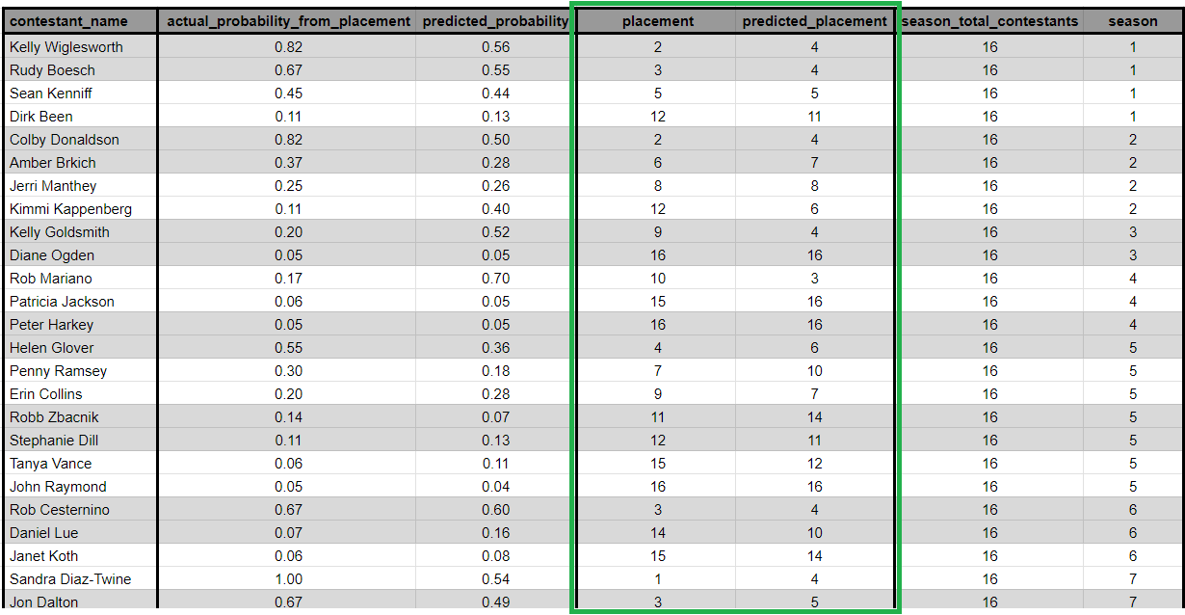
Model Performance: Test Dataset
· 29% of placement predictions were exact or off by 1. · 57% were within 3 places.
Model Predictions on Test Dataset (25/165 rows; full data on GitHub)

Slide 7
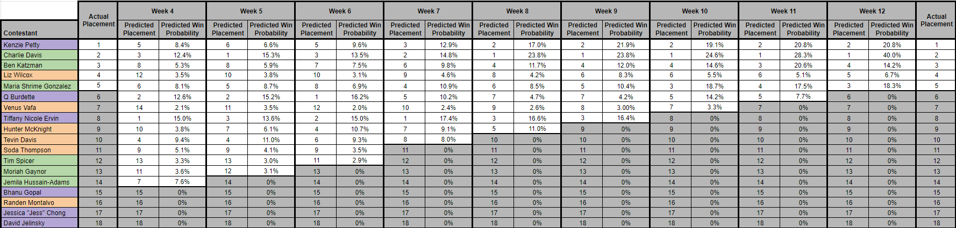
Model Performance: S46 Week-to-Week Predictions
· Consistently forecasted top contestants, especially the top 2. · Predicted Charlie (very close 2nd place) as 1st place winner as early as Week 5, and never predicted him to place higher than 3rd.

Slide 8
ML Model Improvement Opportunities
v3 roadmap plan with areas for potential improvement
GridSearchCV hyperparameter tuning (Random Forest params, α, etc.)
Week-to-week predictions, as opposed to entire season
Pro: Better at handling varying strategies in early vs. mid vs. late game
Pro: Better approach to identify “goats” (i.e., less “threatening” players)
Con: Requires ~15x more data
Explore other features (ex: highest education level and/or profession)
Explore other ML model types

Slide 9
Supplemental Slides

Slide 10
Automated LLM-Analysis: Social & Strategy Scores
Social Score Criteria: Assesses the contestant's interpersonal skills, likability, and ability to navigate and influence social dynamics.
Alliance Formation and Maintenance: The ability to create and maintain alliances that further the contestant's game.
Social Integration: Effectiveness in becoming a key member of the group, avoiding social isolation.
Jury Management: Skill in managing relationships with eventual jury members, crucial for securing votes in the final.
Conflict Resolution: Competence in resolving disputes in a way that does not jeopardize their standing in the game.
Strategy Score Criteria: Assesses the contestant's game planning, tactical moves, and adaptability to changing dynamics.
Strategic Planning: The ability to devise and implement plans that enhance their position in the game.
Adaptability: Quick adjustment to new developments and ability to pivot strategies as the game evolves.
Game-Changing Moves: Successfully executing moves that significantly alter the course of the game, including blindsides and effective use of immunity idols.

Slide 11
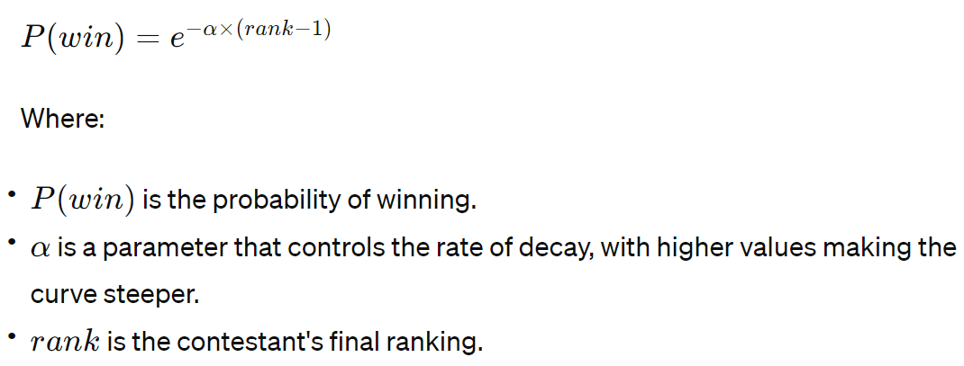
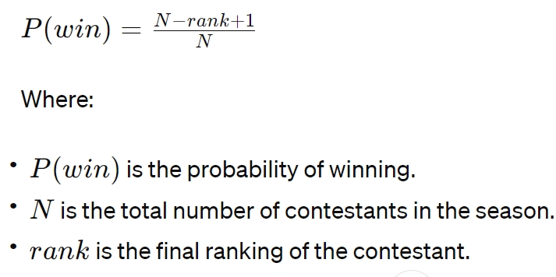
ML Model Feature Importances & Continuous Probability Transformation Functions
v2 Random Forest model feature importances
num_idols_possessed: 0.077
social_score: 0.090
strategy_score: 0.239
challenge_wins_per_day_lasted: 0.285
confessionals_per_epi: 0.308
Exponential Decay:
Linear:

Slide 12
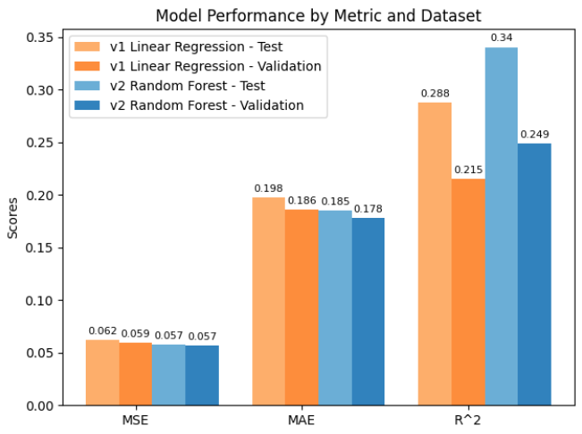
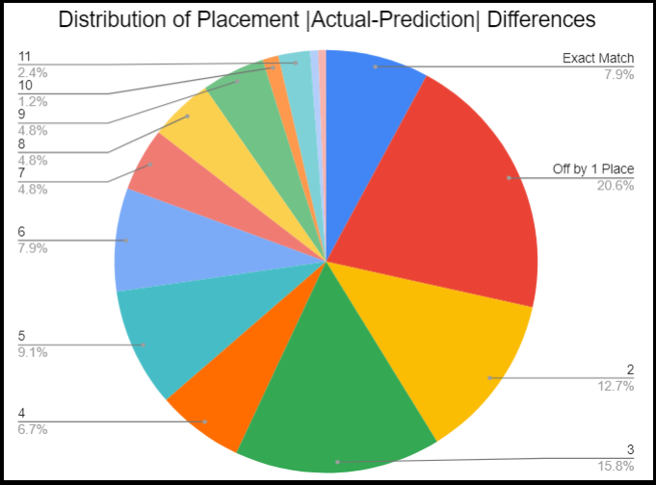
Machine Learning Model Performances

