Slide 1

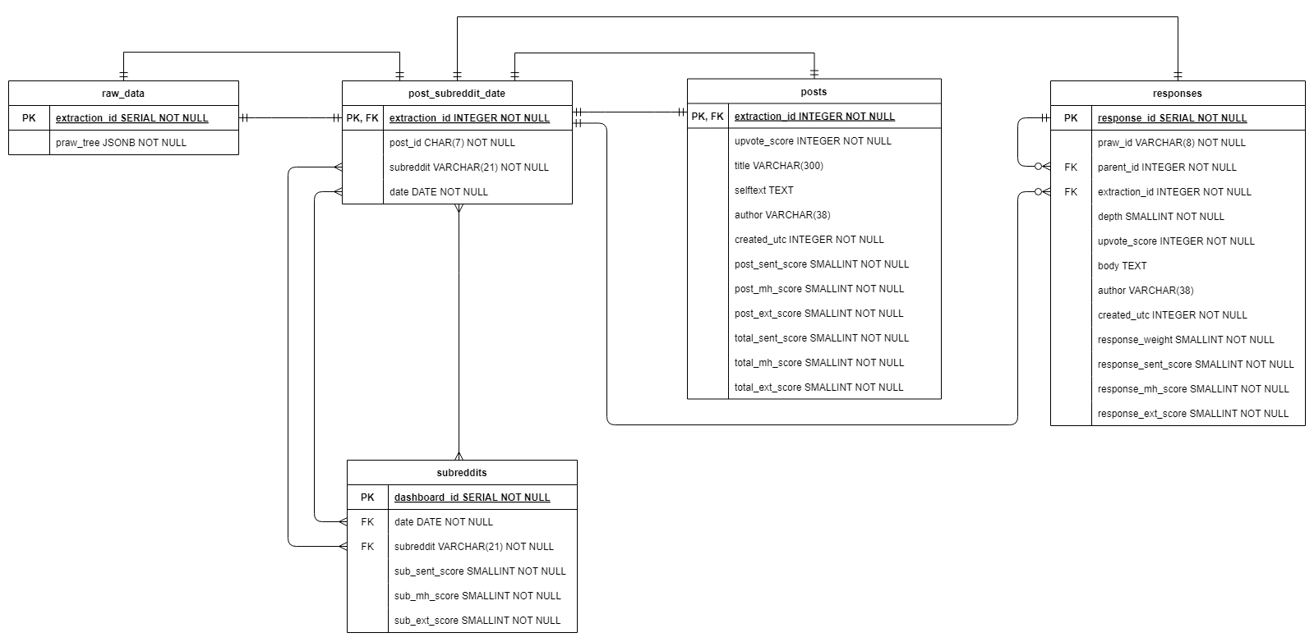


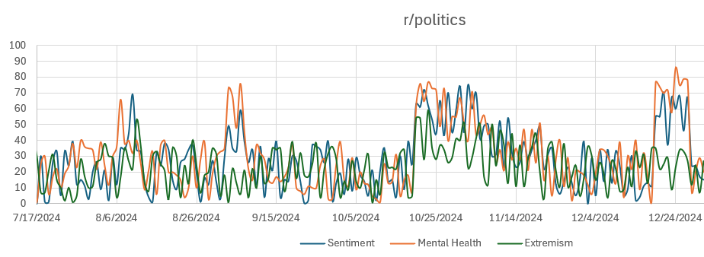
1) Extract Reddit data daily and load to database. Tools: Python, PostgreSQL, & Dagster Orchestration
2) Transform Reddit data into flattened, useable format for text-analysis, submission-weighting, and aggregation.
Tools: dbt, Python, PostgreSQL, NLP & Machine Learning
3) Data linked to dashboard for visualizations and analysis
Tools: PostgreSQL, Tableau

Slide 2
Entity Relationship Diagram (ERD)

Slide 3
Step 1: Using Python, PRAW, and Orchestration, extract top 10 posts (while limiting comments based on defined extraction parameters) from 25 pre-defined subreddits daily.

Slide 4
Step 2: Flatten JSONB from raw_data into 2 tables:
1) Top-level posts
2) Responses (i.e., both comments and replies)

Slide 5
Step 3: Use upvote_score (relative to the top-level post*) and depth to calculate response_weight, which will later be used during post-level text-score aggregation in Step 5.
* Relative to top-level post – Weights calculated using a logarithmic scaling/dampening function log(n1)/log(n2), though other scaling functions have been considered.
Note: If needed to improve efficiency with OLTP (row-based) system, upvote_score can be moved from posts table to post_subreddit_date association/join table.

Slide 6
Step 4: Process responses.body and CONCAT(posts.title, posts.selftext) through NLP, ML, and/or LLM to score text in multiple areas (sentiment, mental health, extremism, etc.)

Slide 7

Step 5: Post-level text-score aggregation:
Aggregate all submission text scores (i.e., for all posts, comments, and replies) into a total score for each post.
$$\frac{Σ\left(sent_score∗response_weight\right) + post_sent_score}{Σ\left(response_weight\right) + 1}$$

Slide 8
Step 6: Subreddit-level text-score aggregation:
Aggregate all post text scores into a total score for each subreddit for that day, using upvote_score to weight posts relatively*
* Relative to top post for that subreddit for that day – Weights calculated using a logarithmic scaling function log(n1)/log(n2), though other scaling functions have been considered.

Slide 9
Step 7: Results “subreddits” table:
Data available for plotting, dashboard connection, trend analysis, csv export, etc.

