Slide 1
raw_data
post_id | CHAR(7) | PK, FK
praw_tree | JSONB
posts
post_id | CHAR(7) | PK, FK
fetch_date | DATE | FK
subreddit | VARCHAR(21) | FK
upvote_score | INTEGER
title | VARCHAR(300)
selftext | TEXT
author | VARCHAR(38)
created_utc | INTEGER
posts_analysis
post_id | CHAR(7) | PK, FK
post_sent_score | SMALLINT
post_mh_score | SMALLINT
total_sent_score | SMALLINT
total_mh_score | SMALLINT
responses
response_id | VARCHAR(8) | PK, FK
post_id | CHAR(7) | FK
parent_id | VARCHAR(8) or NULL | FK
depth | SMALLINT
upvote_score | INTEGER
body | TEXT
author | VARCHAR(38)
created_utc | INTEGER
responses_analysis
response_id | VARCHAR(8) | PK, FK
response_weight | SMALLINT
sent_score | SMALLINT
mh_score | SMALLINT
subreddits
id | SERIAL | PK
subreddit | VARCHAR(21) | FK
date | DATE | FK
sub_sent_score | SMALLINT
sub_mh_score | SMALLINT

Slide 2
250 rows/day added
25 subreddits
Top 10 posts
raw_data
post_id | CHAR(7) | PK, FK
praw_tree | JSONB
posts
post_id | CHAR(7) | PK, FK
fetch_date | DATE | FK
subreddit | VARCHAR(21) | FK
upvote_score | INTEGER
title | VARCHAR(300)
selftext | TEXT
author | VARCHAR(38)
created_utc | INTEGER
posts_analysis
post_id | CHAR(7) | PK, FK
post_sent_score | SMALLINT
post_mh_score | SMALLINT
total_sent_score | SMALLINT
total_mh_score | SMALLINT
responses
response_id | VARCHAR(8) | PK, FK
post_id | CHAR(7) | FK
parent_id | VARCHAR(8) or NULL | FK
depth | SMALLINT
upvote_score | INTEGER
body | TEXT
author | VARCHAR(38)
created_utc | INTEGER
responses_analysis
response_id | VARCHAR(8) | PK, FK
response_weight | SMALLINT
sent_score | SMALLINT
mh_score | SMALLINT
~25,000 rows/day
~100 rows per post based on tree depth and width limits
25 rows/day
1 row per subreddit
subreddits
id | SERIAL | PK
subreddit | VARCHAR(21) | FK
date | DATE | FK
sub_sent_score | SMALLINT
sub_mh_score | SMALLINT

Slide 3
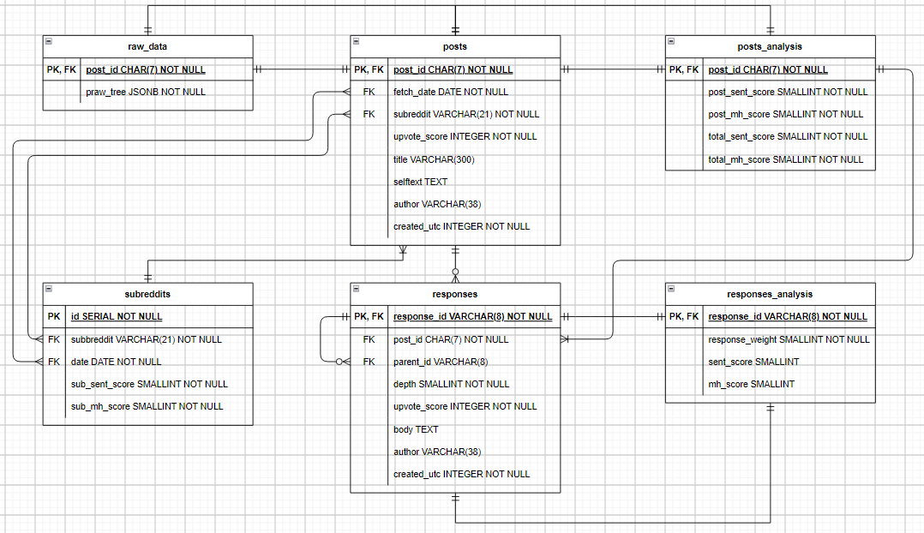

Slide 4

Step 1: Using Python, PRAW, and Orchestration, extract top 10 posts (limiting tree depth and width) from 25 pre-defined subreddits daily.
raw_data
post_id | CHAR(7) | PK, FK
praw_tree | JSONB

Slide 5
Step 2: Flatten JSONB into 2 tables:
1) Top-level posts
2) Responses (i.e., both comments and replies
raw_data
post_id | CHAR(7) | PK, FK
praw_data | JSONB
posts
post_id | CHAR(7) | PK, FK
fetch_date | DATE | FK
subreddit | VARCHAR(21) | FK
upvote_score | INTEGER
title | VARCHAR(300)
selftext | TEXT
author | VARCHAR(38)
created_utc | INTEGER
responses
response_id | VARCHAR(8) | PK, FK
post_id | CHAR(7) | FK
parent_id | VARCHAR(8) or NULL | FK
depth | SMALLINT
upvote_score | INTEGER
body | TEXT
author | VARCHAR(38)
created_utc | INTEGER

Slide 6
Step 3: Use upvote_score (relative* to the top-level post) and depth to calculate response_weight, which will later be used during post-level text-score aggregation in Step 5.
posts
post_id | CHAR(7) | PK, FK
fetch_date | DATE | FK
subreddit | VARCHAR(21) | FK
upvote_score | INTEGER
title | VARCHAR(300)
selftext | TEXT
author | VARCHAR(38)
created_utc | INTEGER
responses
response_id | VARCHAR(8) | PK, FK
post_id | CHAR(7) | FK
parent_id | VARCHAR(8) or NULL | FK
depth | SMALLINT
upvote_score | INTEGER
body | TEXT
author | VARCHAR(38)
created_utc | INTEGER
responses_analysis (partial)
response_id | VARCHAR(8) | PK, FK
response_weight | SMALLINT
sent_score | SMALLINT
mh_score | SMALLINT
Columns filled during step 3b
Columns yet to be filled (step 4)
* Relative to top-level post - Most likely using a scaling/dampening function such as log(n1)/log(n2). Different scaling functions explored.

Slide 7
Step 4: Process responses.body and CONCAT(posts.title, posts.selftext) through NLP, ML, and/or LLM to score text in multiple areas (sentiment, mental health, etc.)
posts
post_id | CHAR(7) | PK, FK
fetch_date | DATE | FK
subreddit | VARCHAR(21) | FK
upvote_score | INTEGER
title | VARCHAR(300)
selftext | TEXT
author | VARCHAR(38)
created_utc | INTEGER
posts_analysis (partial)
post_id | CHAR(7) | PK, FK
post_sent_score | SMALLINT
post_mh_score | SMALLINT
total_sent_score | SMALLINT
total_mh_score | SMALLINT
Columns filled during step 4
Columns yet to be filled (step 5)
responses
response_id | VARCHAR(8) | PK, FK
post_id | CHAR(7) | FK
parent_id | VARCHAR(8) or NULL | FK
depth | SMALLINT
upvote_score | INTEGER
body | TEXT
author | VARCHAR(38)
created_utc | INTEGER
responses_analysis
response_id | VARCHAR(8) | PK, FK
response_weight | SMALLINT
sent_score | SMALLINT
mh_score | SMALLINT
Columns already filled from step 3
Columns filled during step 4

Slide 8

Step 5: Post-level text-score aggregation.
Aggregate all submission text scores (i.e., for all posts, comments, and replies) into a total score for each post.
Retrieve all posts from the “posts” table that match the specified date.
Get all responses from the “responses” table that belong to these posts.
Join the “responses” with their analysis data from the “responses_analysis” table.
Calculate the weighted average text scores for each post using aggregation.
Update the “posts_analysis” table with the calculated total text scores for each post.
posts
post_id | CHAR(7) | PK, FK
fetch_date | DATE | FK
subreddit | VARCHAR(21) | FK
upvote_score | INTEGER
title | VARCHAR(300)
selftext | TEXT
author | VARCHAR(38)
created_utc | INTEGER
5b
posts_analysis
post_id | CHAR(7) | PK, FK
post_sent_score | SMALLINT
post_mh_score | SMALLINT
total_sent_score | SMALLINT
total_mh_score | SMALLINT
5a
5d
5e
$$\frac{Σ\left(sent_score∗response_weight\right) + post_sent_score}{Σ\left(response_weight\right) + 1}$$
responses
response_id | VARCHAR(8) | PK, FK
post_id | CHAR(7) | FK
parent_id | VARCHAR(8) or NULL | FK
depth | SMALLINT
upvote_score | INTEGER
body | TEXT
author | VARCHAR(38)
created_utc | INTEGER
5c
responses_analysis
response_id | VARCHAR(8) | PK, FK
response_weight | SMALLINT
sent_score | SMALLINT
mh_score | SMALLINT
5d
May also filter out responses with a weight below a certain threshold to minimize resource requirements.

Slide 9
* Relative to top post for that subreddit for that day - Most likely using a scaling/dampening function such as log(n1)/log(n2). Different scaling functions explored.
Step 6: Subreddit-level text-score aggregation.
Aggregate all post text scores into a total score for each subreddit for that day, using upvote_score to weight posts relatively*
Retrieve all posts from the “posts” table that match the specified date.
Calculate post weights based on upvote scores and join with sentiment scores.
Group posts by subreddit and date, then compute daily subreddit text-scores.
Insert these text-scores for the given date into the subreddits table.
posts
post_id | CHAR(7) | PK, FK
fetch_date | DATE | FK
subreddit | VARCHAR(21) | FK
upvote_score | INTEGER
title | VARCHAR(300)
selftext | TEXT
author | VARCHAR(38)
created_utc | INTEGER
posts_analysis
post_id | CHAR(7) | PK, FK
post_sent_score | SMALLINT
post_mh_score | SMALLINT
total_sent_score | SMALLINT
total_mh_score | SMALLINT
subreddits
id | SERIAL | PK
subreddit | VARCHAR(21) | FK
date | DATE | FK
sub_sent_score | SMALLINT
sub_mh_score | SMALLINT

Slide 10
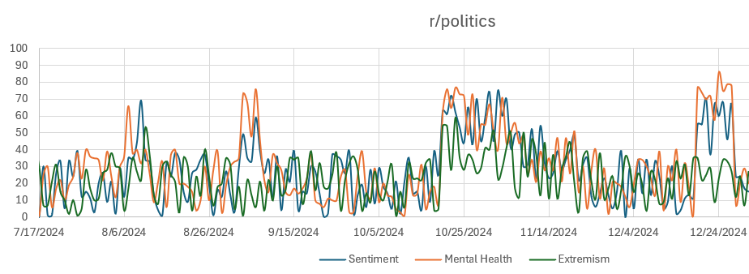
Results “subreddits” table: Data available for plotting, dashboard connection, trend analysis, csv export, etc.
subreddits
id | SERIAL | PK
subreddit | VARCHAR(21) | FK
date | DATE | FK
sub_sent_score | SMALLINT
sub_mh_score | SMALLINT

