Slide 1
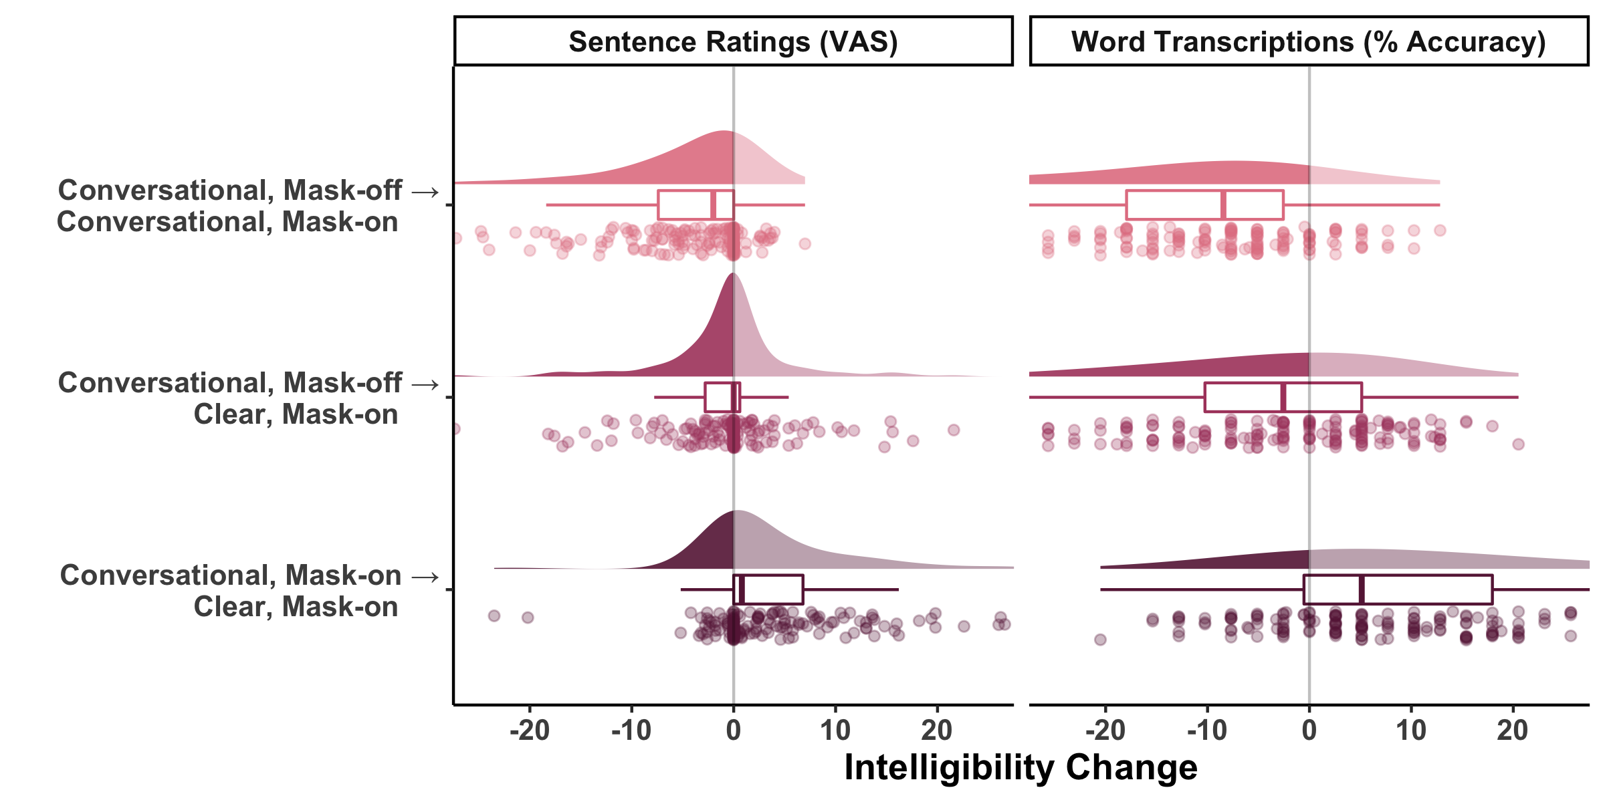
*
*
*
*
*

Slide 2
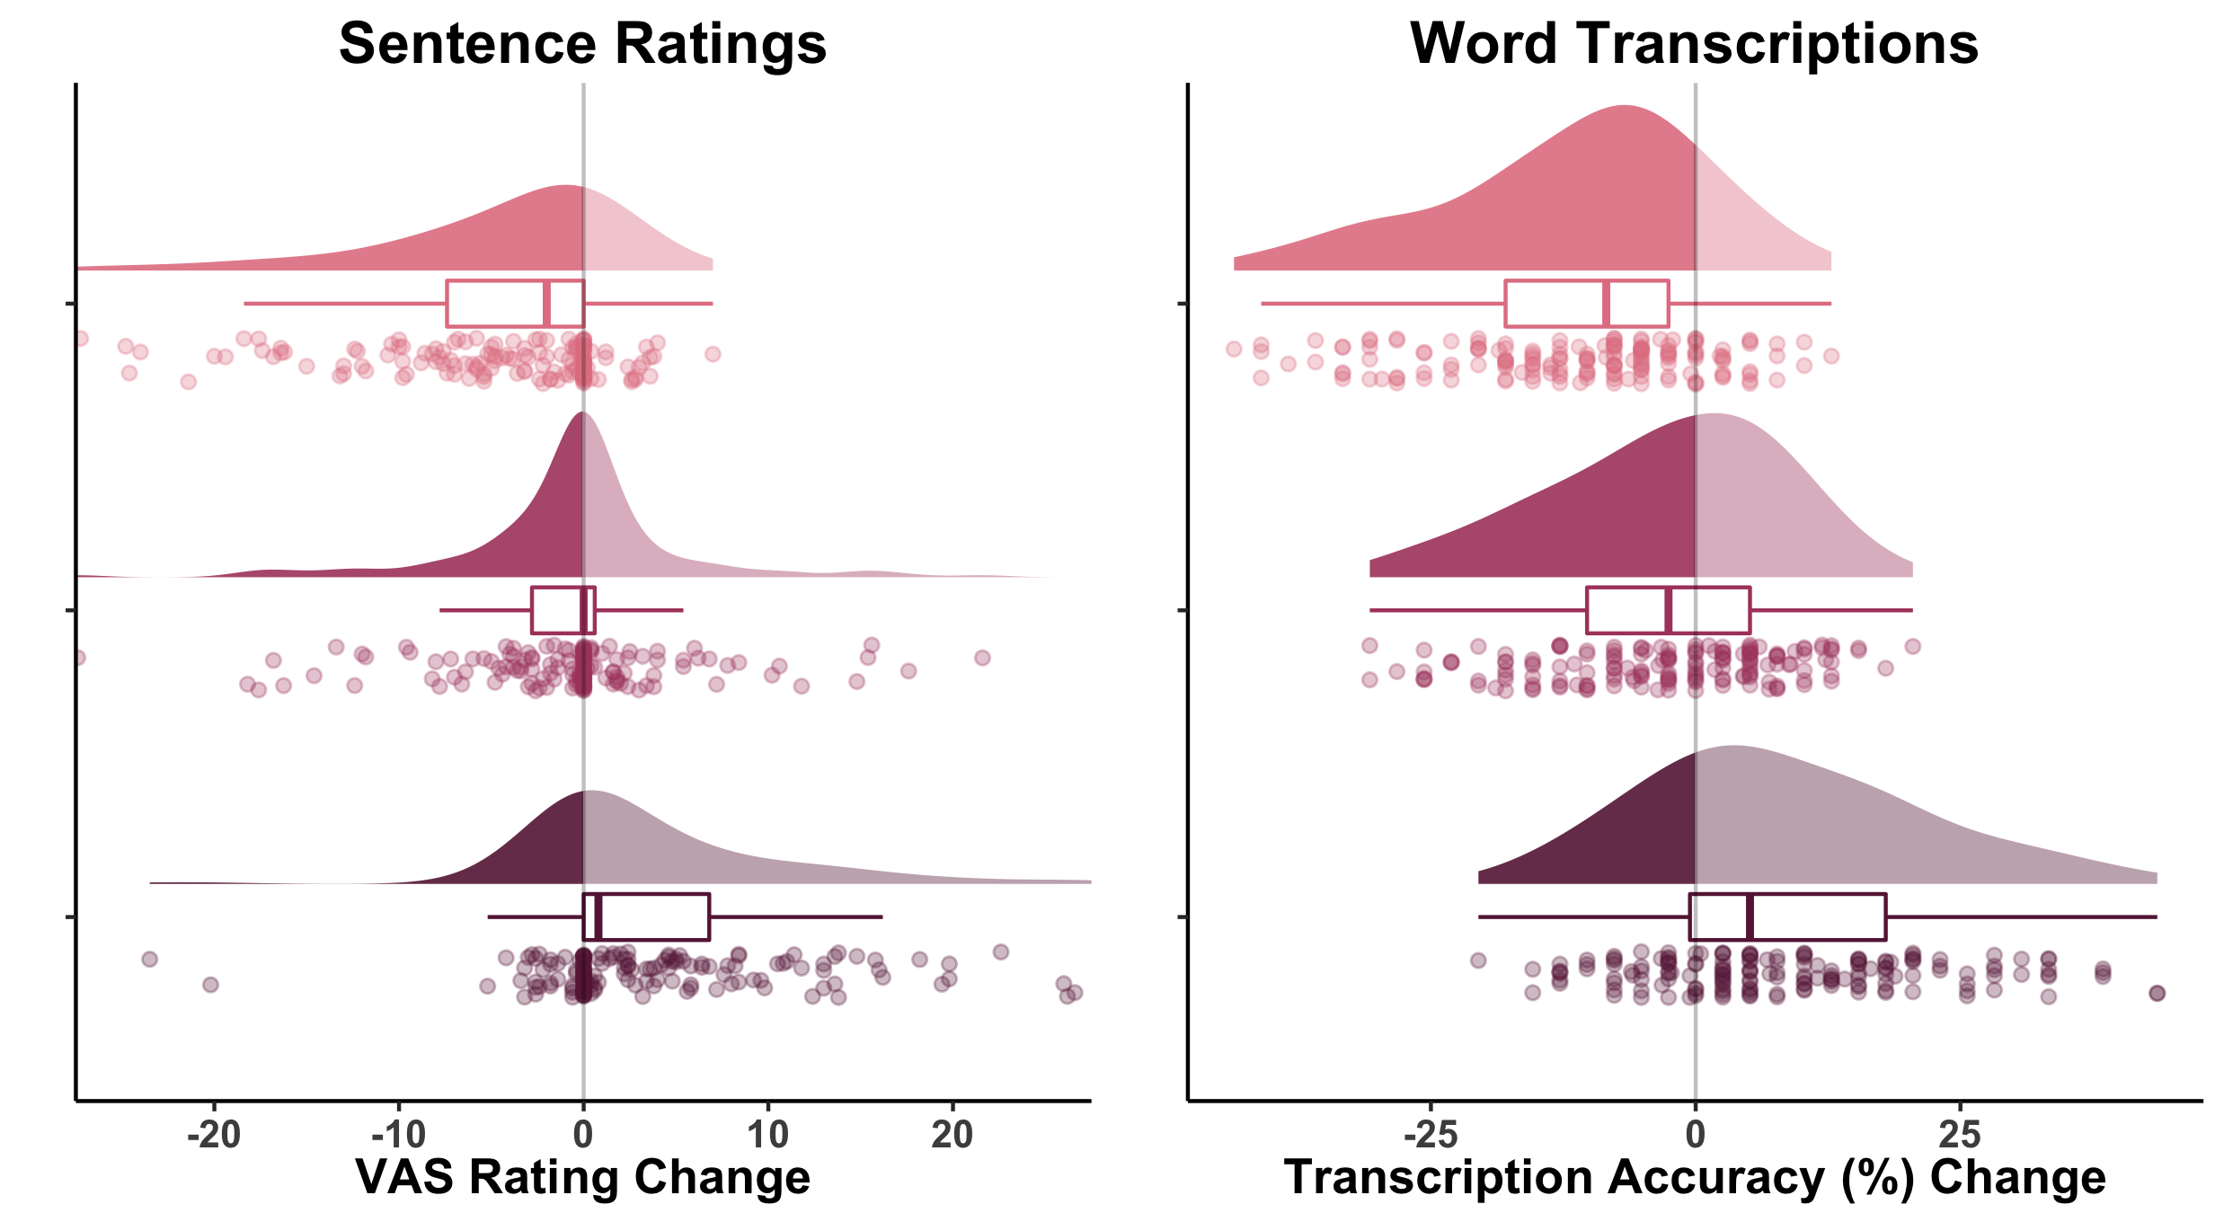







*
*
Conversational,
Mask-off
Conversational,
Mask-on
Conversational,
Mask-off
Clear,
Mask-on
*
Conversational,
Mask-on
Clear,
Mask-on

