Slide 1



Computational Analysis of Network Data
Testing network-level statistics through simulation
Austin van Loon
SICSS 2019 Flash Talk

Slide 2
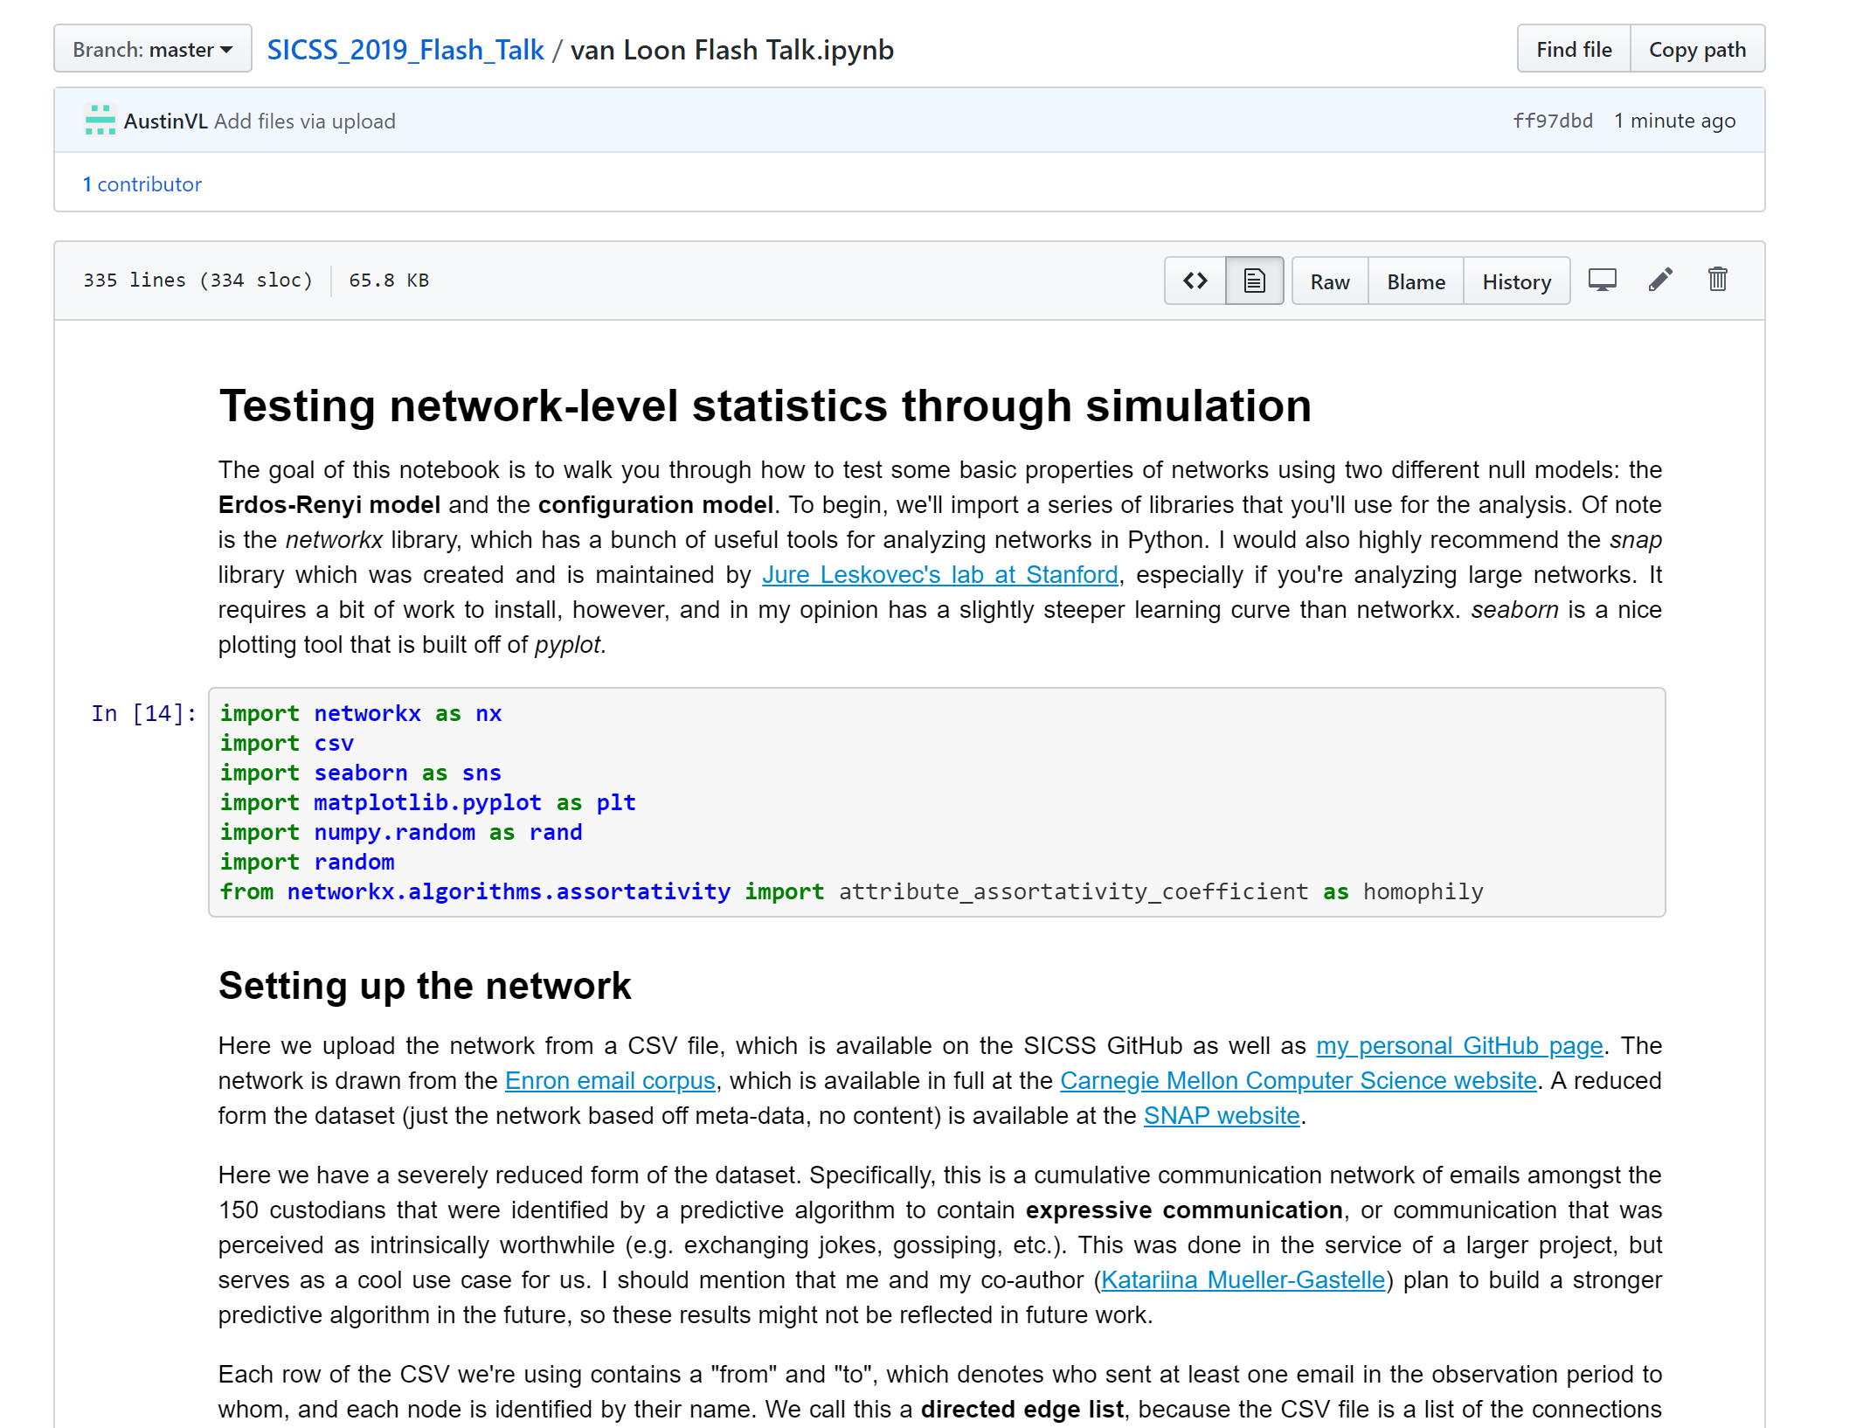
WARNING! Lots to Cover
Jupyter notebook with Annotated code and explanation

Slide 3

Outline
The why/when of networks
Testing network-level statistics
Define a statistic
Homophily
Average clustering coefficient
Pick a null model
Erdös–Rényi model
Configuration model
Code

Slide 4
Outline
The why/when of networks
Testing network-level statistics
Define a statistic
Homophily
Average clustering coefficient
Pick a null model
Erdös–Rényi model
Configuration model
Node2Vec
Embedding space
Random walks
Embedding a node’s position using random walks

Slide 5
When/Why Networks?
Standard econometrics assumes i.i.d
In many cases, we’re interested in interdependence!
Examples:
Relationships
Communication
Language
Computer networks
Protein interactions
Hyper-links
Generally anything in which there’s measurable interdependence!

Slide 6
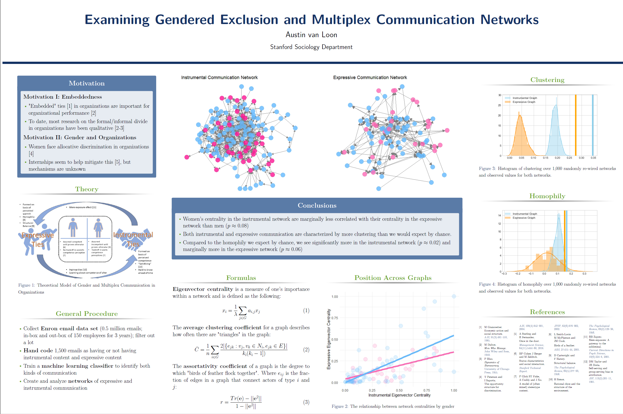

Slide 7
Outline
The why/when of networks
Testing network-level statistics
Define a statistic
Homophily
Average clustering coefficient
Pick a null model
Erdös–Rényi model
Configuration model
Node2Vec
Embedding space
Random walks
Embedding a node’s position using random walks

Slide 8
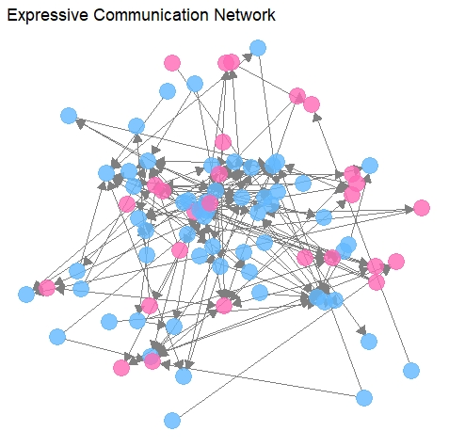

Slide 10
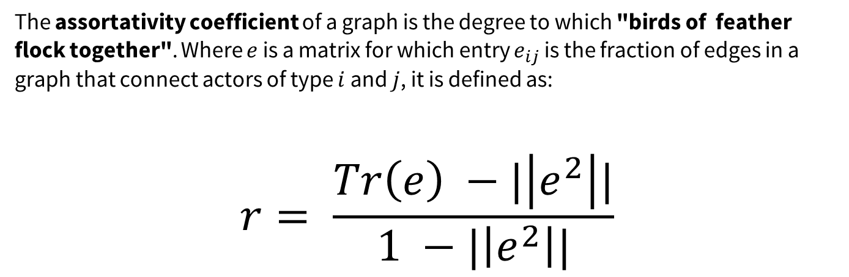
The assortativity coefficient of a graph is the degree to which "birds of feather flock together". Where $e$ is a matrix for which entry $e_{ij}$ is the fraction of edges in a graph that connect actors of type $i$ and $j$, it is defined as:
$$r= \frac{Tr\left(e\right) −|\left|e^{2}\right||}{1 −|\left|e^{2}\right||}$$

Slide 13
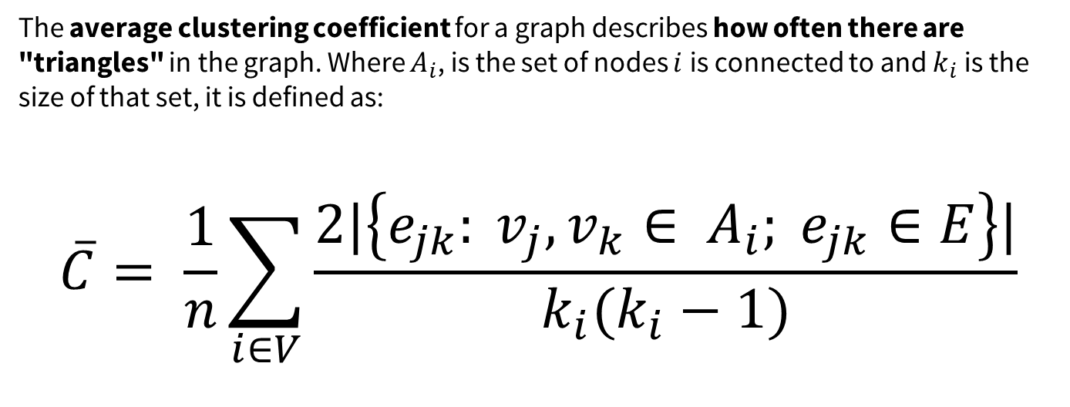
The average clustering coefficient for a graph describes how often there are "triangles" in the graph. Where $A_{i}$, is the set of nodes $i$is connected to and $k_{i}$is the size of that set, it is defined as:
$$\overline{C}= \frac{1}{n}\sum_{i∈V}{\frac{2|\left\{e_{jk}: v_{j}, v_{k}∈ A_{i}; e_{jk}∈E\right\}|}{k_{i}(k_{i}−1)}}$$

Slide 14
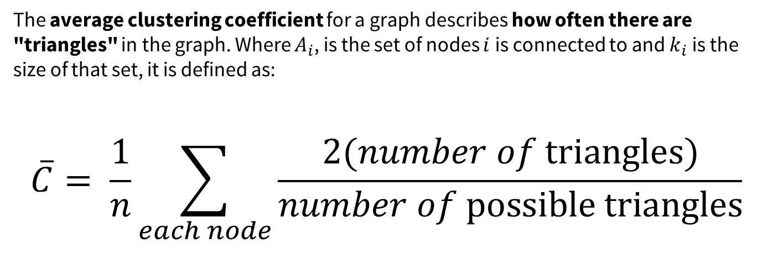
The average clustering coefficient for a graph describes how often there are "triangles" in the graph. Where $A_{i}$, is the set of nodes $i$is connected to and $k_{i}$is the size of that set, it is defined as:
$$\overline{C}= \frac{1}{n}\sum_{each node}{\frac{2(number of \text{triangles})}{number of \text{possible} \text{triangles}}}$$

Slide 15
More than by chance?
Erdös–Rényi model holds constant
Number of nodes
Average degree
Configuration model holds constant
Number of nodes
Exact degree distribution
Correlation between attributes and degree

Slide 16
Testing network-level statistics
Simulate the network under the null model times
For each simulation, measure the test statistic
Compare your observed statistics to this distribution
How likely of a draw is it? That’s your p-value!

Slide 17
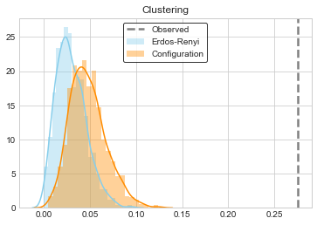
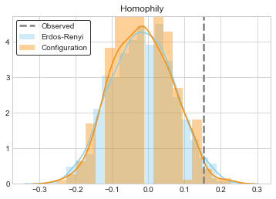


What do we observe in our network?
Erdös–Rényi: $p ≈0$
Configuration: $p ≈0$
Erdös–Rényi: $p ≈0.054$
Configuration: $p ≈0.038$

Slide 18
Thank you!
Personal website:
https://ankenyav.wixsite.com/austinvanloon
Email:
avanloon@stanford.edu
Austin van Loon

