Slide 1



Computational Analysis of Network Data
Testing network-level statistics through simulation
Austin van Loon
SICSS 2019 Flash Talk

Slide 2
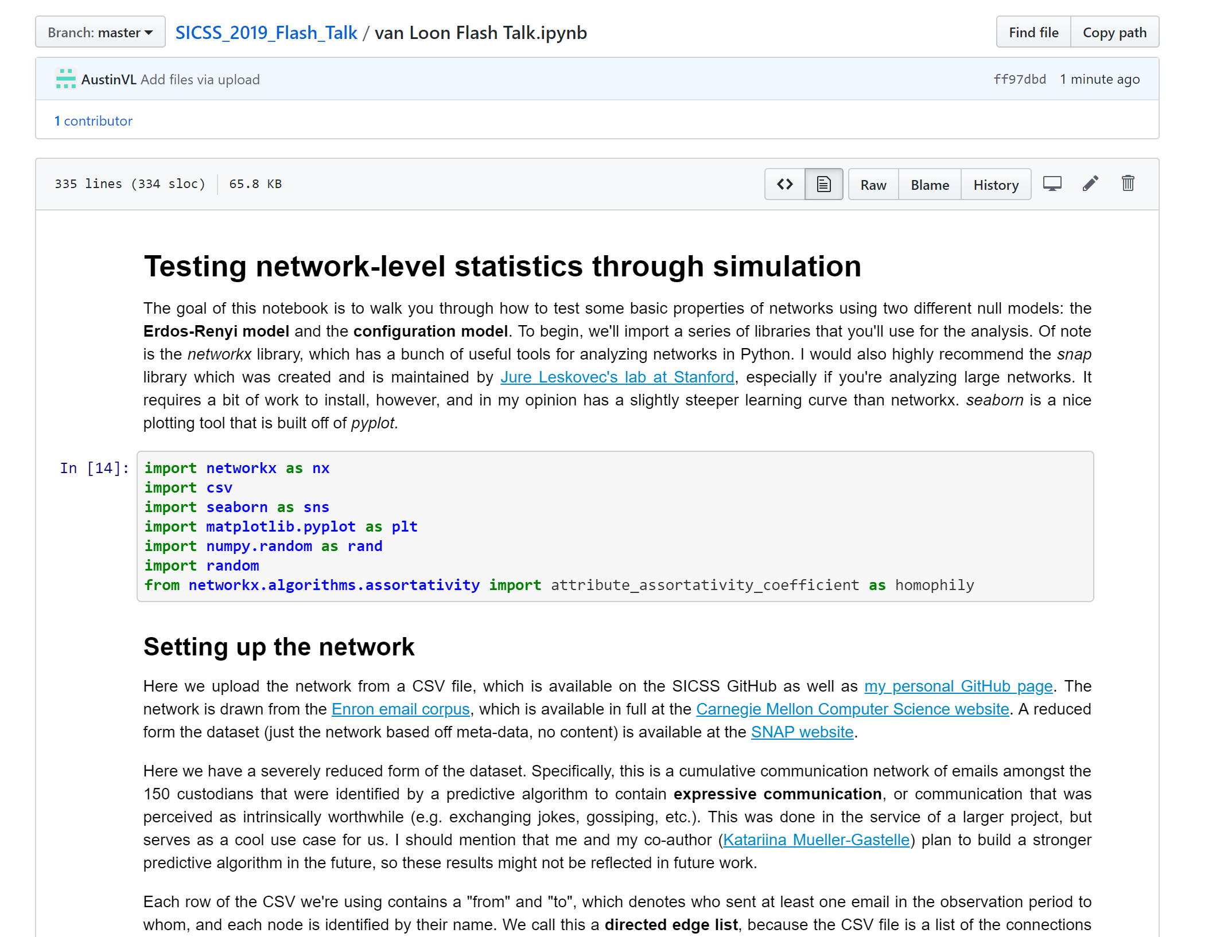
WARNING! Lots to Cover
Jupyter notebook with Annotated code and explanation

Slide 3

Outline
The why/when of networks
Testing network-level statistics
Define a statistic
Homophily
Average clustering coefficient
Pick a null model
Erdös–Rényi model
Configuration model

Slide 4
Outline
The why/when of networks
Testing network-level statistics
Define a statistic
Homophily
Average clustering coefficient
Pick a null model
Erdös–Rényi model
Configuration model

Slide 5
When/Why Networks?
Standard econometrics assumes i.i.d
In many cases, we’re interested in interdependence
Examples:
Relationships
Communication
Language
Computer networks
Protein interactions
Hyper-links
Generally anything in which there’s measurable interdependence!

Slide 6
Outline
The why/when of networks
Testing network-level statistics
Define a statistic
Homophily
Average clustering coefficient
Pick a null model
Erdös–Rényi model
Configuration model

Slide 7
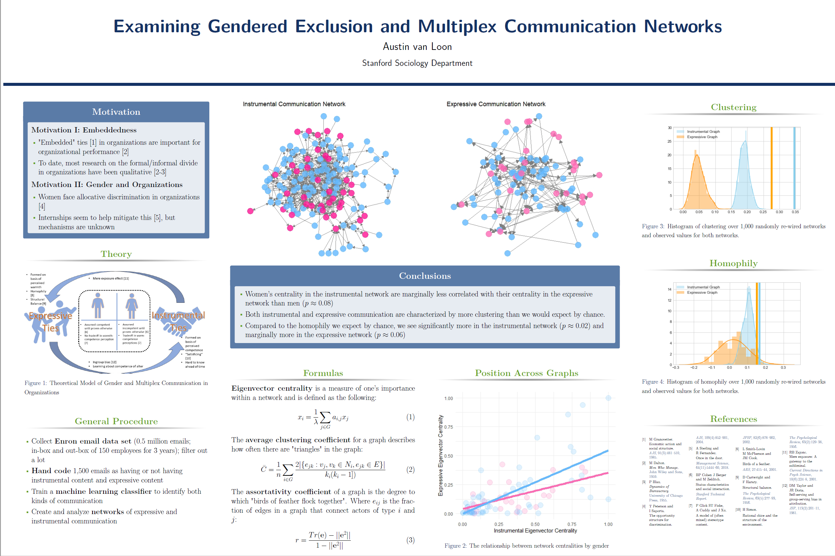

Slide 8
Outline
The why/when of networks
Testing network-level statistics
Define a statistic
Homophily
Average clustering coefficient
Pick a null model
Erdös–Rényi model
Configuration model

Slide 9
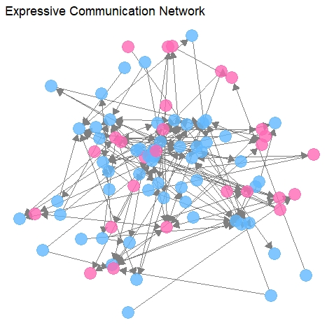

Slide 11
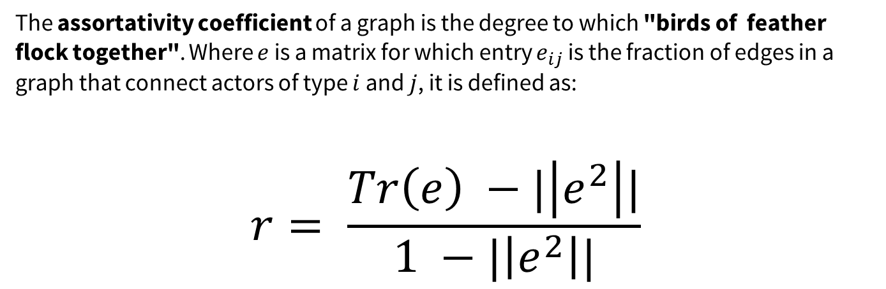
The assortativity coefficient of a graph is the degree to which "birds of feather flock together". Where $e$ is a matrix for which entry $e_{ij}$ is the fraction of edges in a graph that connect actors of type $i$ and $j$, it is defined as:
$$r= \frac{Tr\left(e\right) −|\left|e^{2}\right||}{1 −|\left|e^{2}\right||}$$

Slide 14
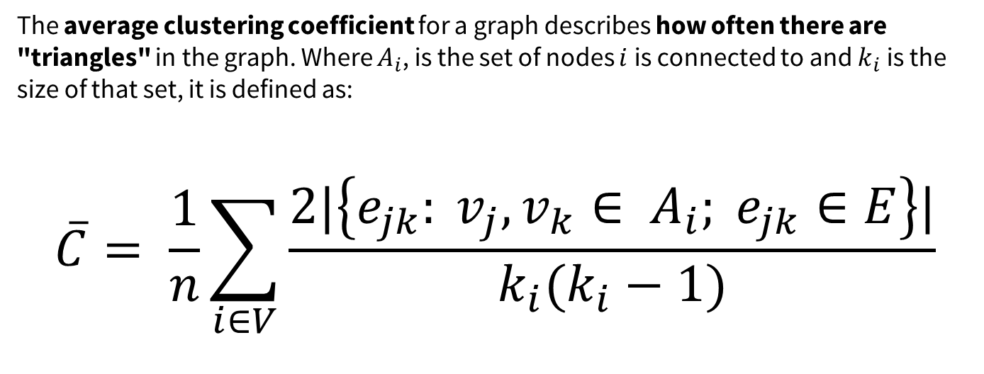
The average clustering coefficient for a graph describes how often there are "triangles" in the graph. Where $A_{i}$, is the set of nodes $i$is connected to and $k_{i}$is the size of that set, it is defined as:
$$\overline{C}= \frac{1}{n}\sum_{i∈V}{\frac{2|\left\{e_{jk}: v_{j}, v_{k}∈ A_{i}; e_{jk}∈E\right\}|}{k_{i}(k_{i}−1)}}$$

Slide 15
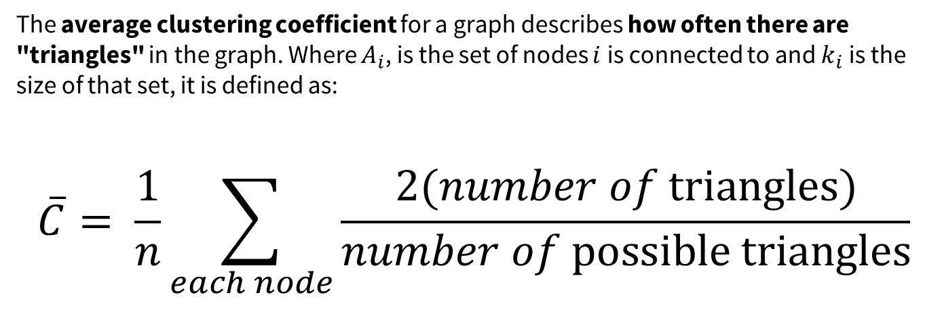
The average clustering coefficient for a graph describes how often there are "triangles" in the graph. Where $A_{i}$, is the set of nodes $i$is connected to and $k_{i}$is the size of that set, it is defined as:
$$\overline{C}= \frac{1}{n}\sum_{each node}{\frac{2(number of \text{triangles})}{number of \text{possible} \text{triangles}}}$$

Slide 16
Outline
The why/when of networks
Testing network-level statistics
Define a statistic
Homophily
Average clustering coefficient
Pick a null model
Erdös–Rényi model
Configuration model

Slide 17
More than by chance?
Erdös–Rényi model holds constant
Number of nodes
Average degree
Configuration model holds constant
Number of nodes
Exact degree distribution
Correlation between attributes and degree

Slide 18
Testing network-level statistics
Simulate the network under the null model many times
For each simulation, measure the test statistic
Compare your observed statistics to this distribution
How likely of a draw is it? That’s your p-value!

Slide 19
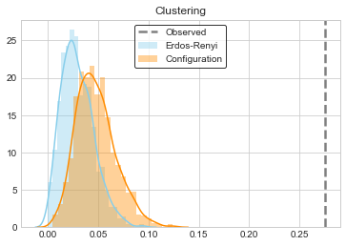
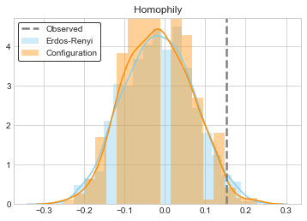


What do we observe in our network?
Erdös–Rényi: $p ≈0$
Configuration: $p ≈0$
Erdös–Rényi: $p ≈0.054$
Configuration: $p ≈0.038$

Slide 20
Thank you!
Personal website:
https://ankenyav.wixsite.com/austinvanloon
Email:
avanloon@stanford.edu
Austin van Loon

