Slide 1
Click to Start the
Game
Score
End Game
You must begin the slideshow to create the game..
To begin slide show, click on the Slide Show tab, then click
on From Beginning.
Click here once you start the show to begin (This box will disappear).
Click on each number in order.
#1 - Click To Enter Category Subjects
#2 - Click To Enter Category 1 Questions And Answers
#3 - Click To Enter Category 2 Questions And Answers
#4 - Click To Enter Category 3 Questions And Answers
#5 - Click To Enter Category 4 Questions And Answers
100
100
100
100
200
200
200
200
300
300
300
300
400
400
400
400
500
500
500
500

Slide 2
for 100
00

Slide 3
for 200
00

Slide 4
for 300
00

Slide 5
for 400
00

Slide 6
for 500
00

Slide 7
for 100
00

Slide 8
for 200
00

Slide 9
for 300
00

Slide 10
for 400
00

Slide 11
for 500
00

Slide 12
for 100
00

Slide 13
for 200
00

Slide 14
for 300
00

Slide 15
for 400
00

Slide 16
for 500
00

Slide 17
for 100
00

Slide 18
for 200
00

Slide 19
for 300
00

Slide 20
for 400
00

Slide 21
for 500
00

Slide 22
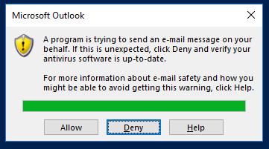
Final Score!
An email will automatically be created and sent containing your score. A notification like this will appear. After 5 seconds, you will be able to select Allow.
If you are not able to select allow, then that means Outlook isn’t open.
You must select the “Allow” button. Once that is done, you may exit the game by clicking the button below. Thanks for playing!
Exit Game

