Slide 1

Used Car Price Predictions
Milestone 2: Project Progress Presentation
Team Insight Works
Austin Gammill · Bryce Armand · Samantha Varela · Bryson Rabon · Gustavo Gonzalez
IT 4793 Applied Data Driven Solutions · Advisor: Dr. Arindam Khanda · October 20, 2026
Notes:
Introduce the team and the project: Used Car Price Predictions. This presentation covers our progress up to Milestone 2 (due 10/20/2026): the modeling approach, the research report draft, and the working dashboard prototype.

Slide 2



Project Recap
Where we started and what we are building
The problem
Used car prices vary widely, and it is hard for buyers and sellers to know what a fair price is.
Our approach
Use historical used car data to:
Describe the most important factors in price change (descriptive analytics)
Predict used car prices from those factors (predictive modeling)
Deliver it all through an interactive price estimator dashboard
Stakeholders
Used car buyers, private sellers, dealerships, and online car marketplaces
Success Metrics
Average predicted car price, and mean absolute percentage error (MAPE) vs. current selling prices
Status at Milestone 2
Modeling approach defined, research report drafted, and a working prototype live on the project website
Notes:
Quick recap for context. The goal has not changed: determine fair selling prices for used cars from historical data, and measure success by average predicted price and MAPE compared with current selling prices. At Milestone 2 we now have a defined modeling approach, a drafted research report, and a working prototype.

Slide 3

Project Roadmap
Milestone 1 complete, Milestone 2 deliverables in hand, Milestone 3 next
Milestone 1
Milestone 2
Milestone 3
Due 9/25/2026 (complete)
Due 10/20/2026 (current)
Due 11/10/2026
Project Scope Document
Communication Plan Document
M1 Progress Presentation
Model / Analysis Approach Document
Research Report Draft
Working dashboard prototype
M2 Progress Presentation
Analysis completed
Final Report submitted
Fully operational dashboard
Final Presentation
Notes:
We are at Milestone 2. Milestone 1 (planning documents, website, M1 presentation) is complete. For Milestone 2 we have the modeling approach document, the research report draft, the working prototype, and this presentation. Milestone 3 (11/10) wraps up the analysis, final report, fully operational dashboard, and final presentation.

Slide 4
Milestone 2 Progress
All Milestone 2 deliverables completed
Modeling Approach Document
100%
4 of 4
Samantha
Completed
Research Report Draft
100%
Austin (write), Bryce (review)
Completed, posted in Teams
Milestone 2 deliverables completed
Data gathering, cleaning, and loading
100%
2 models
Samantha, Bryson, Bryce, Austin, Gustavo
Completed, CSV loads in browser
Working Dashboard Prototype
100%
trained and predicting in the prototype: linear regression and a regression tree
Austin, Gustavo
Completed, live on project website
M2 Presentation
100%
Bryson
Completed
Notes:
Every Milestone 2 deliverable is complete. Samantha finished the model/analysis approach document, Austin wrote the research report draft with Bryce reviewing, the dataset is cleaned and loads into the prototype as a CSV, and the price estimator prototype is live on the project website with two trained models.

Slide 5
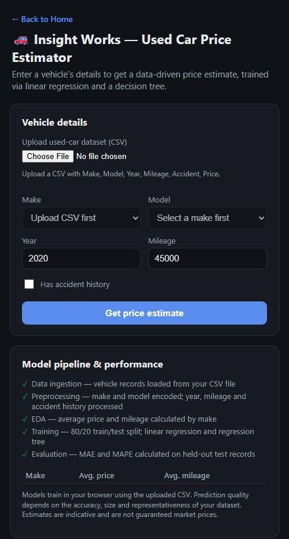



Working Prototype: Price Estimator
Live at austinwg47.github.io/Insight_Works/estimator
Upload the dataset in the browser
Choose a CSV with Make, Model, Year, Mileage, Accident, and Price; it loads and trains instantly, no server needed
Enter the vehicle
Make, model, year, mileage, and accident history drive the estimate
Two predictions side by side
Linear regression and decision tree each return an estimated market value
Built-in EDA and metrics
Average price and mileage by make, plus MAE and MAPE on held-out test records
Notes:
The prototype is a browser-based price estimator on the project website. Users upload the cleaned used-car CSV directly in the browser, the models train on that data in JavaScript, and then the user picks make, model, year, mileage, and accident history to get a price estimate from both a linear regression and a decision tree. The page also shows the pipeline steps, a summary table by make, and evaluation metrics. It is a prototype: it works end to end, and Milestone 3 is about making it accurate and polished.

Slide 6
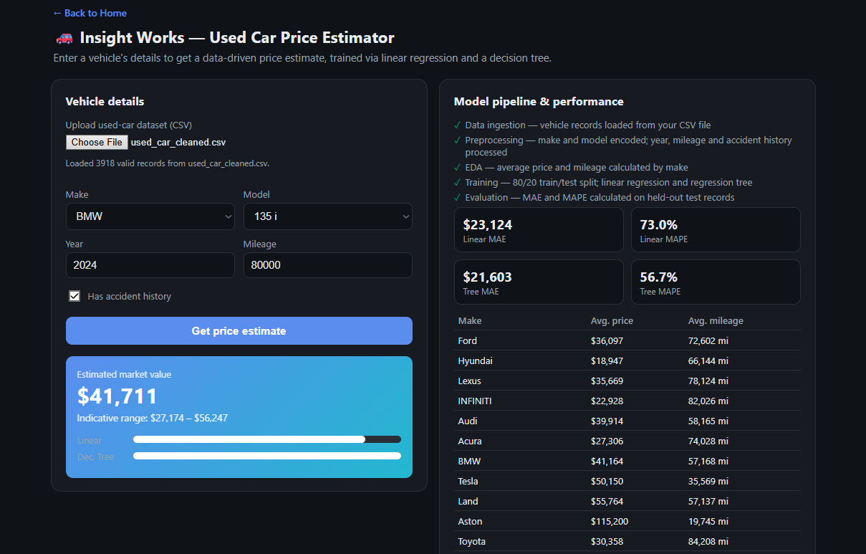
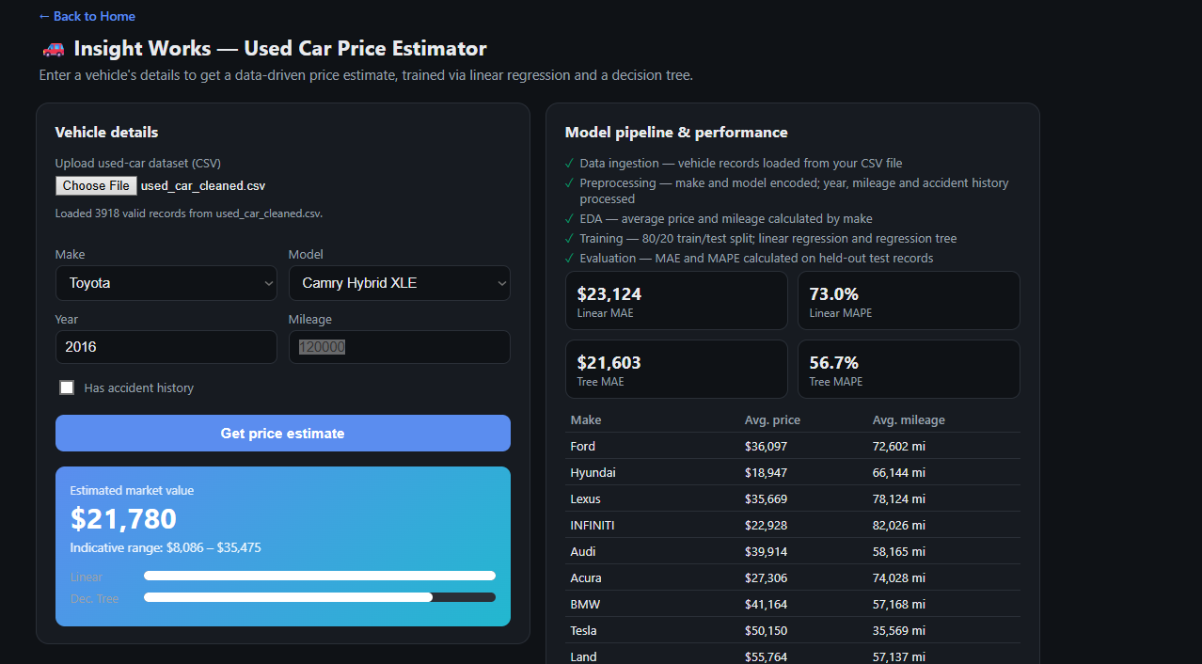
Dashboard Examples (Prototype)
MAPE is currently too high, and improvement will be a main focus in M3.

Slide 7





Model and Analysis Approach
Pipeline from raw CSV to evaluated predictions
01
02
03
04
05
Data ingestion
Preprocessing
EDA
Training
Evaluation
Vehicle records loaded from the cleaned CSV
Make and model encoded; year, mileage, and accident history processed
Average price and mileage calculated by make
80/20 train/test split; linear regression and regression tree
MAE and MAPE on held-out test records
Linear regression
Regression tree
Baseline model. Fits a weighted combination of year, mileage, accident history, and encoded make/model to price. Fast, easy to interpret, and shows which factors move price most (descriptive analytics).
Splits the data on the strongest factor at each step, so it can capture non-linear effects such as mileage mattering more on newer cars than on older ones. Compared against the baseline on MAE and MAPE.
Notes:
The approach document lays out a five-step pipeline, and the prototype implements all five in the browser. We train two models on an 80/20 split: a linear regression as the interpretable baseline, and a regression tree to capture non-linear interactions such as how mileage affects price differently depending on the vehicle's age. Both are evaluated with MAE and MAPE on the held-out 20 percent, which ties directly to our success metric.

Slide 8



Early Results and Challenges
The prototype works end to end; accuracy is the focus for Milestone 3
~50%
Mileage means different things at different ages
100,000 miles on a 2002 car barely moves the price, but 100,000 miles on a nearly new car cuts it sharply. A single mileage weight cannot capture that; we need age-aware features or tree depth tuning.
current prediction error on held-out test records
Make-to-model filtering bug
Not where we want it, but a working baseline with a clear, measurable target to beat in Milestone 3. Our success metric (MAPE) is now computed automatically on every run.
The model dropdown is not yet restricted to the selected make, so mismatched combinations (a BMW model under Toyota) can be chosen. Known issue, fix queued for M3.
Training in JavaScript
Running the models in the browser keeps the site serverless, but JavaScript lacks Python's modeling libraries, so feature engineering and tuning take more hand-built code.
Notes:
Being transparent about where the prototype stands: prediction error is currently around 50 percent on held-out records, so there is real work left on accuracy. The main modeling challenge is that mileage interacts with vehicle age. We also have a known UI bug in the make-to-model filter, and training in JavaScript rather than Python makes tuning slower. All three are scoped for Milestone 3.

Slide 9
Schedule & Workload
Team hours per week from our Gantt chart: 96 of 143 planned hours reached through Milestone 2
Milestone 1
26 hrs
Completed: planning documents, website, M1 presentation
Milestone 2
70 hrs
Completed: data pipeline, modeling approach, prototype, research draft
Milestone 3
47 hrs
Planned: full dashboard, MAPE testing, analysis, final report
Notes:
Our Gantt chart plans 143 team hours across the semester. The 26 hours for Milestone 1 and the 70 hours planned for Milestone 2 are now behind us (shown in green), leaving 47 planned hours for Milestone 3. Milestone 2 was the heaviest stretch of the project, with data cleaning, loading, and the prototype overlapping in the weeks of 10/9 and 10/16.

Slide 10



Next Steps: Road to Milestone 3
Planned work for the weeks of 10/27 through 11/10
01
02
03
04
05
Improve model accuracy
Fix make-to-model filtering
MAPE testing and analysis
Fully operational dashboard
Final report and presentation
Austin, Bryce
Austin, Gustavo
Bryce, Samantha
Gustavo, Austin
Austin, Bryson
Weeks of 10/27 and 11/3
Week of 10/27
Weeks of 10/27 and 11/3
Weeks of 10/27 to 11/10
Weeks of 11/3 and 11/6
Milestone 3 target (11/10): completed analysis, final report, fully operational dashboard, final presentation
Notes:
Milestone 3 is about making the prototype good: improving accuracy with age-aware mileage features and model tuning, fixing the make-to-model filter, completing the MAPE analysis against our success metric, finishing the dashboard, and writing the final report and presentation. The heavy lifting of Milestones 1 and 2 is done; what remains is refinement.

Slide 11

Thank You
Questions?
Project website: austinwg47.github.io/Insight_Works · Price estimator (Dashboard): /estimator.html
Team Insight Works · IT 4793 · Kennesaw State University
Notes:
Thank the audience and point them to the project website and the live price estimator for a hands-on look at the prototype.

