Slide 1

UNIVERSITY OF CHICAGO
MS in Applied Data Science
Personalized Location
Recommendation System
for ChicagoDoes
Leveraging User Interaction Data to Improve
Engagement and Discovery on a Chicago Tourism Map
Capstone Research
Spring 2026
Yiou Wang · RJ Xia · Kennedy Damtse
Client: Ateema / ChicagoDoes Interactive Video Maps
Supervisor: Sanjay Boddhu

Slide 2
Agenda
1
Introduction & Situational Analysis
2
Business Problem & Opportunity
3
Goals of Analysis
4
Deliverables
5
Literature Review
6
Data: Issues & EDA
7
Analysis Plan & Methodology
8
Model Evaluation Methodology
9
Expected Findings
ChicagoDoes Capstone · Spring 2026
2 / 18

Slide 3
1. Introduction & Situational Analysis
ChicagoDoes is an interactive Chicago discovery map operated by Ateema
The Product
Interactive video map of 400+ Chicago restaurants, attractions, bars, museums, parks, theaters, and venues. Mapme-backed; reached via tourism campaigns and partner QR codes.
The Audience
Tourists and locals planning city activities. Behaviorally short-session: over half of users click only 1-2 listings per session before leaving.
The Business Model
Paying business partners purchase placement, CTA links, and featured marketing assets. Engagement drives partner ROI and platform retention.
The Telemetry Gap
GA4 captures rich event signals (marker clicks, filters, dwell, CTA) — but the surface is fully generic. No event is operationalized into ranking.
ChicagoDoes Capstone · Spring 2026
3 / 18

Slide 4
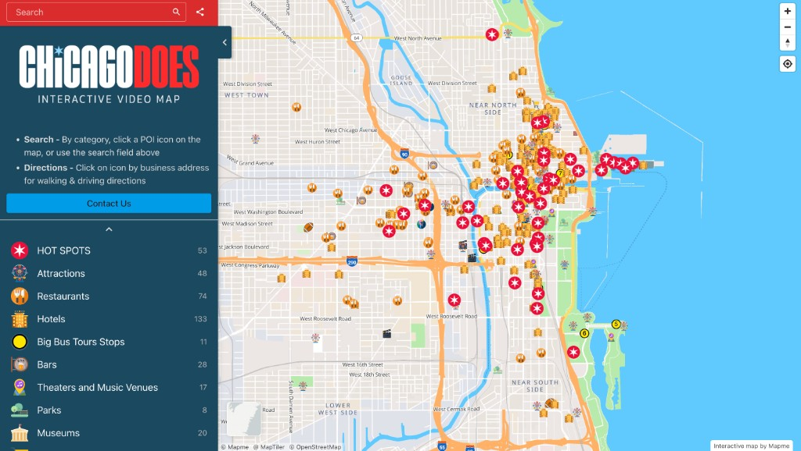
Current ChicagoDoes Experience
The map every visitor lands on today — a single generic surface
What every visitor sees
10 fixed categories in the sidebar
Same default zoom & extent for all
No personalized ranking — markers density-based
No re-entry memory across visits
Partner CTAs visible only after a marker click
Search by keyword or category icon only
Live screenshot of chicagodoes.com · the recommender layer is what is missing today
ChicagoDoes Capstone · Spring 2026
5 / 18

Slide 5
2. Business Problem & Opportunity
Every visitor sees the same generic map, leaving discovery and partner ROI on the table
THE PROBLEM
THE OPPORTUNITY
Identical experience for every visitor
Convert telemetry into personalization
• 15% of map-loaders click any listing marker
• Translate GA4 events into ranking signals
• Most users browse only 1–2 listings per session
• Close the content-discovery gap for visitors
• No personalization layer ingests GA4 events
• Increase partner CTA reach to matched users
• Partner CTAs reach mismatched audiences
• Build a longitudinal behavioral record
• Each empty session loses retention + the chance to build a behavioral history
• Establish data infrastructure for future personalization work
ChicagoDoes Capstone · Spring 2026
4 / 18

Slide 6
3. Goals of Analysis
Seven concrete objectives spanning data engineering, modeling, and validation
1
Warehouse
2
Features
Translate raw GA4 logs into a layered, queryable warehouse of user–location interactions
Engineer leakage-safe predictive features at user and location levels
3
Hybrid Ranker
4
Cold Start
Combine content similarity, item/user CF, session co-visit, transitions, trending
Handle anonymous visitors via onboarding form + K-Means behavioral archetypes
5
Diversity
6
Web App
Apply MMR re-ranking so top-K lists are not category-homogeneous
Ship full-stack FastAPI + JS app exposing evidence behind every recommendation
7
Evaluation Plan
Specify offline (Precision@K, NDCG, coverage) + online A/B evaluation
ChicagoDoes Capstone · Spring 2026
6 / 18

Slide 7
4. Deliverables
What the client receives at the end of the engagement
BigQuery Warehouse
7-layer pipeline: raw GA4 → qualified events → user–location features → candidate set. Decouples user-anonymous priors from per-user behavior to enforce leakage safety.
Hybrid Recommender
Six-signal ranking engine (content + popularity + item CF + user kNN + trending + session/transition) with regime-aware weights for new vs. returning visitors.
Web Application
FastAPI backend + JS frontend with evidence-backed recommendation cards (distinct users, dwell, trending) and an LLM concierge layer for itinerary planning.
Cold-Start System
Onboarding form → TF-IDF pseudo-profile + K-Means archetype (Foodie Wanderer, Sightseeing Explorer, etc.). Seeds collaborative scoring for anonymous visitors.
Evaluation Methodology
Documented offline plan (Precision@K, Recall@K, NDCG, coverage, diversity, MAP) + online A/B (CTR, conversion, return-visit) ready for deployment.
Code & Documentation
End-to-end repository (warehouse SQL, backend Python, frontend JS) with module READMEs and a 35-page capstone paper.
ChicagoDoes Capstone · Spring 2026
7 / 18

Slide 8
5. Literature Review — Foundations (1/2)
Core recommender-systems theory underpinning our scoring blend
1
Implicit-Feedback Collaborative Filtering
Hu, Koren & Volinsky (2008) · Koren, Bell & Volinsky (2009)
Insight
Treat clicks / dwell as confidence-weighted positive signals; matrix factorization with confidence is the canonical implicit-feedback model.
Our system
Foundation for our item–item and user–user CF terms. We use confidence-weighted co-occurrence (sparse Jaccard) rather than full MF, because the GA4 export is short and the catalog is small (~400 locations).
2
Content-Based Methods & TF-IDF
Salton & Buckley (1988) · Pazzani & Billsus (2007)
Insight
Item attributes vectorized via TF-IDF + cosine similarity outperform raw category matching on sparse catalogs.
Our system
We TF-IDF-vectorize each location's category tokens, then compute cosine similarity to a TF-IDF user profile (history-weighted). This is also the backbone of the cold-start pseudo-profile.
3
Hybrid Recommenders
Burke (2002) · Çano & Morisio (2017)
Insight
A weighted/switching hybrid of content + CF empirically dominates either paradigm alone on sparse, implicit-feedback data — the regime where ChicagoDoes operates.
Our system
Directly motivates our six-signal weighted blend, with different weight vectors for new-visitor vs. returning-user regimes to handle the cold-start↔warm-start transition.
ChicagoDoes Capstone · Spring 2026
8 / 18

Slide 9
5. Literature Review — Applied & Domain (2/2)
Session, diversification, tourism, and LLM literature shaping the deployment surface
4
Session-Aware Recommendation
5
Diversity — Maximal Marginal Relevance
Hidasi et al. (2016) · Quadrana et al. (2018)
Carbonell & Goldstein (1998)
Insight
Insight
Anonymous, short-session traffic still carries in-session intent — captured via co-visit graphs and previous→next transition counts.
Relevance-only top-K lists become category-homogeneous; MMR re-ranks by trading λ relevance vs. (1−λ) novelty.
Our system
Our system
Same-session Jaccard (0.6) + transition probability (0.4). Crucial since >50% of ChicagoDoes traffic is single-session.
Applied at λ = 0.7 over the top-60 candidates — prevents the 'eight bars in a row' failure mode in baseline runs.
6
Tourism RS & Cold Start
7
LLMs as Presentation Layer
Borrás et al. (2014) · Gavalas et al. (2014)
Lewis et al. (2020) · Wu et al. (2024)
Insight
Insight
Tourism is dominated by cold-start anonymous visitors; standard recipe = lightweight onboarding form + behavioral segmentation.
LLMs perform best when ranking is deterministic and the LLM only narrates / re-orders within a small retrieved pool (RAG pattern).
Our system
Our system
Onboarding form → TF-IDF pseudo-profile + K-Means archetype (k = 6: Foodie, Sightseer, …) seeding CF for new users.
ChicagoDoes 'concierge': deterministic hybrid produces the pool; LLM writes copy + ordering — never invents locations.
ChicagoDoes Capstone · Spring 2026
9 / 18

Slide 10
6. Data: Sources & Issues
GA4 event stream + canonical dimensions, layered into 7 warehouse tables
DATA SOURCES
KNOWN DATA ISSUES
GA4 Daily Events
events_YYYYMMDD + events_intraday tables in BigQuery
Implicit only
No star ratings or post-visit feedback exist
Short window
Only a few weeks of GA4 export — no annual seasonality
Location Dimension
Official Mapme / Ateema location & category lists
Anonymous users
Most visitors single-session; no demographics
Crawler Bridge
Cleaned location × category mapping
Conversion blind spot
Once user clicks off the map, downstream events are not observable
Sparse content
Locations carry categories but few free-text descriptions
Engagement Filter
Strong / weak / nav / noise event classification
Leakage risk
Aggregated user features could leak labels → isolated
ChicagoDoes Capstone · Spring 2026
10 / 18

Slide 11
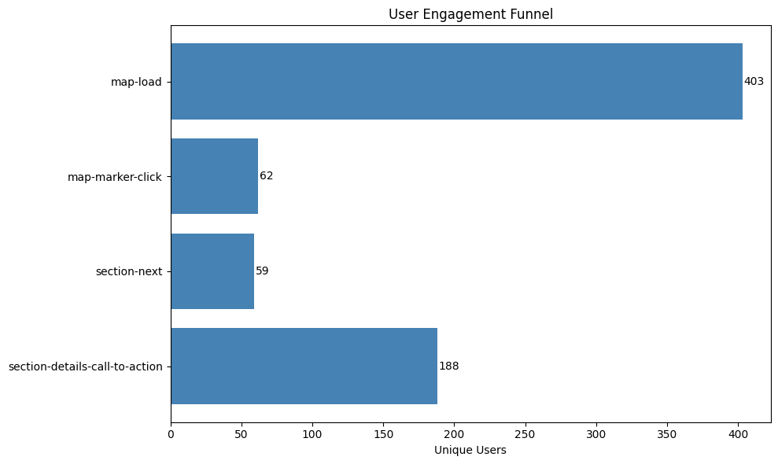
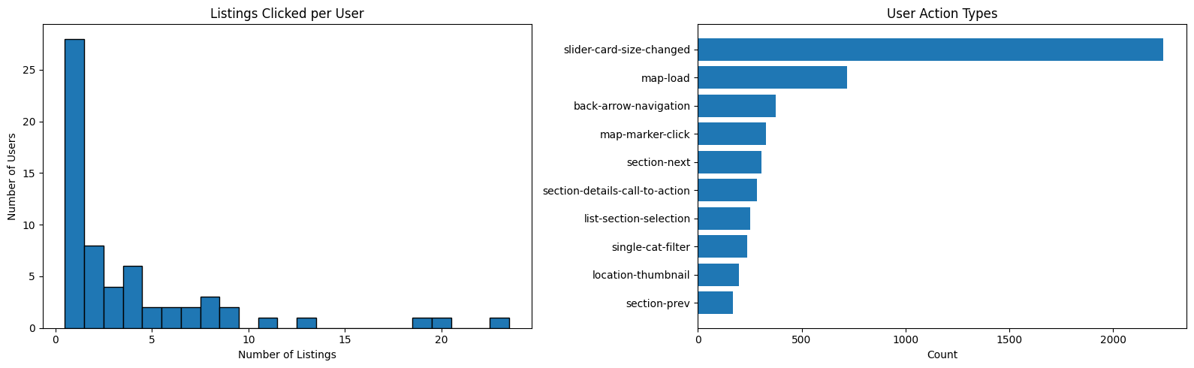
6. EDA — Engagement Is Shallow & Heavy-Tailed
Funnel drops sharply at first marker click; most users click only 1–2 listings
Key takeaway
Only 15% of map-loaders click a marker and >50% click ≤2 listings per session — the recommender must front-load the most relevant places in the first two impressions.
ChicagoDoes Capstone · Spring 2026
11 / 18

Slide 12
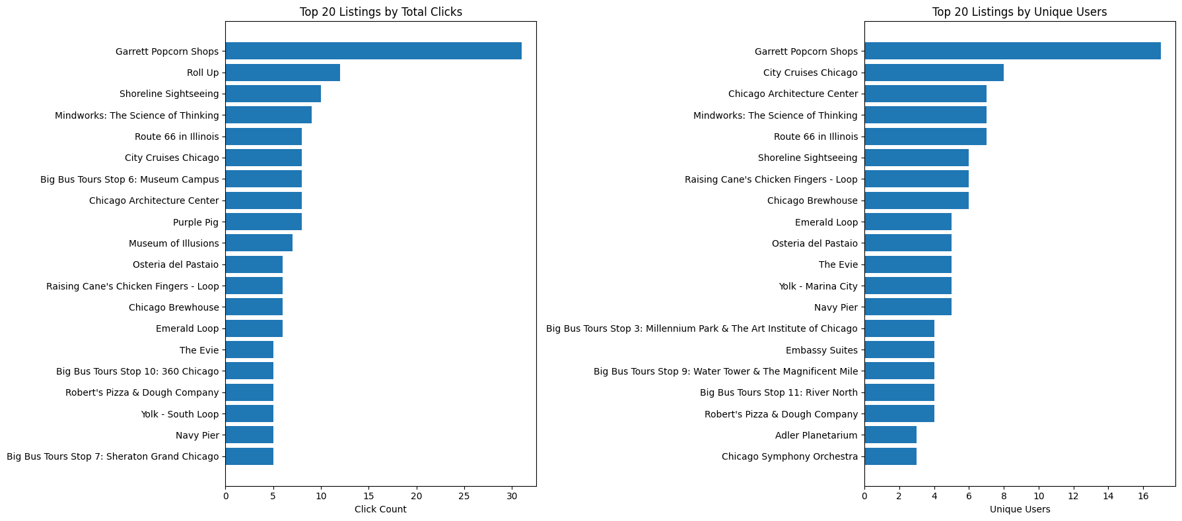
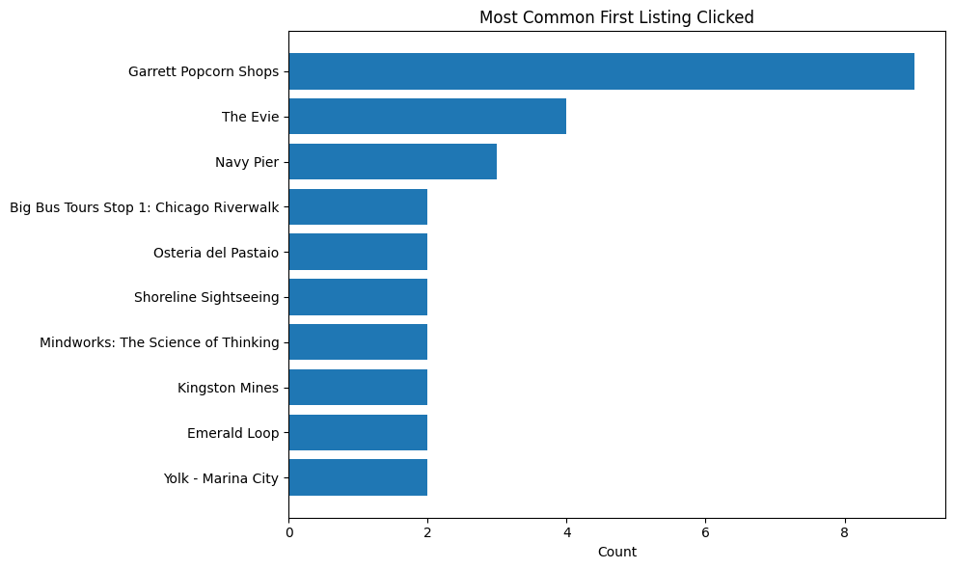
6. EDA — Repeat-Driven Popularity & Multi-Intent Visitors
Same listings dominate by total clicks vs. unique users; first-click entry points are diverse
Design implications
Popularity must be computed per distinct user (not raw clicks) — and entry-point heterogeneity justifies segmenting visitors into K-Means behavioral archetypes.
ChicagoDoes Capstone · Spring 2026
12 / 18

Slide 13
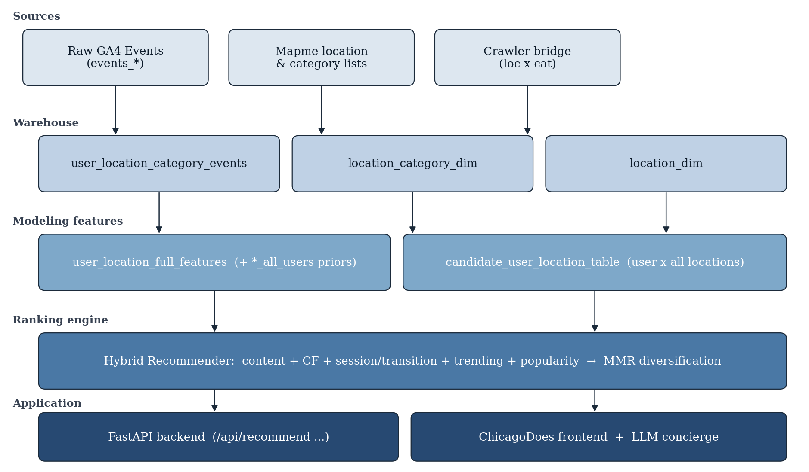
7. Analysis Plan — System Architecture
Layered warehouse → six-signal hybrid ranker → MMR diversification → web app
Each ranking signal is leakage-safe (user-anonymous priors decoupled from per-user behavior)
ChicagoDoes Capstone · Spring 2026
13 / 18

Slide 14
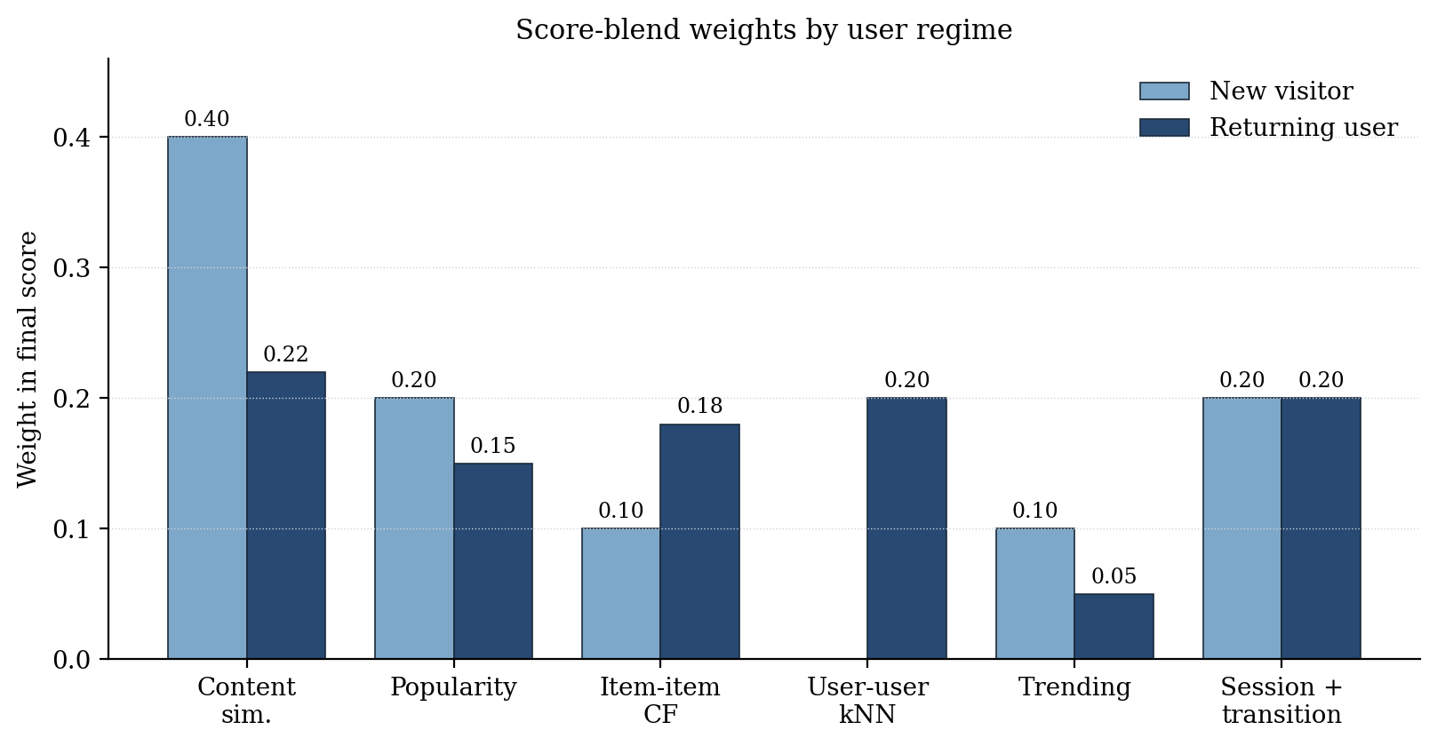
7. Modeling Framework — Six-Signal Score Blend
Each location scored on six normalized signals; weights switch by user regime
Six scoring signals
Weights by user regime
Content sim.
TF-IDF cosine between user profile and location categories
Popularity
Distinct-user-based prior; leakage-safe
Item–item CF
Sparse Jaccard between locations engaged by overlapping users
User–user kNN
Top-5 nearest users by category-share cosine
Trending
Recent vs. early-window event ratio per location
Session/transit
Same-session Jaccard (0.6) + previous→next transition (0.4)
ChicagoDoes Capstone · Spring 2026
14 / 18

Slide 15
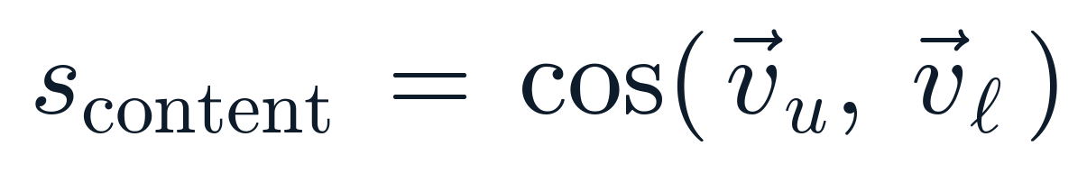

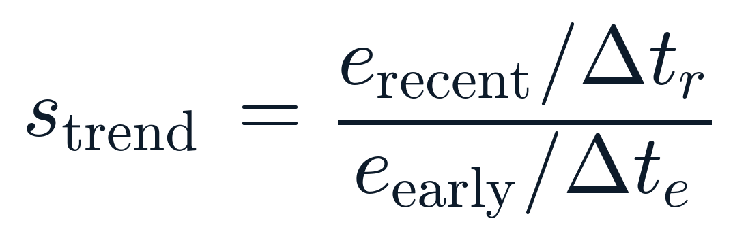
7. Algorithm Detail — Scoring & Re-Ranking
Composite location score, signal computations, and MMR diversification
Composite location score for user u and location ℓ
Content similarity (TF-IDF)
Item–item CF (Jaccard)
Trending (recency lift)
v_u, v_ℓ are L2-normalized TF-IDF vectors over category tokens. v_u is the user's history-weighted average.
U_i = set of users who engaged location i. Per-user score = max Jaccard against history. Sparse and leakage-safe.
Recent vs. early strong-event rates per location. Min-max normalized to [0,1] across the catalog.
MMR diversification (λ = 0.7) — applied to top-60 candidates
S = items already in the result list · 70% relevance, 30% novelty vs. already-picked items
ChicagoDoes Capstone · Spring 2026
15 / 18

Slide 16
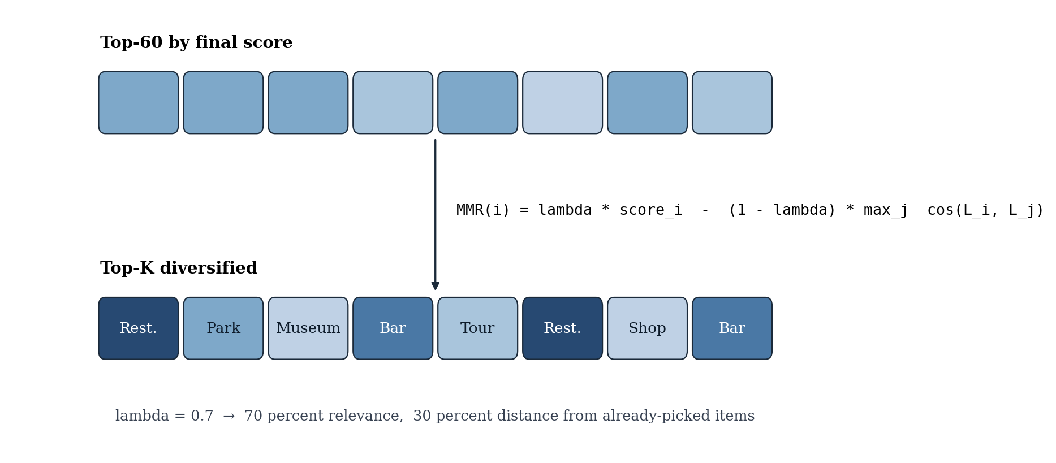
7. Cold Start + Diversity Re-Ranking
Form-derived pseudo-profile + K-Means archetypes, then MMR diversifies the top-K
Cold-start handling
MMR diversification (λ = 0.7)
Onboarding form
Interests, traveler type, vibe → mapped to category weights via lookup tables
TF-IDF projection
Form weights projected into the same TF-IDF space as locations → pseudo-profile
K-Means archetype
k=6 segments: Foodie Wanderer, Sightseeing Explorer, Cultural Enthusiast, etc.
Seed set
Archetype-popular locations seed the item–item CF score for cold-start users
70% relevance + 30% distance from already-picked items → re-shuffles homogeneous top-K lists without dropping the relevance leader
ChicagoDoes Capstone · Spring 2026
16 / 18

Slide 17
8. Model Evaluation Methodology
Offline + online + assumption checks — scoped for the next deployment phase
Offline Holdout
Leave-last-N per user; time-stratified split since trending and session signals are time-aware. Train on remaining interactions.
Ranking Metrics
Precision@K, Recall@K, Hit Rate@K, NDCG@K, MAP at K ∈ {5, 10, 20}
List Quality
Catalog coverage, intra-list cosine diversity (w/ vs w/o MMR), novelty, category entropy
Baselines
(i) Global popularity (ii) Random within interest (iii) Content-only TF-IDF (iv) Item–item CF only
Ablations
Remove each scoring term in turn → quantify marginal contribution; re-tune regime weights
Online A/B
Behind feature flag: locations/session, CTR, dwell, CTA conversions, return-visit rate, partner-side impressions
ChicagoDoes Capstone · Spring 2026
17 / 18

Slide 18
9. Expected Findings
Mapped to the planned baselines + observed in design-validation runs
Dimension
Expectation
Reasoning
Precision@K, NDCG@K
Hybrid > content-only > collab-only > popularity
Content backstop + CF refinement in same model
Hit Rate@K (cold-start)
Hybrid ≈ popularity
Popularity is a strong baseline for new visitors
Intra-list diversity
Hybrid + MMR ≫ Hybrid w/o MMR
MMR explicitly trades 30% relevance for diversity
Catalog coverage
Hybrid ≫ popularity
CF + content surface the long tail
Engagement filter
Top-K Jaccard ≥ 0.7 across policies
Filter removes noise without destroying signal
Online CTR
Personalization wins, partner CTA clicks lift
Standard uplift pattern in DMO / tourism literature
ChicagoDoes Capstone · Spring 2026
18 / 18

Slide 19
Thank You

