Slide 1
Penguin Game
Austin Yam

Slide 2
Bored? Problem Solved…
Nothing to do
No life
Idea of fun is skewed

Slide 3
Current Solutions
Basically every other game app
EX:
Flappy Bird
Angry Birds

Slide 4
Other Ideas
Tried several other ideas:
Tower Defense
2D Side Scroller

Slide 5
Useful Source Code/ Libraries
Java Swing API

Slide 6
Rapid Prototyping
In my prototyping effort, focused on:
Threading
Movement
Organization

Slide 7
Use Case #1
Score Tally
The program will be able to track and give user the final score

Slide 8
Use Case #2
End button to close program
The user will be able to close the program by clicking the END button

Slide 9
Use Case #3
Move Character
The user will be able to control the character’s movements using the arrow keys

Slide 10
Use Case #4
Character respawn
The program will reinitialize the character to its beginning state if the character moves out of bounds

Slide 11
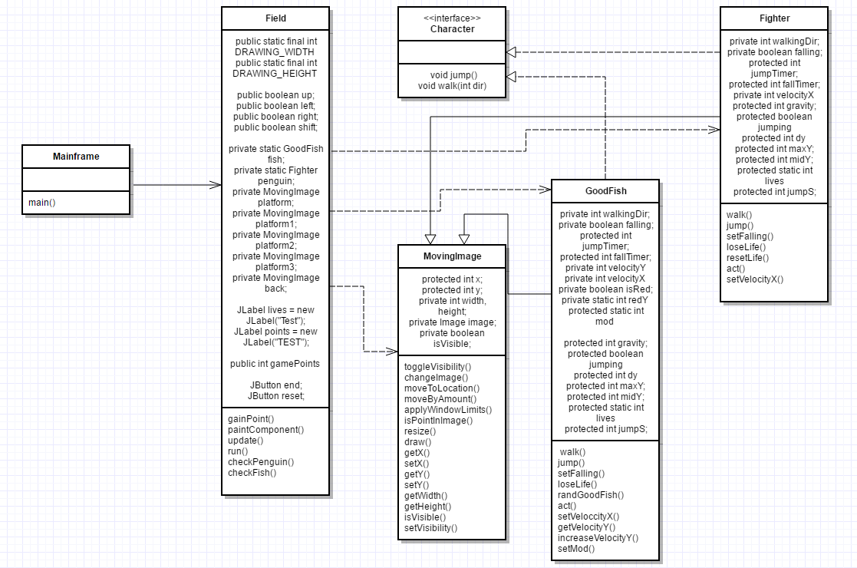
UML Class Modeling

Slide 12
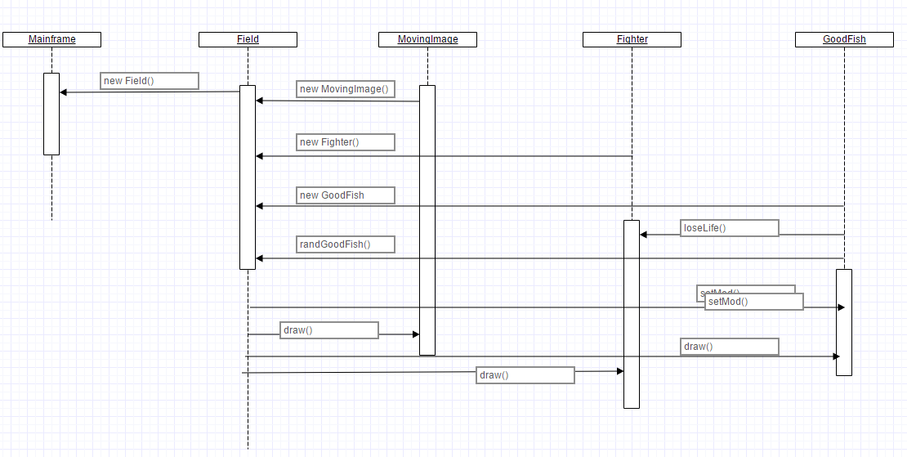
UML Sequence Diagram

Slide 13
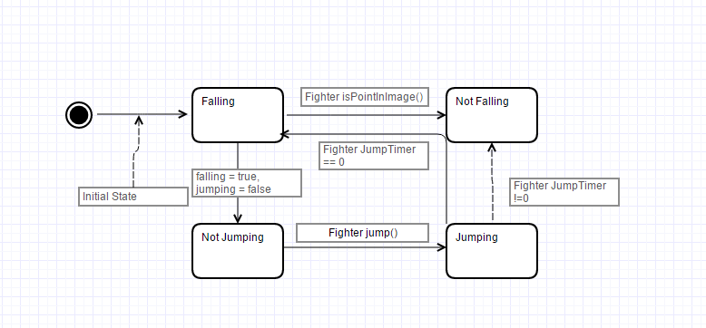
UML State Diagram for Fighter Object

Slide 14
CRC 1: Field
gainPoints()
paintComponent()
update()
Run()
checkPenguin()
checkFish()
GoodFish Fish
Fighter Penguin
MovingImage platform
MovingImage platform1
MovingImage platform2
MovingImage platform3

Slide 15
CRC 2: Fighter
Walk()
Jump()
setFalling()
loseLife()
resetLife()
Act()
setVelocity()
Int walkingDir
Boolean falling
Int jumpTimer
Int fallTimer
Int velocity
Int gravity
Boolean jumping
Int maxY
Int lives

Slide 16
CRC 3: GoodFish
Walk()
Jump()
setFalling()
loseLife()
resetLife()
Act()
setVelocity()
randGoodFish()
IncreaseVelocityY()
setMod()
Int walkingDir
Boolean falling
Int jumpTimer
Int fallTimer
Int velocity
Int gravity
Boolean jumping
Int maxY
Int mod
Int redY

Slide 17
CRC 4: MovingImage
toggleVisibility()
changeImage()
moveToLocation()
moveByAmount()
applyWindowLimits()
isPointInImage()
Resize()
Draw()
getX()
setX()
getY()
setY()
getWidth()
getHeight()
isVisible()
setVisibility()
int x
Int y
Int width
Int height
Image image
boolean isVisible

Slide 18
Java Docs 1
/*
* KeyBindings Fields
* Space = increase velocity
* Up = Jump
* Right = move right
* left = move left
*/

Slide 19
Java Docs 2
/*
* check() methods for penguin and fish
* used to check and update the position of the objects
* if the specified condition is met, then execute the action
* Penguin will be reinitialized at the top of the frame if it falls out of bounds
* Fish will disappear and will be reinitialized at a random point at the top of the frame
* if it has hit the penguin or fallen out of bounds
*/

Slide 20
Java Docs 3
/*
* This updates the game
* contains states for the keybindings to manipulate the penguin
* used to update and stop the game if the number of lives reaches 0
* creates the ScoreScreen frame to display the final amount of points earned
* adds the end button to the top of the frame
*/

Slide 21
Encapsulation
public class Field extends Jpanel{
….
public void checkPenguin() {
int x = penguin.getX() + penguin.getWidth()/2;
int y = penguin.getY() + penguin.getHeight()/2;…
}

Slide 22
Behavior Design Pattern: State Design Pattern
if(left) penguin.walk(-1);
else penguin.walk(0);
if(right) penguin.walk(1);
if(space) penguin.setVelocityX(6);
if(!space) penguin.setVelocityX(3);
Using the true or false states we are able to change the penguin’s movements

Slide 23
Structural Design Pattern: Composite Design Pattern
public interface Character {
void walk(int dir);
void jump();
void act();
}
…
Fighter extends MovingImage implements Character{
public void act()
{
if(jumping){
y -= 10;
}
if(y < maxY){
jumping = false;
falling = true;
y += 10;
}
//MOVE
if(falling)
{
moveByAmount(0,5);
}
moveByAmount(walkingDir*velocityX,0);// 3 is the walking speed
}
GoodFish extends MovingImage implements Character{
public void act()
{
if(jumping){
y -= 3;
}
if(y < maxY){
jumping = false;
falling = true;
y += 10;
}
//MOVE
if(falling)
{
moveByAmount(0,velocityY);
}
moveByAmount(walkingDir*velocityX,0);// 3 is the walking speed
}
Same operations with different values.

Slide 24
Creational Design Pattern: Singleton Design Pattern
public static GoodFish randGoodFish(){
Random x = new Random();
int low = 20;
int high = 780;
int randX = x.nextInt(high-low)-low;
Random r = new Random();
int min = 0;
int max = 100;
int rare = r.nextInt(max-min)-min;
if(rare%mod == 0){
return new GoodFish(randX,5.0);
}else{
return new GoodFish(randX,0);
}
}
class Field()
static GoodFish randGoodFish()
class GoodFish

Slide 25
Running Thread
public class thread implements Runnable{
@Override
public void run() {
try{
Thread.sleep(penguin.jumpTimer);
}catch(Exception e){
e.printStackTrace();
new Thread(this).start();
System.exit(0);
}
}
}
penguin.jumping = true;
new Thread(new thread()).start();
update();

