Slide 1
WORLD HEGHLITED PLACES RECOMMENDER AND ITS DETAILS USING REACT.JS AND REACT HOOKS

Slide 2
Abstract:
The world highlighted places recommender and its details. In today's world, tourism has taken its place as one of the major sources of foreign exchange for both developed and developing economies. Therefore, efficient management of tourists and tourism has become important in accessing the benefits accruing from this sector of the world economy. This system is made for customer can easily know the details about the other places and it travel cost. This site gives new packages on flexible price and this project is flexible on both mobile view and website view with good user Interface

Slide 3
Existing System:
High travel cost
It have slow render system
No much information about the current innovative places

Slide 4
Propose System:
Flexible costs according to the places
Have correct information about the tour places
Better user interface

Slide 5
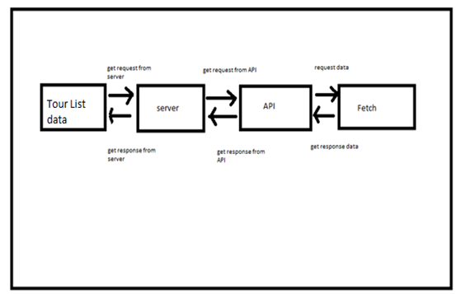
System Architecture:

Slide 6
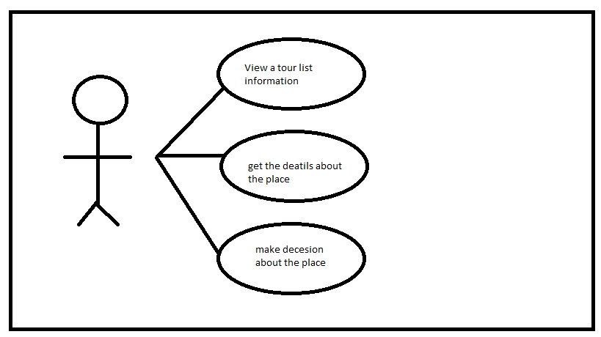
Use case Diagram

Slide 7
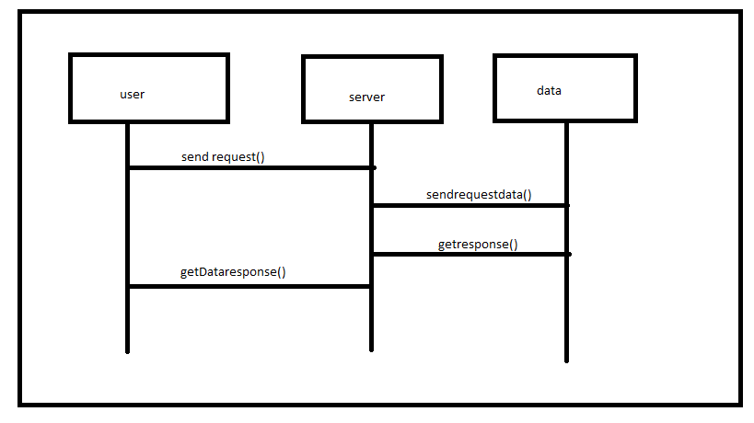
Sequence Diagram:

Slide 8
Software Requirements
Operating System: Windows XP
Compiler: Visual studio code
CMD(command prompt)

Slide 9
Hardware Requirements
Hard Disk – 2 GB.
RAM – 1 Gaga Byte.
Processor – Dual Core or Above.
Mouse
Keyboard
Monitor
CD Drive

