Slide 1
Gamegogy

Slide 2
Introduction
Purpose:
Given course and student files
Display top students as user specifies
Displays bar graph with clickable bars

Slide 3
Features Completed
Feature 1
Allow Student and Course info to be retrieved through command line
Feature 2
Allow ID lists to be retrieved through command line
Feature 3
Graphical Interface for program
Allows user to look up top performing students
Feature 4
Displays a bar graph of student grades
Allows user to click on bar for student info
19 UNIT TESTS TOTAL 81% CODE COVERAGE

Slide 4
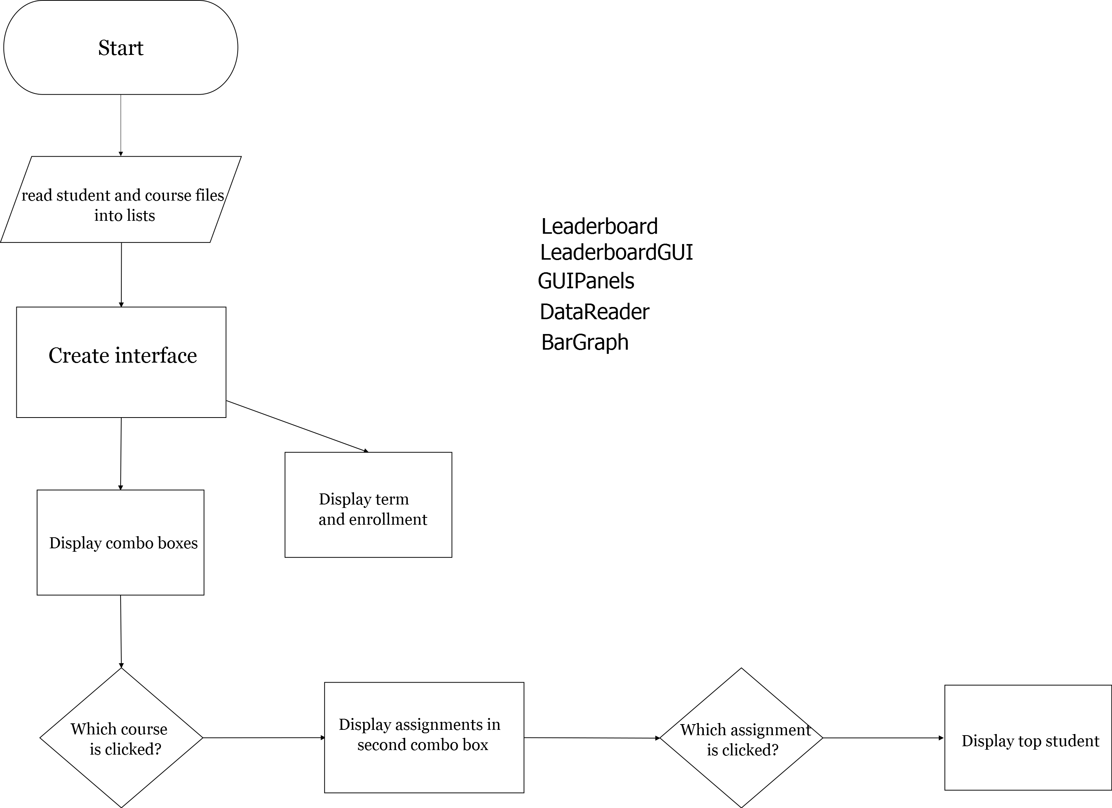

Slide 5
Process
Teamwork oriented
Regular helpful introspection
Planning sets clearly defined goals
Divide and conquer

