Slide 1
Pie Charts and Bar Graphs Using Only HTML and CSS
March 21, 2018

Slide 2

About me
@haltersweb
Adina Halter
Sr. Product Manager, Accessibility
Comcast NBCUniversal
Twitter: @haltersweb
GitHub: haltersweb.github.io/Accessibility/

Slide 3
WCAG 2.0
@haltersweb

Slide 4
1.1.1 Non-text Content
@haltersweb
All non-text content that is presented to the user has a text alternative that serves the equivalent purpose, except for the situations listed below. (Level A)

Slide 5
1.3.1 Info and Relationships
@haltersweb
Information, structure, and relationships conveyed through presentation can be programmatically determined or are available in text. (Level A)

Slide 6
1.3.2 Meaningful Sequence
@haltersweb
When the sequence in which content is presented affects its meaning, a correct reading sequence can be programmatically determined. (Level A)

Slide 7
1.4.1 Meaningful Sequence
@haltersweb
Color is not used as the only visual means of conveying information, indicating an action, prompting a response, or distinguishing a visual element. (Level A)

Slide 8
The Problem
@haltersweb

Slide 9
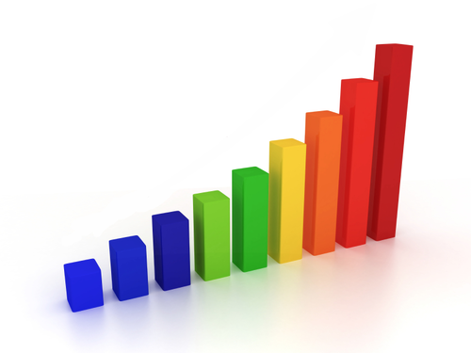
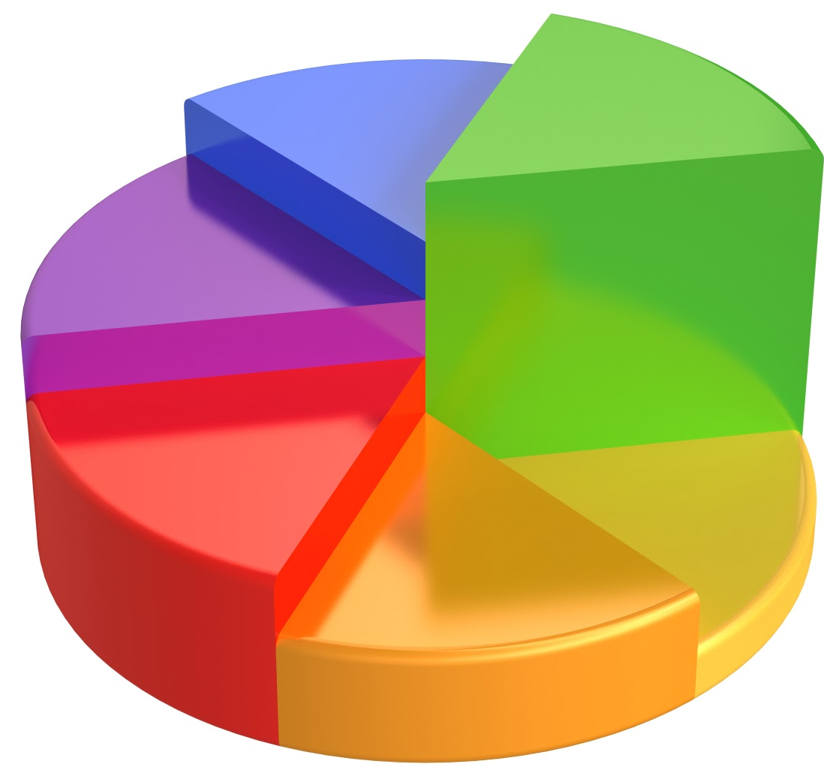
Graphs are visual
Notes:
Current approaches: Images, canvas, or SVG-generated graphs
Difficult to describe with enough detail
Impossible to step through
Heavy load times.

Slide 10
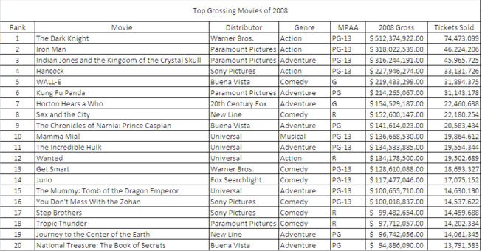
Tables are boring
Notes:
…and often complex

Slide 11
The Solution
@haltersweb

Slide 12
@haltersweb
<table> + CSS
Notes:
Lightweight
One code base
Little if any JavaScript necessary

Slide 13
Bar Graph
@haltersweb

Slide 14
Bar graph source files
@haltersweb
Code pens
https://codepen.io/haltersweb/pen/zWZQLG
https://codepen.io/haltersweb/pen/mxWZog
See also
http://haltersweb.github.io/Accessibility/barchart.html
http://haltersweb.github.io/Accessibility/table-as-data-graphics.html
http://haltersweb.github.io/Accessibility/complex-barchart/cui-barchart.html
Notes:
How to place thead as labels below data
Tfoot is not supported in screen readers

Slide 15
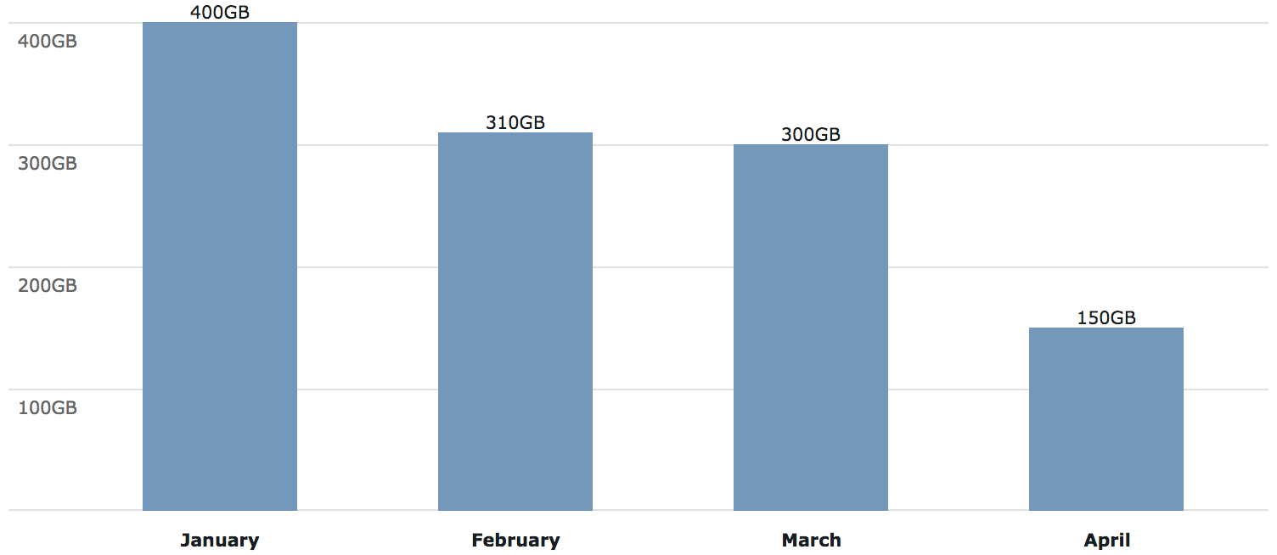
Bar graph
@haltersweb
https://codepen.io/haltersweb/pen/zWZQLG/
Use span for bar
Left headers are TBODY THs
Bottom headers are THEAD THs

Slide 16
Stumbling blocks
@haltersweb
https://codepen.io/haltersweb/pen/zWZQLG/
<thead>
<tfoot>
Notes:
How to place thead as labels below data
Tfoot is not supported in screen readers

Slide 17
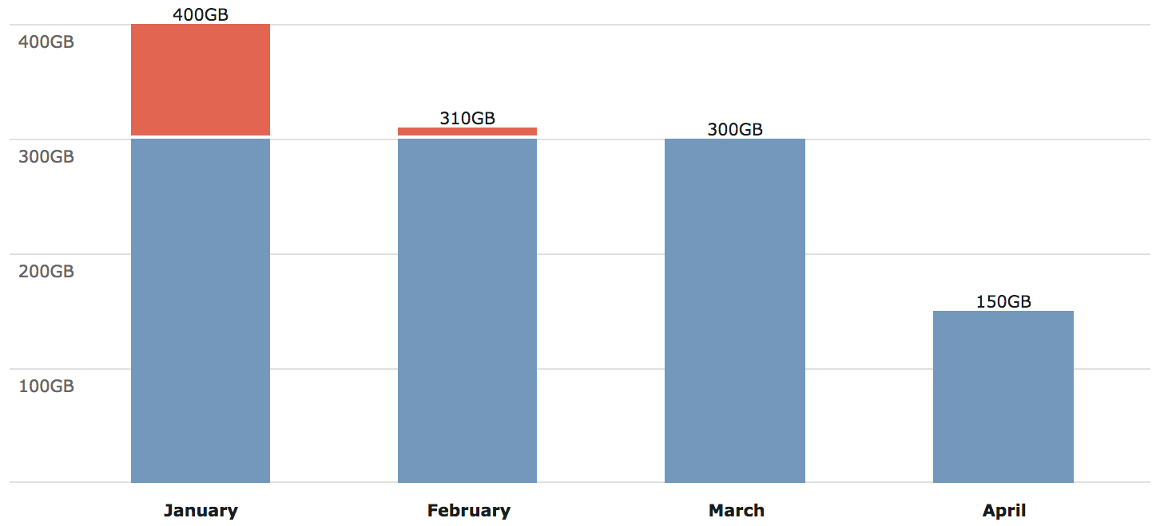
Stacked bar graph
@haltersweb
https://codepen.io/haltersweb/pen/mxWZog/
Use span for bar
Left headers are TBODY THs
Bottom headers are THEAD THs

Slide 18
Pie Graph
@haltersweb

Slide 19
Pie graph source files
@haltersweb
Code pens
https://codepen.io/haltersweb/pen/XZLvJL/
https://codepen.io/haltersweb/pen/pLedNj/
See also
http://haltersweb.github.io/Accessibility/pie-chart.html
http://haltersweb.github.io/Accessibility/pie-chart-dynamic.html
Notes:
How to place thead as labels below data
Tfoot is not supported in screen readers

Slide 20
Method
@haltersweb
Create wedges out of TD pseudo-elements
Rotate wedges around origin
Solve for font resizing (rem units)
Solve for variable-shaped click targets
Solve for TD/Table relationship loss in Firefox

Slide 21

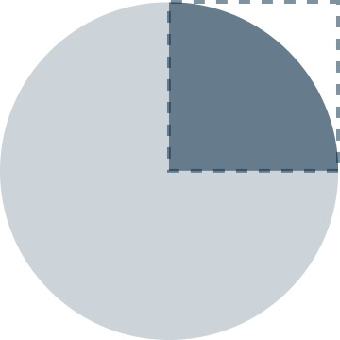
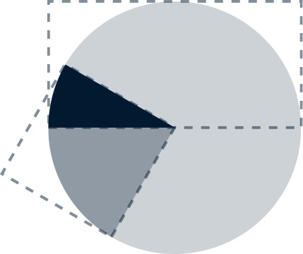
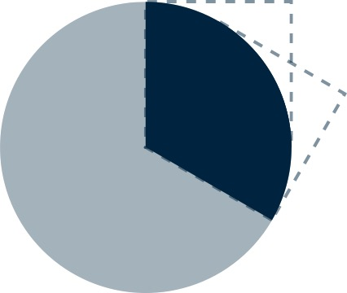
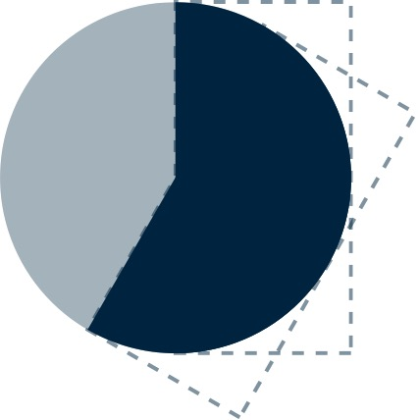
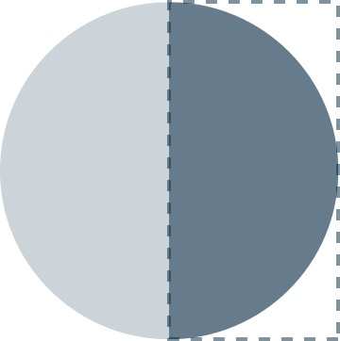
Create pie wedges
@haltersweb
https://codepen.io/haltersweb/pen/XZLvJL/
Create td.wedge and position absolutely relative to table | Create ::before & ::after circles w/ rounded-angle | Assign clip path to ::before & ::after to create ¼ & ½ wedges | ACUTE: negative rotate ::after and use td’s overflow:hidden for masking | OBTUSE: Layer rotated ::after on top of static ::before
table { position: relative; } td.wedge { position: absolute; left: 0; top: 0; height: 20rem; width: 20rem; overflow: hidden; line-height: 45rem; pointer-events: none; cursor: pointer; } | .wedge::before, .wedge::after { content: ""; position: absolute; left: 0; top: 0; display: block; width: 20rem; height: 20rem; border-radius: 10rem; pointer-events: auto; } | .acute::before { content: none; } .acute::after { clip: rect(0, 10rem, 10rem, 0); } .obtuse::before, .obtuse::after { clip: rect(0, 20rem, 10rem, 10rem); } .super::before, .super::after { clip: rect(0, 20rem, 20rem, 10rem); } | .acute { height: 10rem; transform-origin: center bottom; } .acute::after { transform: rotate(-60deg); } | .obtuse::after { transform: rotate(30deg); } .super::after { transform: rotate(30deg); }
Abe | Bob | Carl
53% | 19% | 28%

Slide 22
Position pie wedges
@haltersweb
https://codepen.io/haltersweb/pen/XZLvJL/
Assign transform: rotate() to pie wedge TDs
Rotate angle* = sum of prior wedge angles
*Acute rotation angle = 90 + sum of prior wedge angles
Notes:
TD pointer events none
::before, ::after pointer events auto

Slide 23
Rotation patterns
@haltersweb
https://codepen.io/haltersweb/pen/XZLvJL/
ACUTE WEDGE:
.acute {
transform: rotate(90deg + sum of prior wedge angles);
}
.acute:after {
transform: rotate(wedge angle - 90deg);
}
OBTUSE WEDGE:
.obtuse {
transform: rotate(sum of prior wedge angles);
}
.obtuse:after {
transform: rotate(wedge angle - 90deg);
}
SUPER WEDGE:
.super {
transform: rotate(sum of prior wedge angles);
}
.super:after {
transform: rotate(wedge angle - 180deg);
}
Notes:
TD pointer events none
::before, ::after pointer events auto

Slide 24
Firefox solution
@haltersweb
https://codepen.io/haltersweb/pen/XZLvJL/
Problem: Non-static TDs lose table cell relationship
ARIA 1.1 solution
Wrap table in DIV with role=“table”
Assign the TABLE element role=“presentation”
Reassign TRs, THs, TDs with appropriate role
Notes:
TD pointer events none
::before, ::after pointer events auto

Slide 25
Clickable pie wedges
@haltersweb
https://codepen.io/haltersweb/pen/pLedNj/
pointer-events: none vs. auto
cursor: pointer
Notes:
TD pointer events none
::before, ::after pointer events auto

