Slide 1
Implementing Resizable Text Without Breaking the User Experience
March 21, 2018

Slide 2

About me
@haltersweb
Adina Halter
Sr. Product Manager, Accessibility
Comcast NBCUniversal
Twitter: @haltersweb
GitHub: haltersweb.github.io/Accessibility/

Slide 3
WCAG 2.0
@haltersweb

Slide 4
1.4.4 Resize Text
@haltersweb
Except for captions and images of text, text can be resized without assistive technology up to 200 percent without loss of content or functionality. (Level AA).
Notes:
Essential Images:
Posters
Network Logos

Slide 5
1.4.5 Images of Text
@haltersweb
If the technologies being used can achieve the visual presentation, text is used to convey information rather than images of text except for the following: (Level AA)
Customizable
The image of text can be visually customized to the user’s requirements.
Essential
A particular presentation of text is essential to the information being conveyed.
Note: Logotypes (text that is part of a logo or brand name) are considered essential.
Notes:
Essential Images:
Images
Poster Art
Logos
Iconography

Slide 6
Why resizable text?
@haltersweb
AAAAAA
Reflects OS settings
Global change
User action not necessary

Slide 7
Can’t they just use browser zoom?
@haltersweb
CTRL+
CTRL-
Not automatic
Not global
Comorbidity

Slide 8
Simulating OS resizing
@haltersweb

Slide 9
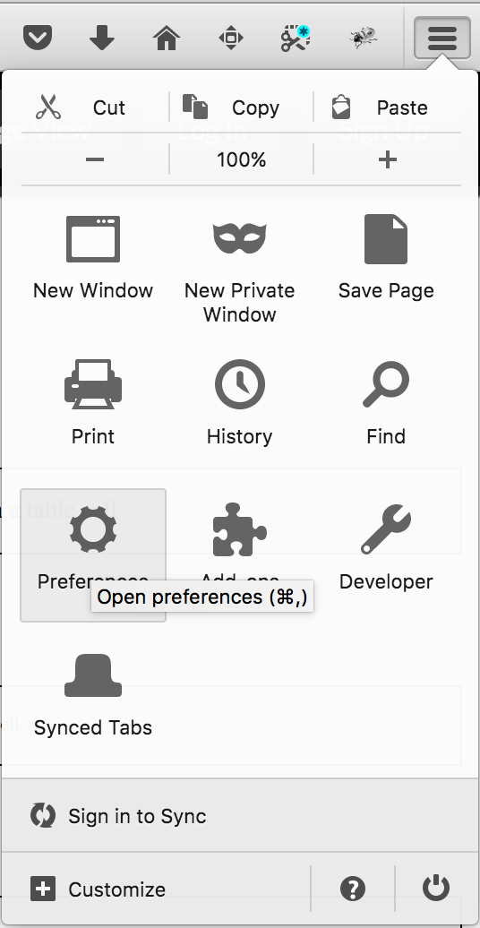
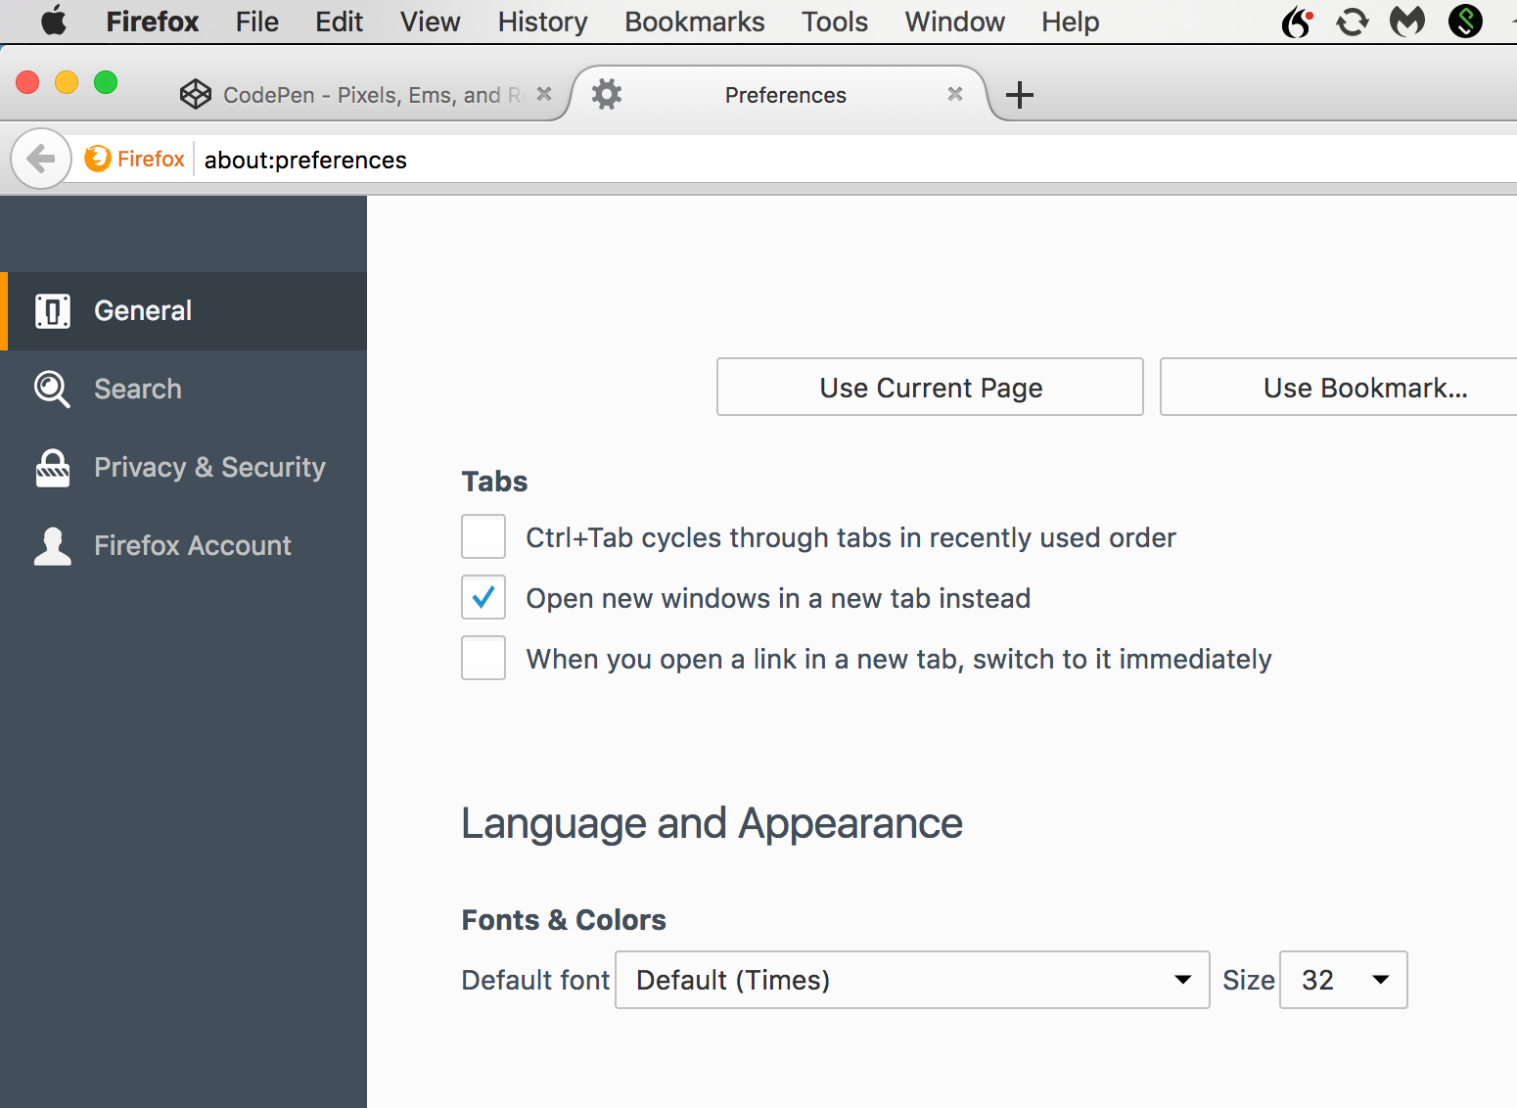
Testing Font Scaling in Firefox
@haltersweb
Open Menu > Preferences > Language & Appearance > Fonts & Colors > Default Font Size
Set to a large font size such as 32px
Default is 16px

Slide 10
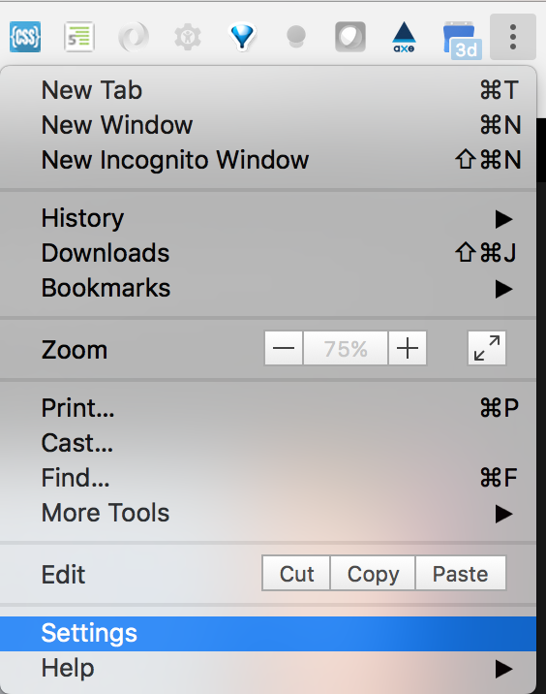
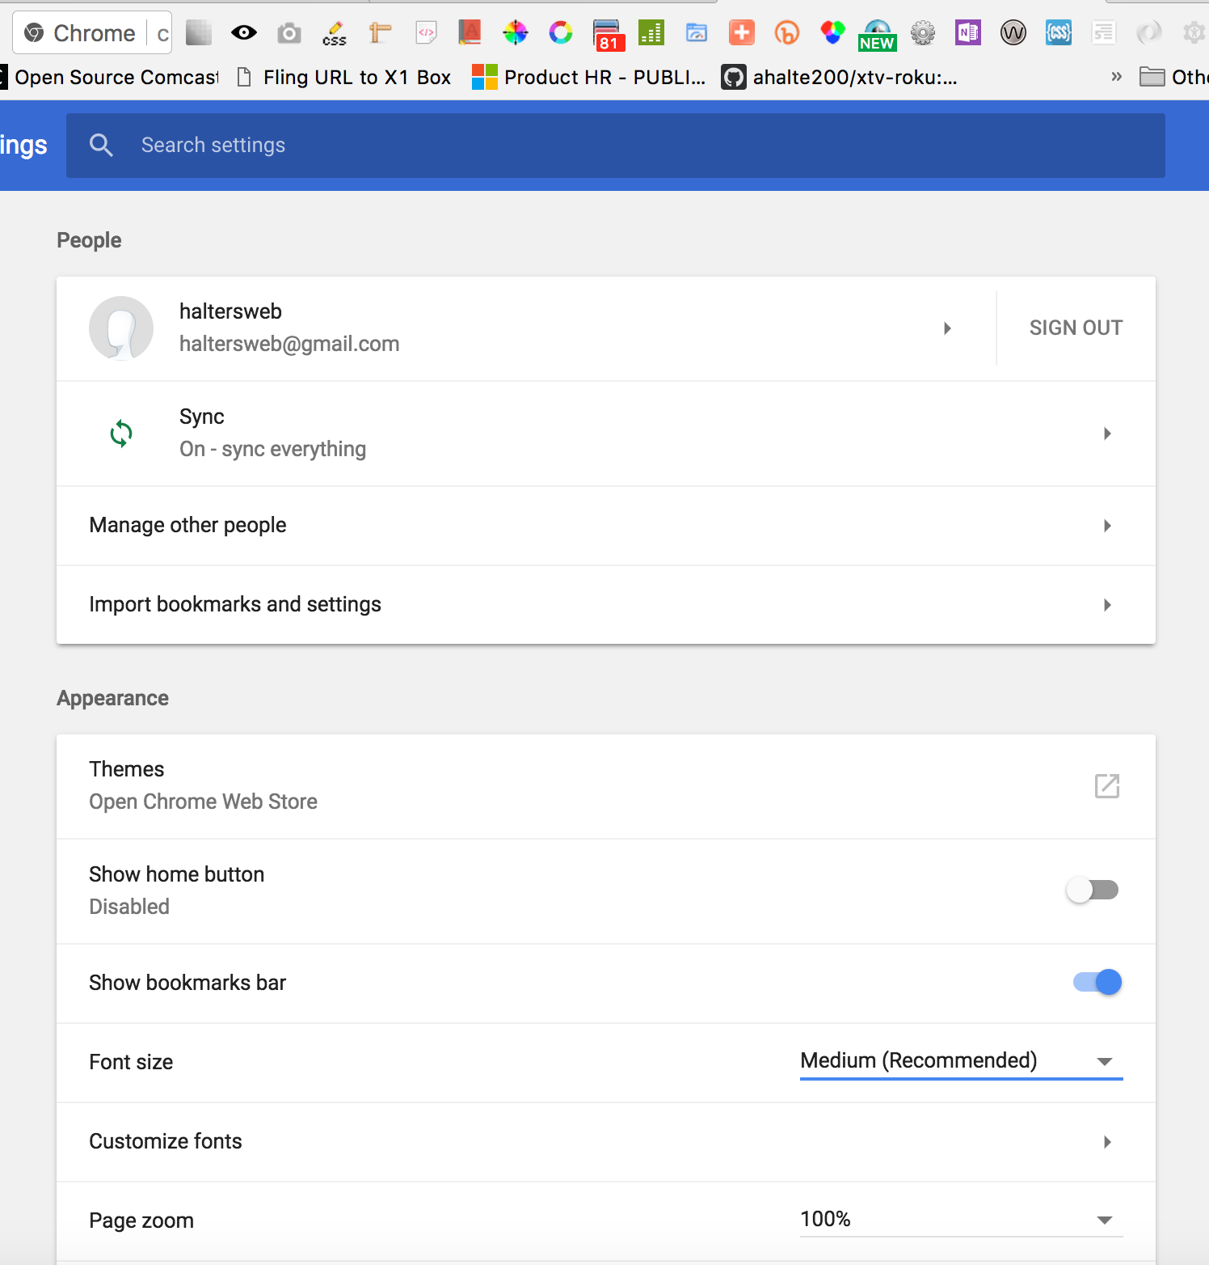
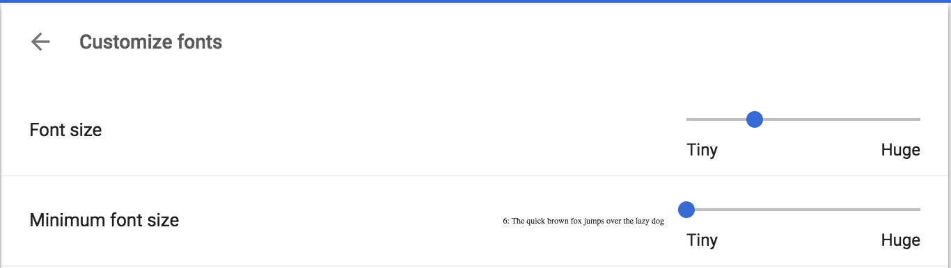
Testing Font Scaling in Chrome
@haltersweb
Open Customize > Settings > Appearance > Font Size (can also use Customize fonts)
Set to a large font size. Use the Customize font size slider to go big!
Default is Medium (16px)

Slide 11
Pixels, ems, and rems
@haltersweb

Slide 12
@haltersweb
Default root <html>:
12pt (16px)
Notes:
16px is rendered value
1em = 1rem = 12pt = 16px

Slide 13
Using 14px at 2x scale
@haltersweb
https://codepen.io/haltersweb/full/Xzjwqj/
What text at 14px and 100% scale looks like
What text at 14px and 200% scale looks like
li, td, p { 14px } 200%
In a table cell
In a list item in a table cell
In a paragraph in a list item in a table cell
FAIL!
Notes:
Example: li, td, p { 14px; }
At 200%
14px

Slide 14
Using 0.875em (14px) at 2x scale
@haltersweb
https://codepen.io/haltersweb/full/Xzjwqj/
What text at 14px and 100% scale looks like
What text at 14px and 200% scale looks like
li, td, p { 0.875em } 200%
In a table cell
In a list item in a table cell
In a paragraph in a list item in a table cell
FAIL!
Notes:
Example: li, td, p { 0.875em; }
At 200%
28px
24.5px
21.44px

Slide 15
Using 0.875rem (14px) at 2x scale
@haltersweb
https://codepen.io/haltersweb/full/Xzjwqj/
What text at 14px and 100% scale looks like
What text at 14px and 200% scale looks like
li, td, p { .875rem } 200%
In a table cell
In a list item in a table cell
In a paragraph in a list item in a table cell
YES!
Notes:
Example: li, td, p { 0.875rem }
At 200%
28px

Slide 16
What is a rem?
@haltersweb
rem
Root Em
Root a.k.a. <html>
CSS3
IE9+
Notes:
Like an em but always based on the root <html> font size, not the parent font size

Slide 17
Oh the math
@haltersweb

Slide 18
Algebra! Really?
@haltersweb
21px = 1.3125rem
1rem
16px
x
21px
=

Slide 19
Redefine the root. Simplify the math.
@haltersweb
html { font-size: 62.5%; }
p { 2.1rem }
/* 21px = 2.1rem */

Slide 20
Let your message breathe
@haltersweb

Slide 21
When to use em
@haltersweb
em
Text padding
Text margins
Media-queries

Slide 22
What about ex
@haltersweb
ex
Height of x
Top & bottom text padding
Top & bottom text margin

Slide 23
Unitless line height
@haltersweb
Multiplier of font’s size
Whole number or decimal
P { line-height: 1.25 }

Slide 24
Sizing imagery with rem
@haltersweb
https://codepen.io/haltersweb/full/gXMQBw/

Slide 25
Sizing images with rem
@haltersweb
https://codepen.io/haltersweb/full/gXMQBw/
Width
Height
Margin
Padding

Slide 26
A word about box sizing
@haltersweb

Slide 27
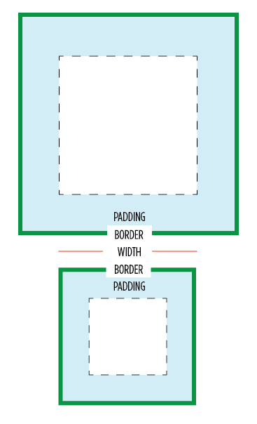
Use border-box for more control
@haltersweb
https://codepen.io/haltersweb/full/JObPay/
content-box (default) vs. border-box
Global reset:
html { box-sizing: border-box; }
*, *:before, *:after { box-sizing: inherit; }

Slide 28
Global box-sizing reset
@haltersweb
https://codepen.io/haltersweb/full/JObPay/
html {
box-sizing: border-box; }
*, *:before, *:after {
box-sizing: inherit; }

Slide 29
Relative media queries
@haltersweb
https://codepen.io/haltersweb/full/gXMQBw/

Slide 30
Media Queries
@haltersweb
https://codepen.io/haltersweb/full/gXMQBw/
Use ems (rems won’t work here)
Screen default: 16px : 1em
Not affected by html style (62.5% setting)
70em = 1120px (120 / 16)
This approach won’t work with device-size

Slide 31
Bonus tip (nothing to do with this talk)
@haltersweb

Slide 32
Never use clear fix again
@haltersweb
my-box { overflow: hidden; }

