Slide 1
Holy grail patterns
Bar charts and autocomplete
Adina Halter Sr. Product Manager, Accessibility Comcast

Slide 2
Bar Charts

Slide 3


GRAPHS ARE VISUAL
Notes:
Images show colorful graphs. One of a bar chart. One of a pie chart.
Graphs can be beautiful works of visual art.
But they give screen-readers little or no information about the data.

Slide 4
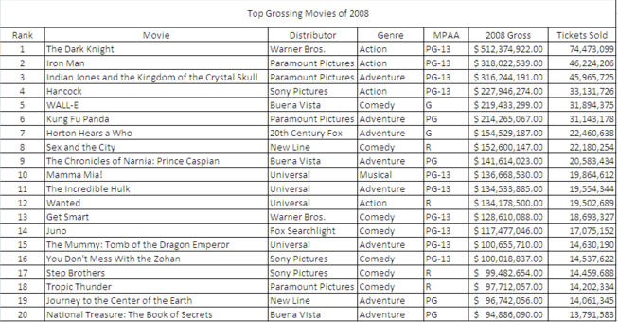
TABLES ARE BORING…
Notes:
Image of a basic bar chart in black and white.
On the flip side, tables are visually BORING…

Slide 5
CURRENT METHODS
Image with description
Graph + table
Javascript plugins
Notes:
Will not be able to triangulate the data
Often not descriptive enough: “bar graph of money invested in 2010, 2011 and 2012”.
Need to rewrite as data changes
Twice as much code to maintain per graph
Double the real estate
Increased download time
Data may need to be translated to JSON (loses the relationship)
Rendering doesn’t mean accessibility
Is plugin support maintained through lifecycle?

Slide 6
OUR SOLUTION
HTML
CSS
No JS
It’s only a table!!

Slide 7
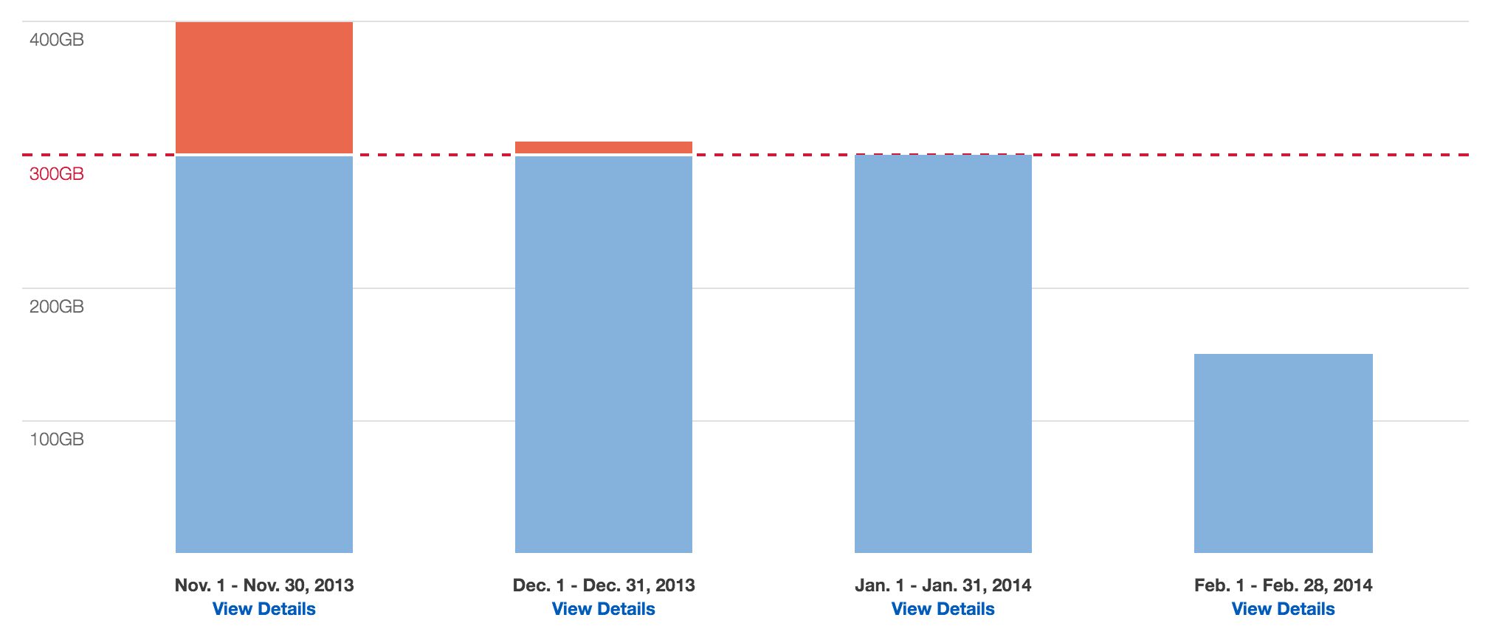
SOLUTION EXAMPLE
http://haltersweb.github.io/Accessibility/barchart.html
Notes:
Image shows a screenshot of a stacked bar-chart from the solution example.

Slide 8
Code: <tbody>
<tbody>
<tr>
<td>
<span data-value="400" style="height: 360px; margin-top: 0px;">
<span class="usage">
400gb
<span class="screen-reader-text">out of 300gb</span>
</span>
<span class="overage" style="height:90px;"></span>
</span>
</td>
<td>...</td>
<td>...</td>
<td>...</td>
</tr>
</tbody>
Notes:
Stumbling blocks:
How to place thead as labels below data
tfoot is not supported in screen readers

Slide 9
CODE: <thead>
<thead>
<tr>
<th scope="col" data-plan="300">
<span class="table-header-text" style="width: 23.5%; left: 0;">
nov. 1 - nov. 30, 2013
</span>
</th>
<th>...</th>
<th>...</th>
<th>...</th>
</tr>
</thead>
Notes:
How to place thead as labels below data
Tfoot is not supported in screen readers

Slide 10
CODE: left labeling and tide-line
<div class="barchart-background" aria-hidden="true">
<div class="increment" data-grid-value="400" style="height:90px;">
<span class="label">400gb</span>
</div>
<div class="increment" data-grid-value="300" style="height: 90px; border: none;">
<span class="label">300gb</span>
</div>
<div class="increment" data-grid-value="200" style="height:90px;">
<span class="label">200gb</span>
</div>
<div class="increment" data-grid-value="100" style="height:90px;">
<span class="label">100gb</span>
</div>
<span class="plan-limit" style="margin-bottom:270px;">
<span class="label">300gb</span>
</span>
</div>

Slide 11
Autocomplete

Slide 12
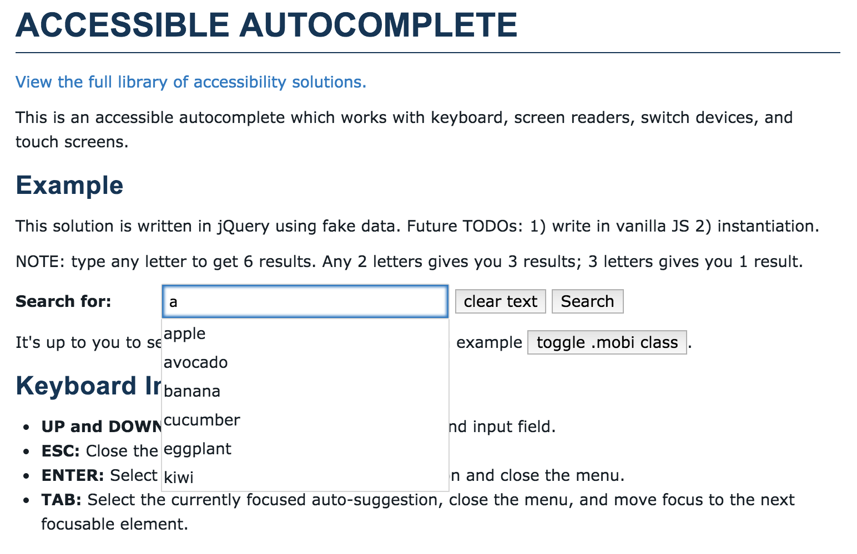
SOLUTION EXAMPLE
http://haltersweb.github.io/Accessibility/autocomplete.html
Notes:
Image shows a screenshot of the example with an input field which has “a” typed and 6 results returned and shown in a list below the input field.
Keyboard Interaction:
UP and DOWN: Cycles through auto-suggestions and input field.
ESC: Close the menu
ENTER: Select the currently focused auto-suggestion and close the menu.
TAB: Select the currently focused auto-suggestion, close the menu, and move focus to the next focusable element.
Screen-reader interaction:
when the search field gains focus an initial instruction is announced.
when search results are returned the count and instructions are announced.
when suggestions are arrowed through they are spoken aloud.

Slide 13
GOALS
Keyboard accessible
Mobile accessible
Enough screen-reader feedback

Slide 14
KEY ARIA
INPUT:
aria-describedby="initinstr”
aria-owns="results”
aria-expanded="false”
aria-autocomplete="both”
aria-activedescendant=""
UL:
id="results”
role="listbox"
LI:
id="" role="option”
aria-selected="false"
Notes:
Note on aria-autocomplete=“both”: both means that:
a list of choices appears and
the currently selected suggestion also appears inline.

Slide 15
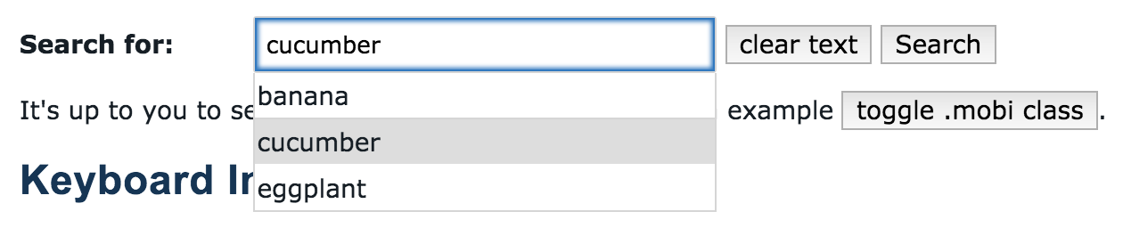
CODE
<div id="a11yAutocomplete">
<form action="">
<div data-widget="accessible-autocomplete">
<label for="search">Search for:</label>
<input type="text" id="search" autocomplete="off" class="autocomplete-search-field" aria-describedby="initInstr" aria-owns="results" aria-expanded="true" aria-autocomplete="both" aria-activedescendant="selectedOption”/>
<button type="button" id="clearText">clear text</button>
<button type="submit" id="submit">Search</button>
<ul id="results" class="autocomplete-list" role="listbox" tabindex="0" style="left: 223.828px; top: 291.203px; min-width: 260px; display: block;">
<li id="" class="autocomplete-item" role="option" aria-selected="false" tabindex="-1">banana</li>
<li id="selectedOption" class="autocomplete-item" role="option" aria-selected="true" tabindex="-1">cucumber</li>
<li id="" class="autocomplete-item" role="option" aria-selected="false" tabindex="-1">eggplant</li>
</ul>
<span id="initInstr" style="display: none;">
When autocomplete results are available use up and down arrows to review and enter to select. Touch device users, explore by touch or with swipe gestures.
</span>
<div aria-live="assertive" class="screen-reader-text"></div>
</div>
</form>
</div>
Notes:
Image shows a screen shot where 3 results have been returned and focus is on the 2nd result.

Slide 16
Resources

Slide 17
LINKS AND CONTACT INFO
Link to solutions:
http://haltersweb.github.io/Accessibility/barchart.html
http://haltersweb.github.io/Accessibility/autocomplete.html
Library of Solutions and Repository
http://haltersweb.github.io/accessibility/
https://github.com/haltersweb/Accessibility
Adina Halter
Email: adina_halter@cable.comcast.com
Twitter: @haltersweb

Slide 18


