Slide 1
Accessible bar graphs
In html and CSS
Adina Halter Sr. Product Manager, Accessibility Comcast

Slide 2
Problem

Slide 3
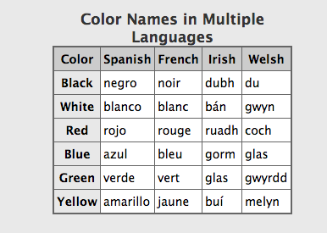
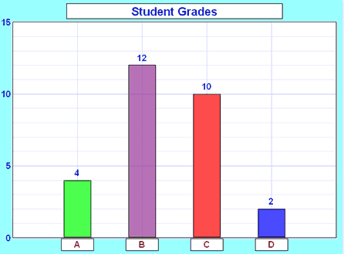
Tables vs Graphed Table Data
Notes:
(Well-formed) tables triangulate headings in screen readers
Bar charts without table relationships:
This example reads ”Student Grades, 15, 10, 5, 0, 4, 12, 10, 2, A, B, C, D”. How many students got a grade of B?

Slide 4

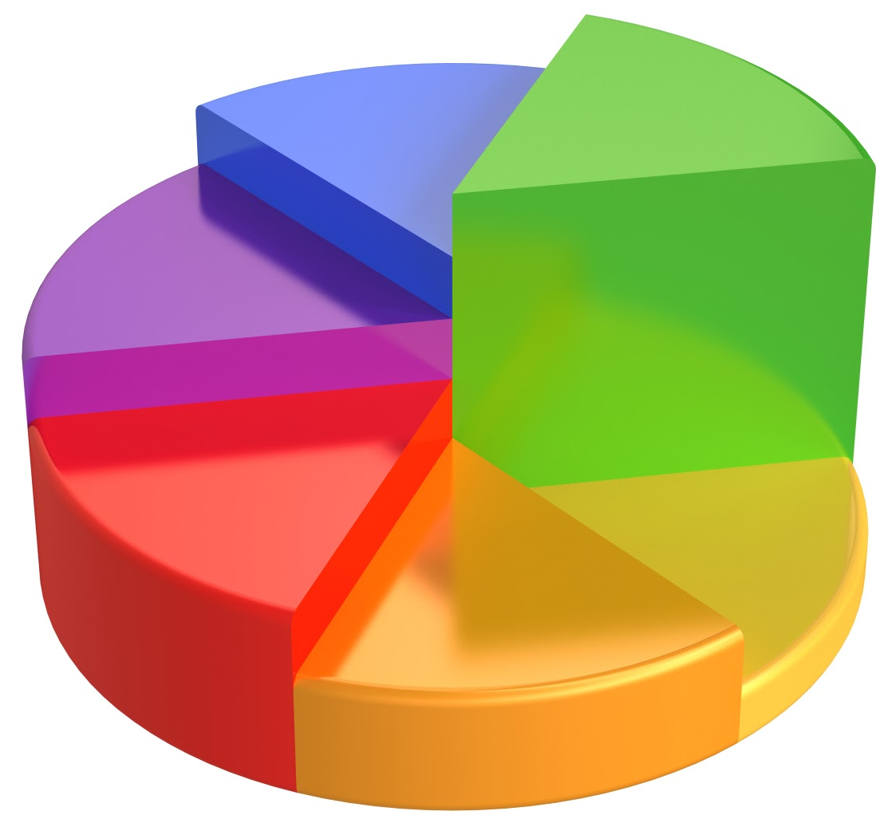
GRAPHS ARE VISUAL
Notes:
Graphs can be beautiful works of visual art.
But often the more beautiful they are the more chance they will be an image without text reference to what they represent.

Slide 5
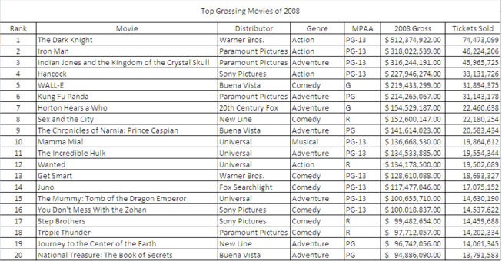
TABLES ARE BORING…
Notes:
On the flip side, tables are visually BORING…

Slide 6
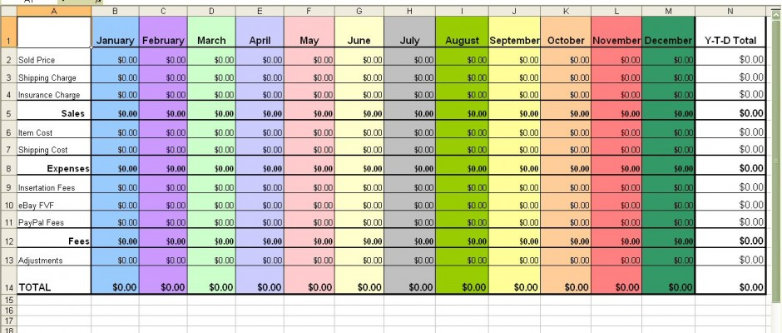
…EVEN WHEN YOU ADD COLOR

Slide 7
Current Methods
Notes:
So what are some of the current methods

Slide 8
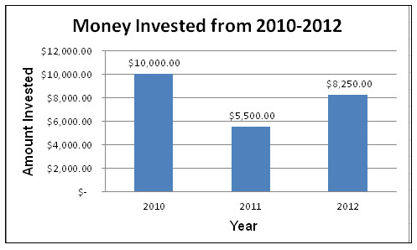
IMAGE WITH DESCRIPTION
Triangulate data?
Descriptive?
Maintenance
Notes:
Will not be able to triangulate the data
Often not descriptive enough
Need to rewrite as data changes
This bar graph image has an alt tag: “bar graph of money invested in 2010, 2011 and 2012”. Not very descriptive.
The summary attribute says “The bar graph shows that every year between and including 2010 and 2012, the money that has been invested has decreased 50%.
Again: not very descriptive AND Inaccurate. No one took the time to rewrite the summary when the data changed.

Slide 9
GRAPH + TABLE
2X code
2X real-estate
Notes:
Twice as much code to maintain per graph
Double the real estate

Slide 10
JAVASCRIPT PLUGINS
Milliseconds count
JSON data?
Accessible?
Support?
Notes:
Increased download time
Data may need to be translated to JSON (loses the relationship)
Rendering doesn’t mean accessibility
Is plugin support maintained through lifecycle?

Slide 11
Our Solution

Slide 12
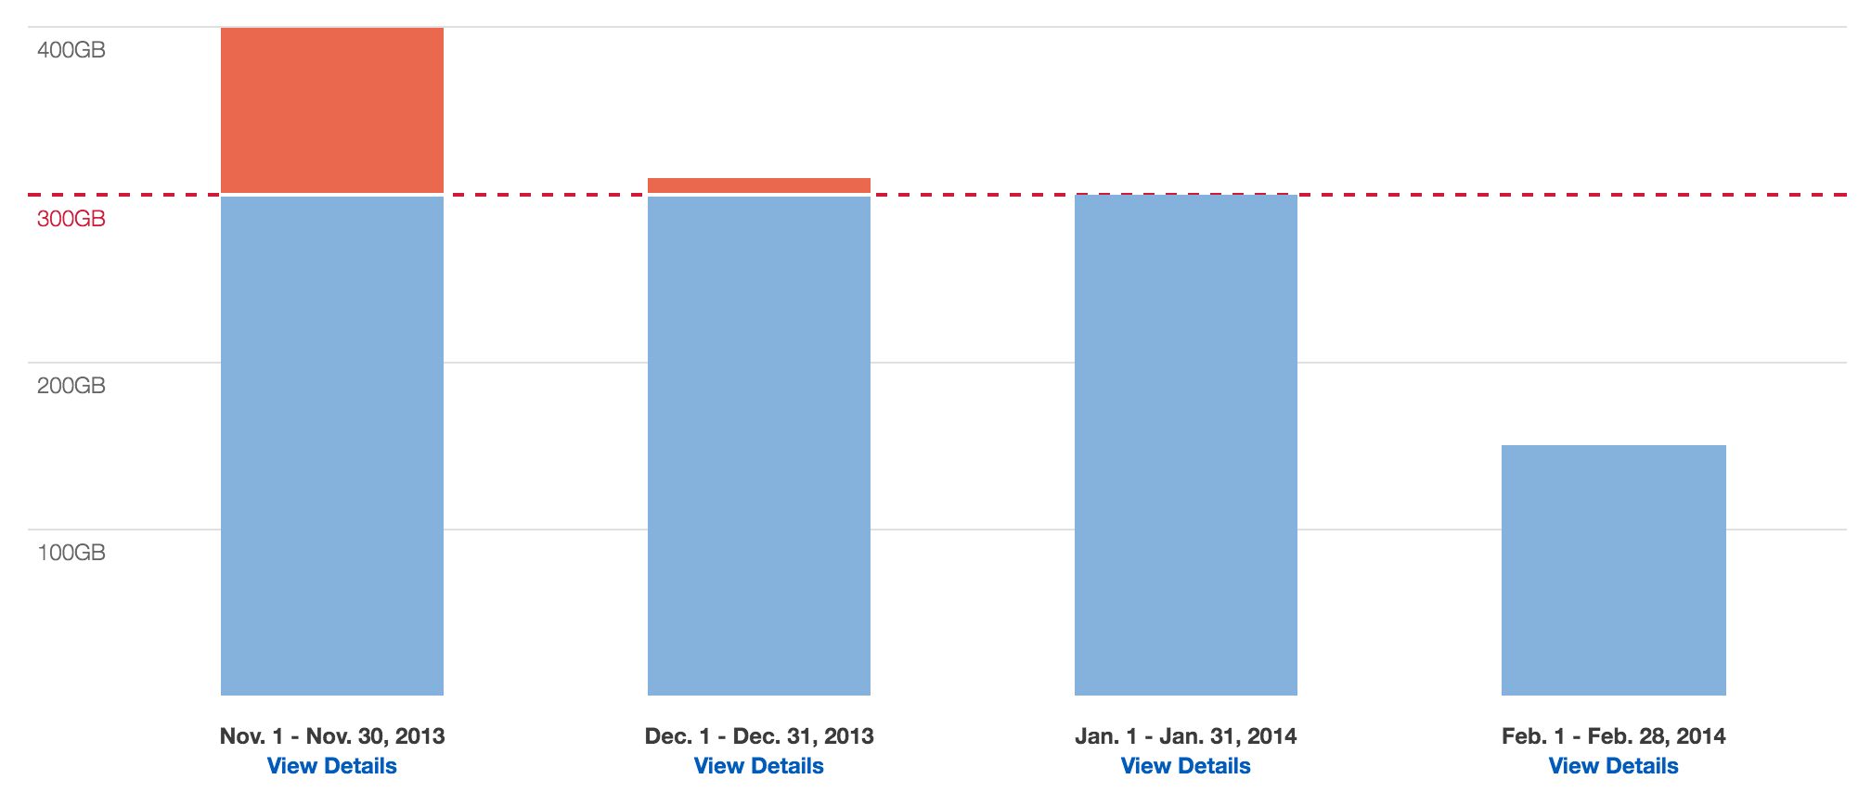
OUR SOLUTION
HTML
CSS
No JS
It’s only a table!!

Slide 13
SOLUTION EXAMPLE
http://haltersweb.github.io/accessibility/barchart.html

Slide 14
STUMBLING BLOCKS
<thead>
<tfoot>
Notes:
How to place thead as labels below data
Tfoot is not supported in screen readers

Slide 15
Resources

Slide 16
LINKS AND CONTACT INFO
Helpful links
Link to solution: http://haltersweb.github.io/Accessibility/barchart.html
Link to powerpoint slides: http://haltersweb.github.io/Accessibility/slides/barchart.pptx
Link to word version of slides: http://haltersweb.github.io/Accessibility/slides/barchart.docx
Adina Halter
Email: adina_halter@cable.comcast.com
Twitter: @haltersweb

Slide 17


