Slide 1
Baseline 策略：自己走得快就走路，走得慢就放板
核心算法：BFS
先算双方最短胜利路径
 |  |  | 7
 |  | 7 | 6 | 7 |  | 7
 | 7 | 6 | 5 | 6 | 7 | 6 | 7
 |  | 7 | 4 | 3 | 4 | 5 | 6 | 7
 |  |  | 3 | 2 | 3 | 4 | 5 | 6
 |  | 7 | 2 | 1 | 2 | 3 | 4 | 5
 | 7 | 6 | 1 | A | 1 | 2 | 3 | 4
7 | 6 | 5 | 4 | 3 | 2 | 3 | 4 | 5
 | 7 | 6 | 5 | 4 | 3 | 4 | 5 | 6
 |  |  | 5
 |  | 5 | 4 | 5 |  | 5
 | 5 | 4 | 3 | 4 | 5 | 4 | 5
 |  | 5 | 2 | 1 | 2 | 3 | 4 | 5
 |  |  | 1 | V | 1 | 2 | 3 | 4
 |  |  | 2 | 1 | 2 | 3 | 4 | 5
 |  |  | 3 | 2 | 3 | 4 | 5
 |  |  |  | 5 | 4 | 5
 |  |  |  |  | 5
如果我走得快，
我就选择一个这里的1走一步。
我要走7步
对方只要走5步

Slide 2
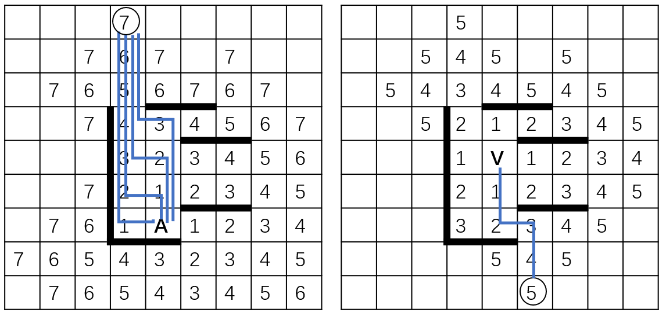
Baseline 策略：自己走得快就走路，走得慢就放板
初始-1，
我方路径 -1,
敌方路径 +2,
取大于等于0格点测试放板
核心算法：BFS
走得慢才放板
-1 | -1 | -1 | -2 | -1 | -1 | -1 | -1 | -1
-1 | -1 | -1 | -2 | -1 | -1 | -1 | -1 | -1
-1 | -1 | -1 | -2 | -1 | -1 | -1 | -1 | -1
-1 | -1 | -1 | -2 | -2 | -1 | -1 | -1 | -1
-1 | -1 | -1 | -2 | -2 | -1 | -1 | -1 | -1
-1 | -1 | -1 | -2 | 0 | -1 | -1 | -1 | -1
-1 | -1 | -1 | -2 | 1 | 1 | -1 | -1 | -1
-1 | -1 | -1 | -1 | -1 | 1 | -1 | -1 | -1
-1 | -1 | -1 | -1 | -1 | 1 | -1 | -1 | -1
我要走7步
对方只要走5步
…
…
我要走7步，对方走7步
收益为7-7=0
我要走9步，对方走7步
收益为7-9=-2
 |  |  |  | 0
 |  |  |  | 1 | 1
 |  |  |  |  | 1
 |  |  |  |  | 1
 |  |  |  | 0
 |  |  |  | 1 | 1
 |  |  |  |  | 1
 |  |  |  |  | 1
 |  |  |  | 0
 |  |  |  | 1 | 1
 |  |  |  |  | 1
 |  |  |  |  | 1
 |  |  |  | 0
 |  |  |  | 1 | 1
 |  |  |  |  | 1
 |  |  |  |  | 1
仍用BFS计算放置每个测试板之后对路径的影响，用放板后的棋盘敌人的路径长度减去自己路径长度作为挡板的收益。
堵死则收益为INT32_MIN
…

