Slide 1
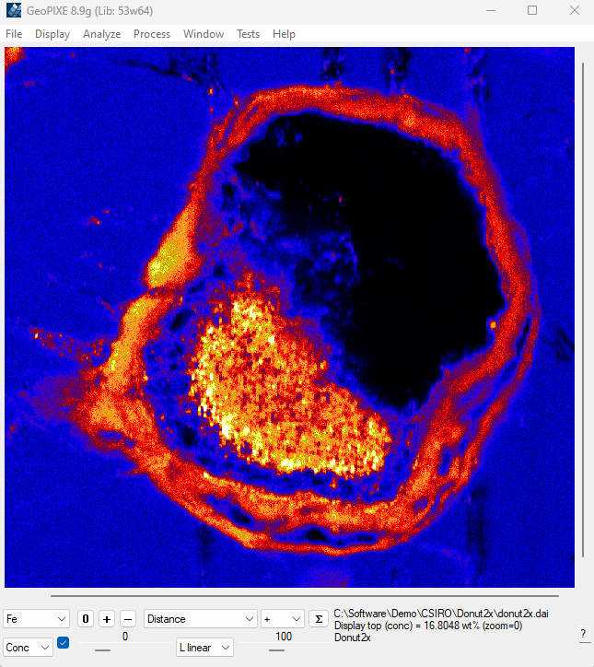
Menus
Shapes
Include “+” / Exclude “-”
Zoom
Analyze “Σ”
Element
Window help
“Conc” / “Var”
Interp
Low
Z axis mode
High
Context sensitive help

