Slide 1
ApplyForge
An honest AI job-search copilot
CSE 552 — Capstone Project
Full-stack AI web app · Next.js + FastAPI + PostgreSQL + Claude · Docker Compose
Tray Branch · June 2026

Slide 2
The problem & the solution
What you built — the problem, the user, the solution
The user: a software engineer job-hunting, drowning in applications.
• The problem: tools like RoboApply/ApplyBlast auto-blast hundreds of applications — recruiters ignore the spam, and it violates job-site terms.
• The insight (from research): the “an AI robot rejects 75% of resumes” claim is a myth (traces to a defunct 2012 vendor). The real levers are honest tailoring, timing, and direct recruiter contact.
• The solution: ApplyForge tells you your REAL match for a role, tailors your resume using only what's actually true about you, and helps you reach a real human.
Why it's “AI-powered”: six Claude endpoints inject the user's own profile + job + pipeline as context — match scoring, resume tailoring, cover letters, recruiter outreach, and a tool-using agent. Not a generic chatbot.

Slide 3
Architecture
Three-tier stack, containerized with Docker Compose
Browser ──HTTP──▶ FastAPI ──SQLAlchemy──▶ PostgreSQL 16
:3000 :8000 :5432
Next.js 14 (App Router, TS, Tailwind) → one typed fetch layer app/lib/api.ts
FastAPI + Pydantic + SQLAlchemy → every Claude call isolated in ai.py
Claude API: Sonnet 4.6 (reasoning) + Haiku 4.5 (transforms)
docker compose up --build → db (healthcheck) → backend (auto-seed) → frontend
Separation of concerns
• Every Claude call lives in backend/ai.py; every network call in frontend/app/lib/api.ts
• Job feed isolated in services/job_feed.py; file parsing in services/resume_text.py
• Data persists in a Docker volume (pgdata); seed runs only when the DB is empty

Slide 4
Data model
7 SQLAlchemy models, PostgreSQL — well beyond the 2-model minimum
Profile (1) ──< Application (many) >── Job (many)
│
├──< GeneratedArtifact (match reports, cover letters, tailored resumes)
└──< ApplicationEvent (pipeline audit log)
Profile (1) ──< Outreach (many) >── Recruiter (many)
• Application is the core CRUD resource: create (track a job), read, update (advance/reject status), delete.
• Relationships: one-to-many Profile→Application→Job, Recruiter→Outreach, plus artifacts & an append-only event log.
• Pipeline state machine: SAVED → APPLIED → INTERVIEWING → OFFER, with REJECTED as a terminal branch (forward-only, validated server-side).

Slide 5
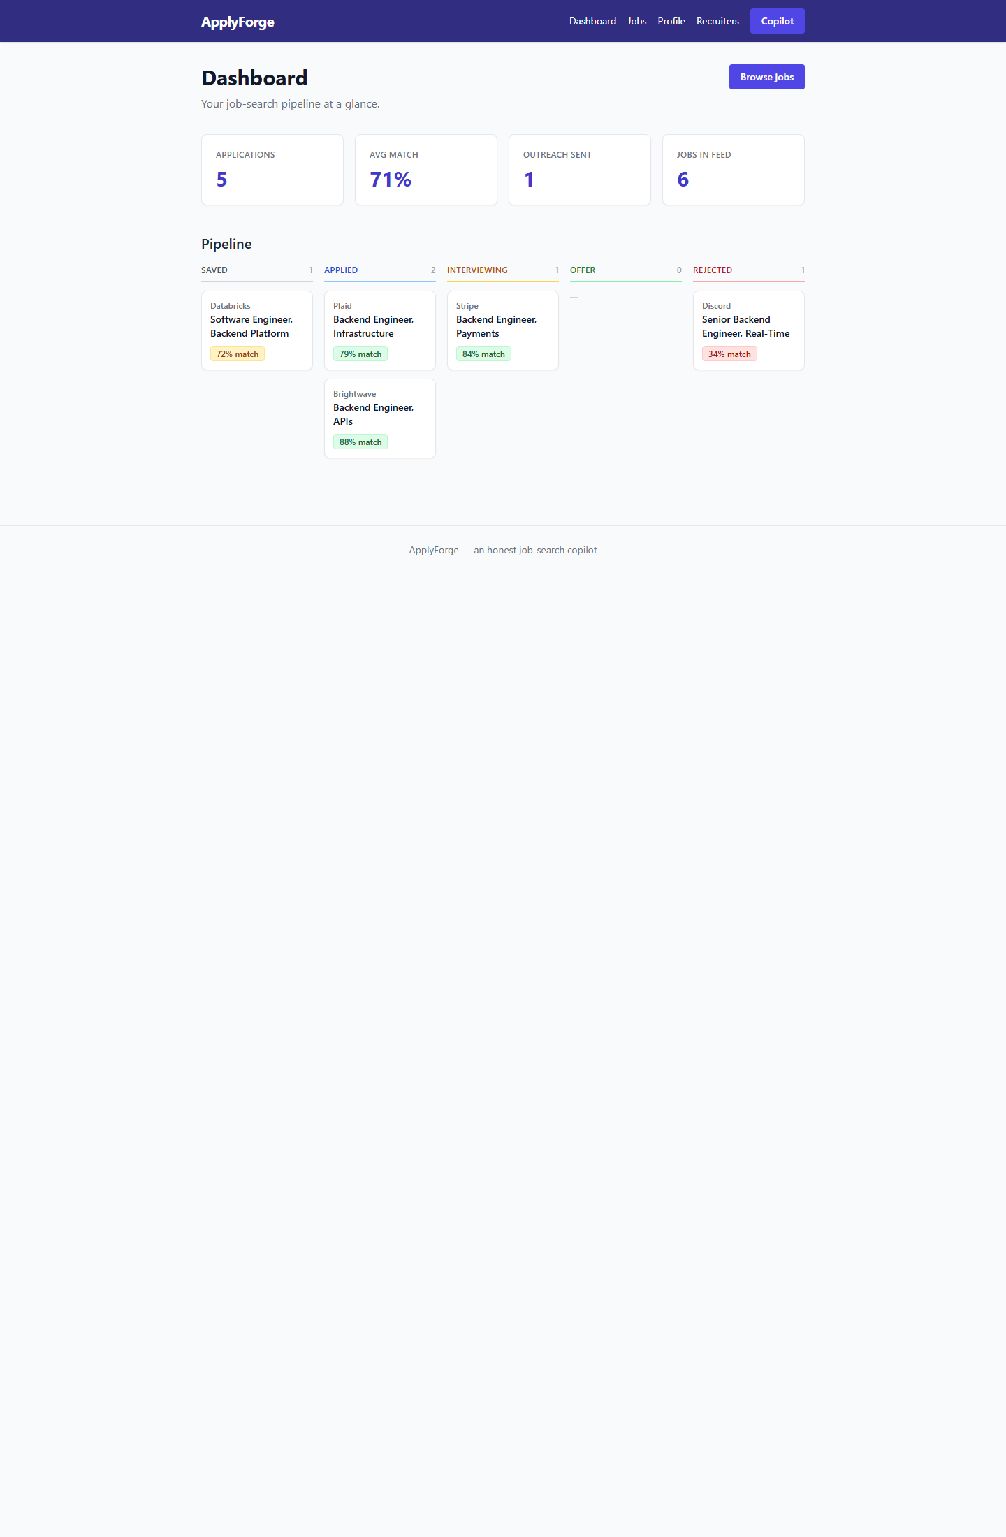
Dashboard — CRUD pipeline
frontend page 1 of 6 · shared nav · responsive
What this shows
• Stat cards from a live /stats aggregate: 5 applications, 71% avg match, outreach, jobs.
• Pipeline board — every tracked application grouped by its lifecycle stage.
• Color-coded match badges (green = strong, red = stretch) from the AI analysis.
• Shared top nav across all 6 pages; fully responsive Tailwind layout.

Slide 6
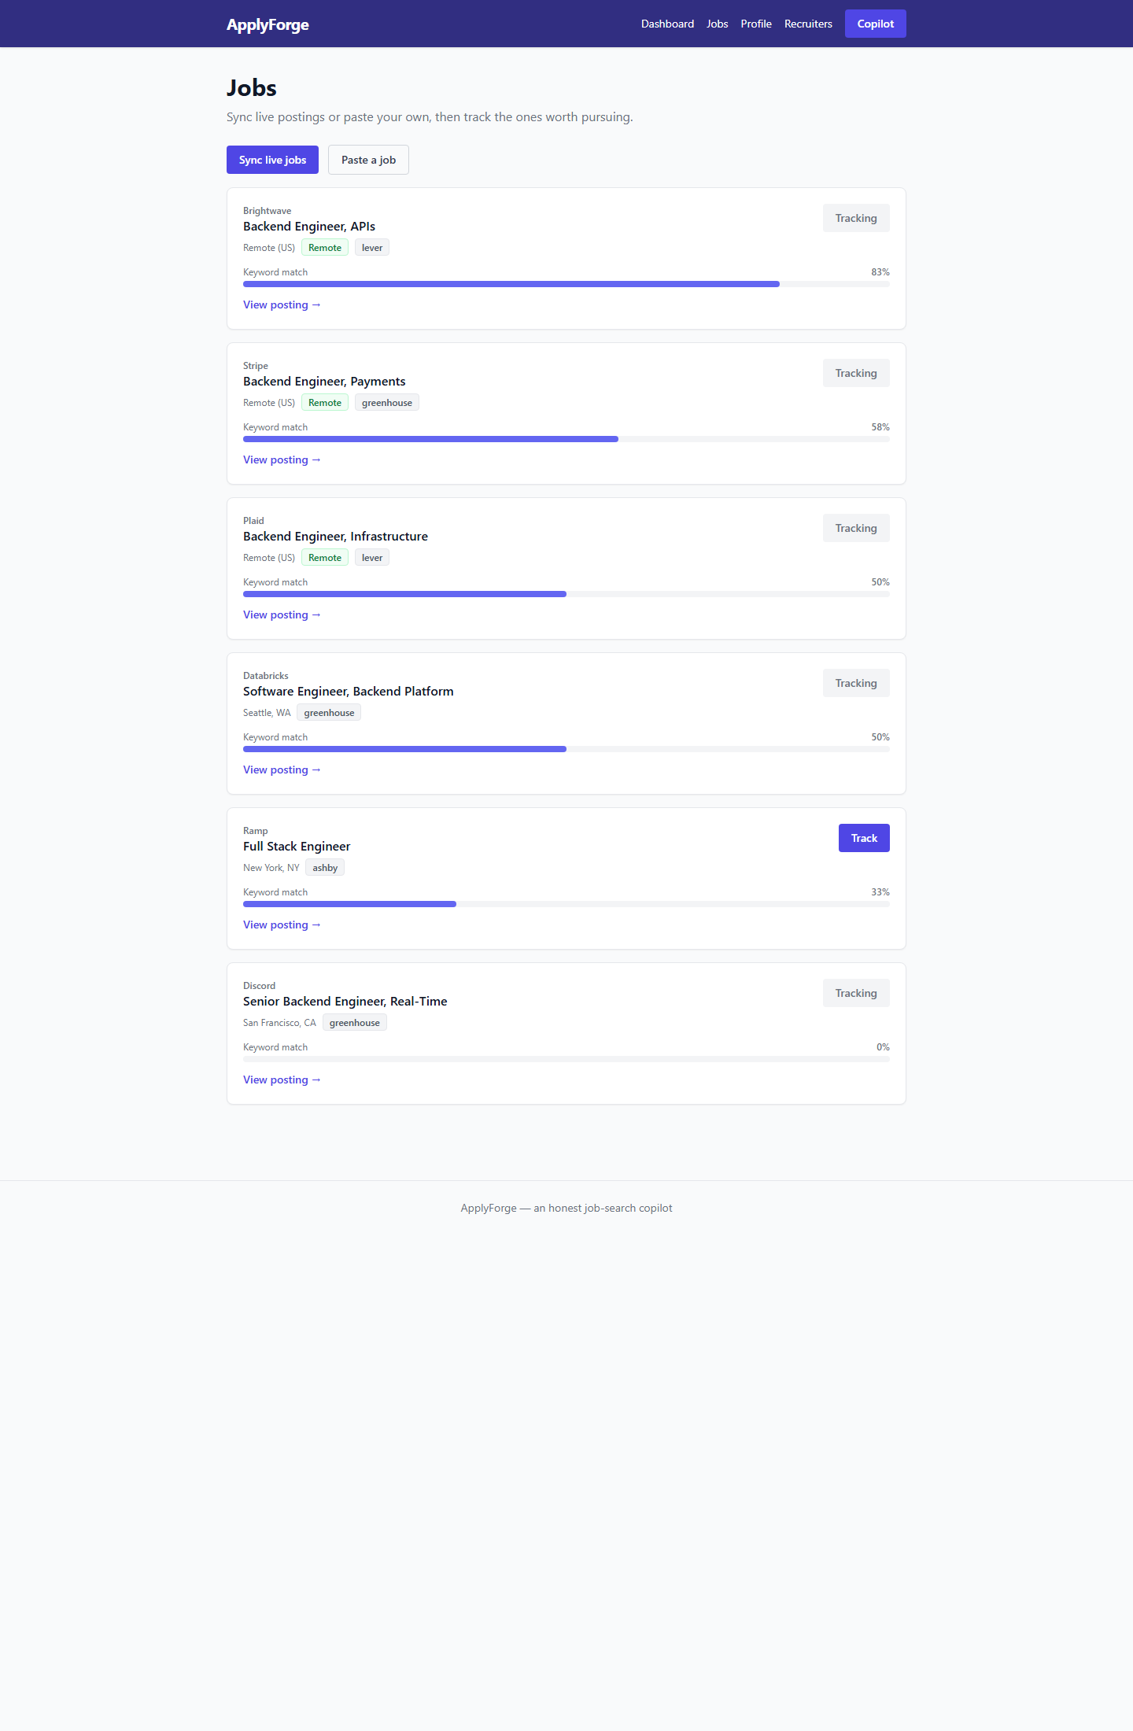
Jobs — real openings from public ATS APIs
page 2 · external API integration
What this shows
• Live job feed pulled from Greenhouse / Lever / Ashby public APIs — no scraping, no keys, no ToS risk.
• Ranked by a quick keyword match against the user's profile.
• “Track” creates an Application (the CRUD create path).
• Paste-a-JD fallback + “Sync live jobs” button.

Slide 7
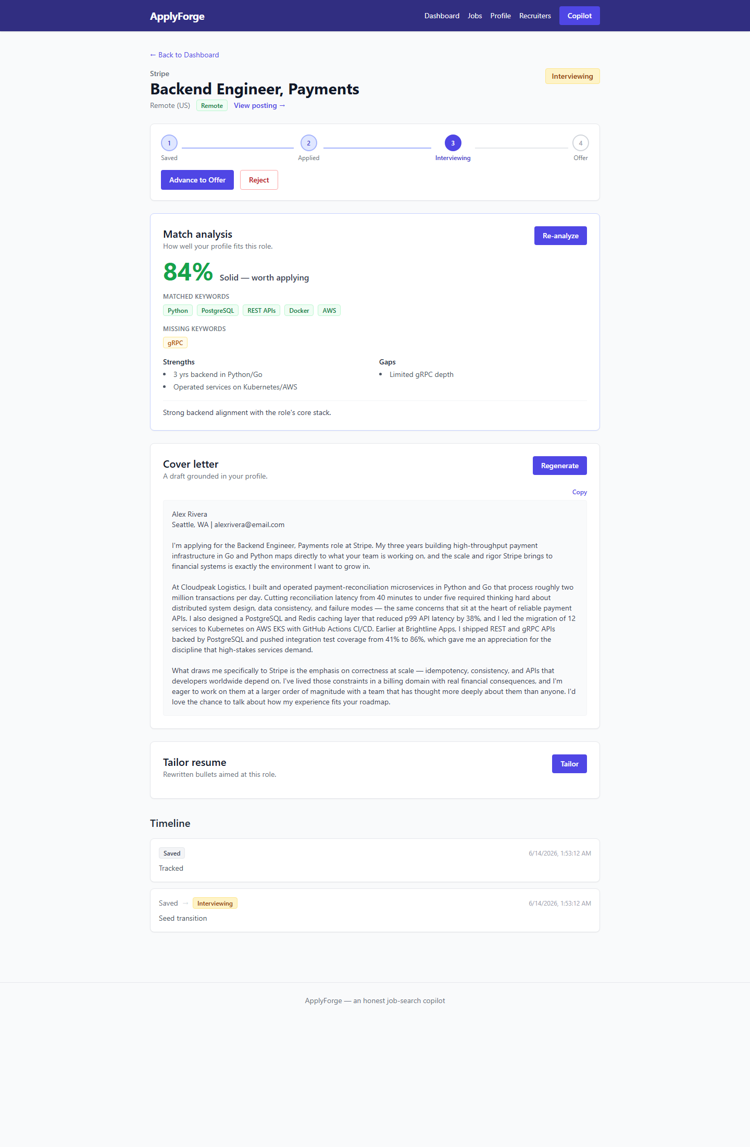
Application detail — the AI hero
page 3 · structured output + generation, both using app data
What this shows
• Match analysis (Claude Sonnet, structured JSON): honest 84% score, matched vs MISSING keywords, strengths & gaps.
• Cover letter generated from the user's real resume — note it cites actual projects & metrics, never invented.
• Truthful tailoring guardrail enforced in the prompt layer.
• Pipeline controls + append-only event timeline (audit log).

Slide 8
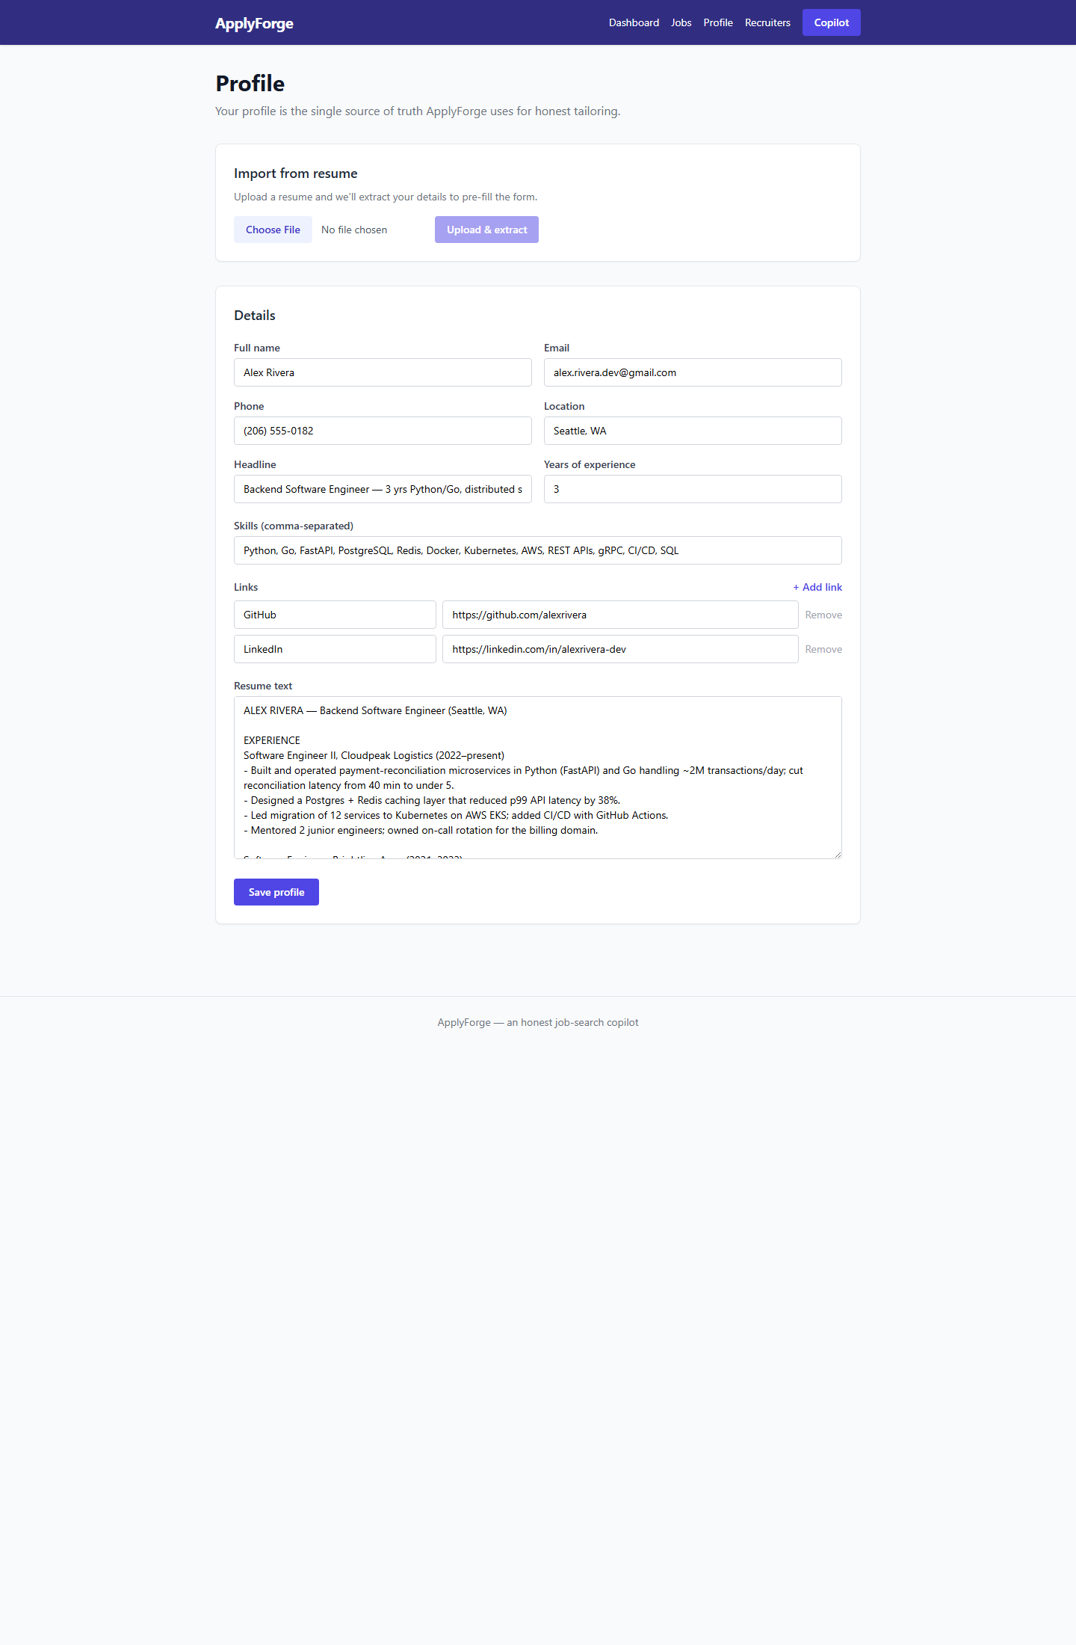
Profile — AI resume extraction
page 4 · structured extraction from unstructured input
What this shows
• Upload a PDF/DOCX/TXT resume → Claude extracts a structured profile (skills, experience, headline).
• This is the source of truth every other AI feature is grounded in.
• Full CRUD edit of profile fields, skills, and links.
• Loading / error / saving states throughout.

Slide 9
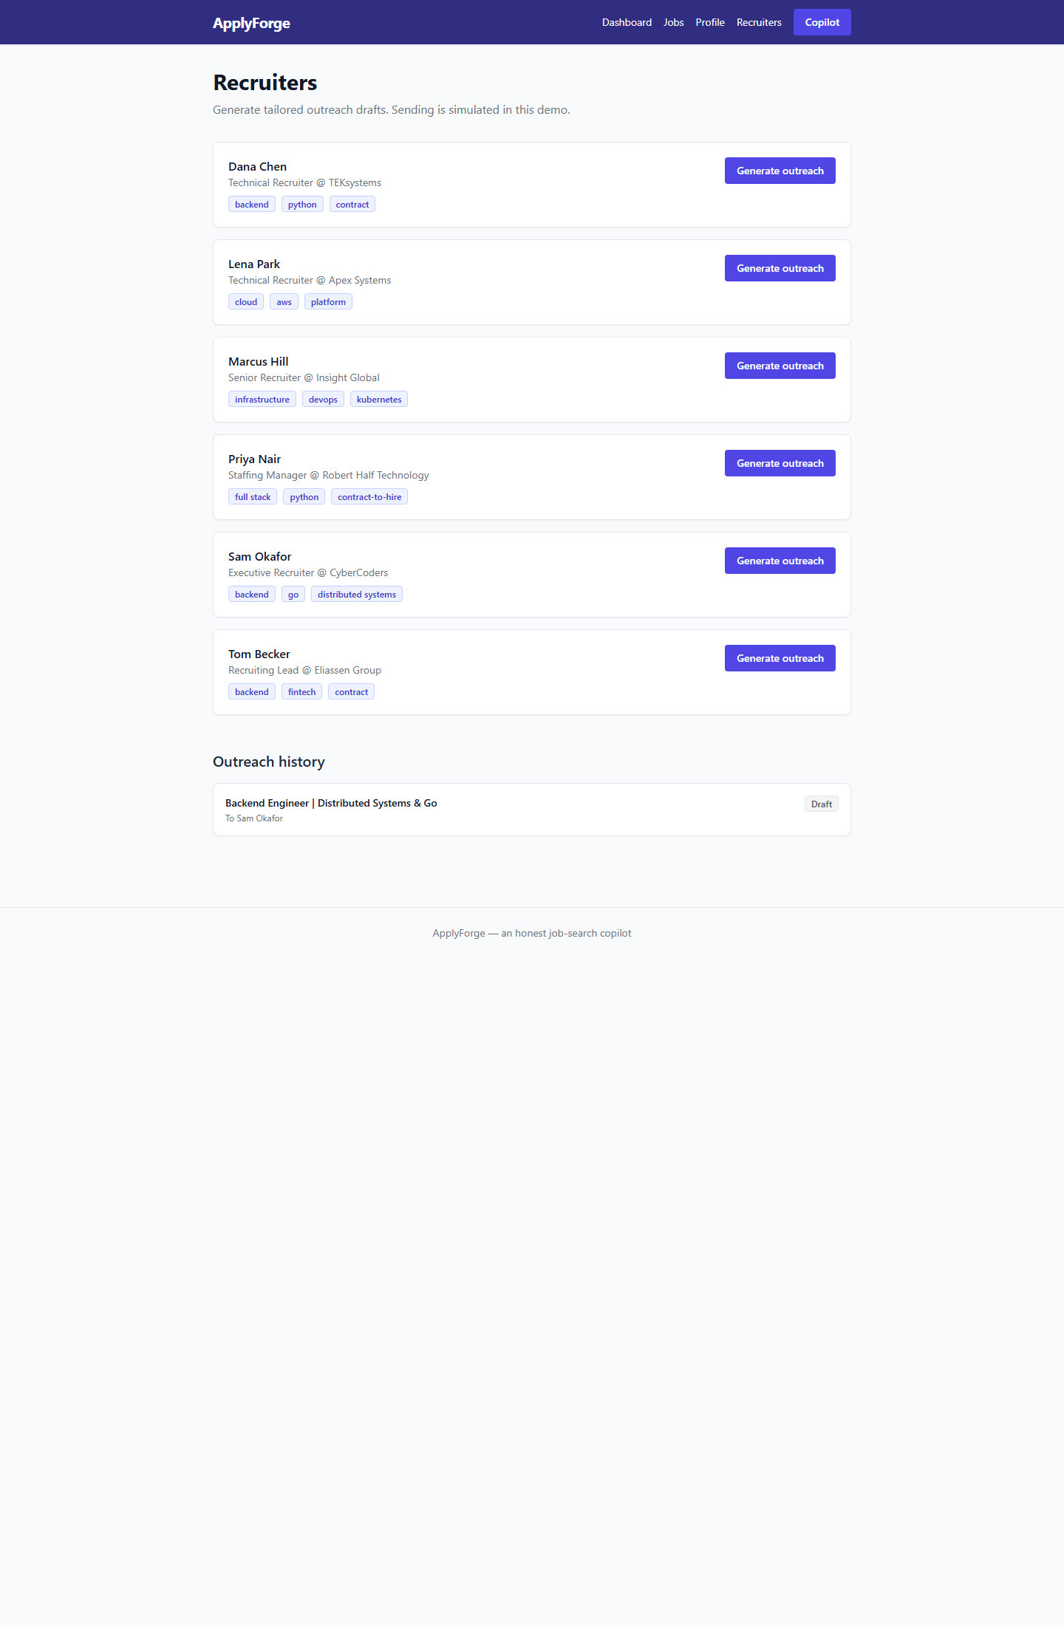
Recruiters — AI outreach generation
page 5 · personalized content generation
What this shows
• Seeded niche recruiters with specialty tags.
• “Generate outreach” → Claude writes a 50–125 word note referencing a REAL accomplishment + the recruiter's niche, with an opt-out courtesy.
• Sending is simulated — honest by design, no spam.
• Outreach history persists per recruiter.

Slide 10
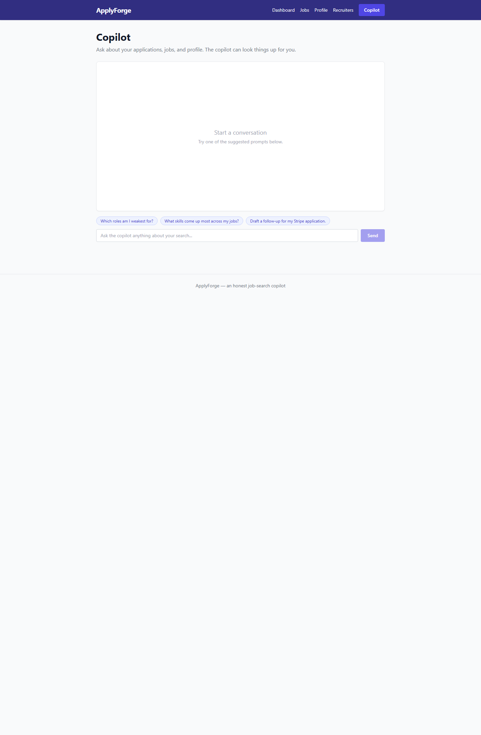
Copilot — AI agent with tool use
page 6 · multi-turn agent that reads your data
What this shows
• A real tool-using agent (Claude Sonnet): tools get_applications, get_application_detail, get_profile.
• Grounded in live data — asks “which roles am I weakest for?” and reads actual match scores to answer.
• Multi-turn conversation with suggested prompts.
• Shows which tools were called under each reply.

Slide 11
The AI integration — 6 Claude endpoints
All inject the user's app data; cost-routed Sonnet / Haiku
Endpoint | Claude technique | Context injected
POST /profile/import | Structured extraction | uploaded resume text
POST /applications/{id}/analyze ⭐ | Structured output (JSON) | profile + job description
POST /applications/{id}/cover-letter | Generation (truthful) | profile + job
POST /applications/{id}/tailor | Generation, structured | resume bullets + job
POST /outreach/generate | Generation (personalized) | profile + recruiter + job
POST /ai/chat | Tool use / agent (multi-turn) | whole pipeline via 3 tools
Meets “at least one of” in spades: structured output (analyze), tool use (chat agent), AND multi-turn conversation — all three.

Slide 12
Technical highlight
The copilot is a real tool-use agent — not a scripted chatbot
• backend/ai.py:copilot_chat runs a genuine agent loop with the Claude Messages API.
• Claude decides which tool to call; the backend executes it against PostgreSQL and feeds the JSON result back; the loop repeats until Claude has enough to answer.
• Tools: get_applications, get_application_detail, get_profile — so answers are grounded in the user's live pipeline, never guessed.
• Verified live: “which application has the highest match?” → called get_applications → correctly answered Brightwave (88), edging Stripe (84).
Honesty enforced in code: a shared TRUTHFUL_GUARDRAIL system prompt is injected into every generation call, and the resume tailor returns a per-bullet “grounded” flag. The integrity claim is enforced at the prompt layer, not just marketing.

Slide 13
Minimum requirements — all met
Every checkbox from the spec
FRONTEND (Next.js)
✓ 6 pages with shared nav (need 4+)
✓ Full CRUD UI for Applications
✓ AI features with working UI
✓ Loading & error states
✓ Responsive design + Dockerfile
BACKEND (FastAPI)
✓ ~20 endpoints (need 6+)
✓ 7 models w/ relationships (need 2+)
✓ 6 AI endpoints (need 2+)
✓ CORS configured + Dockerfile
DATABASE
✓ PostgreSQL 16 via SQLAlchemy
✓ Persists via Docker volume (pgdata)
DEPLOYMENT
✓ docker-compose.yml wires 3 services
✓ Starts with docker compose up --build
✓ .env gitignored (.dockerignore strips it)
AI INTEGRATION
✓ Claude API (Sonnet 4.6 + Haiku 4.5)
✓ AI has user data via context injection
✓ Structured output + tool use + multi-turn

Slide 14
Grading rubric — where each point is earned
Criteria | Pts | Evidence in ApplyForge
Core CRUD works in production | 15 | Applications track/advance/reject/delete + Profile edit, live via docker compose
AI feature meaningful & uses app data | 20 | 6 Claude endpoints inject profile+job+pipeline (analyze, cover letter, tailor, outreach, agent)
All major flows work without errors | 10 | Smoke-tested live; 14 backend tests pass; AI calls verified end-to-end
Frontend: Next.js, multi-page, responsive | 10 | 6 pages, shared nav, Tailwind responsive, loading/error states
Backend: FastAPI, 2+ models, organized | 10 | 7 models, ~20 endpoints, ai.py / services / routes separation
Database: Postgres, persists on restart | 5 | PostgreSQL 16 + SQLAlchemy, pgdata volume, seed-only-if-empty
AI: Claude integrated thoughtfully | 10 | Sonnet+Haiku cost routing, structured output, tool-use agent, truthful guardrail
Docker: Dockerfiles + compose, clean start | 5 | 3 services, healthcheck gate, docker compose up --build

Slide 15
What I'd do next · How to run
If I had two more weeks
• A Chrome extension that maps my profile onto a job form's fields via a /autofill/map Claude endpoint — the SAFE version of auto-apply (review-and-submit, your data, your click).
• Real recruiter data through a licensed API (Apollo / People Data Labs) with proper consent + opt-out handling.
• Multi-user auth + streaming AI responses.
Run it (the graded path)
1. Put ANTHROPIC_API_KEY in backend/.env
2. docker compose up --build
3. Open http://localhost:3000 (API docs at :8000/docs)
Auto-seeds a full demo on first run; data persists across restarts via the pgdata volume.

