Slide 1
Building an AI Assistant from Scratch Agents, MCP
Themistoklis Diamantopoulos, Dimitrios-Nikitas Nastos, Athanasios Michailoudis
Intelligent Systems & Software Engineering Labgroup
Electrical and Computer Engineering Dept. Aristotle University of Thessaloniki, Greece
EESTEC LC Thessaloniki
Artificial Intelligence Symposium

Slide 2
Contents
Part 1: Understanding the AI Stack
Part 2: Build Your Own Assistant
Part 3: A real use case – The ECO-READY AI Assistant

Slide 3
Part 1: Understanding the AI Stack

Slide 4
Why Are Modern LLMs Limited?
Even the most capable LLMs have hard constraints:
❌ Cannot access live systems or real-time data
❌ Cannot reliably execute workflows
❌ Forget every conversation (no memory by default)
❌ Hallucinate facts when uncertain
❌ Cannot safely operate enterprise software

Slide 5
The Evolution of AI systems
Phase 1
Prompt Engineering
Phase 2
RAG
Phase 3
Agents + MCP
LLM answers questions
LLM accesses knowledge
LLM takes actions
Phase 1: User → LLM → Response Phase 2: User → LLM + Documents → Grounded Response Phase 3: User → Agent → Plan → Tools → Iterate → Result

Slide 6
Phase 1: The Prompt Engineering Era
Characteristics:
Static training knowledge (knowledge cutoff date)
Single-shot interactions
No memory between sessions
No tools, no external actions
Mostly “extremely smart autocomplete”
Result: Great for drafting, summarizing, Q&A
Limitation: Knows nothing about your world, right now
Just ask the model
User → LLM → Response

Slide 7
Phase 2: RAG (Retrieval Augmented Generation)
The Problem: LLMs do not know your data
The Solution: Give them access to documents at runtime
RAG made LLMs:
More factual
More production-ready
Up-to-date without retraining
User question ↓ Retriever searches vector DB ↓ Relevant document chunks
injected into prompt ↓ LLM reasons over YOUR data ↓ Grounded, factual answer

Slide 8
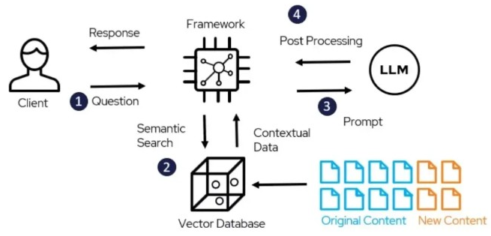
RAG Architecture
Indexing:
Documents → Chunking → Embedding model → Vector DB
Popular vector stores:
ChromaDB, Pinecone, pgvector, FAISS
User question ↓ Retriever searches vector DB ↓ Relevant document chunks
injected into prompt ↓ LLM reasons over YOUR data ↓ Grounded, factual answer
Source: https://deepchecks.com/glossary/rag-architecture/

Slide 9
But RAG is not enough
RAG helps AI KNOW but not DO
An LLM can read a Jira ticket, but it cannot:
Create one
Update its status
Trigger a CI/CD pipeline
Send a Slack notification
Coordinate across multiple systems
RAG = better librarian – Agent = actual entity who gets things done

Slide 10
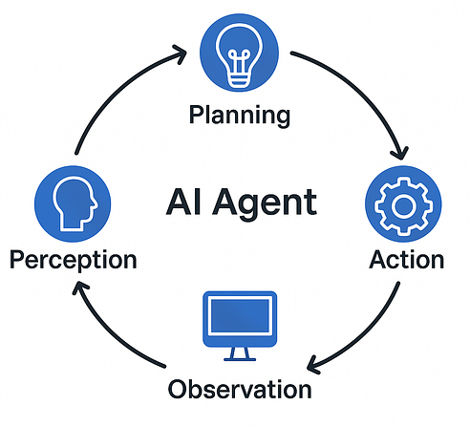
Phase 3: AI Agents
The paradigm shift:
Before:
Question → Answer
After (Agents):
Goal → Plan → Actions → Observe → Iterate → Done
An Agent is an LLM that decides what to do based on what it observes. It can call tools, check results, and even try again autonomously.
Source: AI Agents Explained (Medium)

Slide 11

What is an Agent?
An AI Agent is a system that can:
🎯 Understand and decompose goals
🧠 Reason about the next best action
🔧 Use tools to interact with the world
👁️ Observe results and adapt
🔁 Retry when something fails
✅ Coordinate complex multi-step workflows autonomously
The key word: autonomy: the LLM decides when to stop and what to do next

Slide 12

Chatbot vs Agent
Capability
Answers questions
Completes goals
Has persistent memory
Uses tools & APIs
Multi-step workflows
Autonomous decisions
Can fail and retry
Chatbot
✓
×
×
×
×
×
×
AI Agent
✓
✓
✓
✓
✓
✓
✓

Slide 13
Agent Usage Example
User says: “Prepare the weekly sales report and notify the team”
What the agent does autonomously:
🗄️ Query sales database for this week’s data
📄 Retrieve the standard report template
📊 Generate charts and figures
🤖 Write the executive summary
💬 Post “Report ready” to Slack
📧 Email PDF to the management list
So the only challenge is to integrate these services with the agent

Slide 14
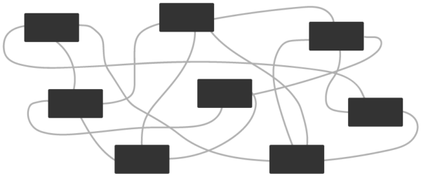
The Integration Problem (Before MCP)
Agents need tools. Before MCP, every integration was custom-built.
5 AI Apps × 10 APIs = 50 custom integrations
Each one required:
❌ Unique authentication logic per API
❌ Custom data format parsing
❌ Breaks when the API changes
❌ Cannot be reused across different LLMs or frameworks

Slide 15

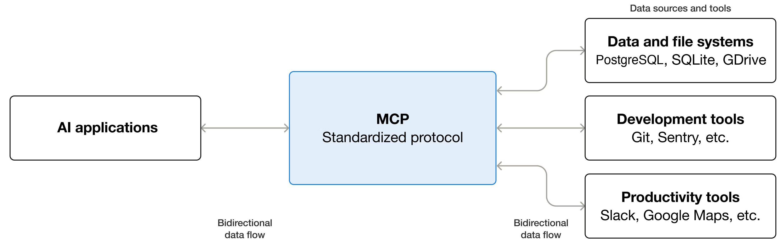
Model Context Protocol (MCP)
Created by Anthropic in 2024, now an open standard
Standardizes how AI connects to tools and systems
Like a USB-C for AI
Write an MCP server → works with any LLM, any framework
Source: modelcontextprotocol.io

Slide 16
What MCP offers
MCP is a runtime protocol, not just a spec
Capability | Description
Tool discovery | LLM learns what tools exist at runtime
Tool invocation | Standard call/response format
Context sharing | Pass structured data between agent and tools
Structured responses | Consistent, typed output
Permissions | What the agent is allowed to do
Interoperability | Any LLM + any tool + any server

Slide 17
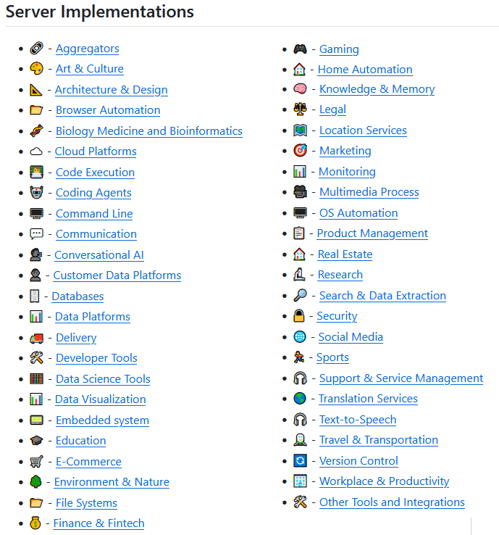
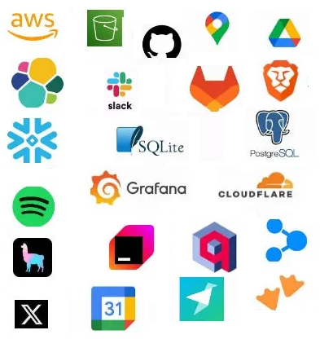
Existing MCP servers
Source: awesome-mcp-servers on GitHub

Slide 18
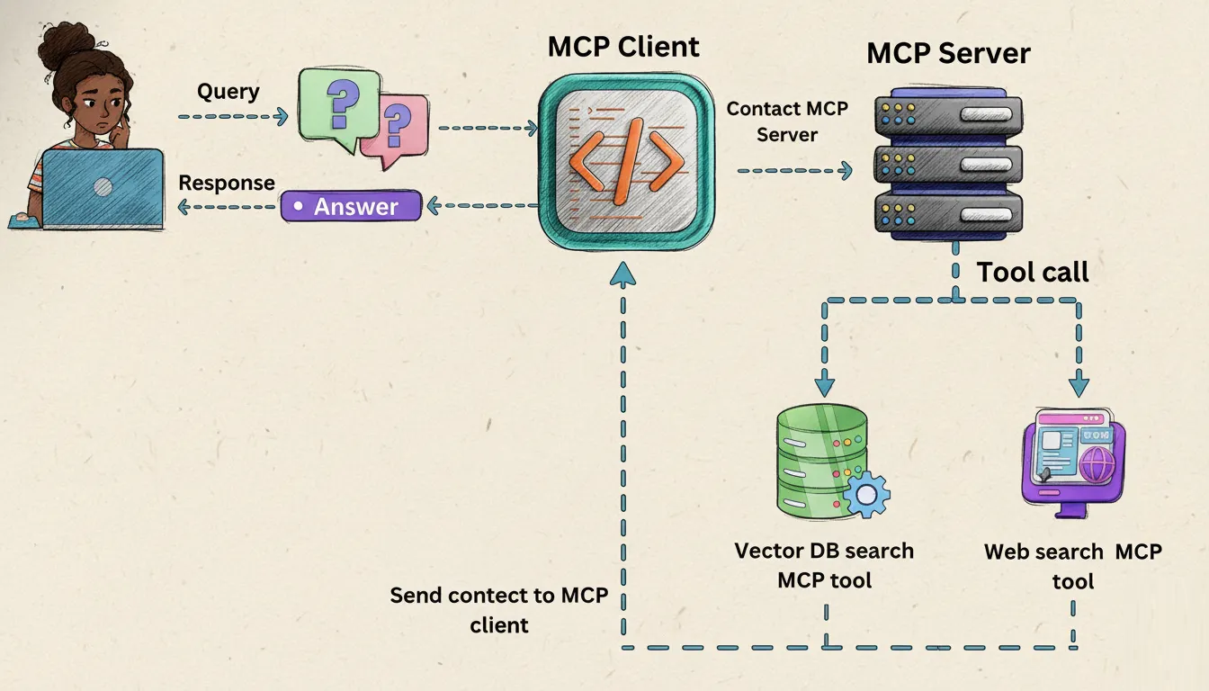
What about RAG using MCP?
Expose DBs/documents as resources
RAG as MCP Tool
Expose semantic lookup functions (e.g. search_vector_db(query))
Let LLM dynamically decide when to run searches and fetch precise text chunks
Other knowledge collection tools are possible to connect, e.g. web search!
Key Benefits
Universal Client Connectivity: Build your RAG server once; use it across AI applications
Token Efficiency: Pull only relevant semantic chunks
Flexibility: Allow the model to autonomously choose when it needs external knowledge
Source: MCP-Powered Agentic RAG (Medium)

Slide 19
Part 2: Build Your Own Assistant

Slide 20
Technologies and Architecture
Python 3
FastMCP

Slide 21
The simplest possible assistant
Open a connection to an LLM model
Collect messages for context
from langchain_core.messages import SystemMessage, HumanMessage
from model import get_model
aimodel = get_model()
system_prompt = SystemMessage(content="You are a helpful AI assistant.")
print("AI Assistant is ready! (Type 'exit' to stop)")
messages = [system_prompt]
while True:
user_input = input("\nYou: ")
if user_input.lower() in ["exit", "quit"]: break
messages.append(HumanMessage(content=user_input))
# Get response
response = aimodel.invoke(messages)
print(f"\nAI: {response.content}")
# Update history for context
messages.append(response)

Slide 22
Model options
import os
from langchain_openai import ChatOpenAI
from langchain_anthropic import ChatAnthropic
from langchain_ollama import ChatOllama
from langchain_google_genai import ChatGoogleGenerativeAI
from langchain_ariadne import ChatAriadne
from dotenv import load_dotenv
load_dotenv()
def get_model():
model = {
"openai": lambda: ChatOpenAI(model=os.getenv("LLM_MODEL"), api_key=os.getenv("LLM_API_KEY")),
"anthropic": lambda: ChatAnthropic(model=os.getenv("LLM_MODEL"), api_key=os.getenv("LLM_API_KEY")),
"ollama": lambda: ChatOllama(model=os.getenv("LLM_MODEL")),
"google": lambda: ChatGoogleGenerativeAI(model=os.getenv("LLM_MODEL"), google_api_key=os.getenv("LLM_API_KEY")),
"ariadne": lambda: ChatAriadne(model=os.getenv("LLM_MODEL"), api_key=os.getenv("LLM_API_KEY"), base_url=os.getenv("LLM_BASE_URL"), provider=os.getenv("LLM_PROVIDER_NAME"))
}[os.getenv("LLM_PROVIDER")]()
return model
Easily connect your API key from Google in the .env file
LLM_PROVIDER=google
LLM_MODEL=gemini-3.1-flash-lite
LLM_API_KEY=...

Slide 23
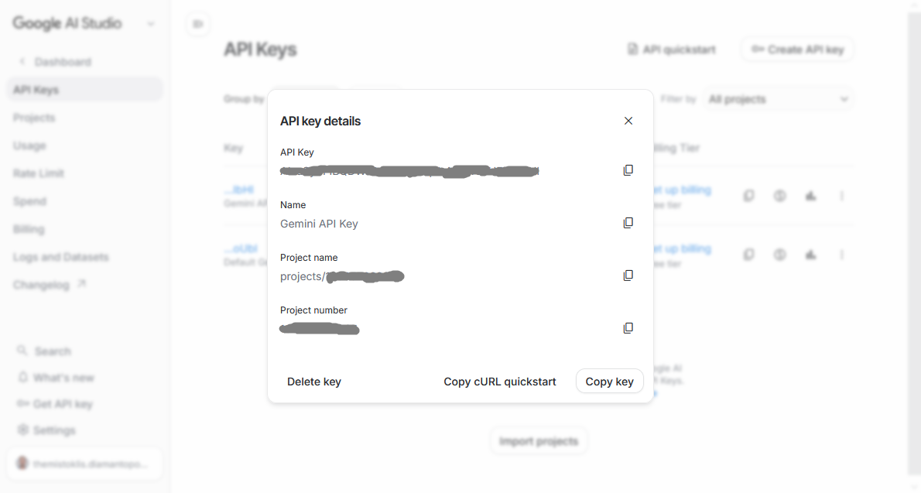
Model options
Navigate to https://aistudio.google.com
Create a New project
Create a New key
Select the model Gemini 3.1 Flash Lite

Slide 24
Assistant improvements
Add a more complete system prompt
aimodel = get_model()
system_prompt = SystemMessage(content="You are a helpful AI assistant. Your tone is professional yet friendly.")

Slide 25

Thank You!
Contact info:
Themistoklis Diamantopoulos
thdiaman@issel.ee.auth.gr

